Slide 1
Excel
KY

Slide 2
Engineering Analysis
Engineering analysis is a systematic process for analyzing problems that arise in the various fields of engineering.
As part of the problem solving process, the data collected has to be processed, analyzed and sometimes displayed graphically by using many mathematical tools that are available.
In many cases, once you have defined and set up the problem properly, numerical methods are required to solve the mathematical equations.
Microsoft’s Excel spreadsheet software has many numerical procedures built directly into its program structure.

Slide 3
Spreadsheets’ Capabilities
Data Analysis Tools
Store, process, and sort data
Graphically display data (Engineering application)
Perform statistical analysis
Fit equation to data points (Engineering application)
Solve single and system of algebraic equations (Engr. Appl.)
Solve optimization problems (Engineering application)
Draw Flow Charts

Slide 4
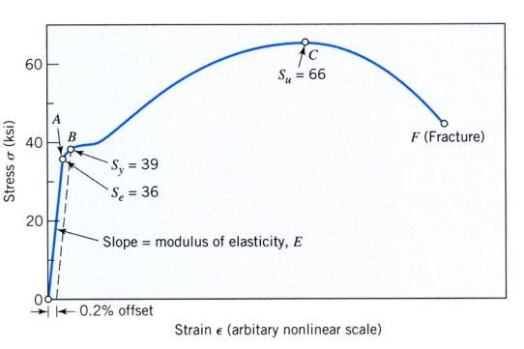
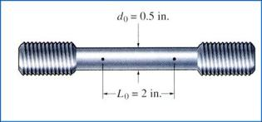
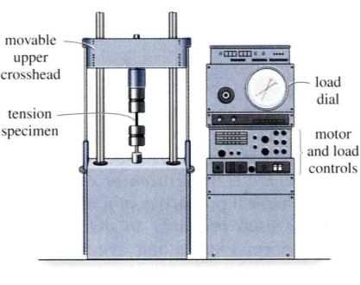
Material Strength
Ductile Steel (low carbon)
Standard Tensile Test
Standard Specimen
Sy – yield strength
S_{u} – fracture strength
σ (stress) = Load / Area
ε (strain) = (change in length) / (original length)

Slide 5
Entering Data into Cells (Cell Content)
Notes:
Data entered into worksheet cells: either numeric values or text (character strings).
Numeric data is right justified and text data is left justified in the cells.
A number can be entered as text by the use of the apostrophe (‘)
Numeric data can be entered as positive or negative integers or scientific notation.
Numeric data can be handled as simple numbers, percentages, dates, time or currency.
Numeric values that require too many characters to fit in the cell are shown as ######
By default, text data that is too long for the cell will extend into a neighboring empty cell. If the adjacent cell is not empty, the visible portion of the text is truncated.
Numeric characters can be handled as text by an apostrophe prefix.
Formatting Data in Cells: Format, Cells, Number. (also Font, etc.)

Slide 6
Relative Addressing
1. =B3+C3 adds the content of cells B3 and C3.
As the formula is copied into D4, D5 and D6,
cell addresses of the formula are incremented.

Slide 7
Absolute Addressing
Using the absolute cell address, $B$1, will keep the cell reference constant for all calculations.

Slide 8
Basic Math Operations
Operation | Algebraic | Excel Format
add | a+b | a+b
subtract | a-b | a-b
multiply | ab, axb, a.b | a*b
divide | a/b | a/b
exponential | a^{n} | a^n
number format | 5.07x10 ⁺¹² | 5.07E12
 |  | 5.07*10^12
 | 3.15x10 ⁻³ | 3.15E-3
 |  | 3.15*10^(-3)

Slide 9
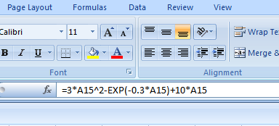
Excel Formulas
In Excel, a formula expresses dependency of one cell on others in the worksheet.
Formula entry for a Cell begins with clicking on the Cell first and then either typing the equal sign “=“ in the Cell itself or clicking on the Formula Bar, and ends with “Enter”.
A Formula can be edited by first clicking on the Cell and then editing the formula on the active Cell or on the Formula Bar.
A Formula may contain functions.
Example
Math syntax: 3x² + e^{(-0.3x)} - 10x
Excel syntax:
=3*(A15^2) + EXP(-0.3*A15) - 10*A15
The value of x is in cell A15

Slide 10
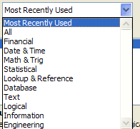
Using Excel Built-in Functions
After clicking on the Cell
Click on the “Formula Bar” (f_{x}), follow instructions on the “Insert Function” window. Or, in the “Formulas” menu select “Insert Function“
Follow instructions on the “Function Argument” window, e.g., select the value, or range of values for the function.
Notes:
Excel provides a variety of built in functions.
Function names may be typed directly or can be selected from “Insert Function” window.
The insert Function shows the ten most recently used functions.
If the function you are looking for is not in this list then select the category of your function
From the category, select the function and click OK.
In the “Function Argument” state the cell address of the value you apply to the function.

Slide 11
MAX and MIN Functions
=MAX or MIN(X1, X2, X3…) will take the maximum or minimum of the numbers in the parentheses (not used for a large field of data).
=MAX or MIN(X1:X4) will take the maximum or minimum of all the numbers from X1 to X4.
COUNT Function
=COUNT(A1:B20) will count the number of cells that contain numbers and the arguments in the list that are numbers.
Example
=COUNT(A1, A2, A3) will return 2, because of the 4 and 9.
=COUNT(A1:A4) will return 3, because of the 4, 9 and 3.
=COUNT(A1:A4, -17, “world”) will return 4, because of the 4, 9, 3 and -17.

Slide 12
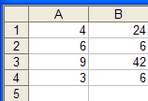
COUNTIF Function
=COUNTIF(range, criteria) will count the number of cells in the range that match the criteria.
Note: if the criteria consists of a relational expression, such as “>5”, it must be enclosed in double quotes.
Example
=COUNTIF(A1:A4, “>5”) will return 2, because 6 and 9 are greater than 5.
=COUNTIF(A1:B4, “=6”) will return 3, because three cells in the range contain 6.

Slide 13
IF Logical Function
=IF(logical_test, value_if_true, value_if_false) returns the second argument if the test is true, and the third if it is false.
Example
=IF(A1>3, “A1 is larger than 3”, 0) would return “A1 is larger than 3”.
=IF(A4>3, “A1 is larger than 3”, 0) would return 0.

