Slide 1
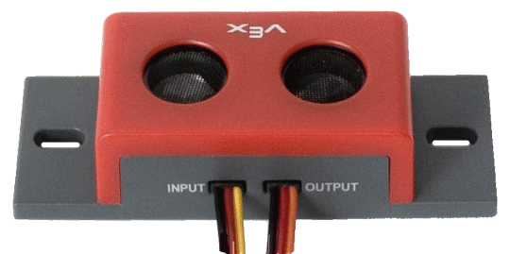
Vex Ultrasonic Sensor (US) Interfacing and Programming

Slide 2
Ultrasonic Sensors
Generally have a transmitter and receiver.
Transmits a high-frequency sound.
Waits to receive echo.
Calculates distance based on time it took to receive the echo.
d = (v)(t)
Round-Trip Distance
d = (v)(t)/2
One-Way Distance
d = distance, v = speed of sound, t = time to receive echo
2

Slide 3
The Vex Ultrasonic Sensor
INPUT
Sends ultrasonic wave
Connect to digital output of the controller
OUTPUT
Receives the echo
Connect to the input of the controller
The labeling is a bit counter-intuitive!
3

Slide 4
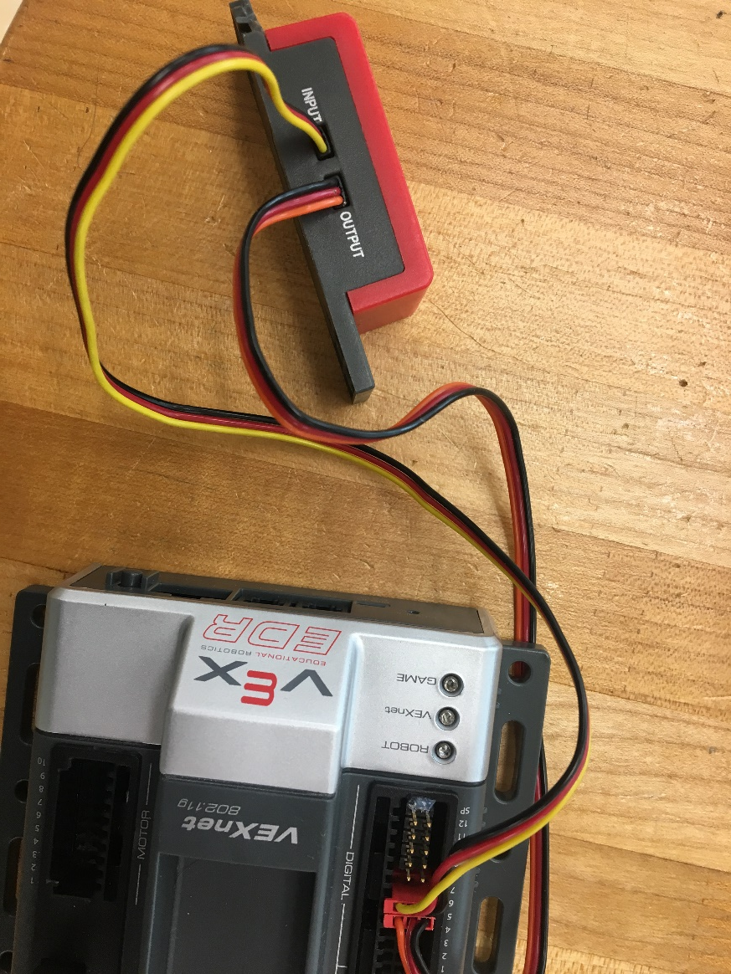
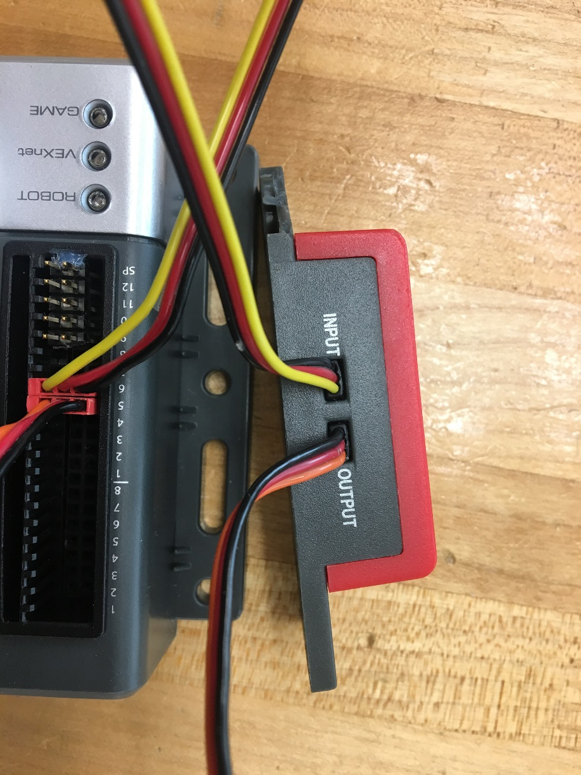
Connecting the sensor to the controller

Slide 5
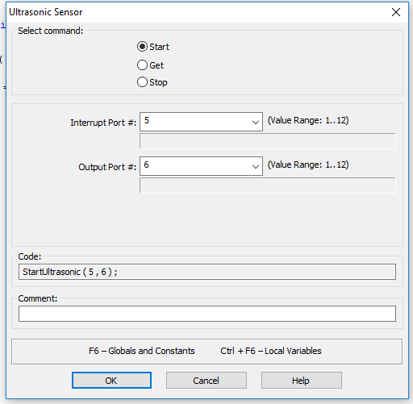
Ultrasonic Sensor Programming
The following statement starts an ultrasonic sensor i.e., the sensor starts sending and recording the sound signals.
Sensor connected to output port 6 through which it receives digital control signals from the controller.
StartUltrasonic ( 5, 6 ) ;
Sensor connected to input port 5
Select start

Slide 6
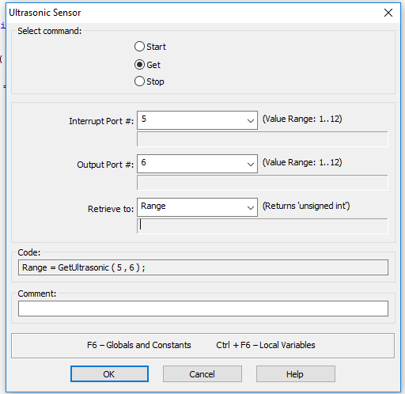
Ultrasonic Sensor
The following statement is used to read a value from the sensor
Range = GetUltrasonic ( 5 , 6 );
Variable into which the translated value is stored
The sensor is connected to output port # 6 on the controller
Input to Ultrasonic port #5
Select Get option
Define variable Range

Slide 7
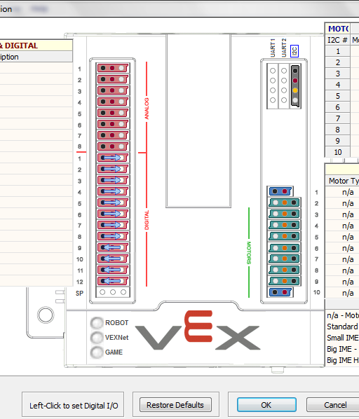
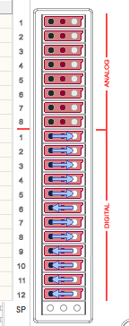
Cortex Controller
Select Config to Change input port #6 to an output port
Change port 6 from input to output by clicking on the circle
Digital ports taken by the IRB

Slide 8
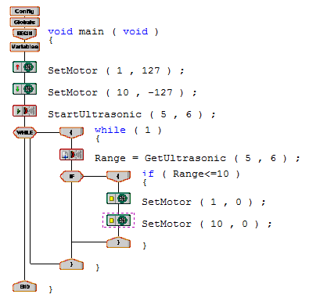
Input to Ultrasonic sensor connected to output port 6 on controller
Output from Ultrasonic sensor connected to input port 5 on controller
Checking if the obstacle is near or far

