Slide 1
Asian Philosophy
Lecture 10

Slide 2
Returning to the Vedas
At a certain point in the history of Indian philosophy the supposed authority of the Vedas becomes a problem because challenges to the authority have been made by unorthodox schools, such as:
The Buddhists
The Jains
The Carvaka
Two Questions Arise:
How are the Vedas known to be error free?
What makes the Vedas infallible?

Slide 3
Returning to the Vedas
There are two parts to the Vedas:
The portion concerning action and rituals.
The portion concerning knowledge.
Uttar Mimamsa refers to the portion concerning Knowledge.
Purva Mimamsa refers to the portion concerning Action and Rituals.

Slide 4
Mimamsa and Vedanta
“Mimamsa” means solution to a problem by critical examination and reflection.
The Purva Mimamsa school aims to makes sense of the rituals and practices that were central to the Vedas.
The Uttar Mimamsa or Vedanta school aims to make sense of the knowledge portion of the Vedas.
Jointly these schools attempt to answer questions concerning the authority and strength of the Vedas.

Slide 5
Purva Mimamsa Key Figures
The core founder of Purva Mimamsa is:
Jaimini (400BCE). Author of the Mimamsa Sutras.
Sabara (200CE). Author a principle commentary on Mimamsa Sutras.
The two main schools of Purva Mimamsa are:
The Bhatt school started by Kumarila Bhatt (600CE)
The Prabhakara school started by Prabhakara (650CE)

Slide 6
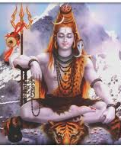
Kumarila Bhatt (660 CE)
Main proponent of Purva Mimamsa School.
Core Doctrine:
Svataḥ prāmāṇya
Some mental states have intrinsic reliability which determines how they have immediate justification.
Core Text:
Slokavarttika

Slide 7
Purva Mimamsa Goals
Goals of Mimamsa:
Offer an account of Dharma (Moral Obligation and Duty)
Remove the necessity of God from the Vedas.
Explain the deities / gods posited by the Vedas as postulates.
Explain rules about how to live one’s life that are expounded in the Vedas.
Explain the authority of the Vedas without God.

Slide 8
Theory of Knowledge: Prama
A prama is a valid cognition that presents a previously unknown object, is not contradicted by another piece of knowledge, and is not generated by a defective sense organ.
A pramana is the efficient cause of a cognition.
Kumarila recognizes six: Perception, Inference, Comparison, Testimony, Postulation, and Non-Perception (absence).
Prabhakara recognizes five: Perception, Inference, Comparison, Testimony, and Postulation.

Slide 9
Theory of Knowledge: The Question of Self-Validation
Questions about knowledge:
1. Does knowledge imply belief?
2. Does knowledge imply truth?
3. Does knowledge imply justification?
4. Does knowledge imply knowledge of knowledge?
5. Does knowledge require additional validation?
Questions (1), (2), and (4) are important in both Western and Indian Philosophy. Question (3) is central in Western philosophy. Question (5) is central in Indian Philosophy.

Slide 10
Mimamsa on Knowledge
Knowledge implies truth.
Knowledge implies certainty.
If x knows that p, then x knows that x knows that p.
Knowledge is self-validating.
The conditions that bring about knowledge bring about its truth.

Slide 11
Kumarila’s Argument for the Self-Validity of Knowledge
If knowledge of what is known depended on an additional piece of knowledge in order for it to be known, then there would be an infinite regress of supporting knowledge claims. Every knowledge claim would depend on an infinite regress of supporting knowledge claims.
There cannot be an infinite regress of supporting knowledge claims. There must be a terminating point, which is self-validating.
So. the knowledge of what is known does not depend on an additional piece of knowledge.
So, knowledge of what is known comes about from the conditions that generate the knowledge.
So, knowledge is self-validating.

Slide 12
Theory of Knowledge: Self-Validation
Knowledge does not depend on correspondence to reality.
Knowledge does not depend on success in practice.
For Mimamsa, knowledge is self validating.
Core Question:
How do we account for the fact that sometimes knowledge claims turn out to be false?

Slide 13
Theory of Knowledge: Error
In order for one perception to be judged as being false, there must be a body of claims that one accepts as being true. One cannot judge that a prior perception was false unless one has sufficient warrant from another set of beliefs to judge that the prior perception was false. Those alternative beliefs must be known.
All identifications of error depend conceptually on a background of information that one takes to be knowledge.
To judge that the oar submerged underwater is not bent, even though it appears that way visually, I must be able to say that I know why what appears to me one way is in fact not actual because I also know something about how the world can make something appear to me when in fact it isn’t that way.

Slide 14
Example of Error
I see a snake in the distance. It turns out to be a coiled rope.
To know that what I perceived to be a snake was actually a rope I have to have additional experiences and beliefs.
I believe that snakes look like ropes in certain conditions.
I believe that there are snakes and ropes.
I have experienced both snakes and ropes in the past.
On each occasion of error it is only after the my initial judgment that I come to know that a prior case of purported knowledge is in fact not a case of purported knowledge. I come to know these things because future experiences contradict my prior experience.

Slide 15
Prabhakara Account of Error
Consider one who utters, “This is a snake,” when looking at a rope because one is too far away to see that it is a snake rather than a rope.
P’s maintain there is no error. There are two cognitions:
Perceptual: there is a this in front of me.
Recollection: there is a snake in front of me.
The error comes about from confusing two mental states: Perception with Recollection. Both are correct. You are seeing a this. And you have seen a snake. But your error comes from confusing two different states.

Slide 16
Bhatt Account of Error
Consider one who utters, “This is a snake,” when looking at a rope because one is too far away to see that it is a snake rather than a rope.
B’s maintain that there is still some object in the error state which is seen. So, they don’t take failure to discriminate between two states as sufficient to account for error.
Rather, they hold that there is no mistake in the perception, there is a mistake in the relationship between what is seen and the predicate applied. There is a relationship error between the object seen, this here now, and the predicate applied, snake. One is applying the concept snake to a perceptual this to which it does not apply. The error is not in the perception but in the concept application.

Slide 17
Perception of Absence
Both Nyaya and Mimamsa take up the issue of how we come to know of absences. There are two components to the question of how we come to know of absences.
Ontology: what is the ontological status of absences? Do we need them in final ontology? Could they be accounted for by simply saying there are only presences in final ontology?
Epistemology: Regardless of whether there are absences in final ontology there are situations in which one perceives that something is absent.
The table is absent my laptop!!!! How do we account for this?

Slide 18
Absence Does not Require an Additional Instrument: Prabhakara
The Prabhakara view of the non-perception of absence is as follows.
Ontology:
The absence of my laptop is identical to the locus of the absence, the table top.
Epistemology:
One cognizes y that possesses the absence of x.
One has query as to whether there is x in y.
After having the query, one revisits one’s knowledge of y and from that discovers that x is not in y.

Slide 19
Absence Does Require an Additional Instrument:
Bhatt
The Bhatt view of the non-perception of absence is as follows.
Ontology: An absence is not a non-entity. It is an entity that is a property of its locus.
Epistemology
One cognitively apprehends an entity y and one’s senses capture various positive features of y. Then one remembers x and expects to cognize x in y.
One does not capture x in y perceptually or inferentially or through any other epistemic instrument.
Without depending on the senses one knows that x is absent from y.

Slide 20
How are the Vedas Authoritative without an Author
Testimony is a source of knowledge.
All sources of knowledge are self-validating.
We can read the Vedas, and through the testimony of them we can gain knowledge about reality.
The knowledge gained on the basis of the Vedas is self-validating.
So, the knowledge gained on the basis of the Vedas does not need an additional source of knowledge to verify it as a piece of knowledge.
A source of knowledge provides one with self-validating certainty about something. Testimony is a source of knowledge. So Vedic testimony provides one with self-validating knowledge about reality.

Slide 21
Testimony and the Vedas
Testimony is a source of knowledge.
There is both personal and impersonal testimony.
Personal testimony refers to a person that through language offers information about something.
Impersonal testimony refers to testimony that does not have an author.
The Vedas are a case of impersonal testimony. Mimamsa does not believe in a creator of the world nor a divine author.

Slide 22
Mimamsa on Testimony and the Vedas
The basic sounds of reality are the basic sounds of any language.
The portions of the Vedas that discuss conduct and rituals are written in a language where the sounds capture reality.
Since the language and what is discussed have an authorless relation to reality, the kind of reliability at issue in personal cases of testimony are not at issue in authorless testimony from the world.
If authorless testimony does not have a reliability challenge and all knowledge is self-validating, then knowledge from the Vedas is self-validating.
So, knowledge from the Vedas is Self-Validating.

Slide 23
Vedanta
“Vedanta” means end of the Vedas.
Vedanta is focused on the Upanishads of the Vedic Period.
There are many schools of Vedanta, they all focus on the following two claims:
Brahman is ultimate reality
Atman is Brahman
They differ on how they try to make sense of plurality and individual selves in the world with an underlying singular Brahman.

Slide 24
Vedanta
Two Main Schools:
Advaita Vedanta (non-dualism) of Shankara
&
Visistadvaita Vedanta (qualified non-dualism) of Ramanuja
Vedanta is the most influential of Indian Schools of Philosophy in Modern Times. It is safe to say that the popular imagination associates Indian philosophy with Vedanta.

Slide 25
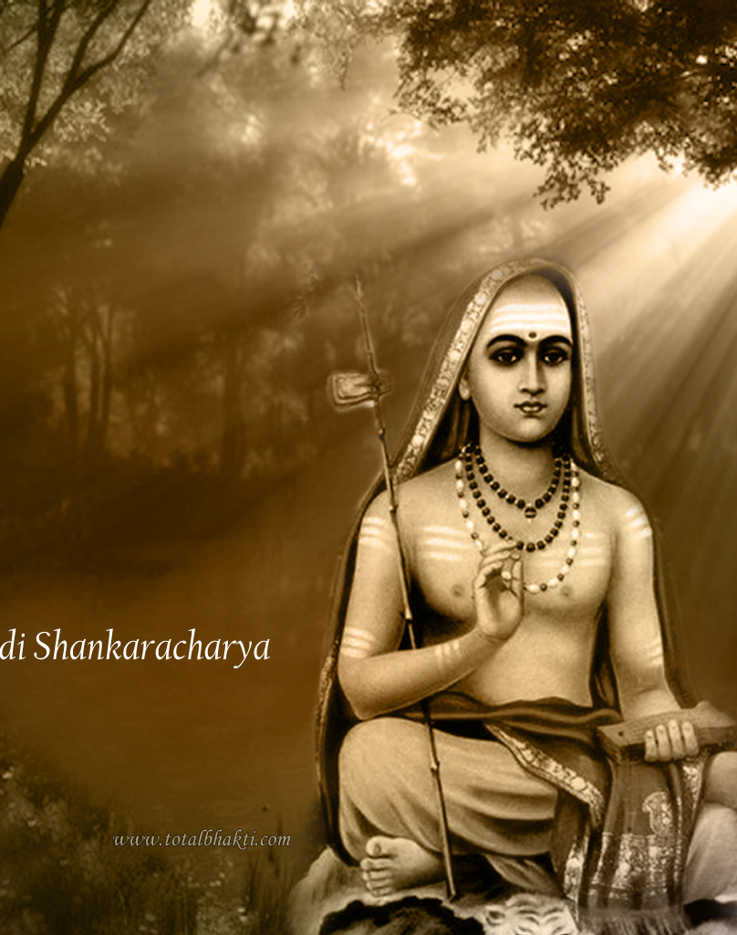
Adi Shankarachary is the founder of Advaita Vedanta.
Born 788 CE in Kerala.
Core View: Non-Dualism
The Brahman is the truth, The world is false, and the finite individual is none other than the Brahman.

Slide 26
Advaita Vedanta
There is one absolute independent reality, which alone exists as real and unchanging. This reality is the Brahman of the Upanishads.
Brahman is pure consciousness.
Brahman is not mere appearances.
Brahman is best described negatively rather than positively.
Brahman does not fall into a category, such as substance.
Brahman has no qualities, no differences, it has no beginning and no end.
Brahman is the foundation of the world we experience.
Brahman cannot be known through the senses or by the mind. It must be known through testimony or yogic intuitive knowledge.

Slide 27
Advaita Vedanta Ontology
Advaita Vedanta ontology is opposed to:
Buddhism – there are no macroscopic wholes. There are only parts. There is no persistent self over time. Everything is dependently originated.
Sankhya – the world is a function of a single entity undergoing spontaneous transformation that accounts for the evolution of matter. One thing constantly undergoing change.
Vaisheshika – the world is a function of atoms combining in various ways to make individual entities. Many things combine to make many things.
Advaita Vedanta – there is one thing Brahman, all else exists as appaerance.

Slide 28
Advaita Vedanta Ontology
Against the Sankhya view they argue that spontaneous generation cannot account for the harmony that we perceive in nature.
Against the Vaisheshika view that argue that unconscious atoms moving about cannot produce a moral law.
In general, Brahman is truth, knowledge, infinite, and blissful. However, these are not qualities of Brahman. For if they were, there would be differences in Brahman, but there cannot be.
Brahman has many names.

Slide 29
Advaita Vedanta on Causation
Two Views:
The effect exits in the cause. Sankhya Philosophy
The effect does not exist in the cause. Nyaya Philosophy
Advaita Vedanta argues against both:
The effect is neither present in the cause, nor is it something new that is produced by the cause.
Why? Because change is mere appearance.

Slide 30
Against Real Change
The only way there is real change is if both form and matter are distinct, but part of reality at the same time. For then there can be change in form, and because form is part of reality there is a change in reality.
But: Is form a distinct part of reality that changes?
Advaita Vedanta: No! Because
All forms depends on matter. So, there is no form of a cup that is separate from the cup that has the form.
If form were distinct from matter, then there would have to be a third thing that connected them. This would lead to an infinite regress.

Slide 31
Maya, Avidya, and Adhyasa
“Maya” means illusion.
“Avidya” means ignorance.
“Adhyasa” means superimposition:
Avidya & Adhyasa as two components of why the world is Maya:
Absence of Knowledge: one is ignorant when they lack knowledge.
Superimposition: one is ignorant when they see x as F when it is G because they posit F on to x.
The experienced world is an illusion not only because we don’t know its ultimate nature but because they superimpose upon it something that it lacks at the fundamental level.

Slide 32
Levels of Reality
The objects of dream experience are real from the perspective of dream experience.
The objects of waking experience are real from the perspective of waking experience.
BUT
The objects of dream experience are appearances from the knowledge of waking experience.
The objects of waking experience are appearances from the knowledge of Brahman.

Slide 33
Perceptual Error and the World as an Illusion
The world or plurality must be shown to be an illusion.
So, a theory of perceptual illusion which works in the everyday case, such as seeing a rope for a snake, must be useable in the case of how we perceive the world or plurality as being real when it is an illusion.
Note: the Nyaya theory of perceptual error cannot work for the case of how we see the whole plurality of the world as an illusion.
So, the actual account of perceptual error matters –not just the point that we have perceptual errors, and our perception of the world as consisting of difference and plurality is just one error.

Slide 34
Comparing Theories of Error
The substitution vs. misplacement theory :
Misplacement Theory: Perceptual error occurs when the sense organ comes in contact with an object and a memory based concept is triggered and placed into the stream of consciousness.
Substitution Theory: Perceptual error occurs when the object actually present is not perceived and the mind constructs another object substituting it for the actual object.
Snake-Rope Misperception
Misplacement: the rope is perceived, but it triggers a memory-concept of a snake that is put into the stream of consciousness.
Substitution: the rope is not perceived, and a snake concept is put into the stream of consciousness.

Slide 35
Perception as Extended
Advaita Vedanta on Perception:
The inner sense comes in contact with the organ of vision, reaches out to the object and becomes one with it.
The mental mode removes the concealment of the object from the perceiver.
The consciousness underlying the object, being manifested as a result of the removal of the concealment, reveals the object.
The mind effects an identity between the consciousness conditioned by the object and the consciousness conditioned by the subject.
The person perceives the object.
Perception involves the mind extending outside of the body and taking on the form of what is perceived.

Slide 36
Appearances Exist, but are not Real
The world of change and plurality is a mere appearance.
However,
Just as the objects of dreams exist, the world of change and plurality also exists.
Moreover,
Just as the objects of dreams are not ultimately real, the world of change and plurality is not ultimately real.
Brahman reality provides us with a fourth realm for considering the appearance / reality distinction. From Brahman reality all is appearance because only Brahman is real.

Slide 37
Atman is Brahman
Advaita Vedanta maintains that
The individual Pure Self is identical to the one real thing Brahman.
This is a core Vedic view.
Advaita makes good on this claim by saying that there are no substantial selves that are distinct from Brahman.
Rather,
The individual self that is real just is Brahman, and the appearance of a self distinct from reality is an illusion

Slide 38
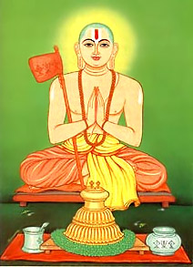
Sri Ramanuja is the founder of Visistadvaita Vedanta.
Born 1017 CE in South India.
Core View: Qualified Non-Dualism
Brahman is the ultimate reality. It is not distinct from the world we experience. Rather the world we experience is part of it. Brahman is a unity made up of differences that constitute the experienced world.

Slide 39
Identity and Difference
Identity and Difference are Correlates. They depend on each other.
Brahman is the unity of different selves and things making up the world.
Brahman is the identity of the parts in their existing substrata.
Brahman is an organic unity constituted by the identity of the parts. It is not abstract, but concrete, being made up of the various objects of consciousness as well as consciousness itself.

Slide 40
The Analogy of the Self and the Body
Person = Body + Self, which is one thing made up of two components.
Individual things and selves are distinct from the Brahman in the way that the self is distinct from the body.
Unity is the person = Body + Self
Plurality is the parts Body and Self.

Slide 41
Ramanuja on Consciousness I
Consciousness is intentional.
Consciousness always has an object.
Consciousness is of some object via some characteristic.
So, there is no pure consciousness that lacks a subject and an object.

Slide 42
Ramanuja on Consciousness II
Consciousness is a property.
X is a property only if X is a property of something.
So, consciousness is a property of something.
So, Brahman cannot be pure consciousness.
Brahman cannot be a pure X with no distinctions, since if it is conscious there must be a difference between the subject of consciousness and the object of consciousness.

Slide 43
Ramanuja on Individuals
Ramanuja denies that the individual self is an illusion based on ignorance.
Rather,
The very idea of ignorance requires that there is an individual that is ignorant.
So, ignorance cannot explain the illusion of the self, since ignorance requires a self.
Thus, there are many individuals that are in fact ignorant.

Slide 44
Ramanuja’s Theism and the Upanishads
Some, such as the Mimamsa, interpret the Vedas and Upanishads as not involving a GOD.
Ramanuja by contrast does argue that there has to be a God.
The organic unity that is Brahman or Lord Ishvara.
Ramanuja has a much harder time making sense of the idea that Atman = Brahman, since he maintains that the many different selves are not an illusion.

Slide 45
Shankara vs. Ramanuja
Category | Shankara | Ramanuja
Brahman | Indeterminate | Determinate
Consciousness | Self-Manifesting | Intentional
Bliss | Brahman is pure Anand (BLISS) | Doesn’t make sense to attribute Anand to Brahman
Ignorance | Is definable by what we don’t know and what we project | Not definable: it is either what is false or what we are unaware of, but it cannot be what is neither real or unreal

