Slide 1
Asian Philosophy
Lecture 2

Slide 2
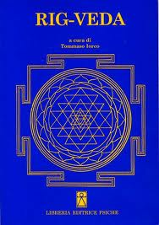
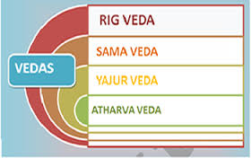
The Vedas are verses of Wisdom.
They are thought to be timeless because they were revealed to the first human beings.
They are authorless because they are revealed by reality and not by persons.
The Rig Veda, dating around 1500BCE, is the oldest collection of sacred verses of wisdom.

Slide 3
The Vedas
Agni = the God of Fire
Soma = the hallucinogen of ecstasy and illumination.
Indra = the god of courage and strength in people.
Vac = speech, the god of communication. She represents both words and the consciousness underlying the words.
Rita = the order present in the universe, both in terms of natural phenomena such as the seasons and human phenomena such as the laws of morality and justice.

Slide 4
Rig Veda and The Origins of Existence
Rig Veda:
Verse 1:
In the beginning there was neither existence nor non-existence;
Neither the world nor the sky beyond.
What stirred? Where? Who protected it?
Was there water, deep and unfathomable?

Slide 5
The Origins of Existence
Verse 1: Argument for the whole over opposition.
Either the source of existence comes from something that exists or it comes from something that is non-existent.
If it comes from something that exits, then it cannot be the first existence, since we can always ask: what was the source of that particular existence?
If it comes from something that is non-existent, then it cannot be the source of existence, since we can ask: how can something arise from nothing?
So the origins of everything derive from something that is neither existence nor non-existence.

Slide 6
The Origins of Existence
Verse 1: Critical Questions
Is it possible for something to be neither F nor non-F? For example, my shirt can be neither blue nor green, because it is red, but can my shirt be neither blue nor non-blue?
Why can’t there be a first existing thing?
Why can’t something come from nothing?
Can thought about origins go beyond the dualistic options we are given for thinking about it?

Slide 7
The Origins of Existence
Rig Veda:
Verse 2:
Then there was neither death nor immortality,
Nor any sign of night or day.
THAT ONE breathed, without breath, by its own impulse; Other than that, there was nothing at all.

Slide 8
The Origins of Existence
Verse 2: Argument for oneness as a source
There are oppositions in our reality, such as death vs. immortality, night vs. day, and existence vs. non-existence.
Dualistic oppositions are derived from something that has no opposition. For example, through a whole from which the opposites can be derived.
So, what is beyond reality is oneness. Something that is a whole that is unified and from which oppositions, such as existence and non-existence, can be derived.

Slide 9
The Origins of Existence
Verse 2: Critical Questions
Is there another way to account for oppositions other than the positing of a unified whole?
How can something breathe without breath?
What does the use of the paradoxical language suggest?
Is paradoxical language the only way to point to what is beyond dualistic oppositions?
What kind of understanding does paradoxical language provide?

Slide 10
The Origins of Existence
Rig Veda:
Verse 3:
Then there was darkness, concealed in darkness,
All this was undifferentiated energy.
THAT ONE, which has been concealed by the void,
Through the power of heat energy was manifested.

Slide 11
The Origins of Existence
Verse 3: Argument for knowledge of oneness beyond dualism
The whole that was present is undifferentiated because it is darkness covered in darkness.
If something is undifferentiated as a whole, and uniform in every way, then there are no markers differentiating parts of it, it is everything.
If something is undifferentiated in every way, then there is no way by which one can know it through dualistic oppositions, since there are no makers by which to know it.
So, knowledge of oneness transcends dualistic oppositions.

Slide 12
The Origins of Existence
Verse 3: Critical Questions
What is the relation between differentiation and knowledge?
Can I know of an undifferentiated thing, if there are no markers by which I can know it?
How can an undifferentiated thing produce anything, unless one acts upon it?
If action is required for an undifferentiated thing to produce something, then isn’t it differentiated by the actor / substance relation?

Slide 13
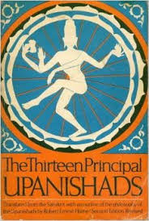
The texts are generally more philosophical.
Focused on:
What is the nature of reality?
What is the nature of the self?
Vision of the seer is important.
Kena
          Chandogya
          ISA
          Prasna
          Katha
          Mandukya
Kaushitaki
Maitri
Svetasvatara
Brihad-Aranyaka
Mundaka
Taittiriya
Aitareva

Slide 14
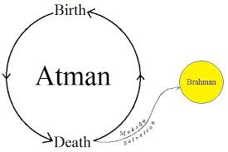
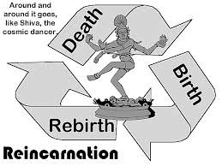
The Upanishads are focused on how we can attain release from the cycle of birth and death.
Moksha = release from the cycle of rebirth.

Slide 15
The Quest for Brahman
Brahman = that which makes great.
It is used to capture that which is ultimate reality.
It is not a descriptive name capturing features of ‘that which makes great’. The classical way of identifying Brahman is through the method of negation.
Invisible, incomprehensible, without genealogy, colorless, without eye, or ear, without hands or feet, unending, pervading all and omnipresent, that is the unchangeable one whom the wise regard as the source of being.

Slide 16
Argument for method of negation
If something is responsible for the existence of something else, then it cannot be limited by those things.
Brahman is responsible for time, space, and causality.
So, it cannot be conditioned by those things.
Critical Questions:
Can something be responsible for the existence of something else, yet be conditioned by it?
How should we understand this question?

Slide 17
The Quest for the Self
What is the nature of the Self that thinks the question: What am I?
The Self (Atman) which is free from evil, free from old age, free from death, free from grief, free from hunger and thirst, whose desire is the real, whose thoughts are true, that Self should be sought, that Self one should desire to understand. He who has realized and understands the Self, he obtains all worlds and desires.
Chandogya Upanishad VIII.7.1
Critical Questions:
Do we each possess a self that has these traits?
Is there a self beyond the mere appearance of a self?

Slide 18
The Distinction Between Subject and Object
Thesis: The self that is the ultimate subject cannot be known as an object.
Argument:
If x is known, then it must be known by a knower K.
Thus, if the self knows the self, the knower would not be the self because the self would be the object of knowledge.
So, the Self cannot be known as an object of knowledge by the same self.
Critical Question: Why can’t the self know the self?
Theory: Self can be realized in total self-awareness.
Distinction: Knowledge vs. Realization

Slide 19
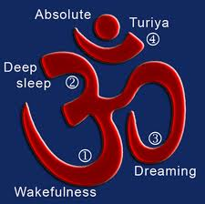
The Four Types of Self:
The waking self – The subject that is reflected in the mirror.
The dreaming self – the subject that experiences dreams.
The deep-sleep self – the subject that is present in deep-sleep.
The self of self-consciousness and illumination – the “subject” that transcends the subject-object distinction.
The fourth state goes beyond all dualities.

Slide 20
Atman is Brahman
Atman = the true self present in the fourth state that is different from the physical, dreaming, and deep-sleeping self.
Brahman = that which makes great and is the ultimate reality, which can only be defined negatively.
Atman = Braham
Our ultimate self = ultimate reality.
Understanding the ultimate self leads to the identification of it with ultimate reality. It can only be understood through pure awareness.

Slide 21
Tat Tvam Asi
That which is the subtle essence, this whole world has for its Self (Atman). That is the true. That is the Atman. That art thou (tat tvam asi).
The subtle essence = Brahman. A person P = P’s Atman.
So,
P’s Atman = Brahman.
Atman is the ultimate subject that can never be known in the way that ordinary objects are known. It must be realized.
Knowledge of Atman is similar to knowledge of love, only those that experience it can know it.

Slide 22
Critical Questions
If we are all ultimately identical, shouldn’t we live in a society that treats us equaly?
If we are all ultimately identical, what explains our manifest differences? If they are just appearances, from where do they come about?
If the self is identical to ultimate reality, then how can we explain the contingency of our existence in contrast to the necessity of ultimate reality?

Slide 23
Vedic View Upanishadic View
Primary Values: Virtue, success, and enjoyment
Key to perfection: ritual
Emphasis on community
Prayer is important
Cycle of rebirth not mentioned
Karma not important
Texts: Vedas
Emphasis on plurality of existence
Self refers this body-mind
Supported by Mimamsa philosophy
Focus on the other (spiritual) world
Primary value: liberation
Key to perfection: knowledge
Emphasis on the individual seeker
Meditation is important
Cycle of rebirth is seen as the fundamental problem
Karma is important
Texts: Upanishads
Emphasis on unity of existence
Self refers to the Atman that is Brahman
Supported by Vedanta philosophy

Slide 24
Orthodox vs. Unorthodox Traditions
Unorthodox Traditions: Do not take the Vedas as authority, nor do they aim to make their theories consistent or compatible with the Vedas.
Jainism, Buddhism, Carvaka.
Orthodox Traditions: Take the Vedas as authority, and they aim to make their views consistent and compatible with the Vedas.
Nyaya, Vaisheshika, Sankhya, Yoga, Mimamsa, and Vedanta.

