Slide 1
Asian Philosophy
Lecture 8

Slide 2
Sankhya or Samkhya
The oldest school of classical Indian Philosophy
‘Sankhya’ means enumeration or discrimination that results from analyzing reality.
Kapila is the supposed founder of the school. He wrote the Sankhya sutras. The school existed roughly from 1st to 11th century.
On Sankhya theory: the universe has no creator.

Slide 3
Sankhya or Samkhya
Metaphysical Goal:
Offer an account of reality that avoids monistic materialism (all is matter) and monistic idealism (all is consciousness).
Metaphysical Result:
Dualism of nature and spirit
Where nature is distinct from spirit.
But nature is for spirit.

Slide 4
Two Approaches to The Fundamental Nature of Reality
Atomism: posit a plurality of atoms, use principles of interaction to show how they combine in order to produce aggregates.
Holism: posit a unified undifferentiated whole that can undergo change by something acting on it, and out of which all diversity arises.
Buddhism and Jainism take Atomism.
Samkhya and Vedanta take Holism.
However, Samkhya goes further to posit a kind of dualism between spirit and nature, while Vedanta does not.

Slide 5
Sankhya Four Basic Ideas
Prakriti = Nature, Matter
Purusha = Self
Prakriti ≠ Purusha
The universe undergoes change as the result of matter undergoing transformation via causation.
Prakriti is for Purusha

Slide 6
Questions About Causation
Does the cause or the material cause contain the effect in any form prior to its production?
Can causality be defined in terms of efficacy or productivity?
How should causal conditions be classified?

Slide 7
Views About Causation
Satkaryavada = The effect e exists in some way in the cause c prior to e’s occurrence.
Asatkaryavada = The effect e does not exist in any way in the cause c prior to e’s occurrence, or in some cases e is not presently prior in c.
Note for contrast. Main debate in Modern Western Philosophy focuses on the debate between regularity vs. necessitarian views of causation. Regularity views deny the presence of any necessary force between c and e. Necessitarianism for the most part acknowledges counterfactual support: were c not to have happened, e would also have not happened. Counterfactuals go beyond mere regularity.

Slide 8
Causation: Satkaryavada
Satkaryavada: The effect of a cause already exists in some way in the cause. It is not a wholly new entity produced by the cause.
Causality, material causality in particular, is a matter of transformation. It is not the production of something completely new. Examples
The oil that comes from the seed.
The sweater knitted from the yarn.
The pot molded whole from the clay.

Slide 9
Causation: Satkaryavada
Sankhya arguments for Satkaryavada:
The effect exists before the operation of the cause:
because of the non-productivity of non-being;
because of the need for an (appropriate) material cause;
because of the impossibility of all things coming from all things;
because something can only produce what it is capable of producing;
because the effect is non-different from the cause.

Slide 10
Argument for Satkaryavada by Arbitrary Effect
Suppose A, B and C are numerically distinct and qualitatively similar in some respects.
Suppose A always causes B. A never causes C.
Assume A does not already contain part of B in it.
Problem: If A does not already contain B in it in some way, it would follow that A would be just as likely to cause C as it would B, since neither is part of A already.
So, A causes B because A already contains part of B in it, and does not contain part of C in it.
Is this the only possible explanation of why A causes B, but not C?

Slide 11
Causation: The Non-Productivity of Non-Being
Argument:
Nothing can come out of nothing.
So, if nothing was present at the beginning, acting on nothing could only produce nothing. Because what is there to get transformed is nothing.
But there is something now.
So, the something existing now has to be a transformation of a prior something for which there is a relation of relevant similarity.
An infinite regresses is impossible.
So, there must be a first cause.
Upshot: There must be something that gets transformed in the beginning in order for there to be anything now.

Slide 12
Evolution of the World from a Single Material Cause
Argument for single material cause:
The present world exists because of previous change.
Change is not the production of something radically new. But only the transformation of something already present.
So, the whole present world with all of its diversity came from a single material cause or there is an infinite regress of causes.
There is no infinite regress.
So, there is only a single material cause.

Slide 13
The Fundamental Nature and The Manifest Nature
The fundamental nature of the world is Prakriti, which is the fundamental material cause of everything. All entities are a modification via transformation of the one single cause.
How can we explain plurality and diversity?
Adopt the view that prakriti has three different properties (gunas), sattva, rajas, and tamas.
Everything is distinct because of differences in how these basic elements are put together. All mental and physical phenomena are just different combinations of these three gunas.

Slide 14
The Three Gunas: Sattva
Sattva:
Concerned with happiness.
Component: lightness, brightness, pleasure.
Associated: ego, mind, and intelligence.
Essence: purity, fineness, and subtlety.
It is the essential condition for consciousness.

Slide 15
The Three Gunas: Rajas
Rajas
Concerned with actions of objects.
Associated: activity, motion, and pain.
It is essential for motion in objects.

Slide 16
The Three Gunas: Tamas
Tamas
Concerned with inertia and inaction.
In living beings it is associated with coarseness, negligence, indifference, and inactivity.
In a person it manifests itself as ignorance, insensitivity, and inaction.

Slide 17
How do we know that Purusha exists
Purusha exists because:
aggregations or combinations exist for another;
this other must be apart or opposite from the three gunas;
this other must be a superintending power or control;
there must be an enjoyer;
there is functioning for the sake of isolation and freedom.

Slide 18
Argument 1
All composite things exist to serve the purpose of a being, and that being is Purusha.
Why?
Because
Where ever there is an aggregate of parts, the aggregate exists for something or someone. Prakriti is a combination of the three gunas. So, it must be for someone, that someone is Purusha.

Slide 19
Argument 2
All objects of knowledge are composed of the three gunas, which implies that there is a subject which is not an object of experience, that subject is Purusha.
Why?
Because
There cannot be entities which are the object of knowledge without there being entities that are the subject of knowledge.

Slide 20
Argument 3
Experiences need to be regulated. The consciousness that coordinates is Purusha.
Why?
Because
Were they not regulated there would be no order, and chaos would prevail. But there is order now. So, there must have been order from which order came from.

Slide 21
Argument 4
Prakriti being non-intelligent cannot experience what evolves from it. So, There must be an intelligent experiencer, and that is Purusha.
Why?
Because
Were there no experiencer, there would be no aggregates which come into existence only for something. Since there are aggregates there must be an experiencer to experience the evolution of everything from the single first cause.

Slide 22
Argument 5
There is a striving for release, which implies the existence of Purusha that strives for and obtains release.
Why?
Because
Were we to live in a ordered universe where things find realization, and there were no entity to realize the evolution of the universe that would be a frustrating situation of tension. So, there must be a Purusha.

Slide 23
The Nature of Purusha
Purusha is never observed, it is always an observer.
Purusha is of the nature of freedom, isolated from the bondage of Prakriti.
Purusha is indifferent, not moved by pleasure and pain.
Purusha is a spectator.
Purusha is inactive and unmoved.

Slide 24
How are Purusha and Prakriti Connected?
Ignorance confuses purusha and prakriti. It does so by making purusha appear as an aspect of prakriti constituted by the gunas.
Purusha is really different from prakriti.
Purusha is a shining light and prakriti is a pool of water reflecting the light. Without purusha doing anything more than shining by its own light, it is reflected in prakriti. Now this reflected light mistakes itself for purusha. But this is not the true light of purusha. It is essentially only a reflection in prakriti. Purusha is lost because we take its reflection in prakriti to be its fundamental nature.

Slide 25
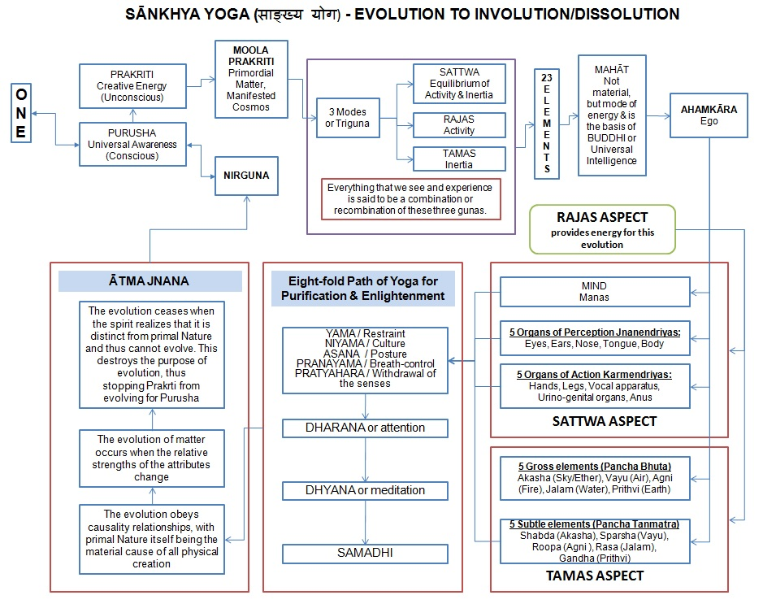

Slide 26
The Yoga School of Philosophy
Primarily concerned with meditative practices.
The main goal is to attain as state of consciousness that is free from any conceptualization in thought, and where the individual is only aware of consciousness – there is no external object of thought.
Attaining this state is beneficial to a person because it frees them from any suffering.
Meditative practices is the means to the attainment of this state.

Slide 27
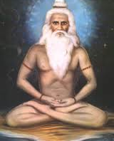
Patanjali’s Yoga Sutras is the first major work of the Yoga school of philosophy. He is the first person to systematize various teachings.
Yoga philosophy lays down a practical path to liberation and moksa.
Samkhya accepts the practical path to realization of the self that Yoga offers. And Yoga philosophy accepts Samkhya metaphysics as its basis.
Yoga = to unite or yoke together things.

Slide 28
Difference between Yoga and Sankhya
Both schools accept the separation of prakriti and purusha. The yoga school accepts basic Sankhya metaphysics.
However,
Sankhya focuses on reasoning about reality as a method for liberation. Knowledge is sufficient for liberation.
Yoga focuses on mediation about mind, consciousness, and self as the method for liberation. Knowledge is insufficient for liberation.

Slide 29
Yoga: Classical vs. Contemporary Modern
Classical Yoga is focused on meditation and cultivation of the mind and consciousness.
Contemporary Yoga is focused on the body and the cultivation of its relation to the mind.
There is hardly any discussion of asanas (postures) in the classical works of the Yoga school.

Slide 30
Four Parts of the Yoga Sutras
Samadhi pada: deals with an explanation of yoga as the cessation of all active states of mind, and outlines various stages of insight that come from ceasing activity in the mind.
Sadhana pada: outlines various moral practices that are required for meditation to be successful.
Vibhuti pada: discusses super-normal powers that can accrue to the practitioner when the mind is in extreme states of concentration.
Kaivalya pada: discusses liberation, and presents Patanjali’s response to the Buddhist program.

Slide 31
Yoga Basics
Sankhya metaphysics:
Prakriti is the primal matter.
Purusha are the innumerable selves.
The three gunas are Sattva, Rajas, and Tamas explain differentiation of matter.
Mind has a preponderance of sattva.
Matter has a preponderance of Rajas and Tamas

Slide 32
Yoga Psychology: Forces of Bondage
Force One: Ignorance of the true nature of the self as distinct from matter and nature.
Force Two: The urge to create and maintain an ego.
Force Three: Raga infatuation with things that express itself through grasping and attachment.
Force Four: Dvesha the dislike and aversion to everything that threatens the material self.
Force Five: Abhinivesha the force to live forever as a material being.

Slide 33
Techniques of Yoga
Moral Restraints:
Prohibition against hurting.
Prohibition against words and intentions that hurt others.
Non-stealing. Don’t take others goods.
Non-grasping. Eliminate the desire for goods.
Prohibition against sexual activity that nourishes the ego.

Slide 34
Techniques of Yoga
Spiritual Observances:
Observe purity in action and word.
Aim to be satisfied with whatever one has.
Practice self-control aimed at self-denial.
Study of sacred texts and yoga teachings.
Devotion to another, such as a teacher.

Slide 35
Techniques of Yoga
Postures (ASANAS)
Control of the body allows for control of consciousness.
Disciplined Breathing (Pranayama): Controlled breath is essential to yogic practices. Breath makes available the vital energy one needs for life.

Slide 36
Epistemology of Yoga School
Perception – In perception the mind is transformed into the shape of the object. It is the most important way of knowing things.
In perceptual knowledge one not only knows the object but knows that they know the object.
Inference – An object is known by way of inference from something the object has universal co-presence with.
Verbal Testimony – is how one comes to know of an object that one does not directly come into contact with.

Slide 37
Epistemology of Yoga School
The Yoga School acknowledges:
Yogic perception as a kind of perception.
Yogic perception is not sensual perception.
There is an issue of whether it is supposed to be understood as
Supernormal perception.
Extra-sensory perception.

Slide 38
Modern Yoga
Modern Yoga in the West can be traced to
Swami Vivekanand 1893 in Chicago.
And
Paramahansa Yogananda 1920 in Boston.
And
Swami Sivananda in the 1960s and 70s who opened many yoga schools.

