Slide 1
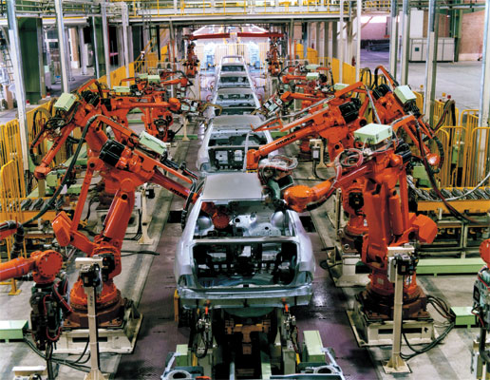
Sa ME 192 Lecture 8/27/14 San Jose State University Overview - Industrial Robotics

Slide 2
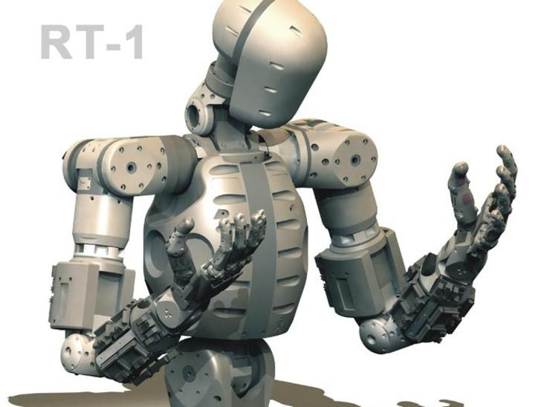
Anatomy
Similar to human torso, shoulder, arm, and wrist in construct, movement, and reach.
Joints – Enables rotation of connected members.
Provides the axes of rotation for adjoining members.
Socket joints:
Human (Shoulder and hip)
Robot (Wrist – combined three rotational joints)
Links – Rigid members between two joints.

Slide 3
Joints & Links
Joints - Enables linear or rotational motion of adjoining members.
Number of joints = Degrees of freedom
Linear (L)
Orthogonal (O)
Rotational (R)
Revolving (V)
Twisting (T)
SCARA: Revolving -Rotational -Orthogonal –Twisting
Cartesian: Linear –Linear –Orthogonal –Twisting
Articulated 6-axis: Twisting –Rotational –Rotational-Y-P-R
Yaw-Pitch-Roll: Wrist socket joint R-R-R
Prismatic
Revolute

Slide 4
Joint Types
➔Prismatic
➔Revolute

Slide 5
Link Length and Link Offset
Six Axis
SCARA
Cartesian
Link Length = A link segment that is normal or radial with
respect to the axis of rotation or sliding.
Link Offset = A link segment that either coincides or is parallel
with the rotation or sliding axis of predecessor.

Slide 6
Jointed Arm (Articulated) Robot

Slide 7
Configurations
Polar coordinate (T-R-L joints)
Cylindrical (L-R-R or L-V-R joints)
Cartesian (Rectilinear) (L-L-O joints)
Articulated (Rotational, Jointed Arm) (T-R-R joints)
SCARA (V-R-O-T) – Selectively Compliant Assembly Robot Arm
Tool Configuration: Rotation on Tool XYZ coordinates
Yaw – R_{Y} axis Pitch – R_{X} axis Roll – R_{Z} axis

Slide 8
Joint Framing – Class Convention
Assignment of a XYZ Cartesian frame at each joint starting at the base and ending at the end effector.
Using the right hand rule:
Align Z_{i} (thumb) with the axis of rotation and with Z_{i-1} (the direction of sliding for prismatic joint)
Align X_{i} (index) with X_{i-1}, pointing at the next joint (Align with Z_{i+1} for prismatic joint)
Set Y to be orthonormal to the X-Z plane,
In prismatic joint, link length a_{i} = 0 with variable displacement d_{i}
In twisting joint, link length a_{i} = 0 and d_{i} > 0.

Slide 9
Robot Configurations -192 Lab

Slide 10
Robot Configurations - Others

Slide 11
Applications & Set up Location
Applications
Primary uses: Part pick & place, part presentation, transferring, visual inspection.
Ex. : Conveyor line robots, Robot centered work cells
Solutions for: Hazardous conditions, tedium, ergonomic
issues, positional accuracy, and precision.
Economic life: General purpose machine. Long useful
life with tool change (end effecter).
Set up Location
Fixed (Robot centered, In-line, Off-line).
On-track (Floor or Ceiling).

Slide 12
Kinematics
Degrees of Freedom – Same as number of joints
4-axes for assembly robots: SCARA (x, y, z, r)
6-axes for material handling robots: Articulated arm robot
Base, links - θ₁, θ₂, θ_{3.} Wrist: y, p, r (yaw, pitch, roll)
Positioning Lead screws for linear move or belt- or direct-drive servo motors for joint rotation.
Drive Power – Electric, hydraulic, pneumatic.
Motor type: Servo motor for rapid movement including
leadscrew mechanism on linear joints.
Gear: Serrated (timing) belt or direct drive.
Motion Control
Using encoders and pulse count.
.

Slide 13
Kinematics - Continued
Coordinate Systems - Cartesian (World) - X, Y, Z.
Polar (Joint) - θ₁, θ₂, θ₃. Tool – (y, p, r)
Wrist Assembly – Typical, 3 degrees of freedom (yaw, pitch, roll).
Three coinciding orthogonal reference frames
Motion Control –
Positional:
Forward - Transformation of Joint values into XYZR gripper position.
Obtained through rotation and translation of joint frames.
Reverse - Transformation of XYZR gripper position into Joint values.
Temporal:
Linear and angular velocity and acceleration of joints
Path Generation – Straight or curvilinear connecting preset via points.

Slide 14
Dynamics
Determination of joint torque needed to support the mass of the robot links, effect the velocity and acceleration of the links, gripper, and the work load.
Motion control base on the relationship between the torque applied to joint links and the linear and angular velocity and acceleration of the links.
Stationary position, non-drift balancing of the arm position with joint torque without applying the brake.

Slide 15
Programming (Ex. Adept V⁺)
Path Generation - Using Teach Pendant
Here P1, Here P2, etc.
Program Instructions – Using C⁺ like language.
Set D1 = Trans(10, 20, 30, , , 90)
Move P1:D1 ;P1 offset by D1
Position Definition
Set P1 = Trans (x, y, z, y, p, r); Cartesian coordinates.
Set #P2 = #ppoint(θ₁, θ₂, θ₃, y, p, r); Angular coord.
Motion Commands (Ex.: a safe drop off)
Appro P1, 50 / Move P1 / Openi / Delay 1 / Depart 50

Slide 16
R-R Robot: Polar to X-Y Conversion
Length/height:
L₀ = Shoulder, L₁ = Upper arm, L₂ = Forearm
Angles (Relative):
θ₀ = Base pivot, θ₁ = Upper arm , θ₂ = Forearm
r = L₁ Cos θ₁+ L₂ Cos (θ₁+ θ₂)
X = r Sin θ₀
Y = r Cos θ₀
Z = L₀ + L₁ Sin θ₁+ L₂ Sin (θ₁+ θ₂)
Exercise: Develop an extension for a R-R-R robot.

Slide 17
T-R-R Robot Coordinates
z
Z
θ₂
(X, Y, Z)
r = L₁ Cos θ₁+ L₂ Cos (θ₁+ θ₂) [θ₂< 0 for left elbow]
X = r Cos θ₀
Y = r Sin θ₀
Z = L₀ + L₁ Sin θ₁+ L₂ Sin (θ₁+ θ₂)
L₂
R
L₁
θ₁
r
y
R
L₀
Y
T
(X, Y, 0)
θ₀
X
x

Slide 18
Peripherals
Programming Tool – Teach (Lead-through path), Program code, Simulator/Code generator
Signal Interface – I/O ports for exchanging signals with other in-line equipment
Vision – Positioning, Gripper orientation, Dimensional gaging, Pattern recognition, Part ID, OCR inspection
Safety Interlock – E-stop, motor stall sennsor, light curtain, pull cord, enclosure. Safety is a big concern on industrial robots. Elaborate, redundant e-stop circuitries are built into a robot system.

Slide 19
Robot Vision
Applications
Part ID by geometric shape or by prototype matching.
Compensation for location shift and orientation change.
Check for a date code, surface defects, and missing features.
Carrier number check for part routing control.
Equipment
Smart camera and software running on PC.
Vintage CCTV camera with vision process PCB and software.

Slide 20
Robot Vision - Continued
Image Processing
Take a snap shot and frame it into window –Frame Grab
Select objects in the window per criteria - Filtering
Convert gray scale image into binary- Thresholding
Enhance binary image: Erosion-Dilation– Morphology
Extract edges & identify the shape –Pattern Recognition
Subject the processed image to Pass/Fail test.
If pass, transform camera location to gripper location.
Perform pick up operation.

Slide 21
Work Envelope
The 3-D space reachable by the end effecter.
Safety Envelope – Additional 12” around the work envelope.
Lab 550 Robot – Plan View

Slide 22
SCARA Work Envelope – Right Arm

Slide 23
Control Resolution, Accuracy, Repeatability
Linear Positioning System
Control Resolution
Distance between two adjacent addressable points
C.R. determined by mechanical limit
Repeatability (Precision) ± 3 σ (σ : Std. mechanical error)
Accuracy ½ of C.R. ± 3 σ
Ex. Lead screw mechanism with gear driven by stepping motor
XY bench on CNC machine, Z-axis drive on SCARA robot.
Robot Positioning System – Cylindrical, spherical
Extension to XYZ rectilinear and θ₁θ₂θ₃ angular work space.

