Slide 1
Communication Studies Department
San Jose State University
The Nature of Human Communication
Dr. Marquita L. Byrd

Slide 2
Defintion
Creation and sharing of meaning through the use of a mutually shared set of symbols, which include verbal and nonverbal cues. These cues are governed by rules, generated in speech communities.

Slide 3
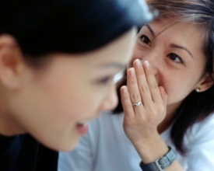
Create and Share
Create: use of available resources to make something that has not been seen, used or done before.
Use of the known to produce something new
When we communicate we make something new
And then we share
Share: take part in, divide equally, own-pay-create in conjunction with another

Slide 4
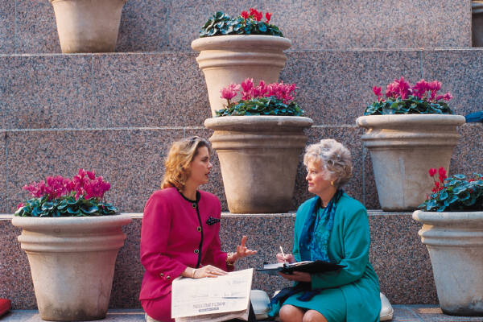
Meaning
Meaning: reactions or responses to stimuli
Thoughts, feelings, memories,
Sounds, smells
“When you said the CD was ‘live’ I thought you
Meant it was recorded live. Now I understand you meant it was ‘good’.”

Slide 5
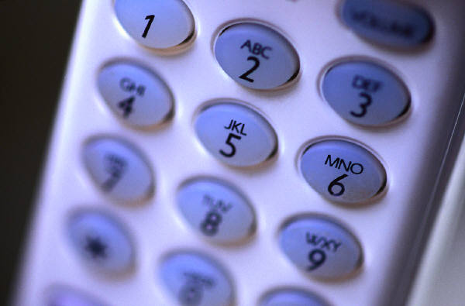
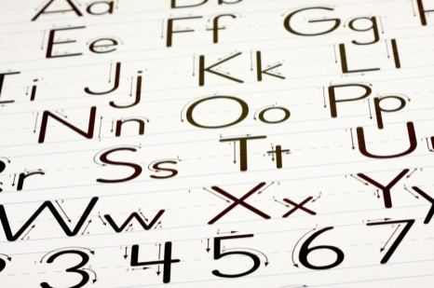
Mutually shared set of symbols
Mutual: two or more in agreement
Shared: distributed between or among
Set: finite group
Symbol: something that stands for something else
Alphabet and Numbers

Slide 6
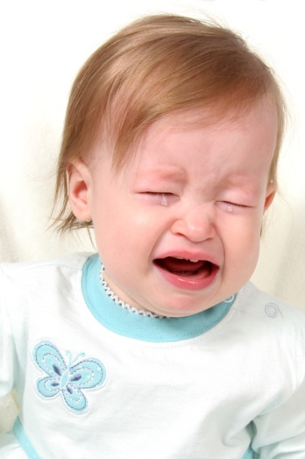

Verbal and Nonverbal Cues
Verbal: aural symbols, actual words
Nonverbal: everything excluding words
i.e. facial expression, eye contact, volume,
pitch ,rate
Cue: prompt, signal, behavior

Slide 7

Governed by Rules
Govern: control, dictate, manage
Rule: guideline for use
Whenever people are communicating they are following many rules such as grammar, syntax, semantic, phonological, etc
Correctness of use depend on whether or not the rules being followed are used in the right context

Slide 8
Rules Generated in Speech Communities

Slide 9
What is a Speech Community?
Nationality
Gender
Religion
Region of the country
Race
Urban
Rural
Age
Education
Group of people speaking the same language or dialect, following the same speaking rules and see themselves as a community. Or they are seen by others as a community.

Slide 10
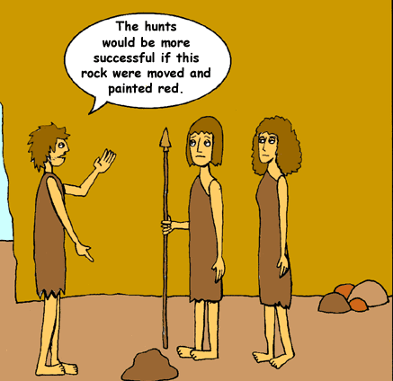

Speech Communication
Oral Symbolic Activity
Defines us as a species
In other words, human beings talk!

