Slide 1
Speaking and Using PowerPoint
Communication Studies Department
San Jose State University
Dr. Marquita Byrd

Slide 2

Speaking and Using PowerPoint is
more difficult than it seems!
The oral presentation is the focus, not the PowerPoint!
You are “giving a presentation using PowerPoint” not a PowerPoint presentation.
Below is a sample speech with an outline in power point and pointers for using PowerPoint.

Slide 3
A Speech About you
What Would you choose to Represent You?
Events or experiences that shaped you or gave you insight into life.

Slide 4
Purpose: Introduce yourself to the class
Three most important events, experiences, individual or group of people.
You may mix and match.
And what would you do if you had one year to live?
5 minute extemporaneous speech: Speech notes on note cards : Reading earns an F
Full sentence outline
PowerPoint with six slides

Slide 5
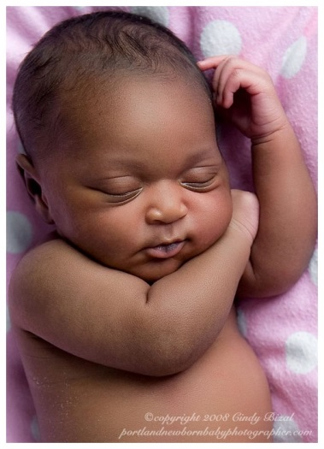
I. My conception and birth were the most important events in my life.
A. there is only one me
B. my parents choose to let me live

Slide 6
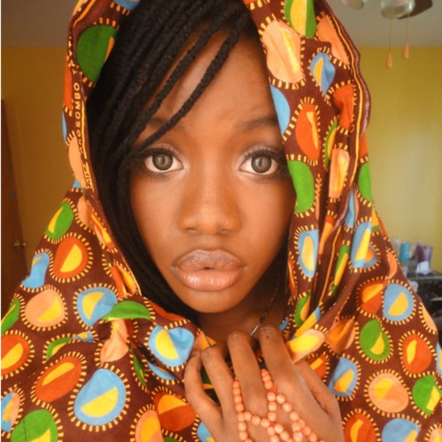

II. Gaining a new family at the age of 4 set me on my way.
A. mother gave me away
B. family took me in
Birth Mother
New Family

Slide 7

III. A car accident at the age of 24 broke my
body and changed my life.
A. importance of accepting help
B. realized the fleeting nature of life
C. understood the fragility of the body

Slide 8
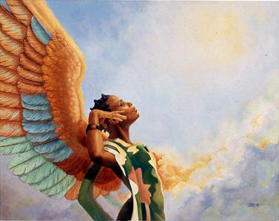
One Year to Live
*This is not the conclusion
Prepare my family
Get right with God
Say good bye’s
Forgive self, others and God

Slide 9
Tell them what you are going to say and then tell what you said!
Introduction
Conclusion
Introduce yourself to class
Theme, quote
Thesis sentence
General statements about life
Transition
10-12 typed lines (120 words)
Summary
Repeat Thesis
Quote, theme
5-6 typed lines

Slide 10
OUTLINE
Introduction: 10-12 types lines
Body: Four main points
I. My conception and birth were the most important events in
my life.
A.
B.
II. I gained an new family at four when my birth mother gave
me away
A.
B.
III. A car wreck taught me the fragility of the human body and
the importance of accepting help
A.
B.
IV. If I had one year to live I would prepare my family, my
spiritual life and forgive.
A.
B.
Conclusion: 5-6 typed lines

Slide 11
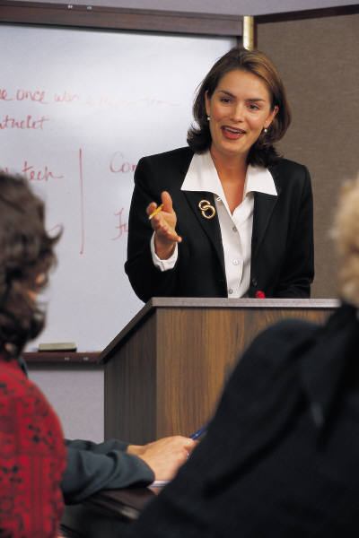
Delivery is Important!
Eye Contact
Volume appropriate for public context
NO READING ESSAY: Note cards with
Outline only

Slide 12
PowerPoint
1. Six slides
Introduction
Each Main point
Conclusion
2. Each slide should
have one picture
3. Each main point
slide should have
ONLY the main
point and A. & B. as
they appear in the
outline
PowerPoint is a visual-audio aid for the audience.
You must already know what is on the slides. YOU CANNOT LOOK UP TO THEM AND READ.

Slide 13
Lecture Summary
5-7 minute extemporaneous Speech
Introduction and conclusion
Four main points
PowerPoint with six slides
Speaking points on note cards (Not torn pieces of paper)
Outline

