Slide 1
Communication Studies
Seven Traditions of Communication Studies
Dr. Marquita Byrd
Department of Communication Studies
San José State University
Marquita Byrd©2012

Slide 2
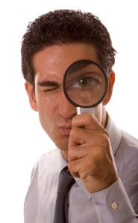

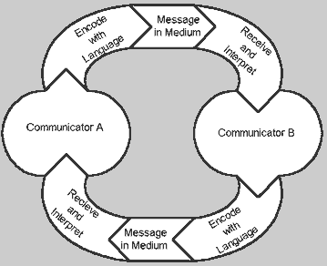
Traditions: Ways of organizing Theories in the Field
Phenomenology
Semiotics
Rhetoric
Cybernetics
Socio Psych
Cause
Effect
Socio Cultural
Me
Us
You
Critical

Slide 3
Rhetoric
Aristotle, Plato, Socrates
Rhetoric
Available Means of Persuasion: Influence and/or control

Slide 4

We experience Life through our own Lenses
Phenomenology
Must be aware of Biases

Slide 5
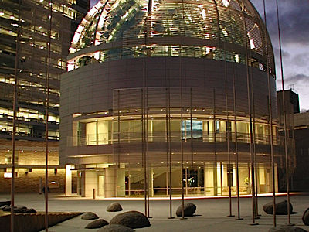
Study of Signs and Symbols in a Society
Semiotics
Symbol
Sign
People
City of San Jose City Hall
Human beings and abstract

Slide 6
Socio-Psychological
Cause and Effect
Cause and Effect
Event
Behavior
Behavior
Event

Slide 7
Socio-Cultural
We co-create reality
Me
Us
You
Shared cultural patterns and social structures

Slide 8
Cybernetics: Information Processing
Shannon and Weaver
Noise, complex individualities, messages

Slide 9
Critical
Power, Discrimination, Oppression
Critical
Ways in which communication constructs and supports the use of power to oppress and ways that communication can reduce use of power to discriminate and oppress.

Slide 10
Traditions: Ways of organizing Theories in the Field
Phenomenology
Semiotics
Rhetoric
Cybernetics
Socio Psych
Cause
Effect
Socio Cultural
Me
Us
You
Critical

