Slide 1
The Fall of the Roman Republic
Standards: 6.7.3, 6.7.4, 6.7.7, and 7.7.1
Chapter 8: Sect. 3 and 4
Rachel Nolan- Group 3

Slide 2
Trouble in the Republic
Rich vs Poor
    Particians- Rich people who owned large farms
      Ran the Senate
      Handled Rome’s finances and directed its wars
  100s BC = farmers falling into debt and poverty
  Farmers fought in wars and were unable to farm = debt.

Slide 3
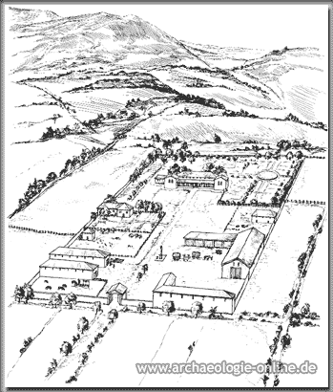
Latifundia- large farming estates
New Labor: prisoners from Italy
Enslaved people helped rich Romans force owners of small farms out of business
Farmers were not able to pay off debts-sold their land and moved to the cities
Free men earned low wages
Roman Politicians were worried about riots- “bread and circuses”

Slide 4
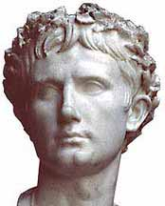
Why Did Reform Fail?
Tiberius and Gaius Gracchus- thought that Rome’s problems came from loss of small farms
Told Senate - take back public land from rich and give it to the landless Romans
Problem: Senators owned most of the public land
Senators killed Tiberius in 133 B.C., 12 years later Gaius was killed as well

Slide 5
The Army Enters Politics
Military leader, Marius, becomes consul in 107 B.C.
Recruited soldiers from the poor
  Paid them wages
  Promised them land
Changed the Roman army
  No longer citizen volunteers, they were paid professional soldiers
General Sulla challenged Marius’ new army in 82 B.C.

Slide 6
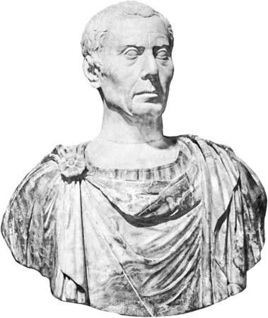
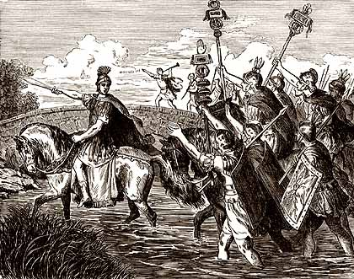
Julius Caesar

Slide 7
Julius Caesar
One of the three men on top in 60 BC
  Pompey (Spain), Crassus (Syria), Caesar (Gaul)
Formed the First Triumvirate to rule Rome
  Triumvirate: a political alliance of three people
49 B.C., Senate ordered Caesar to give up his army and come home
Led his men into Italy crossing Rubicon
  “crossing the Rubicon”

Slide 8
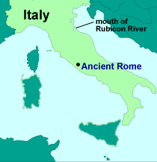

Slide 9
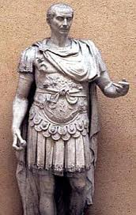
Caesar’s Rise to Power
44 B.C.- Caesar declared himself dictator of Rome for life.
Filled the Senate with new members loyal to him
Provided land for landless, created work for the jobless
Created Julian Calendar

Slide 10
Rise to Power Cont’d….
His enemies believed he wanted to be King
Opponents- Brutus and Cassius, plotted to kill him
“Beware the Ides of March” (March 15)
Caesar stabbed to death in 44 B.C.

Slide 11
Caesar: Reformer or Dictator?
Reformer
Dictator
Won support of soldiers
Ended rule of Roman nobles
Brought order and peace to Rome
Restored cities that had been destroyed
Strengthened and expanded the state of Rome
Created jobs for the poor
Granted citizenship to people from foreign countries/states
Refused to follow the Senate’s order
Started civil war-destroyed the republic
More senators for more supporter
Treated his enemies badly
Punished people who followed the old tradition
Sought glory for himself
Weakened the Senate for absolute power

Slide 12
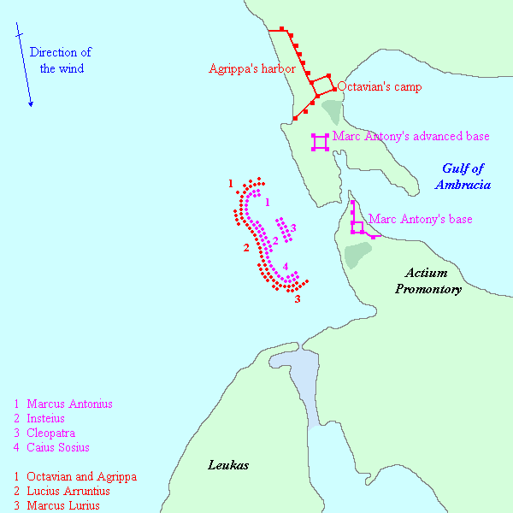
Octavian
Inherited Caesar’s wealth and two of the top generals, Antony and Lepidus.
Formed the Second Triumvirate in 43 B.C.
Drama started- Cleopatra VII
31 B.C.- Battle of Actium
Influence of Cicero

Slide 13
Octavian becomes Augustus
27 B.C. Octavian restored the Republic
Cicero- political leader, writer and public speaker
Imperator-”commander in chief” or “emperor”
Took the title, Augustus- “the reverend or majestic one”
Pax Romana – “Roman Peace”
Achievements
Provided security by having 150,000 soldiers
Created the Praetorian Guard
Conquered Spain and Gaul
Built palaces, fountains, and public building
Appointed a governor
Reformed the Roman tax system and legal system

Slide 14
The Julio-Claudian Emperors
Tiberius (14-37 A.D.)
  Military leader; regulated business to prevent fraud; kept Rome’s economy
Caligula (37-41 A.D.)
  Abolished sales tax; allowed people in exile to return; increased court system’s power
Claudius (41-54 A.D.)
  Built new harbor at Ostia and new aqueduct for Rome; conquered most of Britain
Nero (54-68 B.C)
  Constructed many new buildings; gave slaves the right to file complaints; assisted cities suffering from disasters

Slide 15
The “Good Emperors”
Nerva, Trajan, Hadrian, Antoninus Pius, and Marcus Aurelius (96-180 A.D.)
Agriculture flourished and trade increased
They did not abuse their power
Trajan- gave money to the poor parents to help them raise and educate their children
Antoninus- passed laws to help the orphans
Built arches and monuments, bridges and roads, and harbors and aqueducts

Slide 16
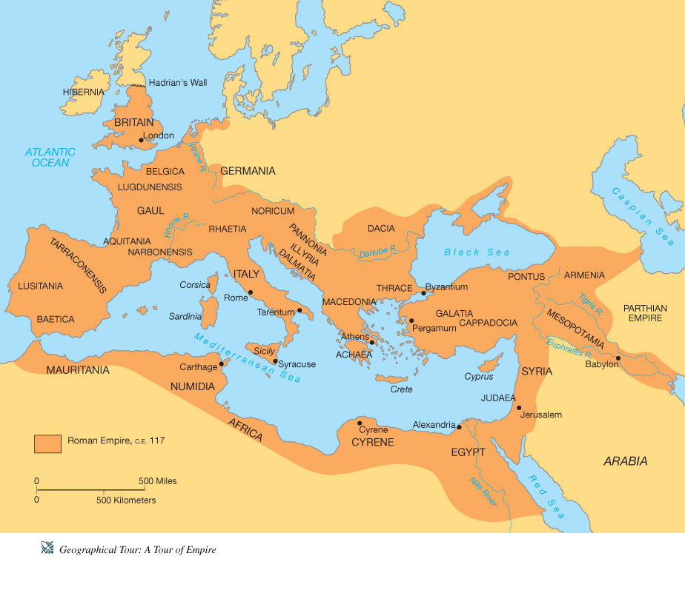

Slide 17
Trajan made the empire reach it’s largest size under his rule
Hadrian set the empire’s northern boundaries at the Rhine River and Danube River
Hadrian built Hadrian’s Wall across northern Britain to keep out the Picts and the Scots
A.D. 100s, Rome was one of the greatest empires, had 3.5 million square miles of land.
A.D. 212, every free person was made a Roman citizen

Slide 18
Economy
Northern Italy- small farms
Central and Southern Italy- latifundias worked by enslaved people
Produced grapes and olives mainly
Agriculture and Industry- IMPORTANT
Potters, weavers, and jewelers—cities became centers for making glass, bronze, and brass

Slide 19
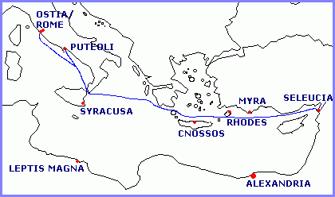

Slide 20
Economy
Two of the largest port cities- Puteoli and Ostia
Had luxury items: silk from China, spices from India, British tin, Spanish lead, and iron from Gaul
During Pax Romana, Rome’s roads reached a total length of 50,000 miles

Slide 21
Study Central
http://www.glencoe.com/apps/studycentral/0078688736/core_content.html
Quizzes, Notes, Review, and Links!

