Slide 1
China in the Middle Ages
Stephanie - The Mongols In China
Shanda - The Ming Dynasty

Slide 2
Standards
7.3 Students analyze the geographic, political, economic, religious, and social structures of the civilizations of China in the Middle Ages.
1. Describe the reunification of China under the Tang Dynasty and reasons for the spread of Buddhism in Tang China, Korea, and Japan.
2. Describe agricultural, technological, and commercial developments during the Tang and Sung periods.
3. Analyze the influences of Confucianism and changes in Confucian thought during the Sung and Mongol periods.
4. Understand the importance of both overland trade and maritime expeditions between China and other civilizations in the Mongol Ascendancy and Ming Dynasty.
5. Trace the historic influence of such discoveries as tea, the manufacture of paper, wood-block printing, the compass, and gunpowder.
6. Describe the development of the imperial state and the scholar-official class.

Slide 3
The Mongols in China
By Stephanie Brownell
Standards: 7.3.3 and 7.3.4

Slide 4
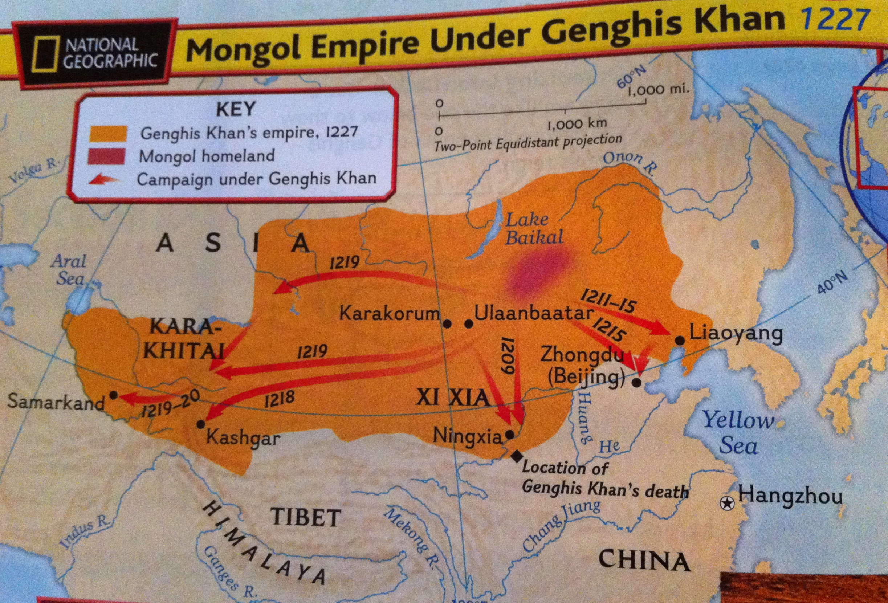
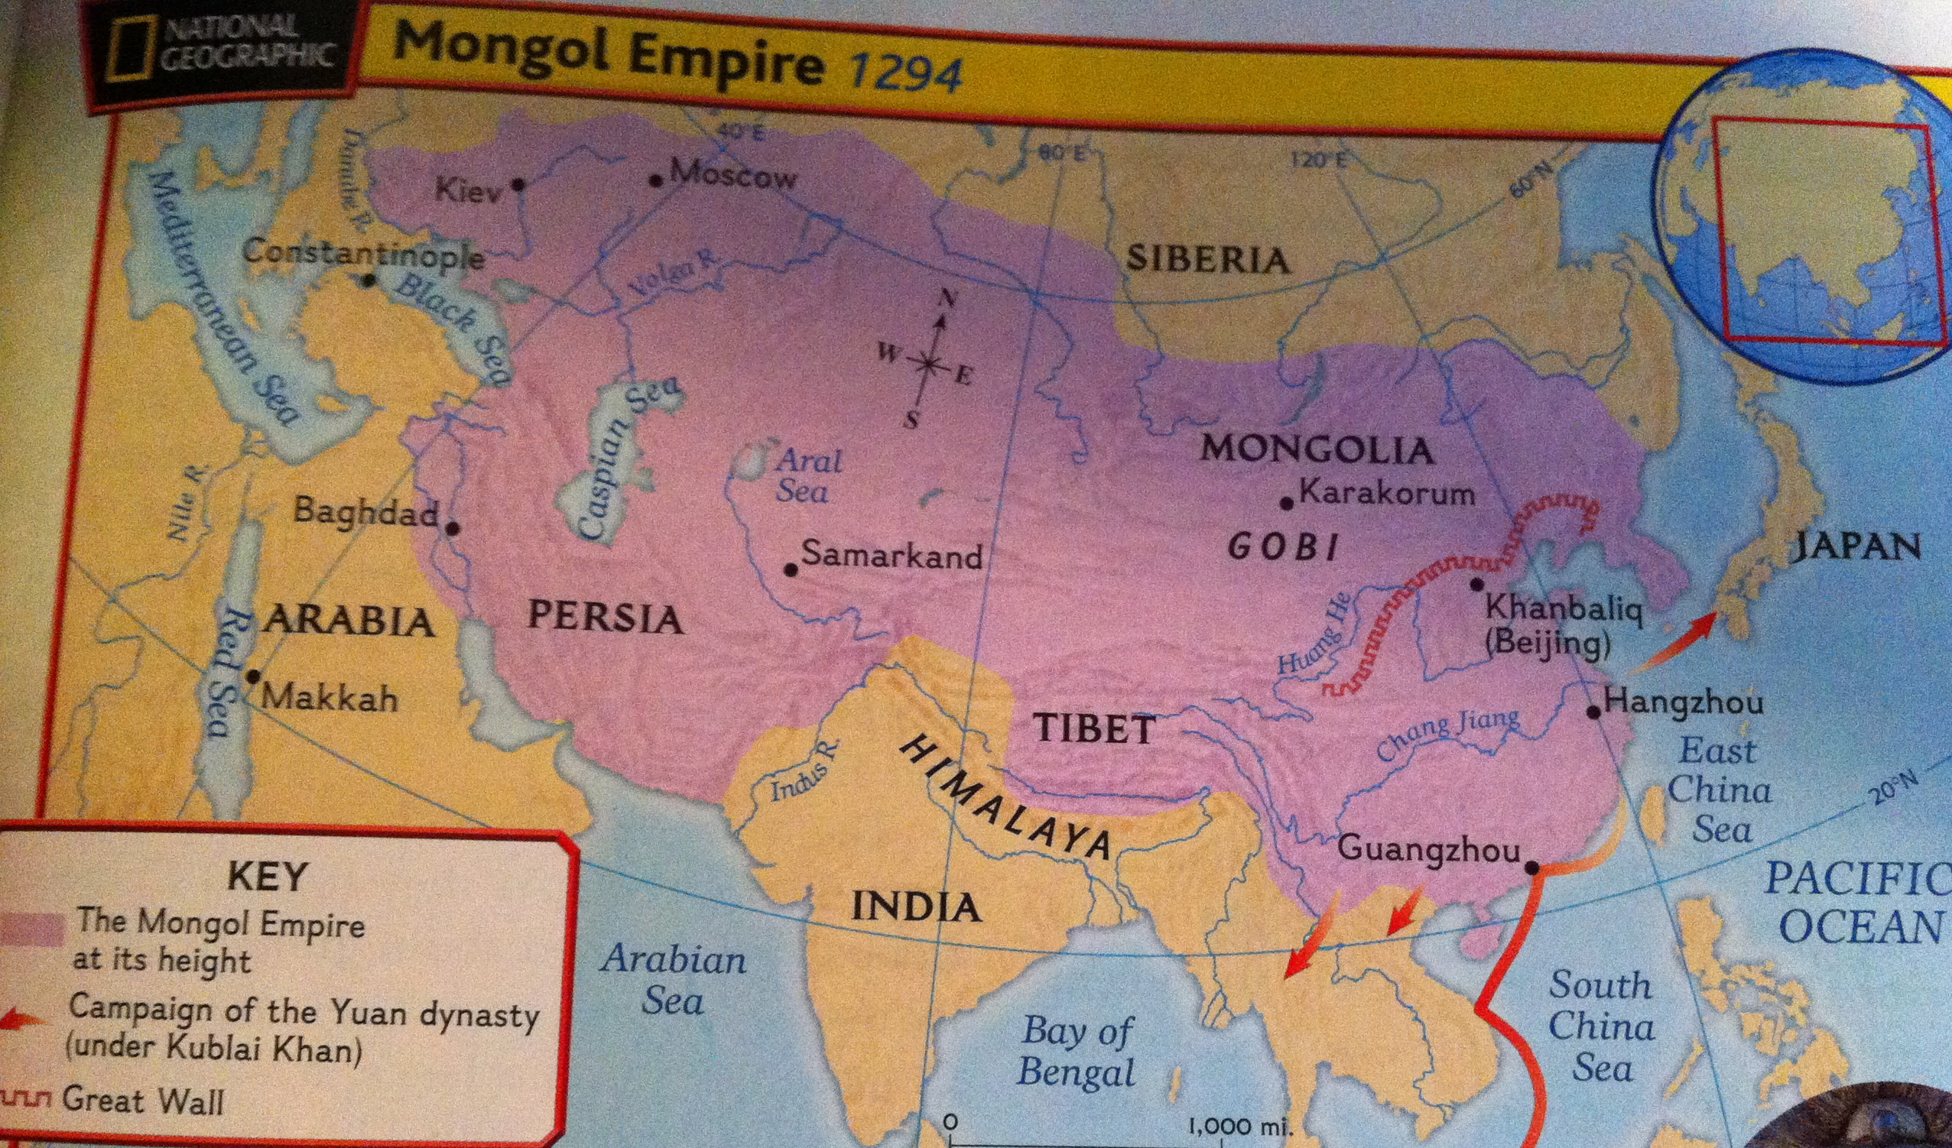
Mongolia
North of China, South of Serbia.
At the empire’s peak it stretched
from the Black Sea to the
Pacific Ocean

Slide 5
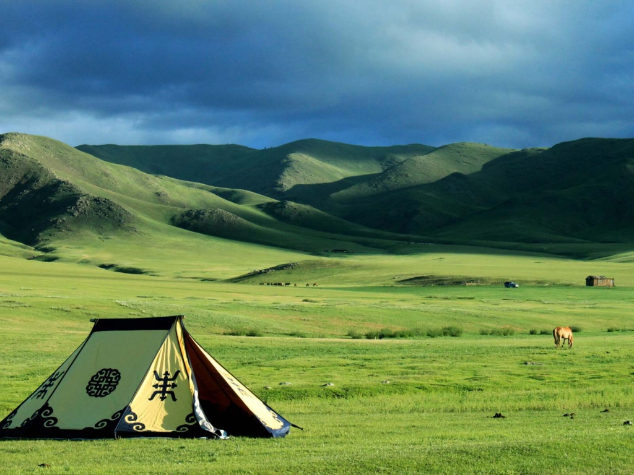
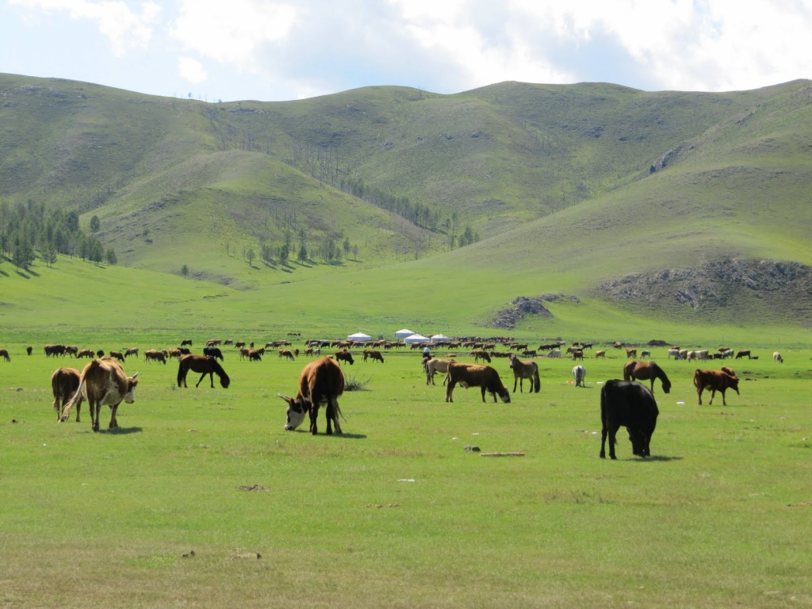
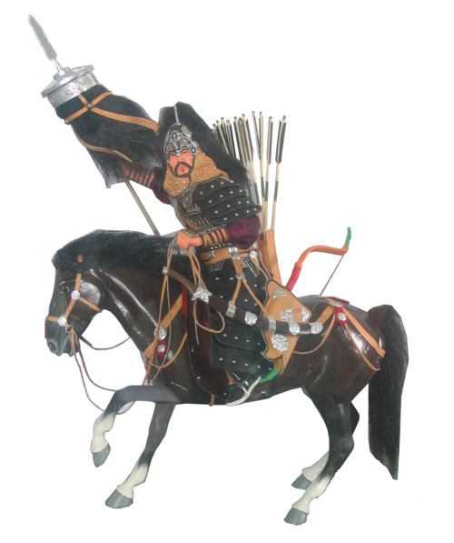
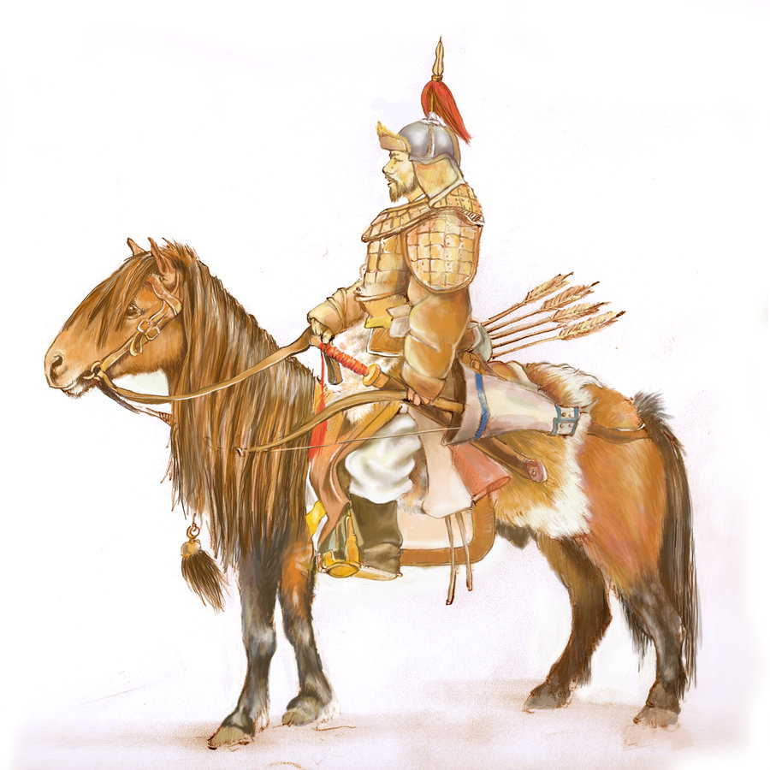
Mongolia
Lived in Tribes
Raised cattle
Steppes – wide rolling grassy hills
Mongols were known for two things:
  Ability to ride horses
  Ability to wage war

Slide 6
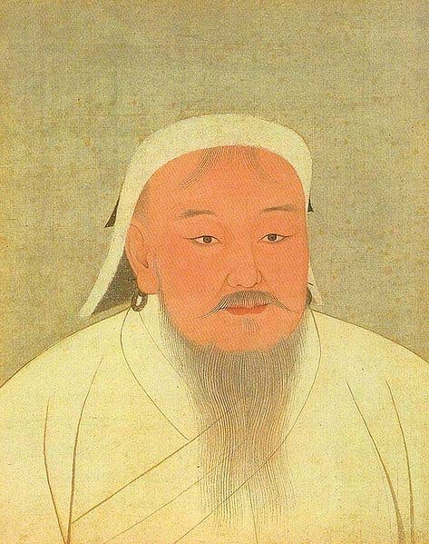
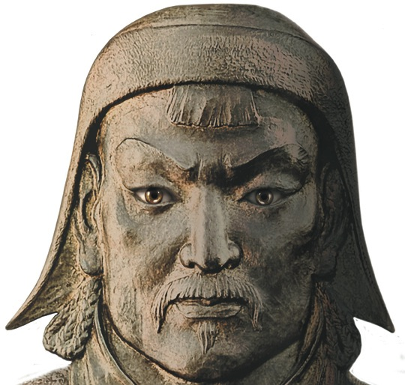
Genghis Khan
Temujin was born 1160’s
Began uniting tribes as a young man
Meeting of Mongol leaders in 1206
  Held in the Gobi Desert
  Temujin was elected Genghis Khan
Created a new code (laws)
Created a group of tribal chiefs

Slide 7
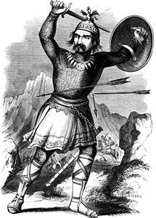
Genghis Khan
Main goal was to conquer lands and expand the empire
Army of more than 100,000 warriors
Became a very skilled fighting force
Victories brought wealth and new soldiers
1211 The Mongols invaded China
Warriors were known for cruelty and terror

Slide 8
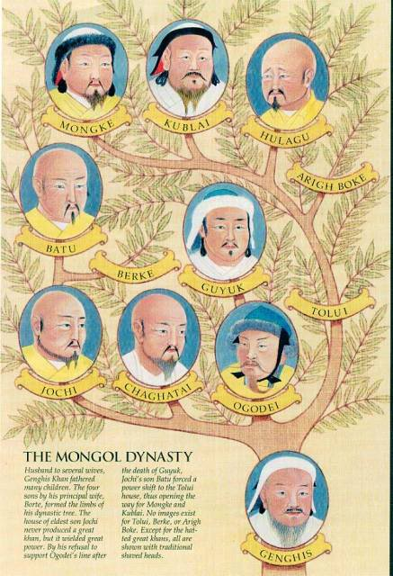

Slide 9
The Mongol Empire
Expanded the empire to Europe and Southwest Asia
In 1258 Baghdad fell
The Mongols expanded to Syria, Palestine, and tried to get to Egypt but did not conquer Egypt
The entire territory was under the Mongol rule
After the destruction there was a time of peace and an abundance of trade
The empire grew very wealthy

Slide 10
Mongol Rule in China
Kublai became the new Khan (ruler)
Moved capital to Khanbaliq (Beijing)
1271 Kublai Khan named himself the new emperor of China
Conquered the rest of Southern China and ended the Song Dynasty
Kublai Khan ruled the Yuan Dynasty for 30 years
The Mongols had their own language, laws and customs that were separate from the Chinese

Slide 11
Trade and Conquest
China prospered because of increased trade
  Goods that were imported
      Silver
      Spices
      Carpets
      Cotton
  Goods that were exported
      Tea
      Silk
      Porcelain
The Mongols also conquered Vietnam and Northern Korea

Slide 12
Genghis Khan: Villain or Hero?
Was Genghis Kahn a ruthless warrior who enjoyed causing death and destruction or was he a skilled leader who improved the lives of those in his empire, or both?

Slide 13
The Ming Dynasty
By Shanda Modrall
Standard: 7.3.4

Slide 14
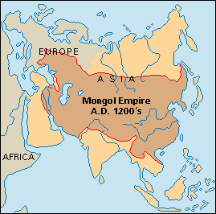
Decline of Mongol Empire
Kublai Khan died in 1294
Weak rulers → decline in power
Mongols broke away from Yuan dynasty
  Chinese resented Mongol control
  Chinese wanted their own dynasty
Series of rebellions drove out Mongols

Slide 15
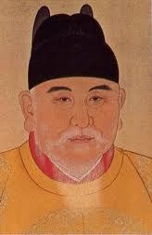
Beginning of Ming Dynasty
Zhu Yuanzhang (JOO YOO-AHN-JAHNG)
  Rebel leader
  Became emperor in 1368
  Reunited country and brought order
  Set up capital in Nanjing (NAHN-JIHNG)
  Founded “Ming” or “Brilliant” dynasty
  Changed name to Hong Wu or “Military Emperor”

Slide 16
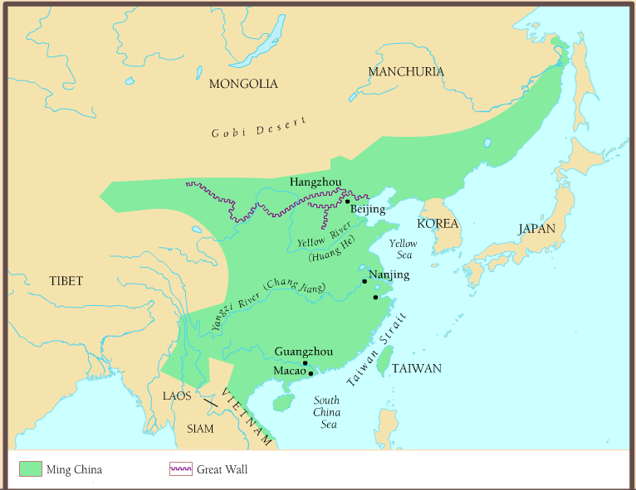

Slide 17
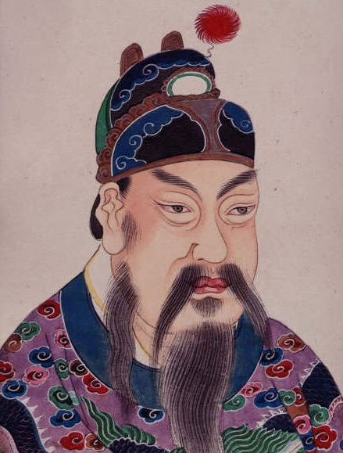
Hang Wu
Hang Wu or “Military Emperor”
  Very cruel leader
  Trusted no one
  Killed officials he suspected of
  treason or disloyalty
Hang Wu ruled for 30 yrs.
Died in 1398
Son became emperor – Yong Le (YUNG LEE)
  Moved capital north to Beijing

Slide 18
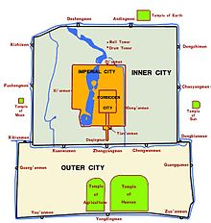
Yong Le
Built Imperial City
  Large palaces and Government buildings
Forbidden City in center of Imperial City
  Only top officials could enter
  Emperor’s home
  Beautiful gardens

Slide 19
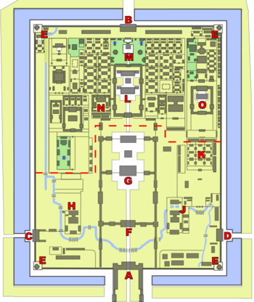
Meridian Gate
Gate of Devine Might
West Glorious Gate
East Glorious Gate
Corner towers
Gate of Supreme Harmony
Hall of Supreme Harmony
Hall of Military Eminence
Hall of Literary Glory
Southern Three Places
Palace of Heavenly Purity
Imperial garden
Hall of Mental Cultivation
Palace of Tranquil Longevity

Slide 20
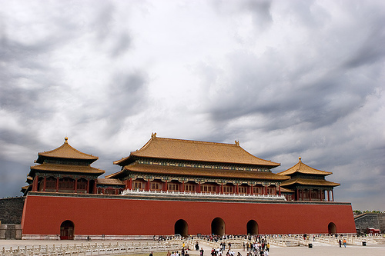
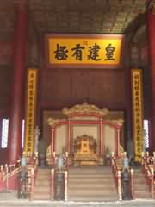
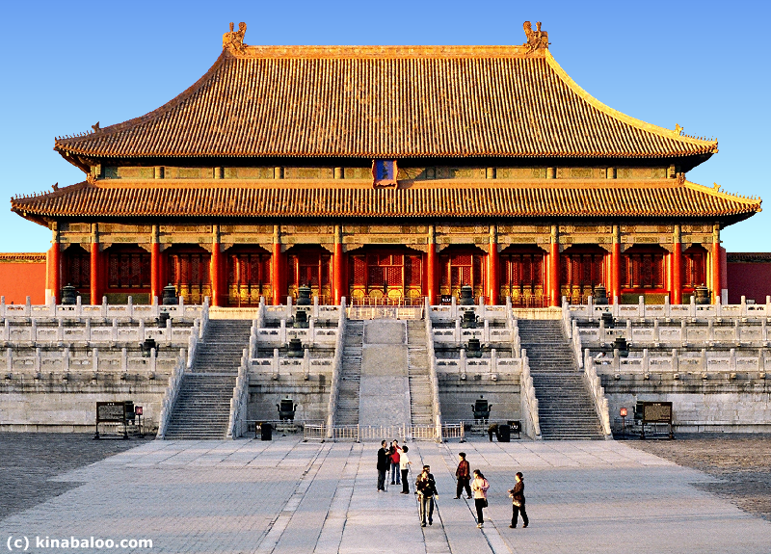
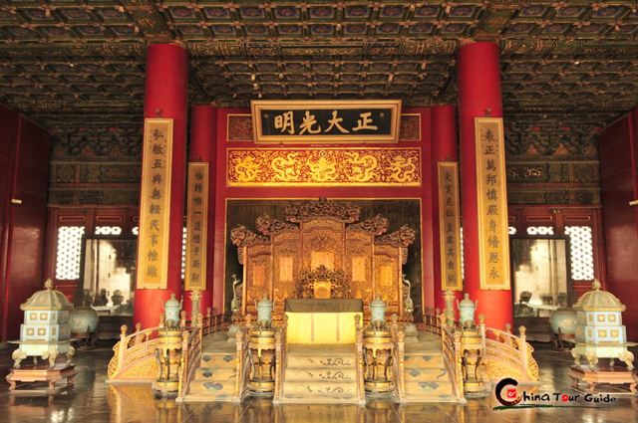
Mandarin Gate
Hall of
Mental
Cultivation
Hall of Supreme Harmony
Palace of Heavenly
Purity (Throne)

Slide 21
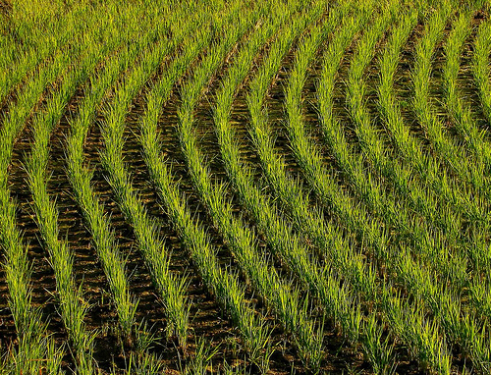
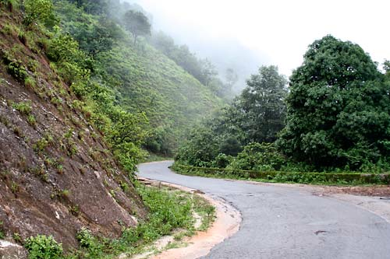
Ming Reform
Emperors
  Made all decisions
  Used officials
  Restored civil service exams
    Made them harder
  Carried out census
    Helped to collect taxes
Economy ↑
  Rebuilt farms and canals
  New farms
  Planted new forests
  New paved roads

Slide 22
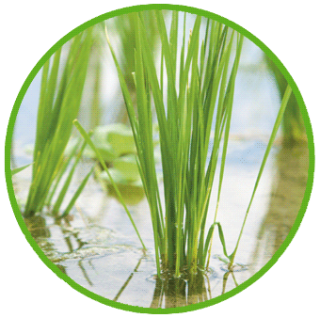
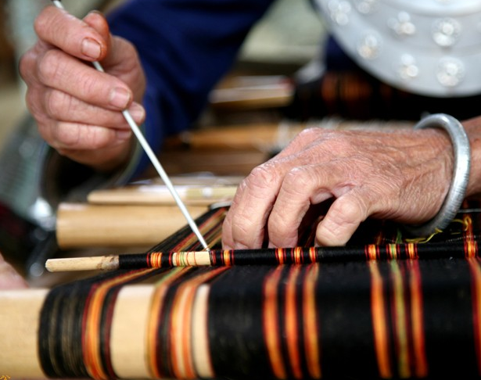
Ming Reform
Agriculture thrived
Rulers repaired & expanded the Grand Canal
  Rice and goods shipped
  southern to northern China connected
Imported faster growing rice
  Helped feed growing population
Farmers grew cotton and
wove into fabric
  Chinese started wearing
  cotton cloth

Slide 23
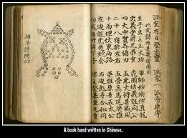
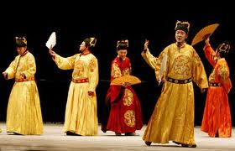
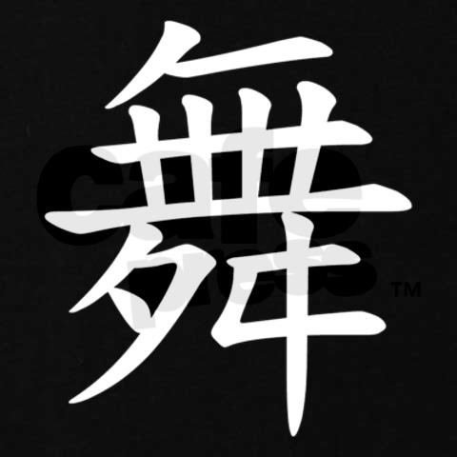
Chinese Culture
Merchants and Artisans grew wealthier
  Wanted to learn more be entertained
Chinese writers produced many novels
Enjoyed dramas on stage that included:
Spoken word Songs | Dance Costumes | Symbols gestures

Slide 24
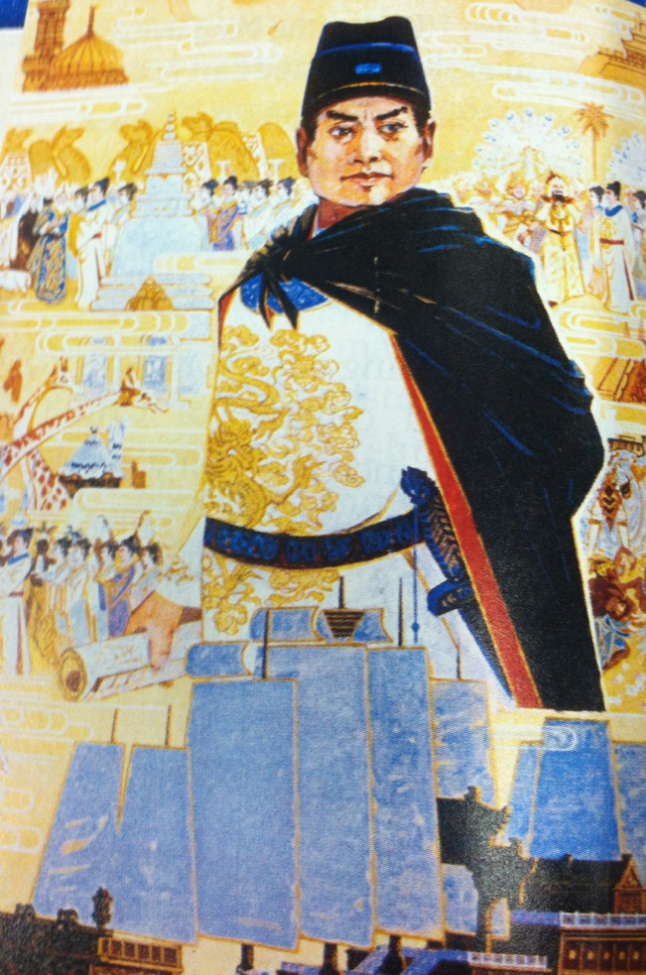
China Explores the World
Yong Le sent fleet on 7 oversea voyages (1405-1431)
  To trade with other kingdoms
  To show China’s power
  To demand weaker kingdoms pay tribute to China
Zheng He (JUNG HUH)
  Leader of voyages
  Chinese Muslim

Slide 25
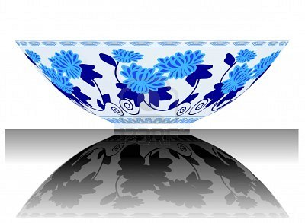
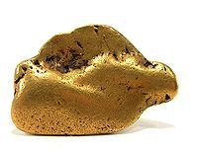
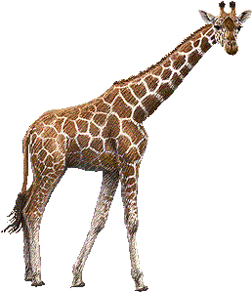
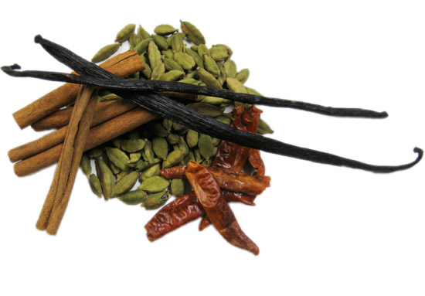
Zheng He’s Travels
First voyage to southeast Asia
Reached: India, Arabia, and East Africa
Traded Chinese goods: silk, paper and porcelain
Brought back: silver, spices, wood,
and zoo animals
Chinese Merchants settled in
Southeast Asia and India

Slide 26
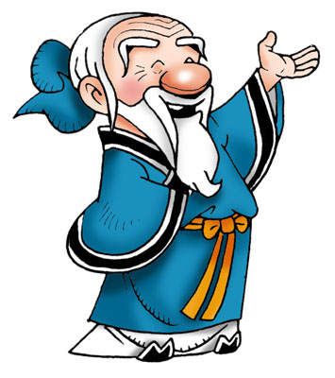
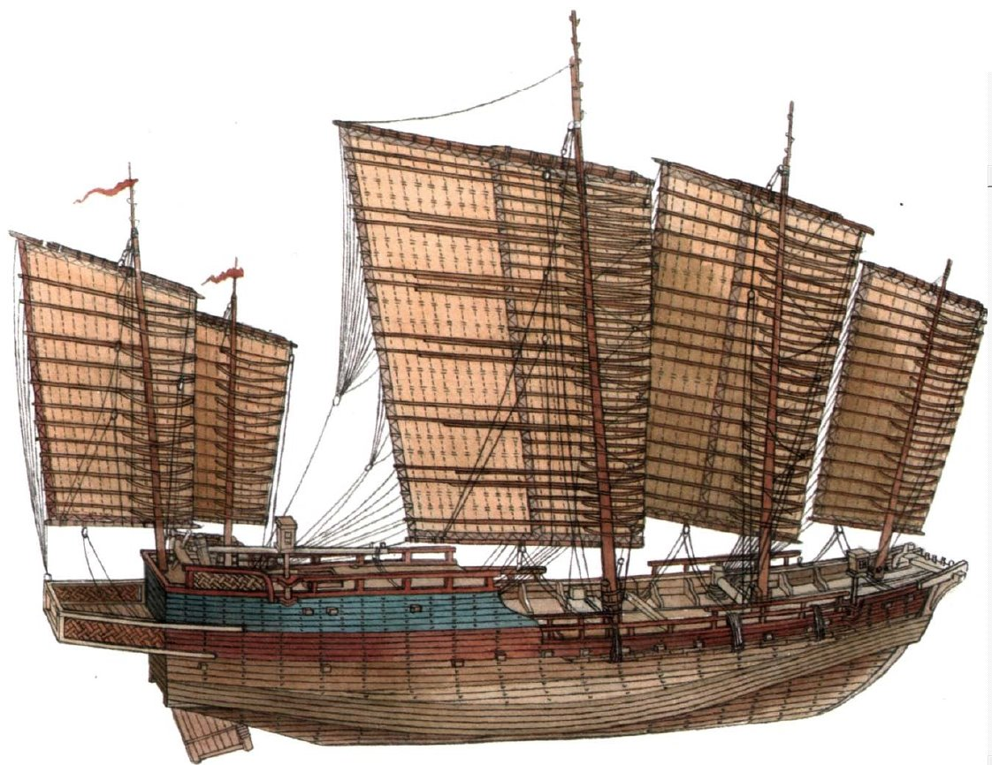
Decline of Ships and Overseas Trade
Chinese officials thought trips were too expensive
Bad for China’s way of life because brought new culture
Allowed merchants to become rich
Went against Confucius’ teaching “loyalty to society before own desires”
Confucian officials convinced emperor to stop trade
Boats destroyed, trade declined, boat technology forgotten

Slide 27
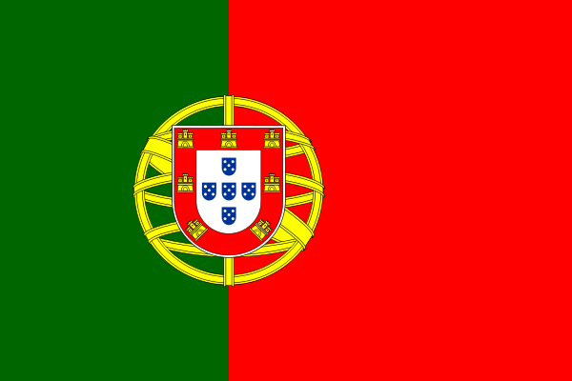
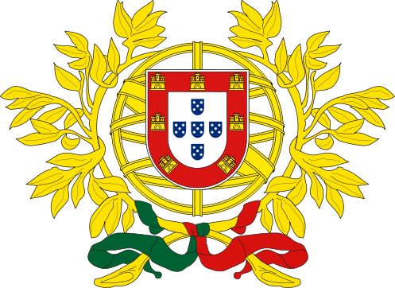
Europeans Arrive in China
1514 – Fleet from Portugal arrived
  First time Europeans had sailed to China
  First direct contact with Europe since Marco Polo
Portuguese wanted to trade
Also wanted to convert Chinese to Christianity
China not threatened by outsiders → refused trade
1600 – Portuguese set up trading
post in Macao (MUH-KOW)
  Trade limited with Europe

Slide 28

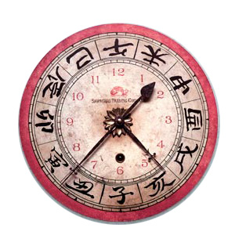
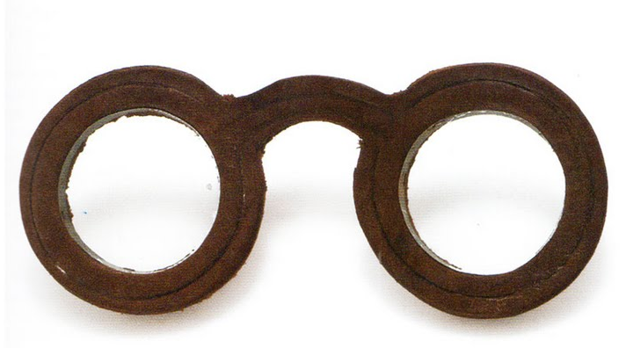
Europeans and Christianity
Despite restrictions European ideas reached
China
Christian missionaries, especially Jesuits
traveled to China
Jesuits highly educated
Tried to bribe Chinese with
  Clocks
  Glasses
  Scientific instruments

Slide 29
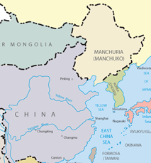
Ming Decline
Emperors had too much power
Officials had little desires make improvements
Overtime emperors became weak
Greedy officials took over
  Placed heavy taxes on peasants
  Peasants revolt
The Manchus attacked China’s northern border
  Manchus lived above the Great Wall in modern day Manchuria
  Defeated Chinese army and took over Beijing
  Set up new dynasty in 1644

Slide 30
Add to Map
Chang’an
Hangzhou
Grand Canal
Great Wall
Khanbaliq/ Beijing
Macao
Nanjing
Guangzhou

