Slide 1
Chapter 15:
The Church and Society
The late Middle Ages

Slide 2
New Religious Order
Cistercian order founded in 1098
Bernard of Clairvaux- most famous Cistercian monk
A.D. 1000 and 1200 women entered convents
Most educated women in medieval Europe were nuns.

Slide 3
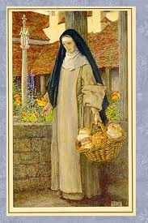
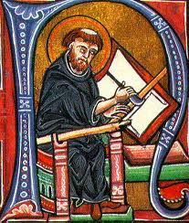
Friars
1200s brought new religious orders
Friars-different from monks because they did not stay in monasteries.
Francis of Assisi- founded the first order of Friars and they became known as Franciscans
Dominicans

Slide 4
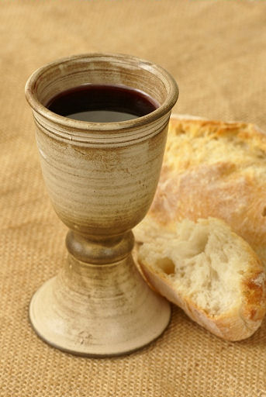
Role of religion
Daily life revolved around the Catholic Church
Sundays and holy days people went to mass
During mass medieval Christians took part in Church rituals called sacraments.

Slide 5
Saints
Holy men and women who had died and were believed to be in heaven.
Their presence before God allowed them to ask favors for people who prayed to them.
Mary the Mother of Jesus
People tried to make a connection to the saints by touching relics

Slide 6
Inquisition
Leaders wanted everyone to accept the Church’s teachings.
The church tried to an end to heresy
Sent groups to preach the Church’s message
1233 Inquisition (church court) was established by the pope

Slide 7
Job was to try people suspected of heresy
People brought before the Inquisition were urged to confess their heresy and ask for forgiveness.
Those who refused: could be tortured until they admitted, considered guilty and turned over to political leaders who would execute them.

Slide 8
How were the Jews treated…
Jews were persecuted as actively as heretics were
Many Europeans hated Jews for refusing to become Christians
Some Jewish people were moneylenders who charged interest and at the time Christians believed charging interest was a sin

Slide 9
Anti- Semitism
Jews became scapegoats
Christian mobs attacked and killed thousands of Jews.
Governments made them wear special badges or clothing
In some places they had to live in separate communities known as ghettos
Lost the right to own land and practice certain trades

Slide 10
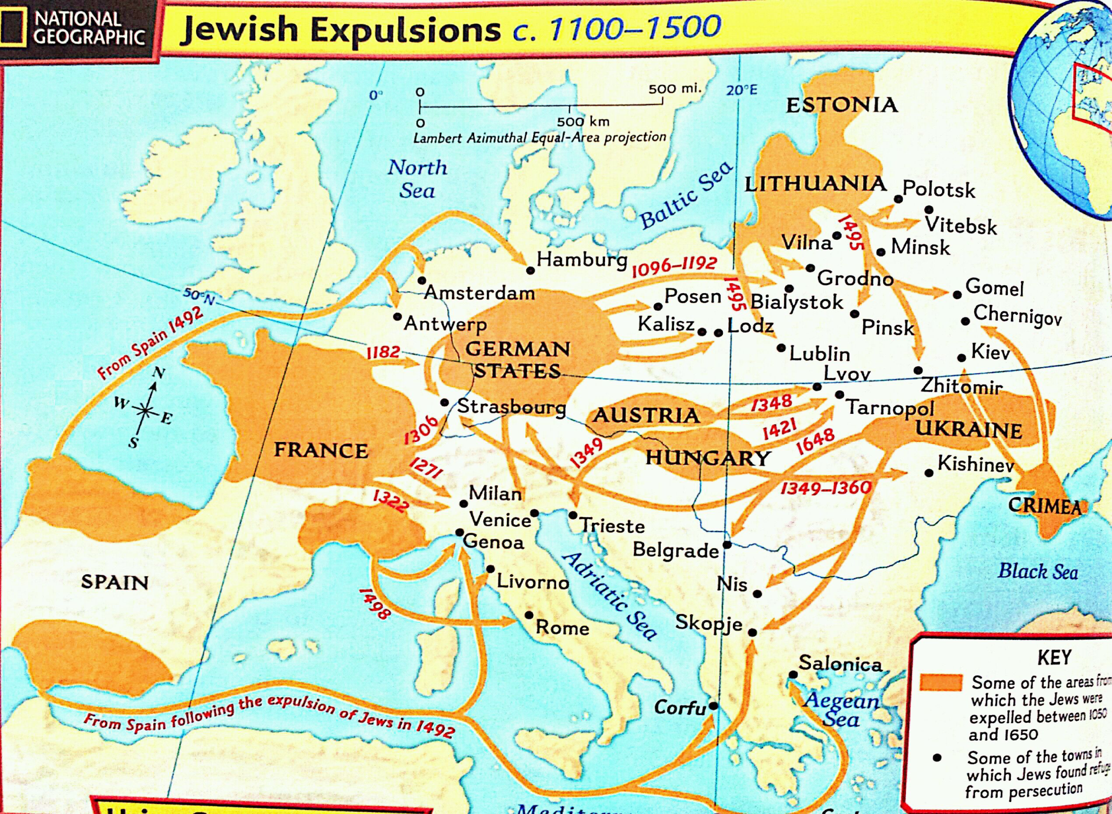

Slide 11
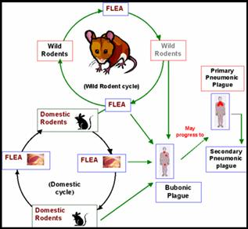
7.6.7 The Bubonic Plague
Medieval Europe 1300’s
The bubonic plague mainly affects rodents, but fleas can transmit the disease to people. Once people are infected, they infect others very rapidly. Plague causes fever and a painful swelling of the lymph glands called buboes, which is how it gets its name. The disease also causes spots on the skin that are red at first and then turn black.

Slide 12
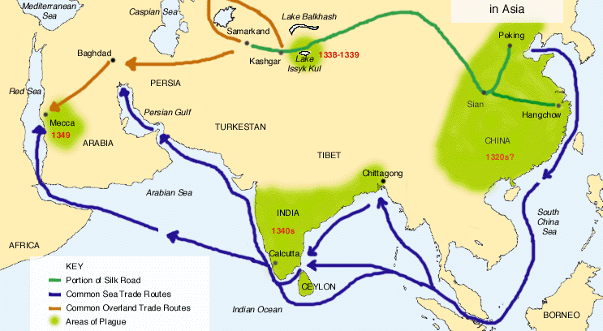
Begins in Central Asia-1330’s

Slide 13
Spreading the Disease
Began in the Gobi Desert in Central Asia
1331 China has its first breakout
1340 Spread to India by ship trade
1346 Spread across to Middle East by Silk Road by 1349 its to the coast of Arabia
1346-1351 Spread around to Europe by ship trade but also hit hard from inside of country trade

Slide 14
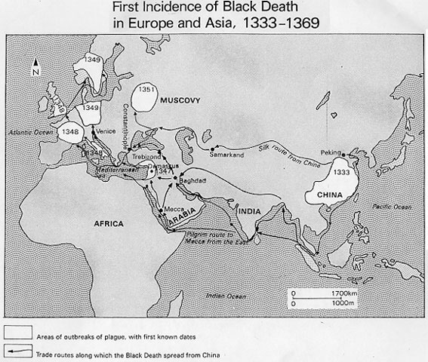
Across the Continent…

Slide 15
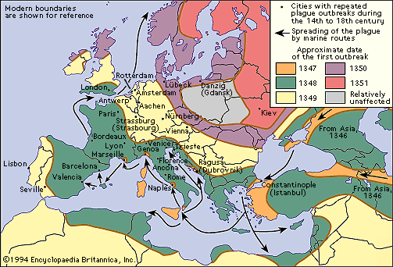
Medieval Europe

Slide 16
IMPACTS
Population massacre (-)
Economic issues (-)
Trade decline (-)
Food and Jobs (+)
Awareness (+)
Weakened feudal system (+)

Slide 17
The Catholic Church from around 1050-1200’s
7.6.8
Medieval Europe- Kings, Popes and the Church
Used it’s power to uphold the teachings of the Church
Thrived politically, intellectually and culturally
The Plague brought out a deeper connection and the society strongly needed faith to get them through those times

Slide 18
POLITICALLY…
End of Heresy (conflicting religious teachings)
Jews & Anti-Semitism
Developed new farming techniques
Roles of Clergy

Slide 19
INTELLECTUALLY…
The Church created the first universities
Preserved the Latin language & translated many works from others
Monastic & Mendicant religious orders
Scholasticism
St. Thomas Aquinas 1225-1274

Slide 20
AESTHETICALLY…
Heaven and the “good life”
Trade, Banking, Business prospered with strong government ruling
Building boom 1000-1100s
Architecture and Culture

