Slide 1
Early India
Stephanie O. - India’s Early Civilization
Kelly M. - Hinduism
Beth N. - Buddhism
Stephanie B. – The Maurya Empire
Shanda M. – The Gupta Empire

Slide 2
Standards
6.5 Students analyze the geographic, political, economic, religious, and social structures of the early civilizations of India.
1. Locate and describe the major river system and discuss the physical setting that sup-ported the rise of this civilization.
2. Discuss the significance of the Aryan invasions.
3. Explain the major beliefs and practices of Brahmanism in India and how they evolved into early Hinduism.
4. Outline the social structure of the caste system.
5. Know the life and moral teachings of Buddha and how Buddhism spread in India, Ceylon, and Central Asia.
6. Describe the growth of the Maurya empire and the political and moral achievements of the emperor Asoka.
7. Discuss important aesthetic and intellectual traditions (e.g., Sanskrit literature, including the Bhagavad Gita; medicine; metallurgy; and mathematics, including Hindu-Arabic numerals and the zero).

Slide 3
India’s Early Civilizations
Stephanie O.
Standards: 6.5.1, 6.5.2, & 6.5.4

Slide 4
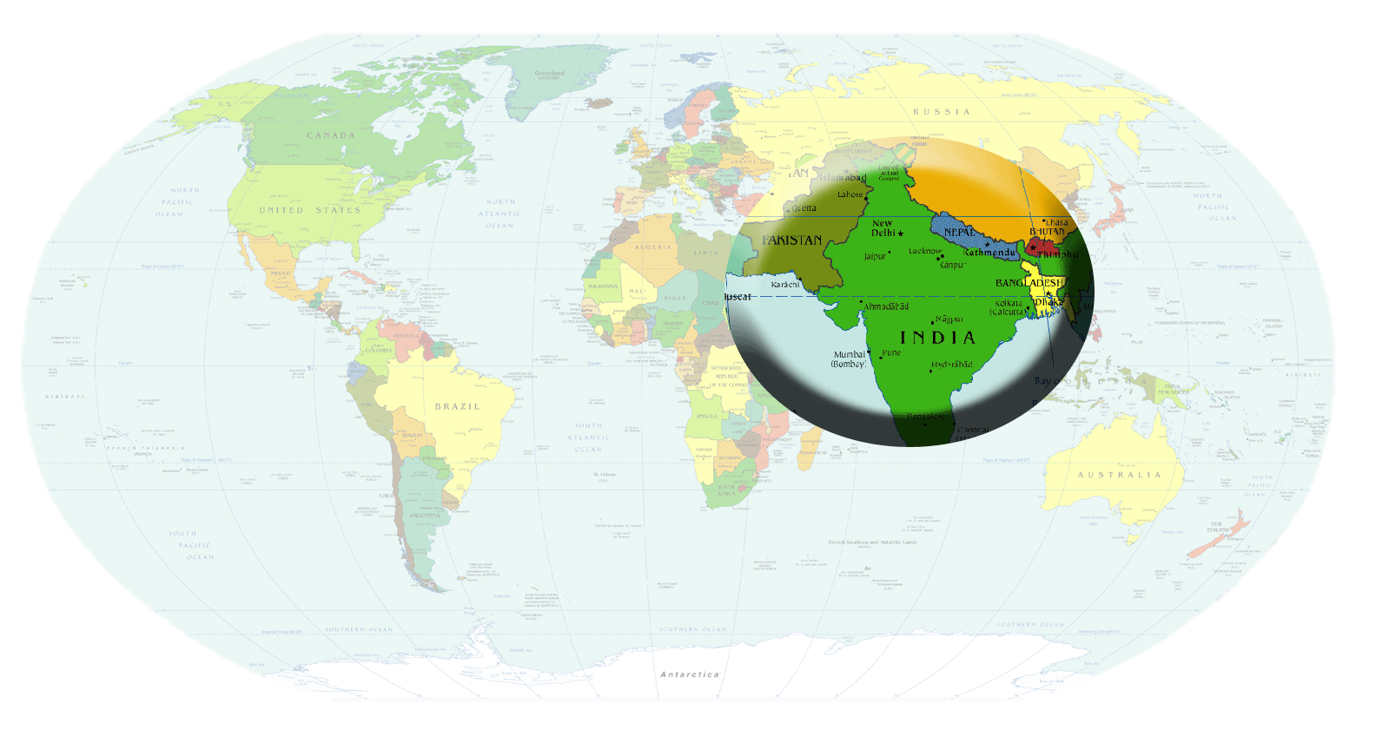
Early India- 3000 BCE

Slide 5
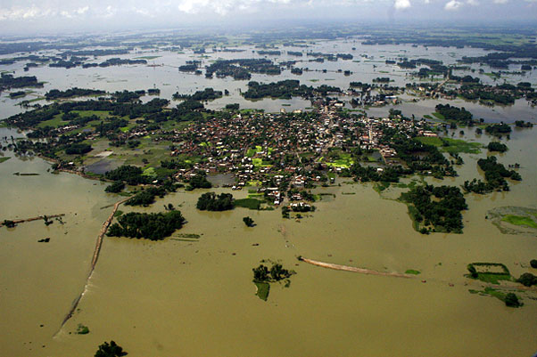
The Land of India
Subcontinent
Himalaya
Ganges River
  South into Indian Ocean
Indus River
  Empties into Arabian Sea
Monsoons
  Winter- cold dry air
  Summer- warm wet air RAIN
http://www.youtube.com/watch?v=yjvgCtCSFno
http://www.indiavideo.org/travel/indian-monsoon-4289.php
http://www.youtube.com/watch?v=1CPj0QZCubk

Slide 6
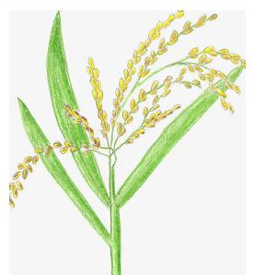
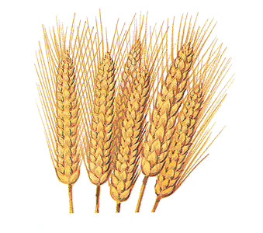
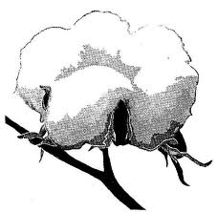
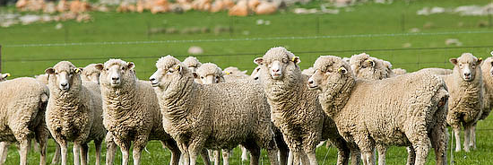
India’s Early Civilization
River Valley
  Harappa and Mohenjo-Daro
    Large cities
    35,00 people
  First urban civilization in India
    Farmers
      Plentiful food supply
    Making tools
    Building houses
      Oven baked bricks
Wheat
Rice
Cotton
Tamed Animals

Slide 7
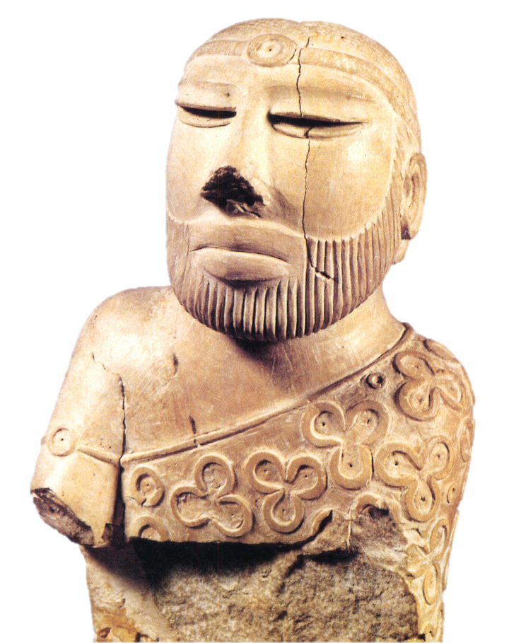
Harappan Society
Special script
  Seals and stamps
Government?
  Royal palace
  Temple
    Both closely connected
Trade
  Mesopotamians
    2300BCE
  Sailors
    Coastline
    Arabian Sea
Harapan Priest-King

Slide 8
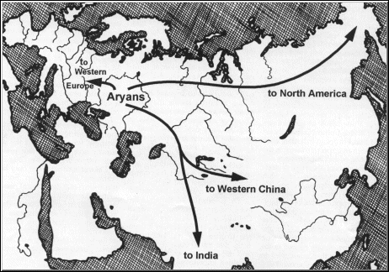
The Aryans 6.5.2
Good by Harappan Civilization
    1500BCE
Aryans migrated south
    larger group
    Cattle = possessions
Indus River Valley
    1500 BCE
Punjab/ Ganges/Deccan Plateau
    1000BCE
    Mixed cultures
http://www.glencoe.com/sites/common_assets/socialstudies/in_motion_08/jat/p_242.swf

Slide 9
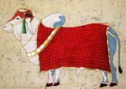
Aryans change
Raise cattle
  Sacred
  forbidden to use as food
Technology
  Plow
  Canals
  Ganges
    Farming land

Slide 10
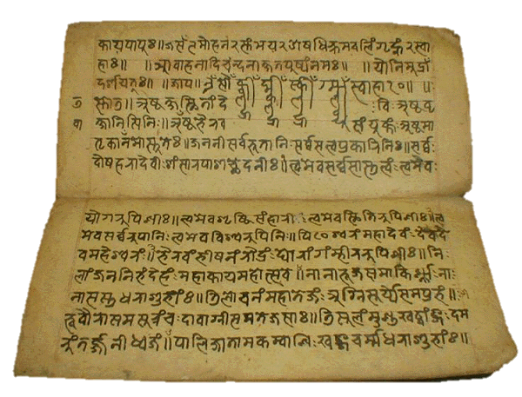
Aryans change
Written Language
  Sanskrit
    Sacred songs
    Poems
    Prayers
Tribes-1500-400BCE
  Led by
    Raja(Prince)
    Small kingdoms
      Fought over
        Cattle, treasure, women

Slide 11
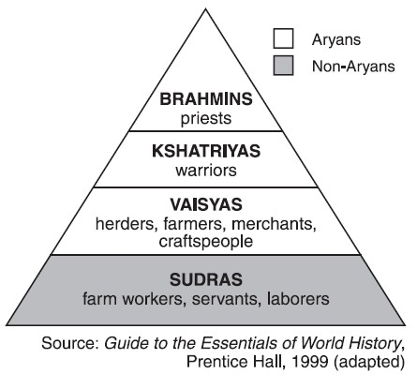
Cast=Jeti
Brahmins
    Religious ceremonies
Kshatriyas
    Government
    army
Vaisyas
    farmers
Sudras
    Manual labor
Untouchable
    Dirty work

Slide 12
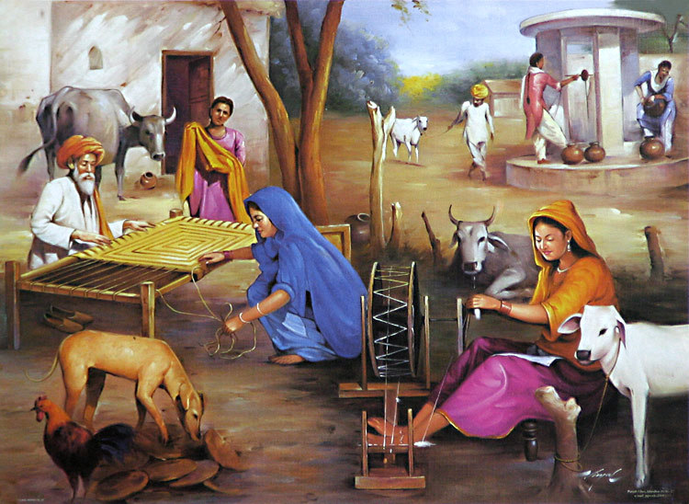
Center of life
Under one house
    All extended family
Education
  Men
    Guru
    12 years
  Women
    Home schooled
Rights
  Men
    Property
    Priesthood
    School

Slide 13
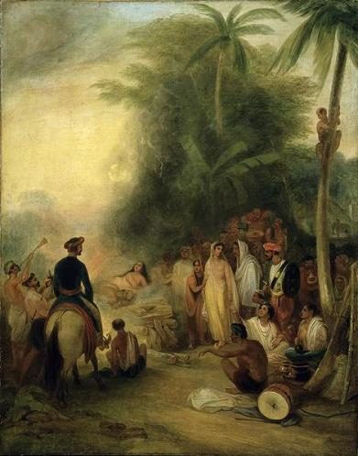
India Marriage
Arrange
    90% even today
Divorced
  Not allowed
  No children
    2nd wife
Suttee
  Cremated
  Great shame
  Avoidance

Slide 14
Hinduism
Kelly M.
Standard: 6.5.3

Slide 15
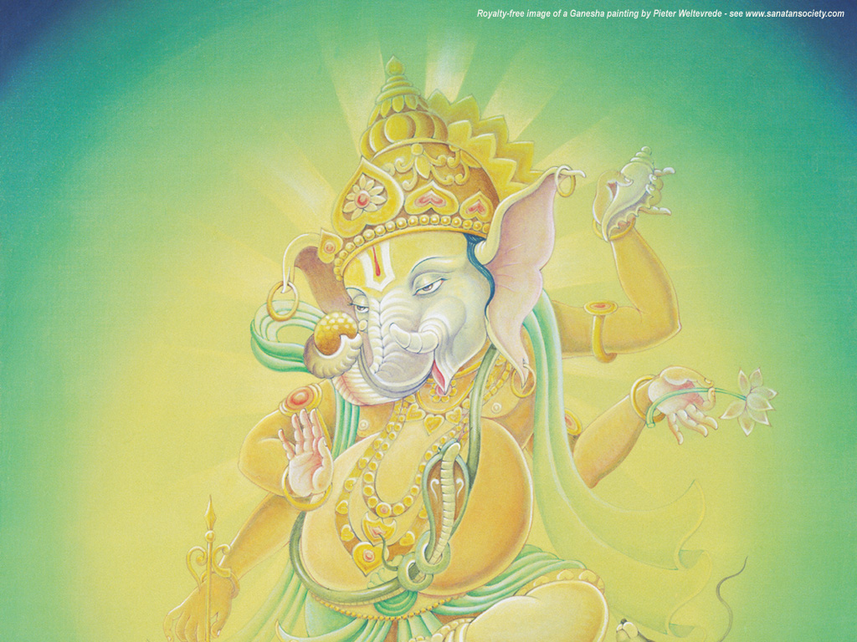
Hinduism
Vocab
  Hinduism
  Brahman (BRAH-muhn)
  Reincarnation
  Dharma (DAHR-muh)
  Karma (KAHR-muh)
  Varna/jati
  moksa
Main Ideas
  Came from ancient Aryans
  Believed in many gods/godesses
  reincarnation

Slide 16
Hinduism
History
  One of oldest religions
  Came from ancient belief of Aryans
    1500 BC arrived in India
    Belief in many gods and godessess
  Grew out of religious customs of many people over thousands of years.
  Hindus thinks of all gods/goddesses as different parts of one universal spirit. This universal spirit is called Brahman.

Slide 17
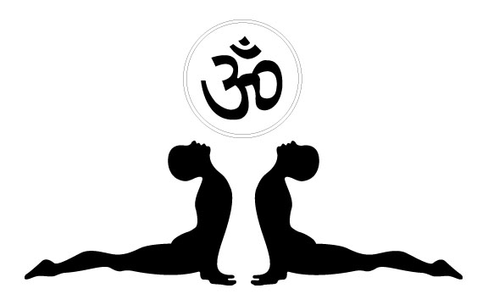
Hinduism
Unlike most religions, Hinduism does not have a certain set of beliefs; ideas are more abstract. Hinduism is intertwined in every aspect of a Hindu’s life.
Believe in:
  Brahman
  Kharma
  Dharma
  Idol worship
  Reincarnation
  moksa

Slide 18
Hinduism
Hindu’s believe that the soul does not join the Brahman (universal spirit) when one dies, the soul is reborn.
How you lived your previous life is a precursor to what varna (social class) you are born into in your next life.
This idea of passing through many lives is called reincarnation.

Slide 19
Hinduism
To earn the reward of a better life, one must perform their duty.
Dharma is the divine law, and requires people to perform the duties of their jati (social group)
Karma is also a part of everyday life. Karma is known as the consequences of how a person lives.

Slide 20
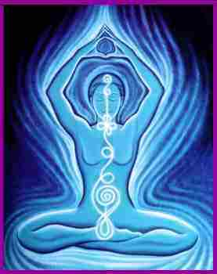
Hinduism
One can achieve moksa, spiritual goal in life, by performing yoga.
There are many different types of yoga, but all help connect the mind, body, and soul together as one.

Slide 21
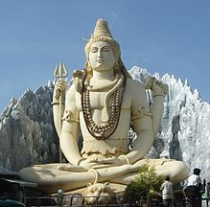

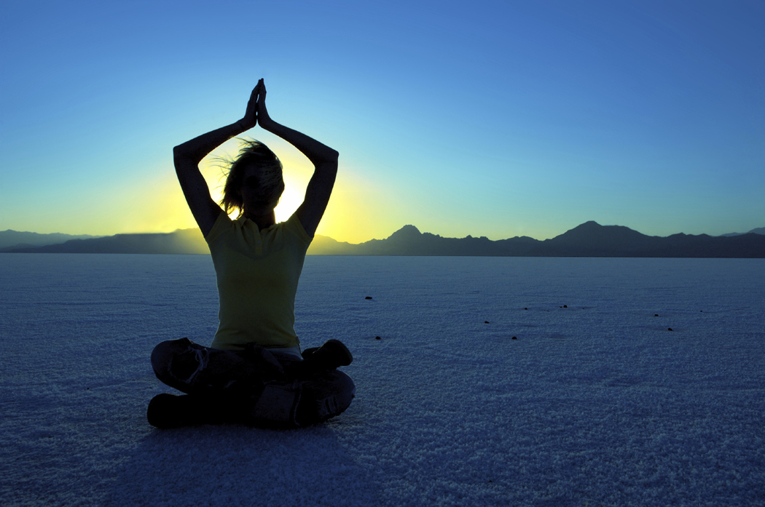

Slide 22
Hinduism
Moral ideas: truthfulness, friendship, non-violence, compassion, fortitude, self-control, purity.
Practices: daily idol worship, food offerings to gods, yoga, provide food for those who need it, serve guests with love and respect.

Slide 23
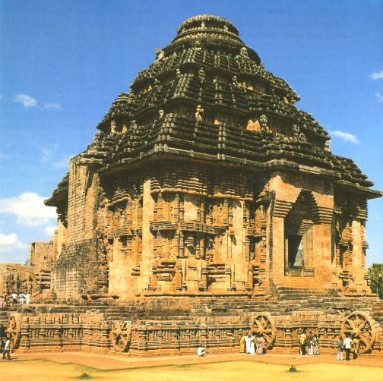
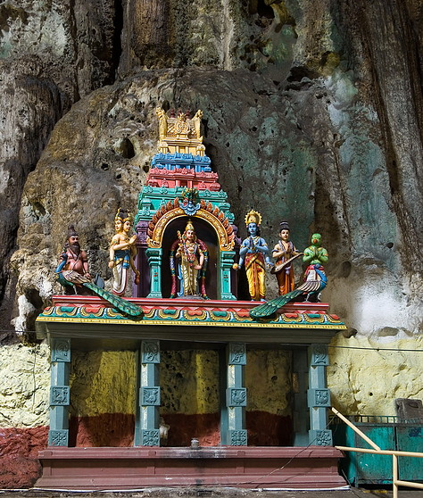
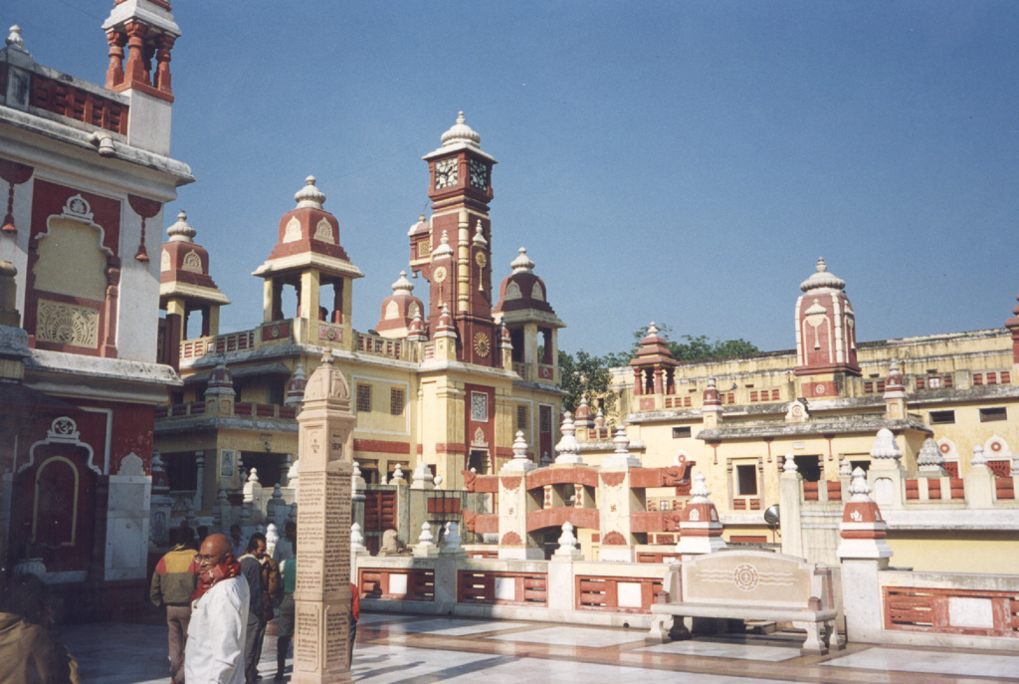
Hindu Temples/
Shrines

Slide 24
Four Stages of Life
Student Stage: 0-18
  Student lives at home, studies Vedas, learns habits and skills for future.
Householder Stage: begins right after marriage
  Attention is turned towards the world: family, career, community
Retirement Stage: begins after birth of grandchild
  Come to terms of who we are, reflection on life
Forest Dweller/Ascetic Stage: begin by leaving home, carrying out spiritual existence in the country
  Man leaves home and all possessions behind, and lives a detached life away from everyone else.
  Stage is optional; one takes on this stage if they never want to return to the world, or be reincarnated.

Slide 25
Major Hindu Gods and Goddesses
Name
Realm
Brahma
Vishnu
Siva
Ganesha
Krishna
Lakshmi
Surya
Indra
Saraswati
Parvati
Creater of the world
Preserver of the world
Destroyer of the world
Lord of existing beings; remover of obstacles
Teacher of the world
Goddess of light, beauty
God of the sun
King of the gods, ruler of heavens
Goddess of knowledge, music, art
Universal mother

Slide 26
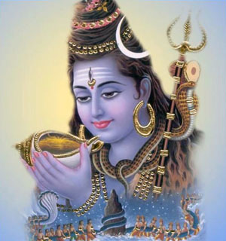
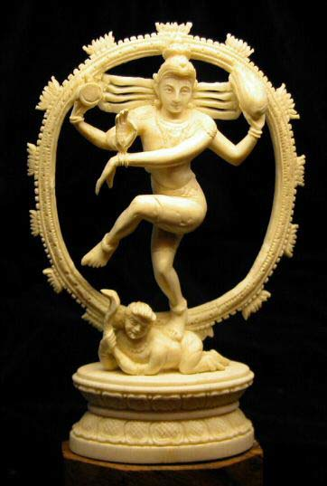
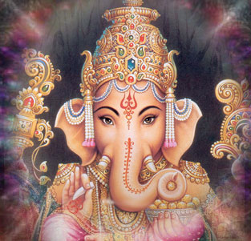
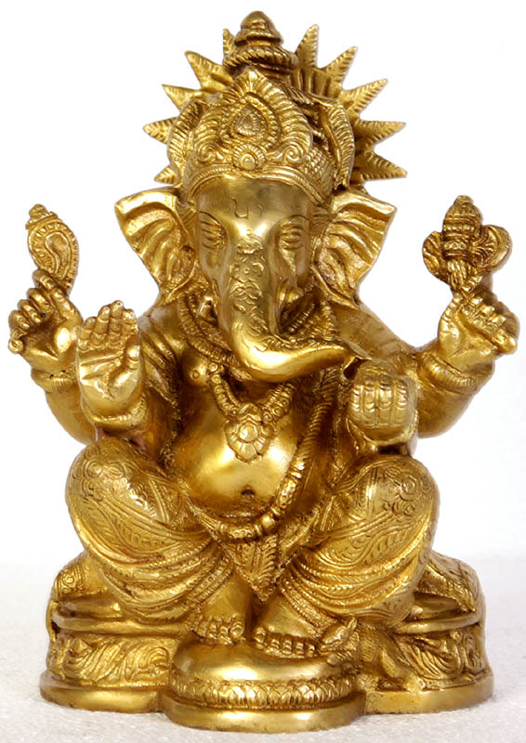
Siva
Ganesha

Slide 27
