Slide 1
Buddhism
Beth N.
Standard: 6.5.5

Slide 2
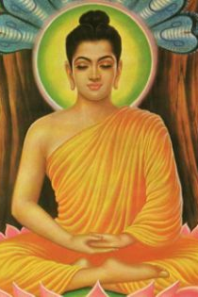
Siddhartha Gautama
C. 563 – 483 B.C.
“Why did people suffer and how could their suffering be cured?”

Slide 3

The Four Noble Truths

Slide 4

The Eightfold Path

Slide 5
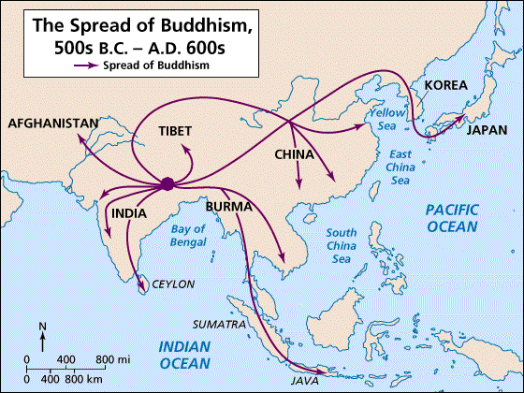
The Spread of Buddhism
Theravada Buddhism
“Teaching of the elders”
Spread to the south and east
vs. Mahayana Buddhism
Spread northward

Slide 6
The Maurya Empire
Stephanie B.
Standards: 6.5.6 and part of 6.5.7

Slide 7
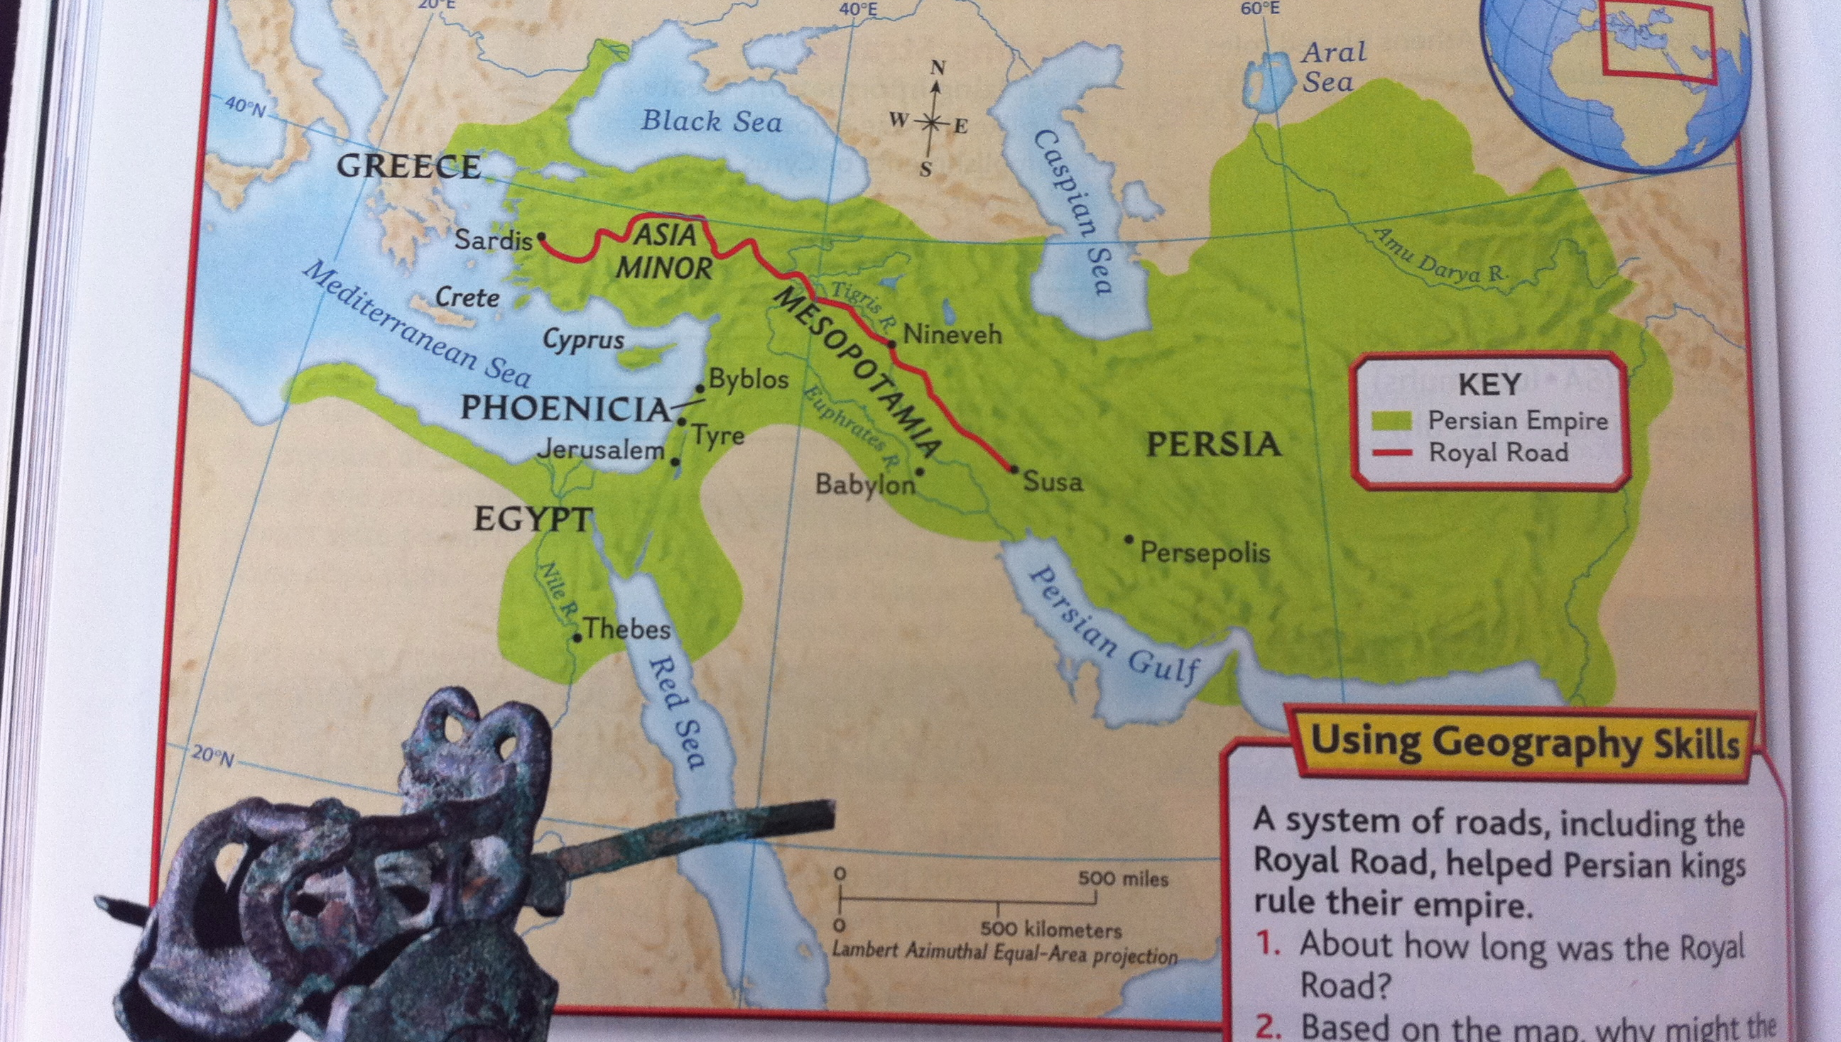
The Persians Invaded

Slide 8
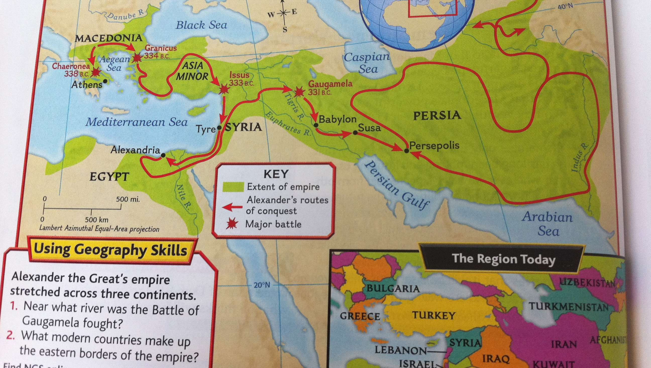
Alexander the Great Invaded

Slide 9
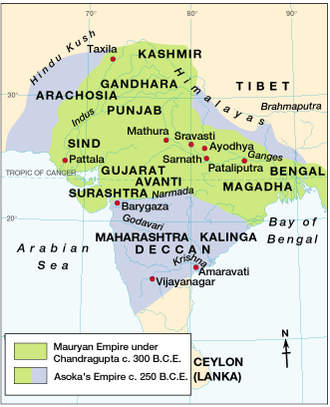
India’s First Empire:
The Maurya Empire
321 B.C. – 183 B.C.
Founded by Chandragupta Maurya
Dynasty began in 321 B.C.
Organized Government
Pataliputra = Capital
Strong Army
Postal System

Slide 10
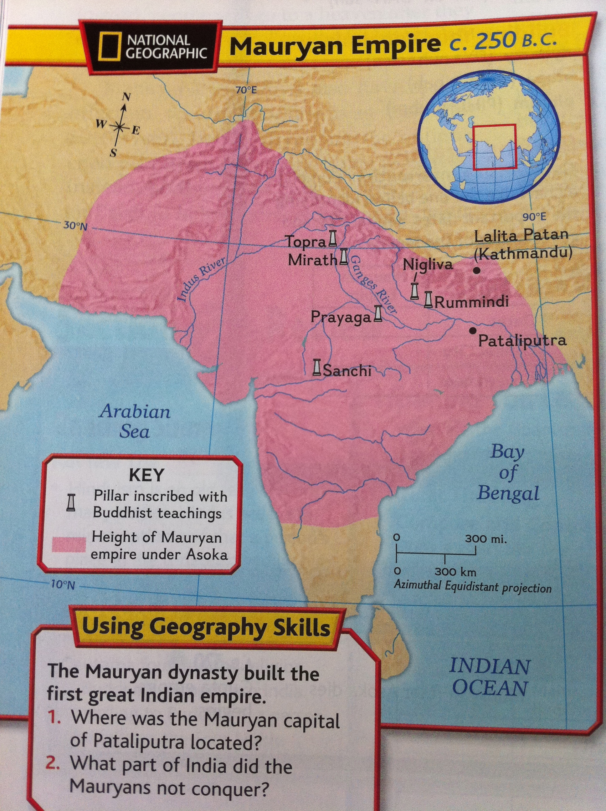
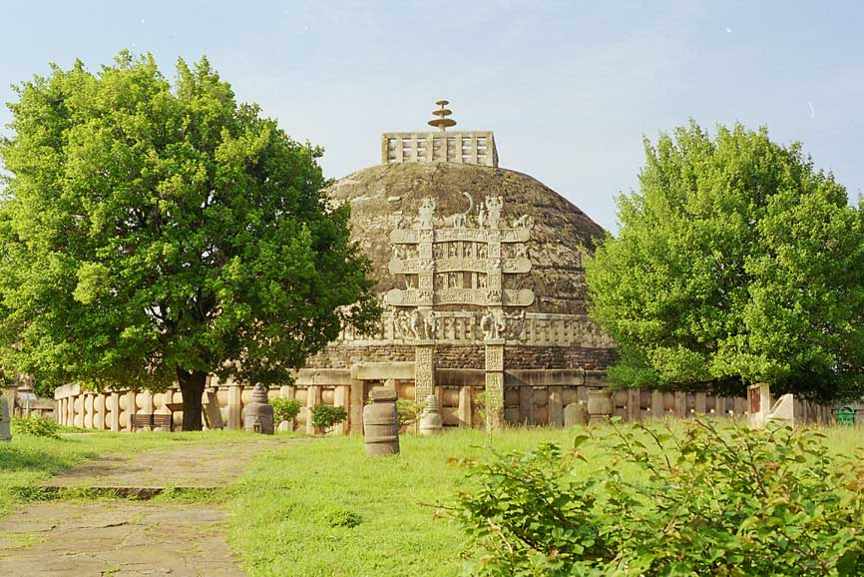
Emperor Asoka
273 B.C. – 232 B.C.
Had a bad temper
Strong Military Leader
Expanded the Empire

Slide 11
“What have I done?
If this is a victory, what's a defeat then?
Is this a victory or a defeat?
Is this justice or injustice?
Is it gallantry or a rout?
Is it valor to kill innocent children and women?
Do I do it to widen the empire and for prosperity or to destroy the other's kingdom and splendor?
One has lost her husband, someone else a father, someone a child, someone an unborn infant.... What's this debris of the corpses?
Are these marks of victory or defeat? Are these vultures, crows, eagles the messengers of death or evil?”

Slide 12
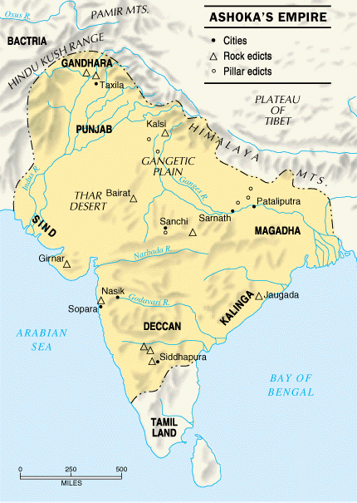
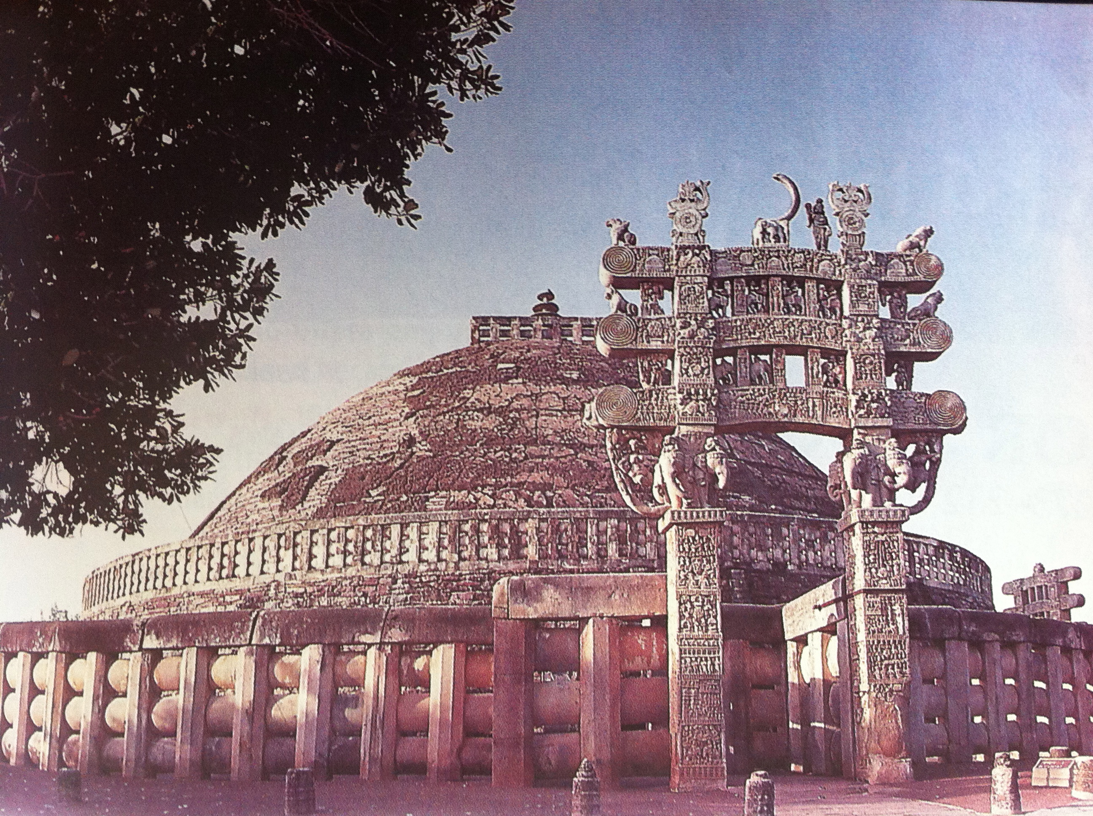
Converted to Buddhism
Nonviolent policy
Asoka became merciful
Built schools, hospitals, & new roads
Treated his subjects as equals
Sent Buddhist teachers to spread the religion
Constructed Pillars &
Stupas

Slide 13
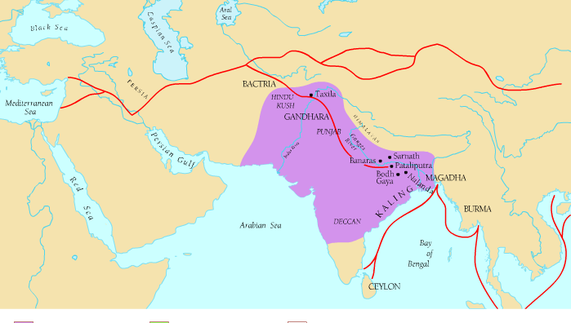
Center for a large Trade Network

Slide 14
The Fall of the Maurya Empire
Emperor Asoka Died in 232 B.C.
The kings who followed didn’t do well
  Made bad decisions
  Turned people against them
  Forced merchants to pay heavy taxes
In 183 B.C. the last Mauryan Emperor was killed

Slide 15
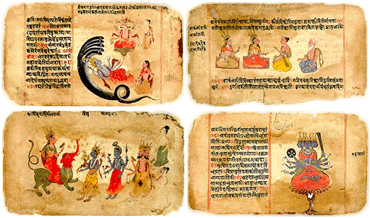
Vedas
Ancient Collection of
sacred verses, hymns,
prayers, & teachings
Primary texts of Hinduism
Written in Vedic Sanskrit
How old?
Four Vedas: the Rig, Sama, Yajur, & Atharua Veda

Slide 16
The Gupta Empire
Shanda M.
Standard: 6.5.7

Slide 17
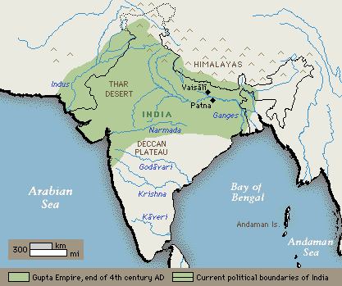
Gupta
320 CE
Chandragupta
Ruled from old Mauryan Empire, Paraliputa

Slide 18
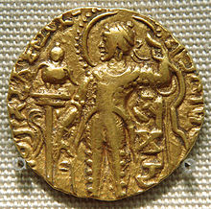
Rulers
Samudragupta
  Chandragupta’s son
  Expanded Gupta Empire to North India
Guptas ruled for 200 years
  Smaller empire = easier to control

Slide 19
Trade & Trade Routes
Trade = Wealth
  Salt
  Iron
  Cloth
Traded to India, Southeast Asia, and the Mediterranean
Rulers owned Gold and Silver mines
Trade created jobs
Cities grew along trade routes
Pilgrims use trade routes for religious reasons
  Temples made cities famous
  Created wealth

Slide 20
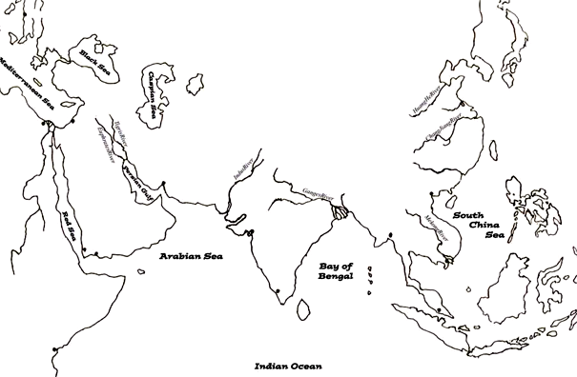
Trade with the World
spices
silks
cotton goods
rice & wheat
spices
horses
gold & ivory
gold & ivory
cotton goods

Slide 21
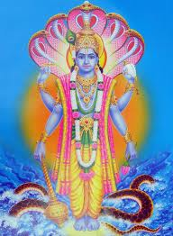
Hinduism
Gupta’s were Hindu
Official religion
Gave money to scholars and shrines
Shrines built of gods and goddesses
  Brightly painted sculptures
  Images from Upanishads

Slide 22
Math
1
4
Aryabhata (AHR-yuh-BUHT-uh)
  leading mathematician
  Used algebra
Gupta empire mathematician developed
  Idea of zero and created symbol (0)
  Idea of infinity, something without an end (∞)
  Symbols for numbers 1-9 that we still use today
    Adopted by Arabs then borrowed by Europeans
  Math algorithms
6
2
9
∞
8
7
3
5
0

Slide 23
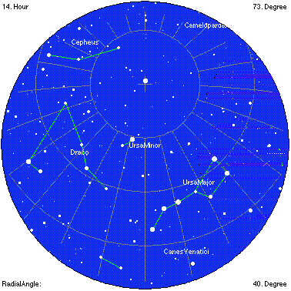
More Math and Science
Gupta science innovations
  Astronomy
    Mapped movement of
    planets and stars
    understood sun as center
    of universe
    Seemed to have understood
    gravity
  Universe makeup
    Many very tiny particles
    Idea of atoms

Slide 24
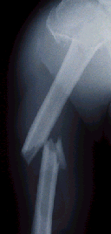

Doctors of the Gupta Empire
Field of medicine advanced for time
  Set broken bones
  Perform operations
  Used herbs to cure illness
  Removed cause of illness
Dr. Shushruta (shoosh-ROO-tah)
  Carried out early forms of plastic surgery
  Restored damaged noses

Slide 25
Add the following to your Map!
Himalaya
Ganges River
Indus River
Deccan Plateau
Arabian Sea
Indian Ocean
Harappa
Mohenjo – Daro
Ceylon
Pataliputra

