Slide 1
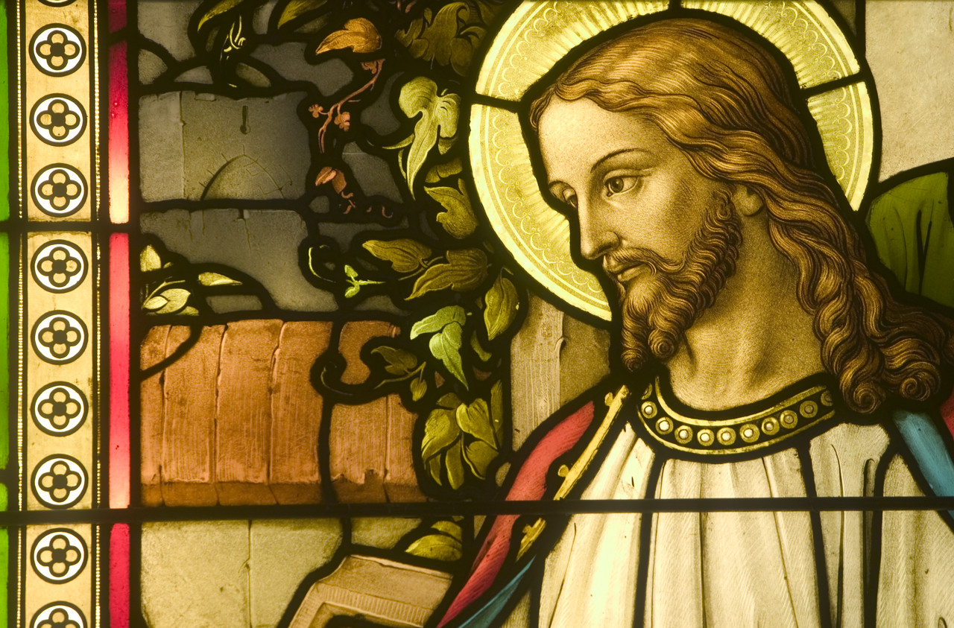
The Rise of Christianity
Amy, Cheryl, Jesus, Mandi, & Tiffany
Content Standards: 6.7.5, .6, & .7

Slide 2
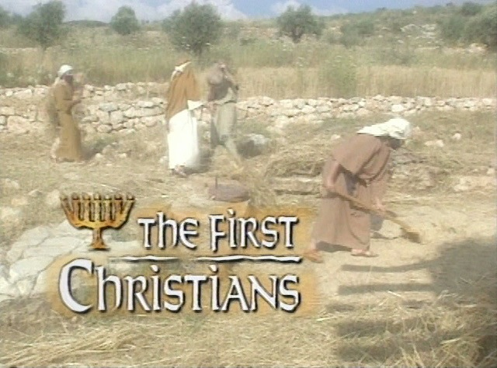
The First Christians

Slide 3
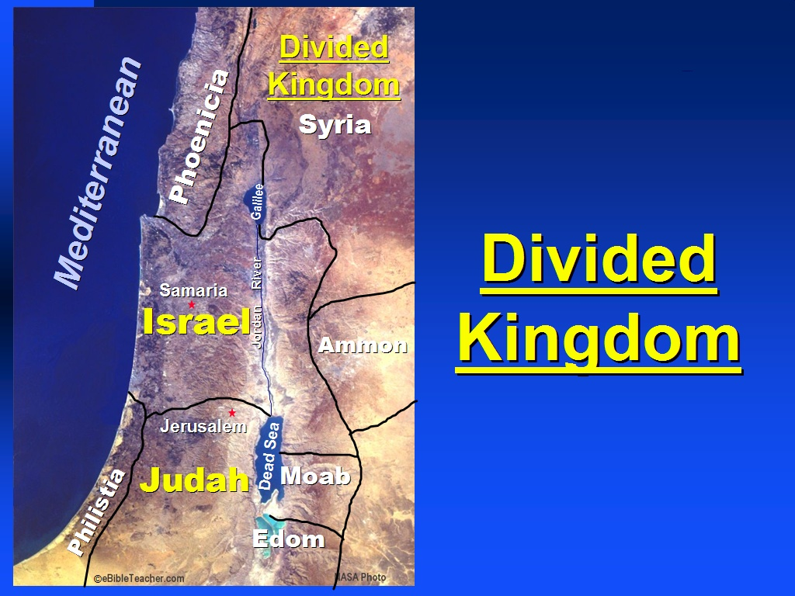
Kingdom of Israel= Division

Slide 4
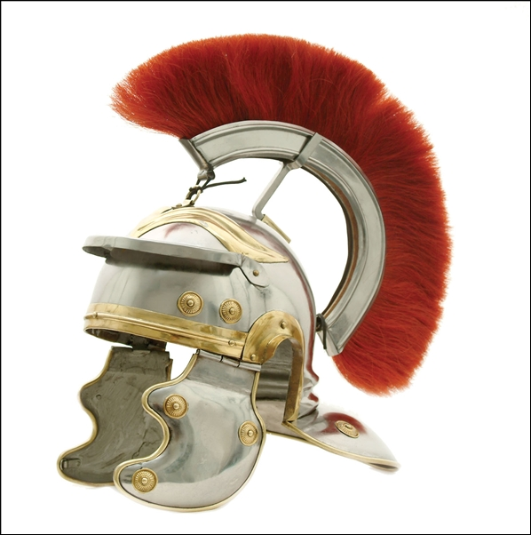
Roman Rule
Jews under Roman control:
- 63 BC Romans took over Judah
6 AD Romans rename Judah, Judaea.

Slide 5
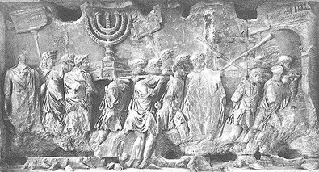
Rebellion
1st revolt - 66 AD – Jews defeated
2nd revolt - 132 AD – Jews defeated
  ⬇ after crushing rebellion the Romans forced all Jews to leave Jerusalem

Slide 6
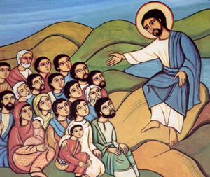
Jesus of Nazareth

Slide 7

The Teachings of Jesus
- turn from sin and follow God
- love your neighbor
- forgiveness
- more than tradition

Slide 8
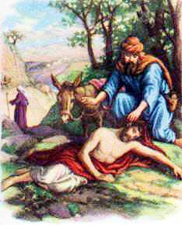
Jesus often used
Parables: stories from everyday life that expressed spiritual ideas.
kkjkjkjzdvsv
Example –
The Good Samaritan

Slide 9
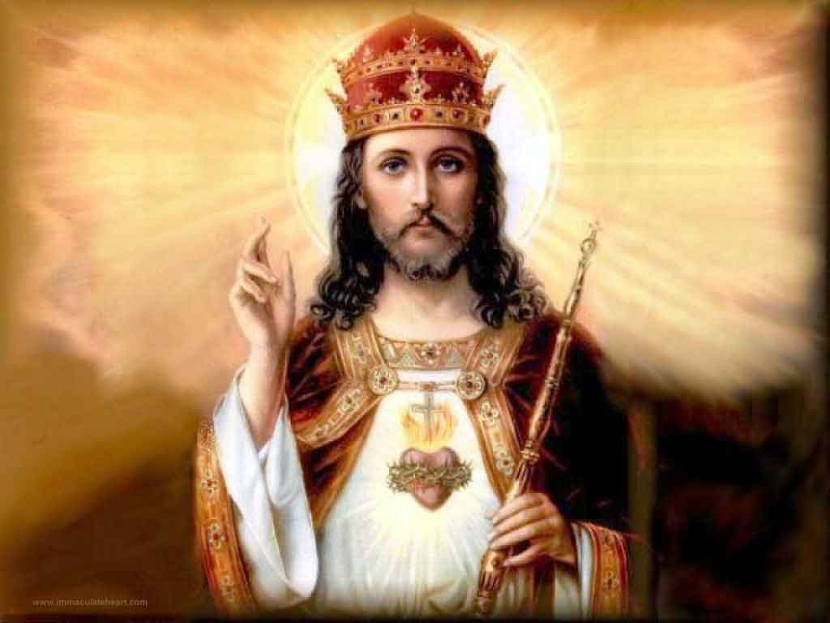
Jesus and the Jews
the Jews believed that a Messiah was coming that would help win their freedom from Roman oppression.

Slide 10
Christianity
Jesus is seen as threat by Roman Rulers
Jesus was Crucified (hung from cross until dead)
Jesus was Resurrected (rose from the dead)
⬇
The Resurrection of Jesus led to new religion:
Christianity

Slide 11
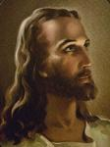
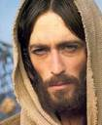
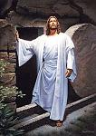

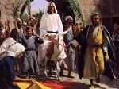
JESUS OF NAZARETH

Slide 12
JESUS OF NAZARETH
Born 6 B.C.
Crucified 33 A.D.
When Jesus arrived in Jerusalem in 33 A.D. he was greeted by cheering crowds.
The night before his death he celebrated Passover with his 12 disciples – THE LAST SUPPER

Slide 13
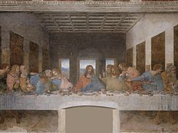
JUDAS betrays Jesus for 30 pieces of silver
He went to the Jewish priests to tell of Jesus’ whereabouts.
Jesus was arrested at the Garden of Gethsemane

Slide 14
Concerns of Roman Rulers
Roman governor was pushed by upper class and the leaders of the Jewish religion to arrest Jesus for treason (disloyalty to the government)
- HE THREATENED LAW AND ORDER (his teachings)
Some were skeptical that he performed miracles (healing the sick and helping the blind to see)
A good majority of Jews did not believe that Jesus was the Son of God – they were waiting for their Messiah (“a deliverer sent by God”) to RETURN ISRAEL to them

Slide 15
CRUCIFIXION
Crucifixion – Rome crucified those that were political rebels and lower-class criminals. You would hang from a cross until death.
Pontius Pilate, governor of Judaea from 26 CE to 36 CE, ordered the death of Jesus. He believed Jesus to be innocent, but was pressured by Jewish religious leaders and an unruly crowd of spectators to put him to death.

Slide 16
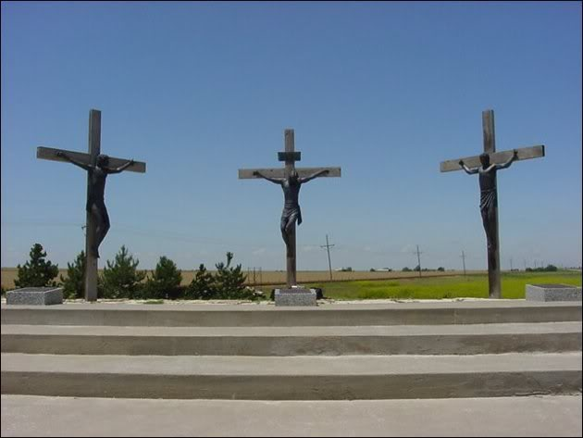
Crucifixion

Slide 17
RESURRECTION
Jesus was laid to rest in a tomb
On the THIRD day he ROSE again
Resurrection – rising from the dead
Mary Magdalene (Jesus cast 7 demons out of her, she stood at the foot of the cross, and she saw him laid to rest in the tomb) confirmed Jesus’ resurrection. She was the first person to see the resurrected Lord.

Slide 18
The Trinity
Most Christians believe in the Trinity: The Father, The Son, and The Holy Spirit. They are one in the same.
- “GOD EXISTS IN THREE PERSONS”
Jews and Christians believed in the God of Israel and both studied the Hebrew Bible.
Christians were told by Jesus and believe that they too will rise again after death and will live with him in Heaven for all eternity. Jesus came and sacrificed himself to save us from our sins’ and to bring us to everlasting life.

Slide 19
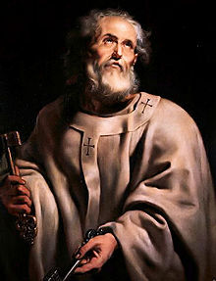
Peter 1 B.C. – 67 A.D.
Fisherman
Jesus made him the First Apostle
Peter set up the first church in Rome
He witnessed the miracles of Jesus
Was ordered to death by Nero in Rome

Slide 20
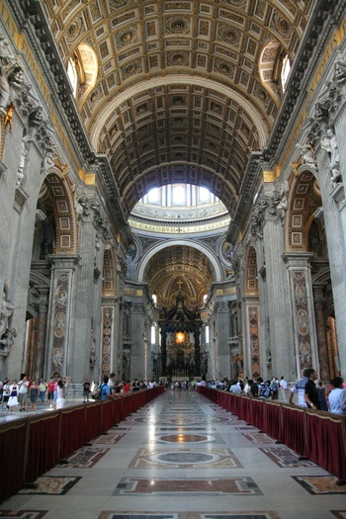
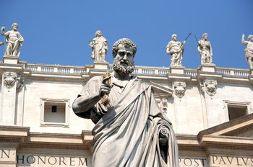
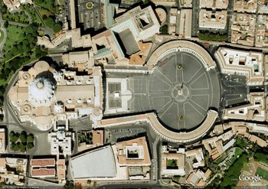
St. Peter’s Basilica

Slide 21
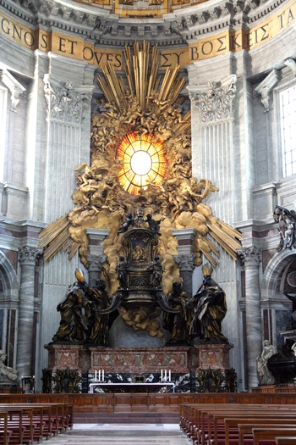
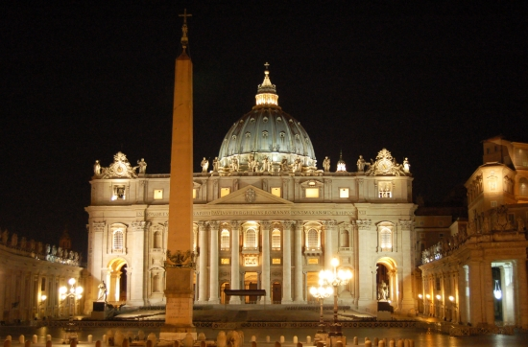
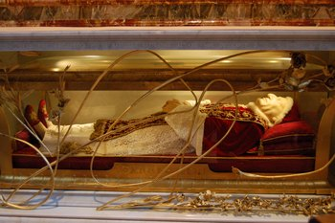
St. Peter’s Basilica

Slide 22
Paul of Tarsus 10 B.C. – 65 A.D.
He was a Roman citizen and a Jew (Pharisee)
He was given the name Saul – after the first King of the Jews
He later took the name Paul when he became a Christian
On a trip to Damascus (Syria) from Tarsus (Asia Minor), he was sent by the chief Jewish priest to stop the spread of Christianity, Paul had a vision from Jesus. Jesus spoke to him and told him to spread the good word. From that day on he accepted Christianity.
He traveled throughout Rome, Greece, and Asia Minor spreading the word of the Lord to non-Jews (Gentiles) and establishing Christian communities
He was ordered to death by Emperor Nero

Slide 23
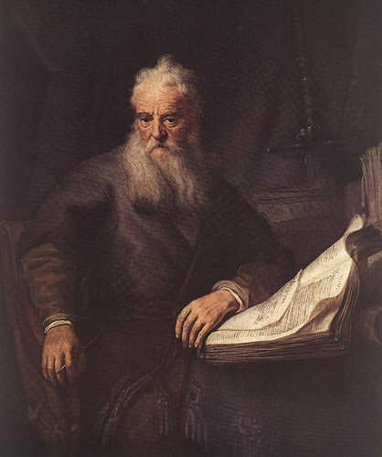
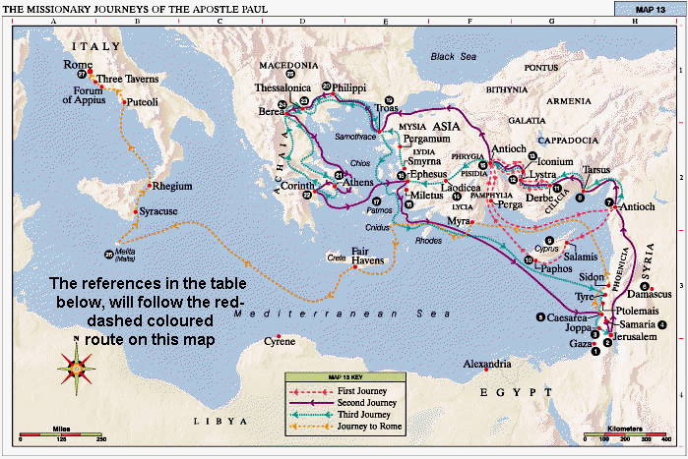
Paul Spreads Christianity
Paul of Tarsus
Paul’s Travel Route

Slide 24
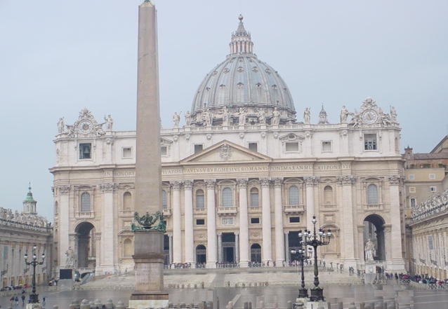
The Christian Church

Slide 25
A growing Faith
In the 100 years after Jesus’ death, Christianity spread through out the Roman Empire.
Common language helped
Spread because of many reason
  Gave hope to people
  Appealed to emotions, promised happiness after death
  Gave a chance to be part of a group

Slide 26
Romans and the Christians
Romans Persecuted the Christians
Many Christians became Martyrs
Even through all the hardships, Christianity spread
Many Romans Admired the Christians’ devotion
By 250 AD, many Romans accepted Christianity

Slide 27
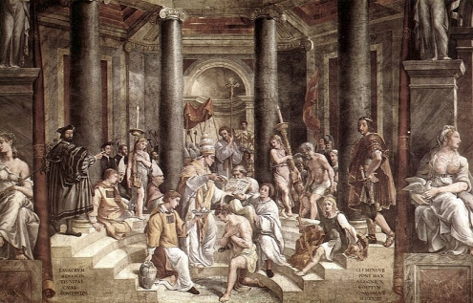
The Church
A.D. 312- Roman Emperor Constantine accepts Christianity.
A.D. 392- Theodosius (thee-uh-doh-shuhs) makes Christianity Rome’s official Religion.

Slide 28
The Church’s structure
The Church was modeled after the Roman Empire.
Hierarchy
Clergy leadership of church
Laity were the regular members
The Hierarchy was as follows
Patriarchs, followed by the Archbishops, followed by the Bishops, followed by the Priests, followed by Laity.

Slide 29
Churches we lead by Clergy called Priests
Churches joined together and form Diocese lead by a bishop
Bishops were sometimes but in charge of whole religions, this made the archbishops
The top 5 leading archbishops made up the Patriarchs.
The Bishops handled church business, from time to time thy would met to discuss questions about the faith
Decisions made would become Doctrine

Slide 30

Doctrine
We know it today as the Four Gospels
They are accounts of the life, teachings, and resurrection of Jesus.
Written by Matthew, Mark, Luke, and John
Became the New Testament of the Bible

Slide 31
The Pope
As the church grew, the Bishop of Rome, who was also a patriarch, claimed to have more power than other bishops.
A.D. 600- the bishop of Rome gained a new title “Pope”.
Latin for Father
Latin Speaking Laity accepted the pope
Greek Speaking Laity Didn’t
Cause separation in the church

Slide 32
The Byzantine Church
Didn’t follow the Pope, developed into the Eastern Orthodox Church
Many admired icons, which were depictions of Christ or other religious figures.
Not all agreed with the use of Figures.
Emperor Leo III did not approve of the figures, and in AD 726 ordered them to be removed.

Slide 33
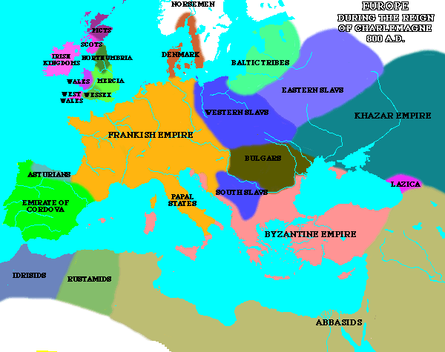

Slide 34
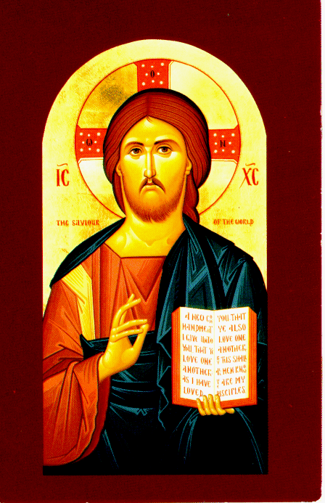
He sent out iconoclasts (eye-kah-nuh-klasts) or image breakers.
Many church leaders opposed the order
After a century, the argument cooled and Icons slowly returned
Still an important part of Eastern Orthodox religious practice

Slide 35
Conflict between Churches
Split on the Pope issue
Would not help if other group was attacked
Pope looked for other help, Found the Franks
In AD 800, the Pope granted the King of the Franks, Charlemagne, the title of Emperor.
This angered the Byzantines, believed their ruler to be the one true Emperor.

Slide 36
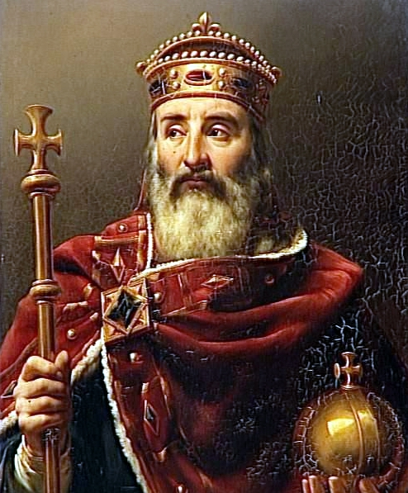
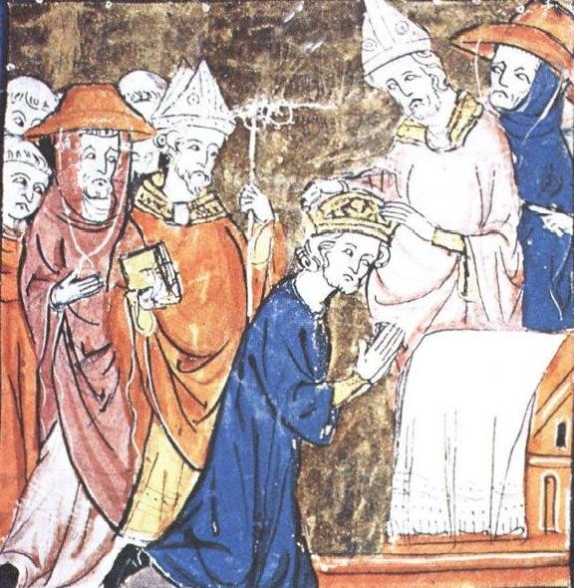

Slide 37
Fallout
After centuries of tension, the churches Excommunicated each other.
Began a schism between the to most important branches of Christianity.
The split between the Roman Catholic and Eastern Orthodox Churches has lasted to this day.

Slide 38
Spread of Christianity
Standards
6.7.7
7.1.3
7.6.2
7.6.4
7.6.8

Slide 39
Church Division
Western Europe, Latin churches: Roman Catholic Church
Eastern Europe: Byzantine Empire
Developed Christianity called the Eastern Orthodox Church
New ways of thinking and living

Slide 40
Church and State
The Emperor represented Jesus Christ on Earth
Crowned in religious ceremony
Chose patriarch of Constantinople, the leading church official of the Byzantine Empire
All church and government officials preserved and spread Christianity

Slide 41
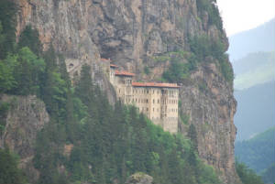
Monasteries
A.D. 300 Men called monks began to form self-supporting religious communities, both near cities and in isolation
Monk life: prayer eight times a day beginning at 2 am, worship, read the Bible, meditation, and chores

Slide 42
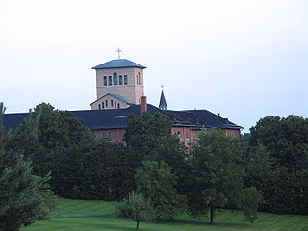
Convents
Women (nuns) formed their own religious communities
Simple life: farmed, made religious clothing, made spiritual cards, baked alter bread, and prayed, worshipped, and adored God
Example: A.D. 400s Paula, a Roman widow

Slide 43
Monk and Nun Rules
Basilian Rule: made by Bishop Basil
For Eastern Orthodox life
Benedictine Rule: made by Italian monk, Benedict
For western communities

Slide 44
Monks and Nuns in Public
Ran schools and hospitals
Helped the poor
Preserved Greek and Roman writings
Taught religion to non-followers

Slide 45
Christianity Spreads West
A.D. 400s Angles and Saxons from the current Germany and Denmark invaded Britain
Anglo-Saxons built settlements and kingdoms
Southern Britain: Angloland (England)
Kicked Celts out of Angloland
Celts went to Ireland or mountains of Britain

Slide 46
Christianity Spreads West
Also A.D. 400s Priest Patrick: missionary to Ireland
Set up monasteries and churches
http://www.history.com/topics/who-was-saint-patrick/videos#st-patrick
A.D. 597 Pope Gregory I from Rome sent 40 monks to England
Converted Ethelbert: ruler of Kent, an English kingdom
Allowed missionaries to build a church in Canterbury
After 100 years, Christianity in most of England

Slide 47
Religious Icons
Church walls and small tables were covered with icons (images of holy people)
Symbols of God's presence, worked miracles, and helped explain Christianity
Others believed honoring icons was forbidden idol worship.

Slide 48
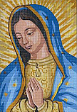
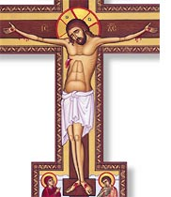
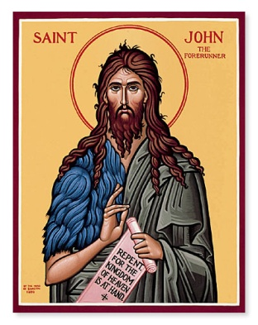
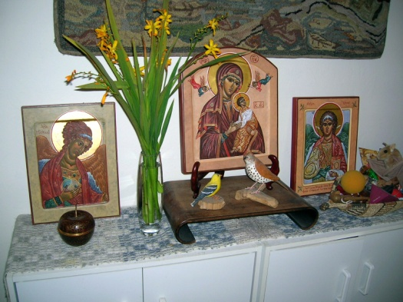
Religious Icons

Slide 49
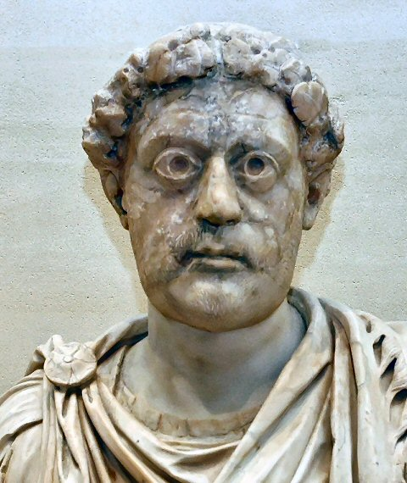
Emperor Leo III
A.D. 726 Ordered removal of all icons
Iconoclasts (“image breakers”) were government officials who carried out this order
Most Byzantines opposed the order
By A.D. 826 icons were accepted again and are still used

Slide 50
Other Conflicts
Religious questions, such as the relationship between Jesus and God
Debates in homes and public
Church operation: Pope vs. patriarch and bishops

Slide 51
Pope and Byzantines Clash
Late A.D. 700s Italy was further invaded by Lombards, a Germanic group from Scandanavia
The Byzantine emperor refused to help the pope.
A.D. 800 Charlemagne and his Franks stopped the invasion.
The pope angered the Byzantines by titling Charlemagne as emperor
Pope and patriarch excommunication
Schism (separation) of Roman Catholic and Eastern Orthodox Churches

Slide 52
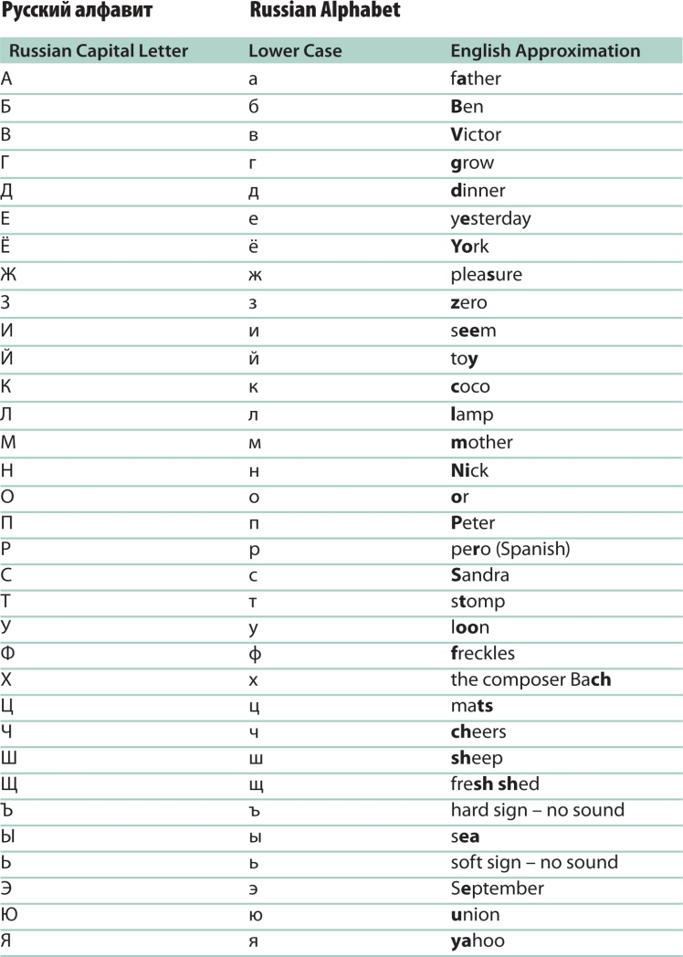
Cyril and Methodius
Missionaries to Slavs in Eastern Europe
A.D. 863 Cyrillic alphabet based on Greek so Slavs could worship and read the Bible
Still used by Russians, Ukranians, Serbs, Bulgarians

