Slide 1
Group #5 Part Two
Amy & Mandi
Content Standards : 6.4 # 4, 7, & 8
Alexander the Great & the Spread of Greek Culture

Slide 2
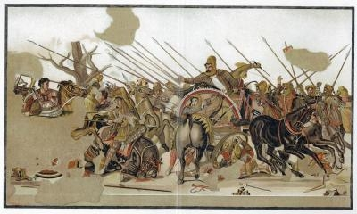
Macedonia
Land north of Greece
A warrior people, that admired Greek culture
By 400 B.C. were very powerful

Slide 3
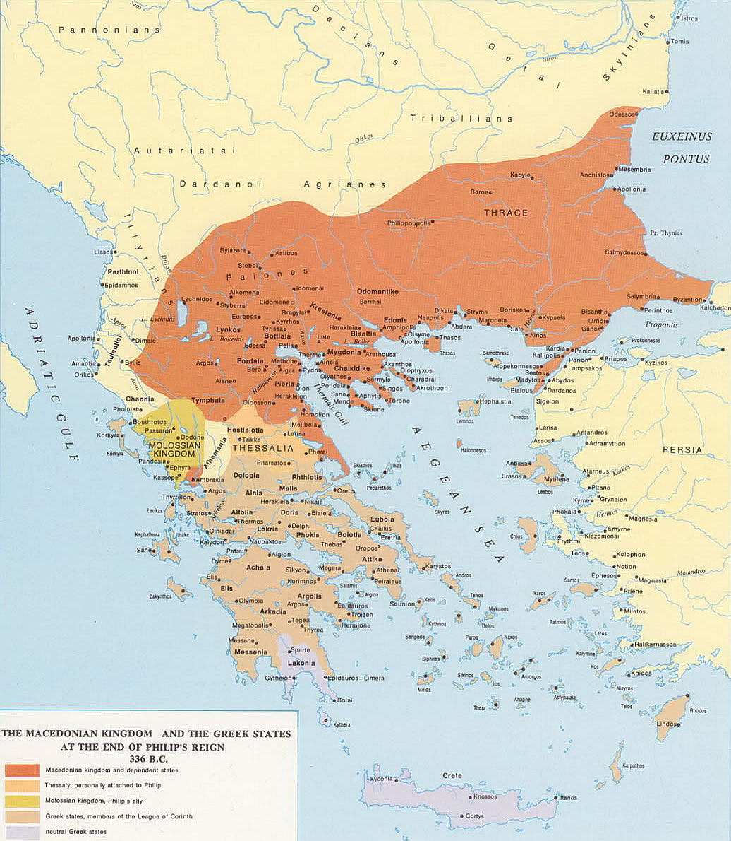

Slide 4
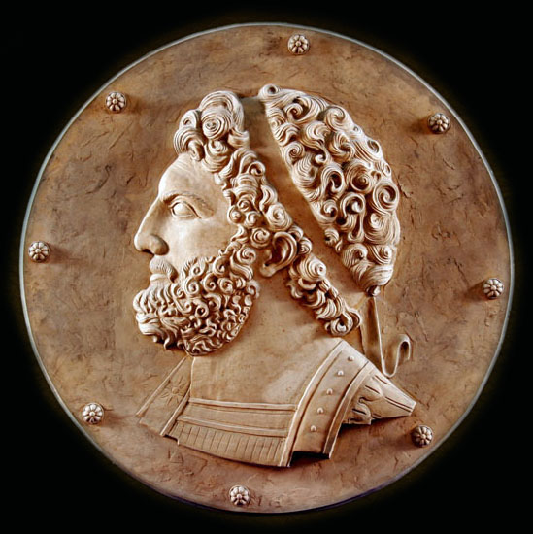
Philip II
- Became king of Macedonia in 359 B.C.E.
- His goal: to conquer surrounding civilizations and to build up his empire to defeat Persian Army.
- Philip II assassinated in 336 B.C. and succeeded by his son, Alexander.

Slide 5
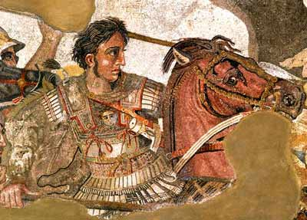
Alexander the Great

Slide 6
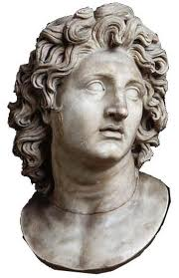
Rising to Power
Militarily trained from a young age
Commander of Macedonian army at age 16
Became king of Macedonia at 20

Slide 7
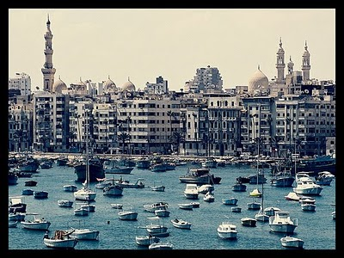
City of Alexandria (Egypt)
Center of business & trade

Slide 8
The Conquests of Alexander
- 334 BC invaded Asia minor
- 333 BC freed Greek cities from Persians
- 332 BC captured Syria and Egypt
- 331 BC defeated Persians near Babylon
* after this victory, Alexander and his army took the Persian army & their empire.

Slide 9
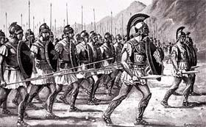
After conquering Persia, Alexander led his army east to India

Slide 10
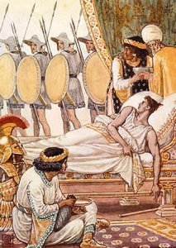
Death at age 32
323 B.C. Alexander dies of fever at age 32.
Four generals appointed, fought for power.

Slide 11
Break of Alexander’s Empire
Empire divided into four regions:
- Macedonia, Pergamum, Egypt, and the Seleucid Empire.
Greeks stayed in control of the different regions, elected Greek officials.

Slide 12
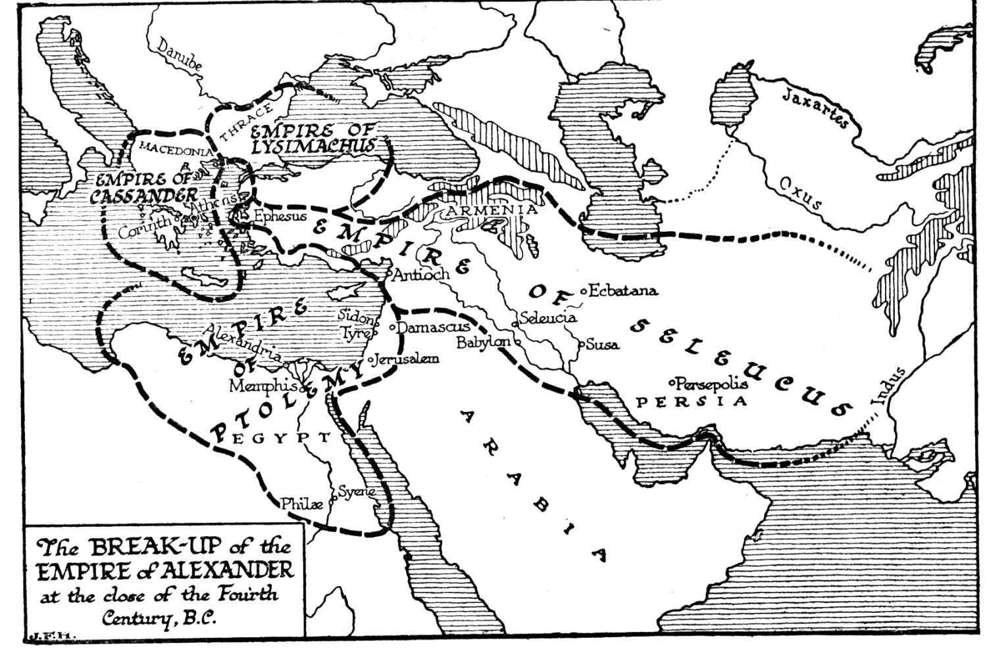

Slide 13
by 241 B.C. the four regions became known as Hellenistic Kingdoms.
Hellenistic Kings created new cities and settlements – spreading Greek culture.

Slide 14
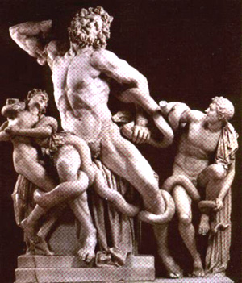
Hellenistic Era
- A time when the Greek language and Greek ideas were spread to non-Greek peoples.

Slide 15
The Legacy of Alexander
Brave & courageous
Inspiring military leader
Largely responsible for the spreading of Greek culture

Slide 16
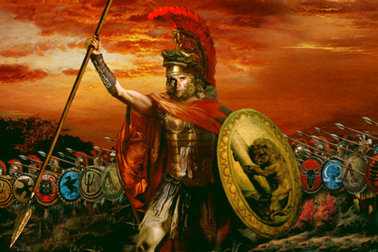
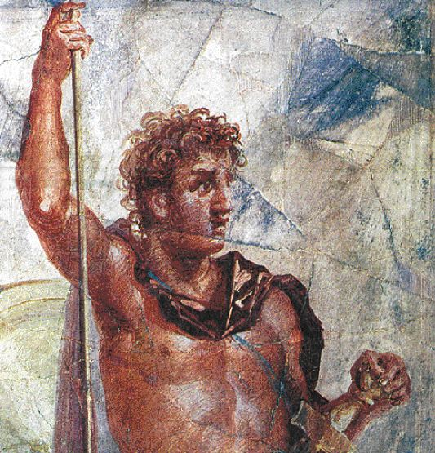
Alexander: Villain or Hero?
VILLIAN
HERO
Destroyed Persepolis
Mistreated his slaves
Had many of his advisors killed
Built new cities in place of destroyed ones
Promoted learning
Visited wounded after battles

Slide 17
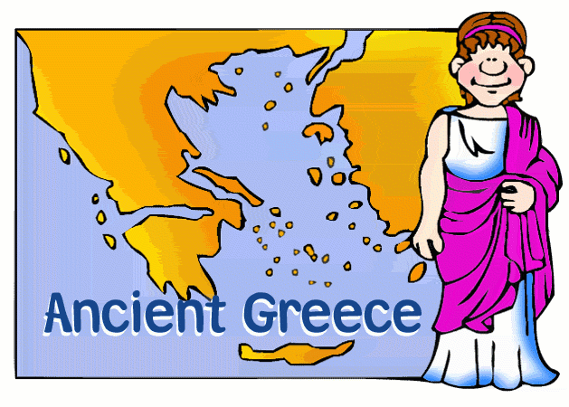
The Spread of Greek Culture

Slide 18
The Dark Age (1100-750 BCE)
NEGATIVES
Overseas trade slows = poverty
- Farmers producing little food
The written language is not being taught, nor are crafts
POSITIVES
Poverty and famine forces Greeks to islands in the Aegean Sea and west coast of Asia Minor IMPROVING TRADE
Greeks learn Phoenician alphabet

Slide 19
The Golden Age
(500-400 BCE)
● Ancient Greece flourished through art, architecture, literature, and philosophy
● The Golden Age ended when Sparta defeated Athens in the Peloponnesian War
(431-404 BCE)
● The Peloponnesian War bankrupted and divided the people of Athens

Slide 20
Hellenistic(“like the Greeks”) Era (323-30 BCE)
● Alexandria’s library held 500,000 scrolls
literature and language
● Philosophers, poets, writers, scientists, and mathematicians move to Asia and Egypt
(primarily to Alexandria) to expand their knowledge
● Scientists conducted research at the
museum in Alexandria

Slide 21
Literature
● Appolonius of Rhodes writes Argonautica
Jason and the Golden Fleece
● Theocritus (300-260 BCE) Poet
Wrote poems about how beautiful nature is. Was the first poet to discuss the differences between people that lived in the town and people that lived in the country.

Slide 22
ART
● Greek sculptors are hired to fill the
streets with statues, baths, theatres, and temples
● Kings and wealthy citizens paid for services
● Writers were also paid handsomely for
their literary works by kings and citizens

Slide 23
Philosophers
● Epicurus – Epicureanism – Happiness is the goal of life. In order to be happy,
YOU MUST SEEK PLEASURE. Held class in the “Garden”. He allowed slaves and women to study philosophy. (341-271 BCE)

Slide 24
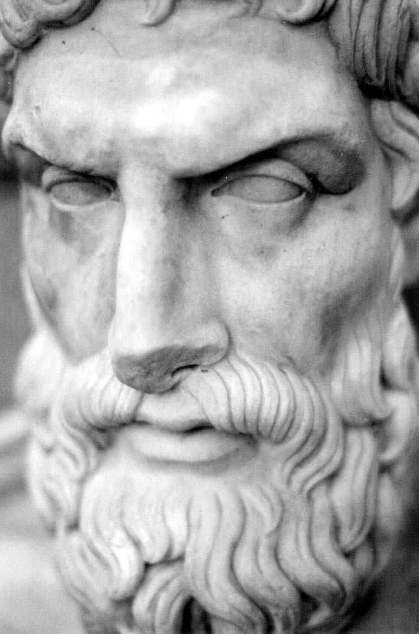
Epicurus – Epicureanism

Slide 25
ZENO (333-262 BCE)- Stoicism
- No emotions
- SEEK REASON
- Duty to serve the city
- He taught from a building called the “Painted Stoa”. The Greek word for porch is “stoa”.

Slide 26
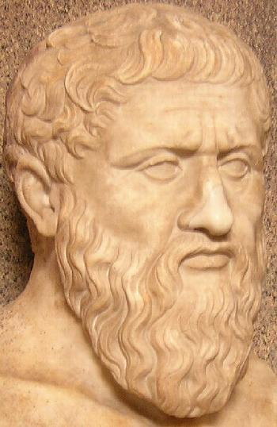
Zeno – Stoicism

Slide 27
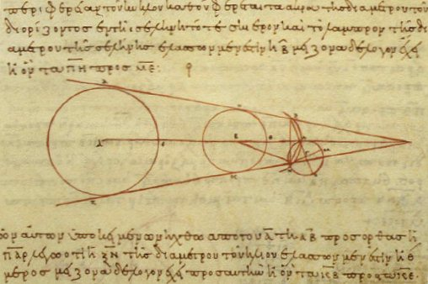
Aristarchus – heliocentric universe
● Aristarchus – Astronomer – The Sun is the center of the universe.

Slide 28
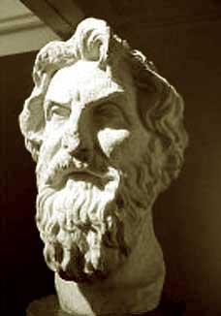
Aristarchus

Slide 29
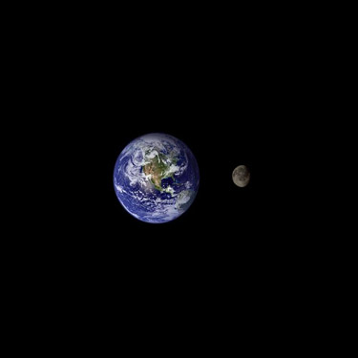
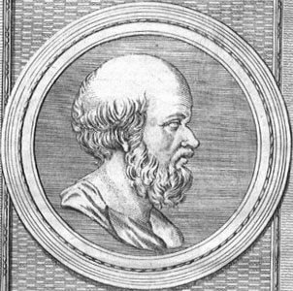
Eratosthenes – Astronomer
(276-195 BCE)
● Alexandria’s librarian. Used knowledge of geometry and astrology to calculate the distance around the Earth.
- Also made a relatively accurate calculation from the Earth to the Sun and the Moon.

Slide 30
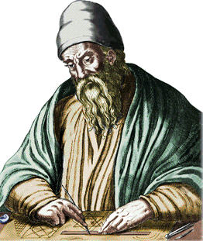
EUCLID – Mathematician
● Wrote Elements – plane geometry information regarding how angles, faces, lines, and points relate to one another

Slide 31
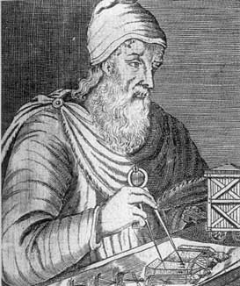
Archimedes

Slide 32
Archimedes of Syracuse, Sicily (287-212 BCE)
● Scientist, physicist, engineer, and mathematician
studied tubes and cylinders
came up with the value of PI (π)
● DESIGNED CATAPULTS
● Established the science of PHYSICS
explained the lever and compound pulley
● Killed in battle by Romans in 212 BCE

Slide 33
Catapult
http://www.youtube.com/watch?v=ransncjTr_c

Slide 34
HIPPARCHUS – Astrologer, Astronomer, Mathematician, and Geographer
● Founder of trigonometry
- Earth is the center of the universe
- Star catalog with names of stars, their positions, and magnitudes

Slide 35
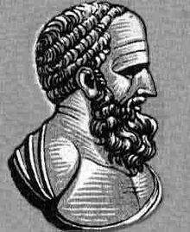
HIPPARCHUS

Slide 36
HYPATIA (350-370?-415 A.D.)
● FEMALE Astronomer, Mathematician, and Philosopher
- She taught mathematics and philosophy at the Platonist school in Alexandria.
Invented the plane astrolabe, graduated brass hydrometer, and hydroscope with Synesius of Greece
Brutally murdered by monks

Slide 37
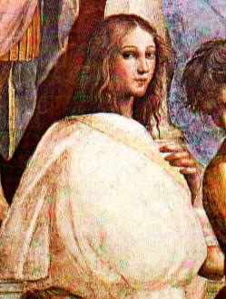
HYPATIA

Slide 38
Pythagoras (570-490 BCE)
● Mathematician – principles of geometry
Pythagorean theorem (sacrificed 300 oxen)
determining lengths of the sides of triangles
- Numerical aspects of musical harmony
believed that music had a healing power
- Led a strict way of life – diet, religious rituals, and self discipline

Slide 39
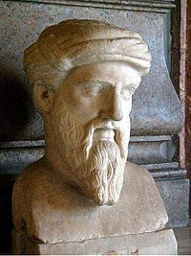
PYTHAGORAS

Slide 40
Hippocrates (460-370 BCE)
● Hippocrates – “Father of Medicine”
Hippocratic Oath – still used today
Physical factors create disease - not evil spirits
Keep proper balance between, “blood, phlegm, black bile, and yellow bile.”

Slide 41
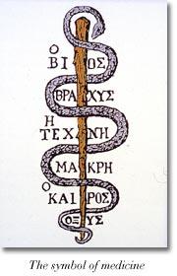
Symbol for Medicine
SYMBOL for MEDICINE and HEALING
The serpent represents rejuvenation/healing
The rod is that of the Greek God Asclepius, son of Apollo
Asclepius was a doctor in Greek mythology
- The sick came to temples to be assisted by priests prior to Hippocrates
- Priests used herbs for ailments, prayed for the sick, and made sacrifices to the Gods
- Hippocrates wanted a separation between religion and medicine
- Hippocrates worshiped Asclepius

