Slide 1
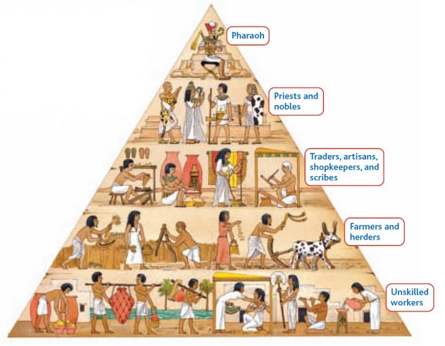
SOCIAL CLASS
> Society divided into groups based on wealth and power

Slide 2
Early Egyptian Family Life
Father was head of the household
Women COULD…
Own & pass on property
Buy & sell goods
Make wills & divorce
What about the children?
Mostly schooled by parents
Mothers taught daughters domestic duties
Fathers taught sons farming and skilled trades

Slide 3
Old Kingdom Rulers
Pharaohs “Great House”
All powerful ruler
Pharaohs word = law
“Officials”
Appointed by pharaoh
Carried out important tasks for pharaoh
Example: Building irrigation canals or assuring crops were planted.
Controlled trade and collected taxes

Slide 4
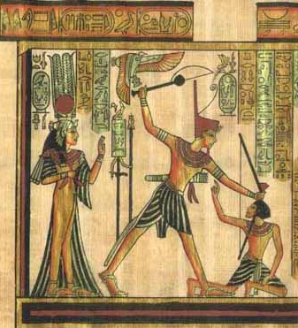
Pharaoh & God Connection
Seen as god on earth
Son of Re (Ray), Sun god
Subjects paid great respect
Example: Pyramids & Mummification
Pharaoh worship seen to benefit the people

Slide 5
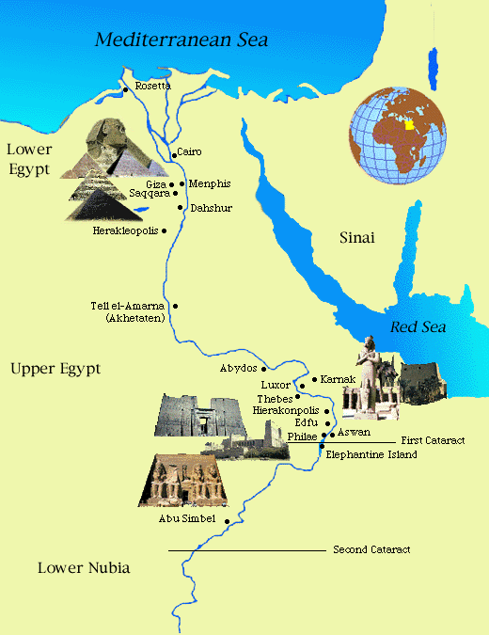

Slide 6
Trade & Transportation
Mediterranean Sea bordered to the north and the Red Sea beyond the desert to the east.
River allowed for communication despite Egypt’s isolated location
Merchants and Artisans contributed greatly to flow of trade
Able to make rafts and baskets with papyrus to increase trade and transportation

Slide 7
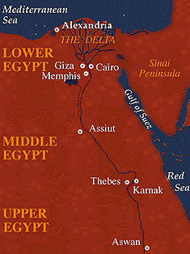
Nile River

Slide 8
Trade
River allowed people to survive in Egypt with fertile land for farming
Nile floods were predictable and could be managed through irrigation
Led to a surplus in food and in turn an increase in trade
Trade increased greatly within Egypt and outside its borders

Slide 9
Egyptians had a strong interest in goods from the south for valuable resources and gold
The southern course of the Nile created the easiest rout to Sub Saharan Africa
Relied on outside trade to gain metals used for weapons

Slide 10
The Middle Kingdom
Lasted from 2050 B.C. to 1670 B.C.
Moved capital to Thebes
Period of growth with an increase in land and farming.
Hyksos defeated Egyptians and gained control in 1670 B.C.

Slide 11
The New Kingdom
After controlling Egypt for 120 years, the Hyksos were defeated by the Egyptian prince, Ahmose.
New Kingdom began in 1550 B.C. and lasted until 1080 B.C.
Marked the peak of ancient Egypt

Slide 12
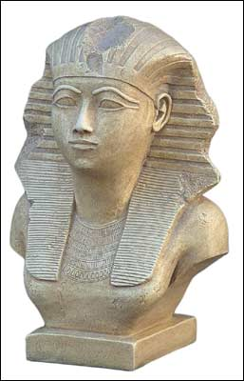
Hatshepsut

Slide 13
Hatshepsut
Reigned 1473-1458 B.C.
One of few women leaders in Egypt
Married to King Thutmose II, and became pharaoh when he died
Depicted as traditional male pharaoh in illustrations

Slide 14
Female queens prior to Hatshepsut, but no other female Pharaoh.
Women had more legal rights and social freedom than those of Mesopotamia.
More interested in trade than conquering land
Increased wealth in Egypt by traveling and trading along east coast of Africa
Built many new temples and restored older monuments

Slide 15
Egypt’s wealth increased greatly under Hatshepsut’s reign
After the mysterious death of Queen Hatshepsut, her step son Thutmose III became the pharaoh.

Slide 16
Akhenaton & Tutankhamen
1370 B.C. Akhenaton came to power
Wanted to take power away from priests, therefore created his a new religion with only one god, Aton
Original name was Amenhotep, but changed name to Akhenaton which means “Spirit of Aton”
Many Egyptians refused to believe new reliegon

Slide 17
Took no action when attacked by the Hittites, and Egypt lost most of land in western Asia
Empire greatly decreased
Tutankhamen, step son of Akhenaton, took control after his death
Only tens years old
Restored old religion, but died after only ruling for nine years
Famous “King Tut” only because his tomb was found containing many treasures

Slide 18
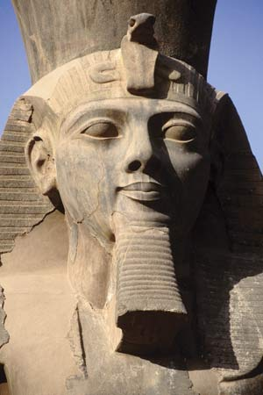
Ramses II

Slide 19
King Ramses II
Known as “Ramses the Great”
Reigned for 67 years from 1292-1225 B.C.
Period was characterized by an increase in wealth and luxury and growth in army and slavery
Rebuilt empire by expanding Egypt’s borders and building many temples

Slide 20
Given the throne at age 20 and was the second longest ruling Pharaoh
Served in the military with his father when he was 10 years old
Once he became leader he was already an experienced warrior
Fought to regain territory in Africa and Western Asia
Constant threat by Libyans, Syrians, Nubians and Hittites

Slide 21
The Hittites
Had already taken over portions of Egypt’s land prior to Ramses
Group of indo Europeans who moved into Asia Minor - modern day Turkey
First to use iron weapons

Slide 22
Battle of Kadesh
Ramses fought to regain land in a war against the Hittites
Battle is one of the most famous of Egyptian History
First king in history to sign a peace treaty which ended many years of war
Two copies of the peace treaty were made and still exist

Slide 23
Had a passion for architecture and built more monuments and temples than any other Pharaoh
Temples also used as banks for storing valuable items
These temples reflect Ramses power and wealth

Slide 24
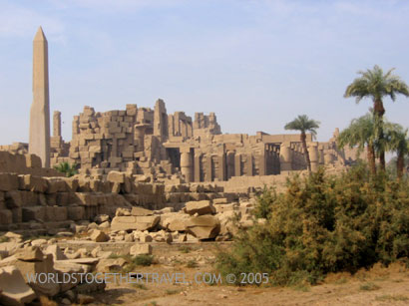
Karnak Temple
Karnak in Thebes was the most famous temple built during Ramses’s ruling.

Slide 25
Egypt’s Decline
Egypt began to lose power after Ramses II
By 1150 B.C. the Egyptians only maintained control of the Nile Delta
In 900 B.C. outside groups took control of Egypt
The Kush people from the south began to rule Egypt in 760 B.C.

Slide 26
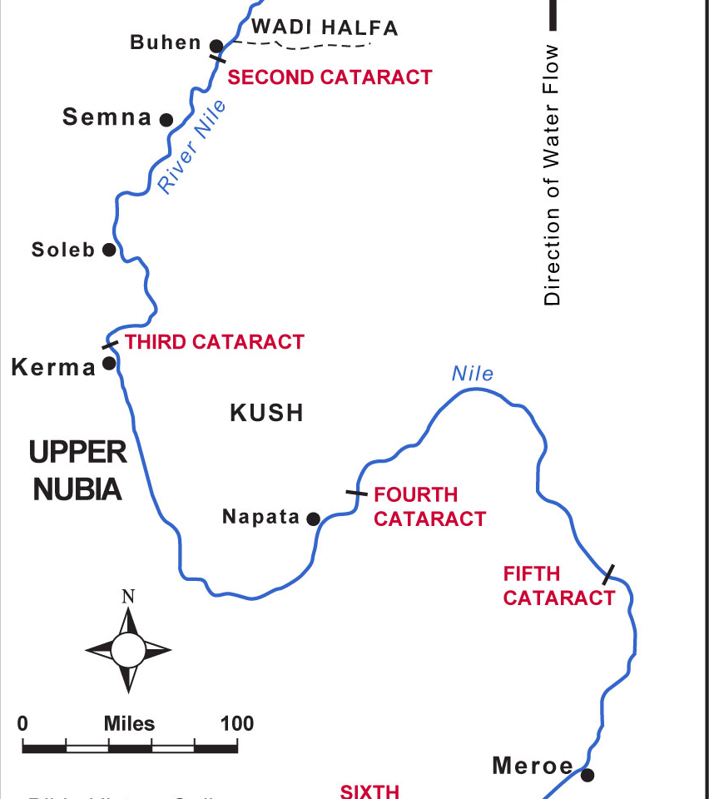
Kerma Kingdom
Around 2000 B.C. to Around 1400 B.C.
-Located to the south of Egypt in Nubia (Present day Sudan) in Africa along the Nile River
-2000 B.C. Hunter-gatherers settle and cultivate small farms/villages around Kerma in Nubia
-The more powerful villages took control to create Kerma Kingdom
-Traded cattle, gold, ivory, enslaved people along Nile
-Developed close ties with Egypt

Slide 27
Egypt Rises
Around 1450 B.C. to Around 900 B.C.
-Egypt’s Pharaoh Thutmose III sent armies into Nubia
-50 year war ended with Egypt ruling for 700 years
-Kerma Kingdom destroyed
-Nubians adopted to many Egyptian ways
-Become culturally tied and economically wiser
-After the 700 year reign, Egypt begins to decline in power

Slide 28
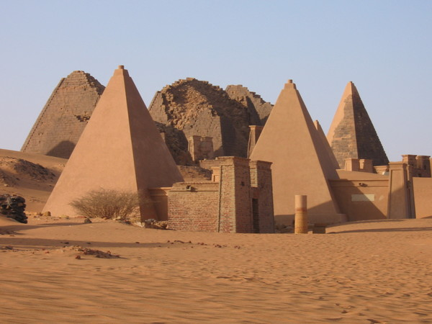
Kush Kingdom
Around 850 to Around 200/350 A.D
-A Nubian group took the fall of Egypt to rise independently as Kush Kingdom
-Capital city south along Nile to Napata, extremely favorable location on the Nile River
-Became a rich, strong kingdom trading as far as China, India and Arabia

Slide 29
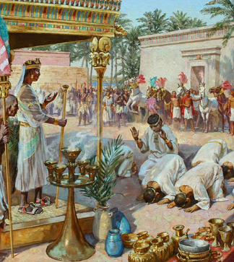
King Kashta & Piye
750B.C. to 670 B.C.
-Believe Kush Kingdom is powerful enough to takeover Egypt
-750 B.C. King Kashta and his son, Piye, head north with army
-728 B.C. King Piye successfully defeats Egyptians and rules Kush and Egypt for around 58 years

Slide 30
Invasion of Assyria
670 B.C.
-Egypt taken over by Assyrians invasion
-Used ‘sophisticated’ iron weapons
-Forced Kush Kingdom to retreat south back to homeland
-Lost the control of Egypt but gained knowledge of fighting and weaponry
-Kushites took strong interest in Iron

Slide 31
Kush Kingdom Falls
540 B.C. to 200/350 A.D.
-Assyrians keep pressure on Kush
-540 B.C. Kush Kings move Capital city further south to Meroe
-Eastern Desert near Meroe contained rich iron deposits
-Kushites became first Africans to devote themselves to iron working
-200 A.D. Kush Kingdom begins to decline
-350 A.D. Armies of Axum burned down Meroe

Slide 32
Hieroglyphics
Created by Egyptians & Evolved by Many
-Around 3000 B.C. begins this form of “sacred writing”
-Mesopotamia, Sumerian Script (special characters)
-Ancient Egypt’s Old, Middle, and New Kingdoms developed thousands of characters
-Painted or engraved on cave walls, pottery, stone, papyrus, mummies etc.
-Written top to bottom, R to L or L to R depending on which way the profiles of the humans and animals faced
-Vowels were used in spoken language but not usually written

Slide 33
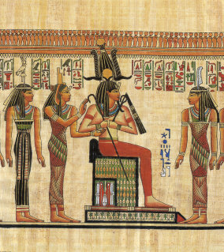
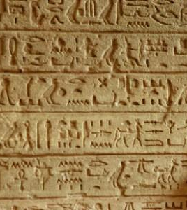

Slide 34
Hieroglyphs are…
-Phonetic glyphs or Alphabet: Single-consonant characters that functioned like an alphabet
-Logographs or Biliterals: Single grapheme which represents a word, pairs of characters
-Ideographs or Determinatives: Graphic symbols that represents an idea

Slide 35
