Slide 1
Chapter 1
The First Civilizations
Beth N. Kelly M. Shanda M. Stephanie B. Stephanie O.

Slide 2
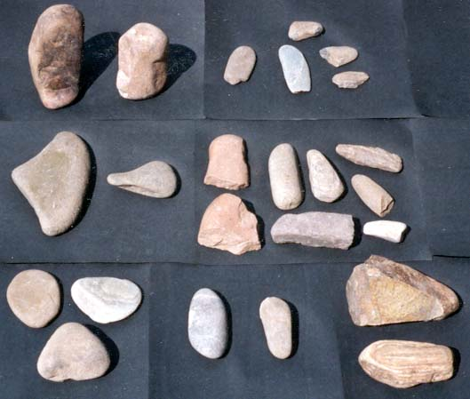
Early Humans: Paleolithic Age
Earliest human period (1 to 2 million years ago)
First evidence of culture seen in ancient history
Paleolithic is a Greek word meaning “old stone”
Named because of the stone tools found used during this time
Long period of hunters, fishers, and gathers, but no producers
Tools, made out of rocks, used by Early Humans

Slide 3
Paleolithic Age
Environment:
  During the early human age, humans had to adapt to whatever environment they were surrounded by.
  Tools, clothing, food, shelter were all made from items found in the surrounding areas
  In cold areas, fur coats were made from wild animals to keep warm
  Most tribes were nomadic
  Would have to travel where the food was
  After generations of nomads, the humans were able to distinguish what animals, berries, and roots were okay to eat
  They were also able to make clothes and shelter from the trees, rocks and mud from surrounding materials

Slide 4
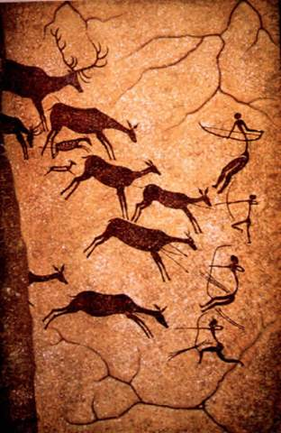
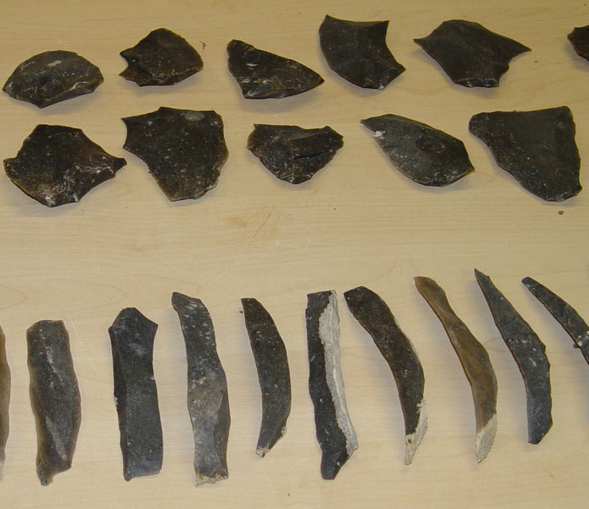
Hunter- Gatherers and Tools

Slide 5
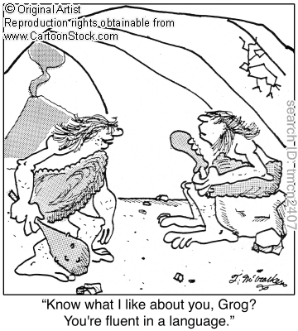
Paleolithic Age: Language

Slide 6
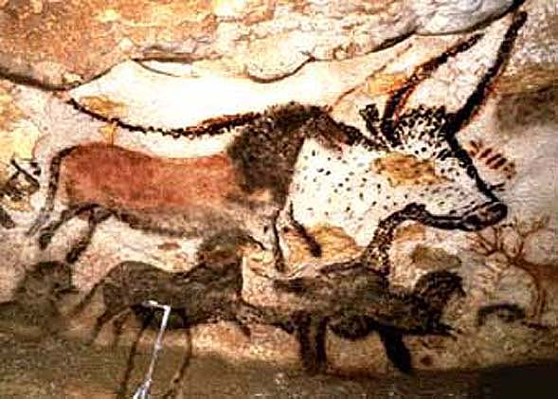
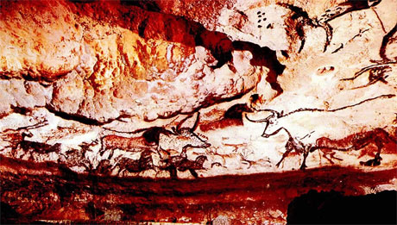
Paleolithic Age: Language
Early humans expressed themselves in art
Historians are not sure why they were created
Lascaux Cave Art

Slide 7
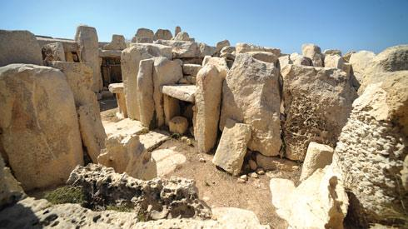
Early Humans: Neolithic Age
Period in which Paleolithic societies advanced from hunting and gathering to agriculture and producing their own food.
New stone tool technology formed– development of precision and chipping/grinding
Neolithic comes from the Greek word meaning “new stone”

Slide 8
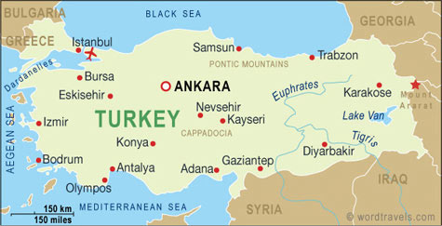
Neolithic Age
One of the first large Neolithic settlements, Catal Hoyuk, was found near Ankara, the present day capital of Turkey.

Slide 9
Neolithic Age
Shift to agriculture/producers
Wild sheep, goats, wheat domesticated
Farming was discovered
Humans began permanently settling by rivers
Built permanent shelters out of materials found in the surrounding environment
Populations began to rapidly rise because humans began farming so they settled into permanent locations

Slide 10

Neolithic Age - Villages
First time people could live in one place
  Permanente homes built
  Steady food supply = healthy, growing population
  Trade of food
  Job specialization
Jerihco and Catal Huyuk
Notes:
1. Locate and describe the major river systems and discuss the physical settings that supported permanent settlement and early civilizations. (Group s1 & 2, Chapters 1 & 2)
{Very little is given about lakes and rivers in the book we will definitely need to find an outside source that talks about the river system as well as the physical settings.}
2. Trace the development of agricultural techniques that permitted the production of economic surplus and the emergence of cities as centers of culture and power. (Groups 1 & 2, Chapters 1 & 2)
{This is topic is covered in the book pictures of kings or rulers will definitely help maybe a list of the benefits that come from each leader within Mesopotamia.}

Slide 11
Neolithic - Farming
First time people could live in one place
Grew grains and vegetables
Farming Revolution
  Farming replaced hunting and gathering
Domesticated animals for meat, wool and milk
Notes:
1. Locate and describe the major river systems and discuss the physical settings that supported permanent settlement and early civilizations. (Group s1 & 2, Chapters 1 & 2)
{Very little is given about lakes and rivers in the book we will definitely need to find an outside source that talks about the river system as well as the physical settings.}
2. Trace the development of agricultural techniques that permitted the production of economic surplus and the emergence of cities as centers of culture and power. (Groups 1 & 2, Chapters 1 & 2)
{This is topic is covered in the book pictures of kings or rulers will definitely help maybe a list of the benefits that come from each leader within Mesopotamia.}

Slide 12
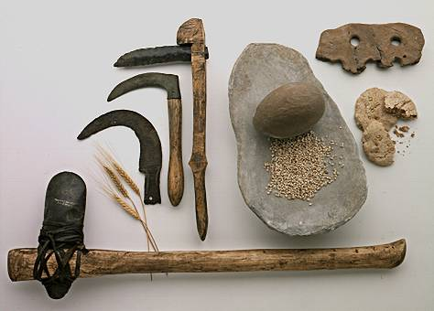
Neolithic Age: Tools

Slide 13
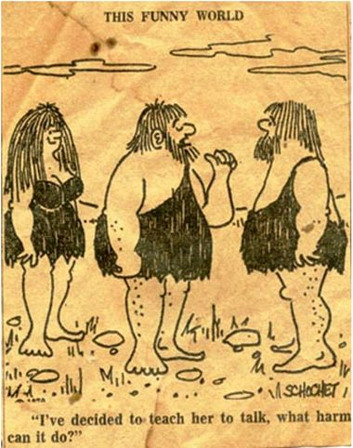
Neolithic Age: Language

Slide 14
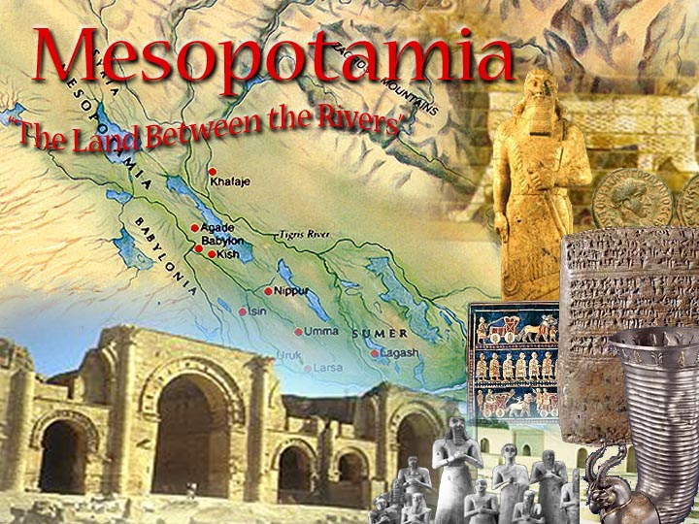

Slide 15
Mesopotamian - Location
Between two rivers
  Tigris River and Euphrates River
River Valleys
  Good farming conditions
  Water transportation for trade
Fertile Crescent
http://glencoe.mcgraw-hill.com/sites/0078688736/student_view0/unit1/chapter1/interactive_map.html#
Notes:
1. Locate and describe the major river systems and discuss the physical settings that supported permanent settlement and early civilizations. (Group s1 & 2, Chapters 1 & 2)
{Very little is given about lakes and rivers in the book we will definitely need to find an outside source that talks about the river system as well as the physical settings.}
2. Trace the development of agricultural techniques that permitted the production of economic surplus and the emergence of cities as centers of culture and power. (Groups 1 & 2, Chapters 1 & 2)
{This is topic is covered in the book pictures of kings or rulers will definitely help maybe a list of the benefits that come from each leader within Mesopotamia.}

Slide 16
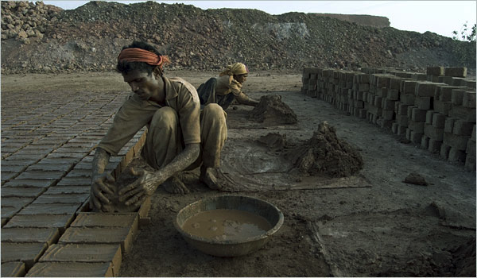
Mesopotamian - Location 2
Southern Mesopotamian region of Sumer
Isolated cities = City-States
  Own government
  Enclosed by mud brick wall
  Not part of larger unit
  Far apart
  War

Slide 17
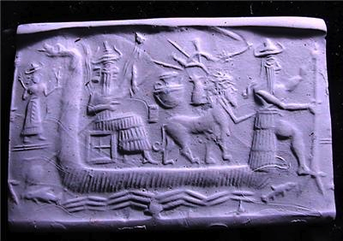
Mesopotamian - Environment
Hot dry climate
Rivers flooded in spring
  Good for farming
  Unpredictable
Notes:
1. Locate and describe the major river systems and discuss the physical settings that supported permanent settlement and early civilizations. (Group s1 & 2, Chapters 1 & 2)
{Very little is given about lakes and rivers in the book we will definitely need to find an outside source that talks about the river system as well as the physical settings.}
2. Trace the development of agricultural techniques that permitted the production of economic surplus and the emergence of cities as centers of culture and power. (Groups 1 & 2, Chapters 1 & 2)
{This is topic is covered in the book pictures of kings or rulers will definitely help maybe a list of the benefits that come from each leader within Mesopotamia.}

Slide 18
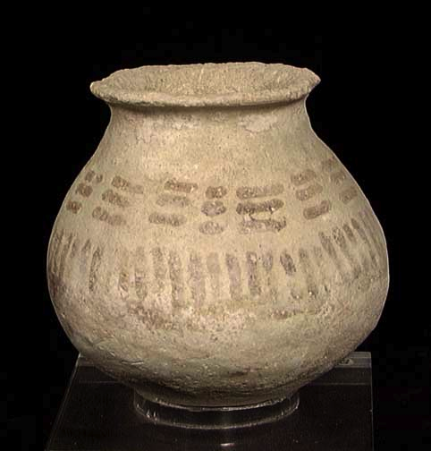
Mesopotamian - Village
Governments formed
Extra time:
  Religion
  Art
  Writing
  Calendars
Class system
  Wealth / Power
  Job title
Notes:
1. Locate and describe the major river systems and discuss the physical settings that supported permanent settlement and early civilizations. (Group s1 & 2, Chapters 1 & 2)
{Very little is given about lakes and rivers in the book we will definitely need to find an outside source that talks about the river system as well as the physical settings.}
2. Trace the development of agricultural techniques that permitted the production of economic surplus and the emergence of cities as centers of culture and power. (Groups 1 & 2, Chapters 1 & 2)
{This is topic is covered in the book pictures of kings or rulers will definitely help maybe a list of the benefits that come from each leader within Mesopotamia.}

Slide 19
Mesopoamian - Farming
Flooding unpredictable
Learned to irrigate
  Dams, channels, walls, water ways, and ditches
http://www.youtube.com/watch?v=5RP2KfewiJA
Notes:
1. Locate and describe the major river systems and discuss the physical settings that supported permanent settlement and early civilizations. (Group s1 & 2, Chapters 1 & 2)
{Very little is given about lakes and rivers in the book we will definitely need to find an outside source that talks about the river system as well as the physical settings.}
2. Trace the development of agricultural techniques that permitted the production of economic surplus and the emergence of cities as centers of culture and power. (Groups 1 & 2, Chapters 1 & 2)
{This is topic is covered in the book pictures of kings or rulers will definitely help maybe a list of the benefits that come from each leader within Mesopotamia.}

Slide 20
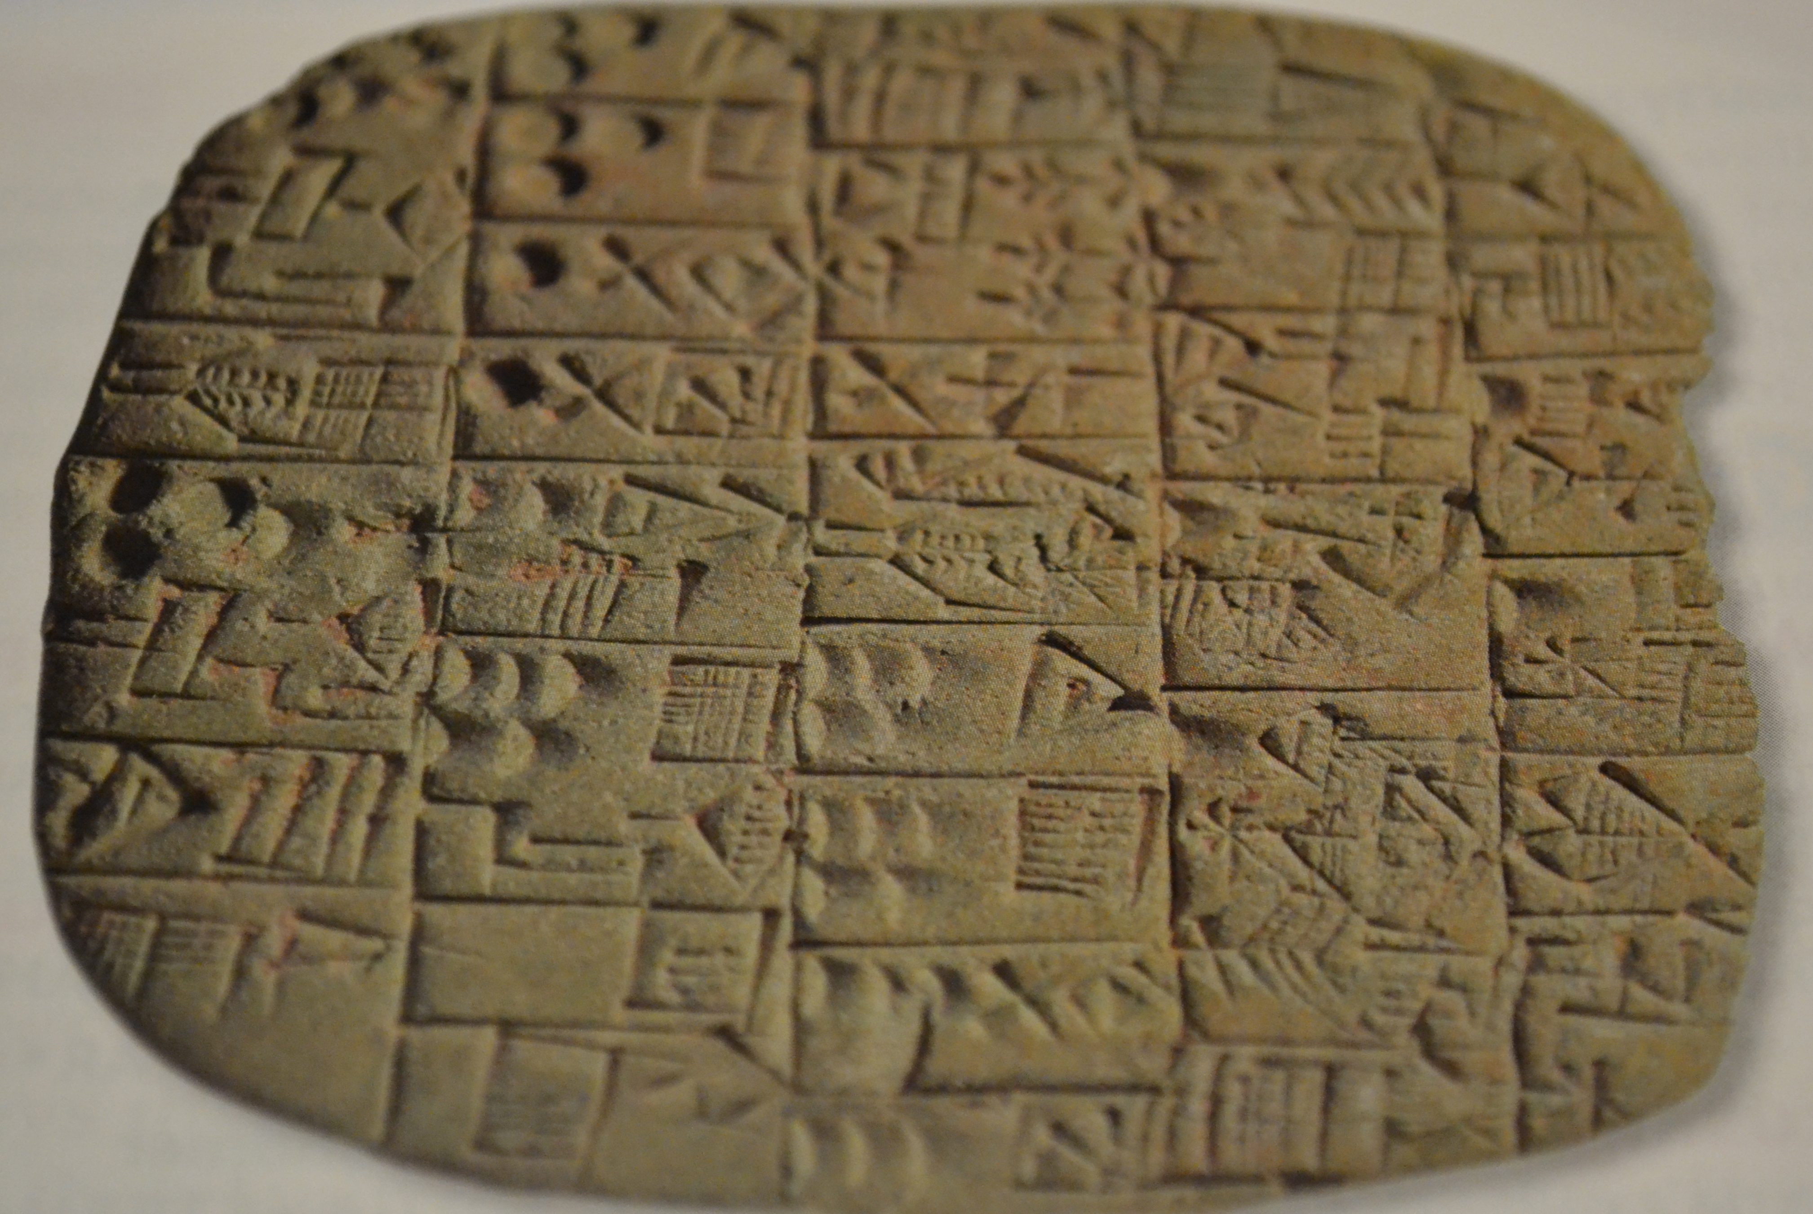
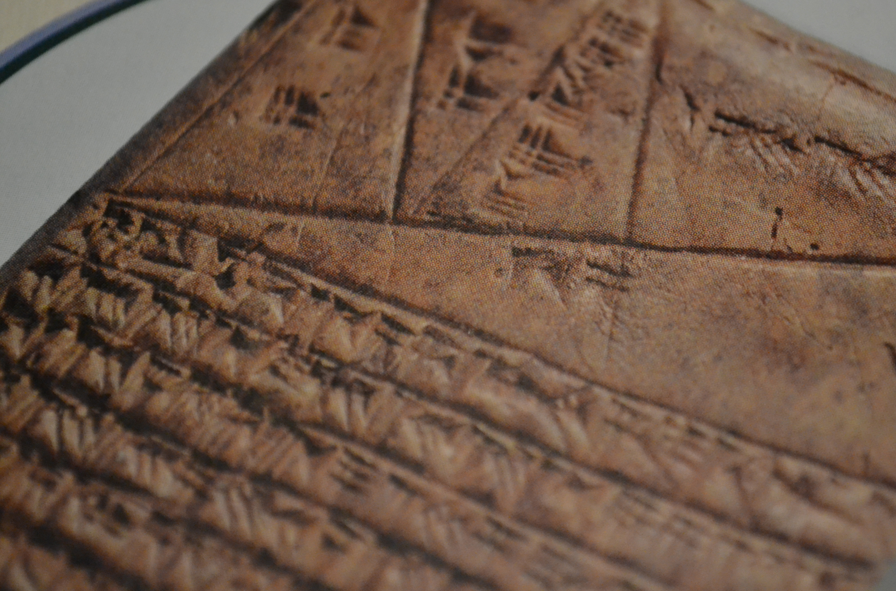
Mesopotamian Language
Inventors of writing called Cuneiform
  Wedge shape marks
  Cut into clay with reeds
Cuneiform invented for many reasons ex: Epic of Gilgamesh
Only boys from wealthy families learned

Slide 21
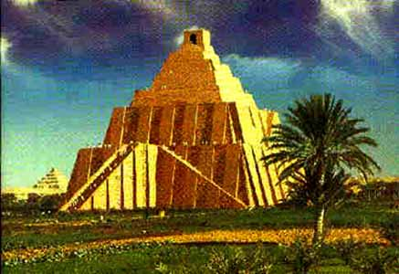
Mesopotamia: Gods and Rulers
Believed in many Gods
  Each had power over natural force or human activity
  Tried hard to please the Gods
Each city-state built a ziggurat to their chief God
Priests held a
lot of power

Slide 22
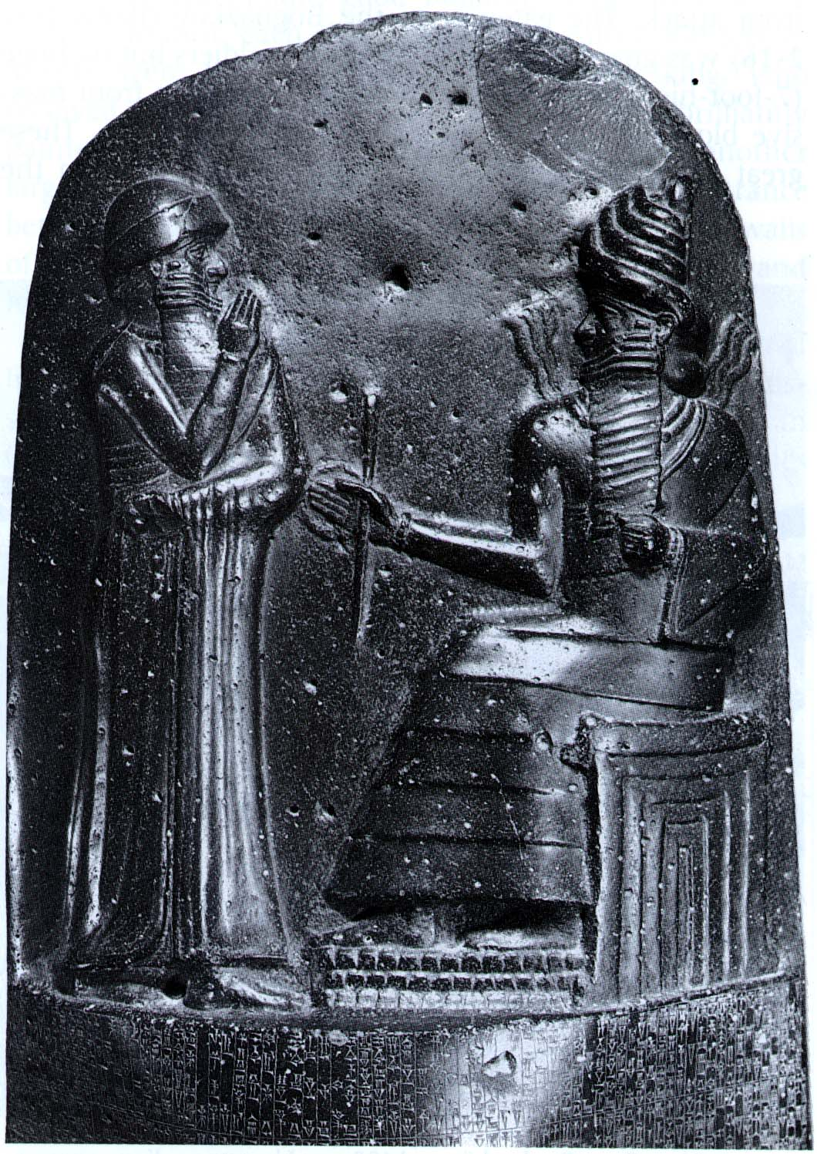
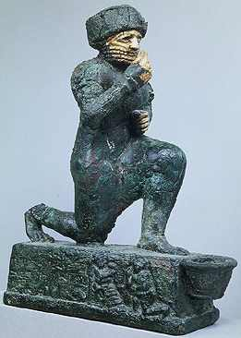
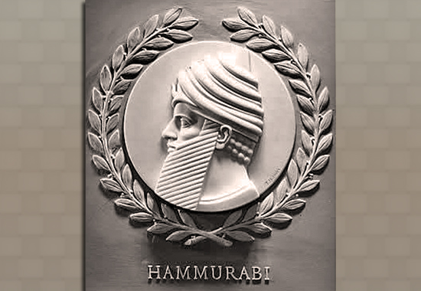
Hammurabi

Slide 23
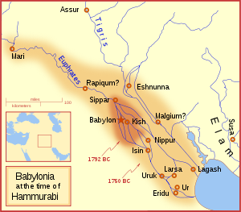
Hammurabi’s Empire

Slide 24
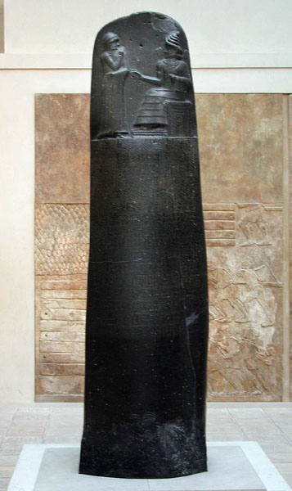
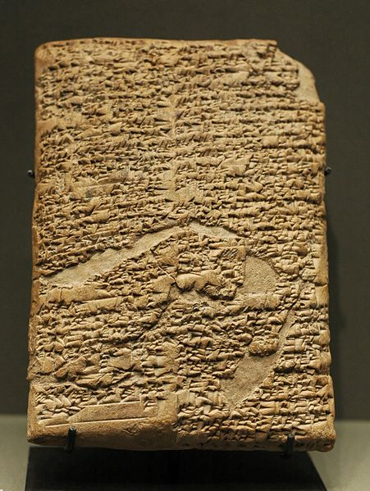
Hammurabi’s Code

Slide 25
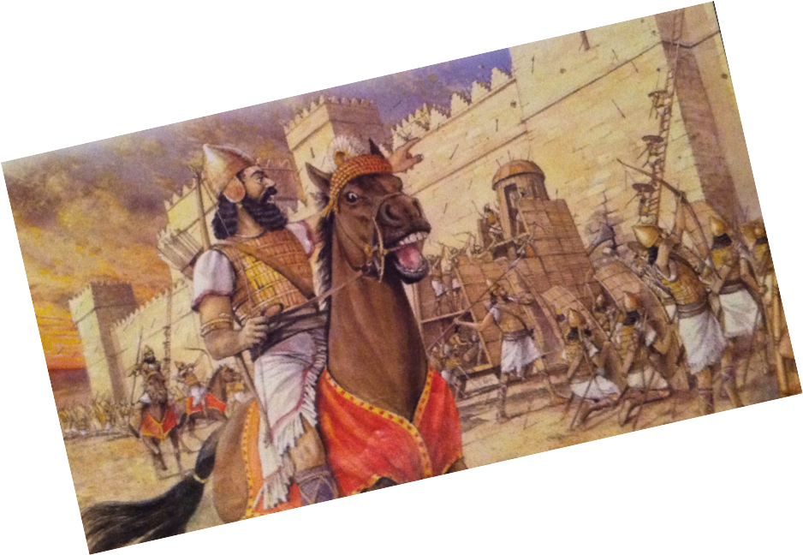
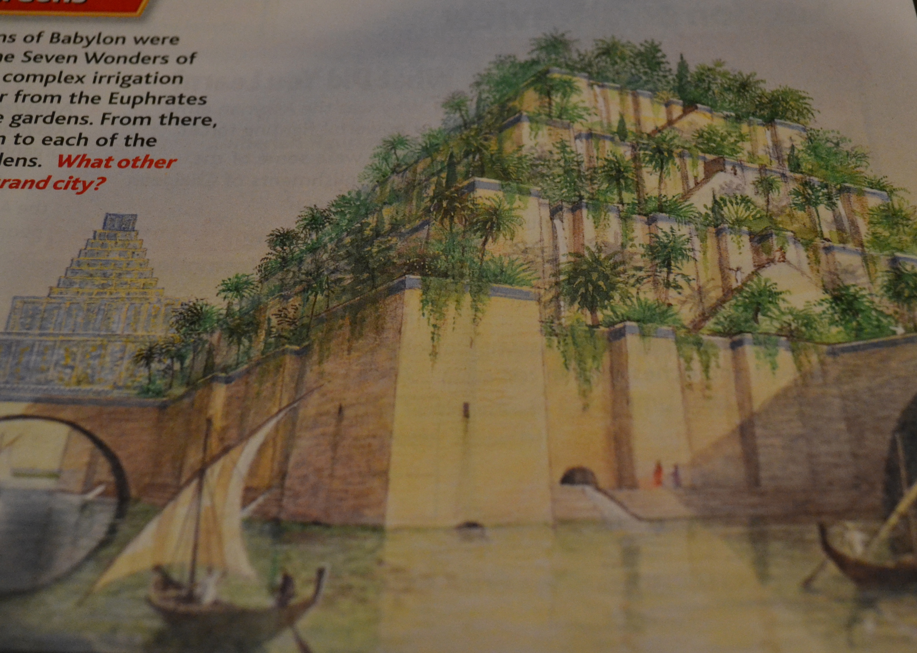
The First Empires

Slide 26
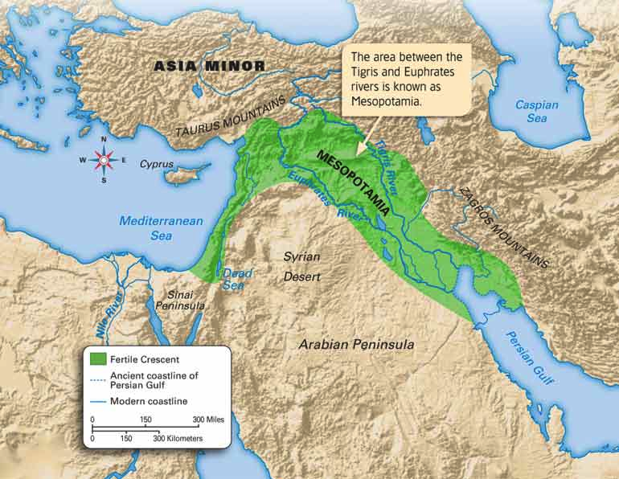
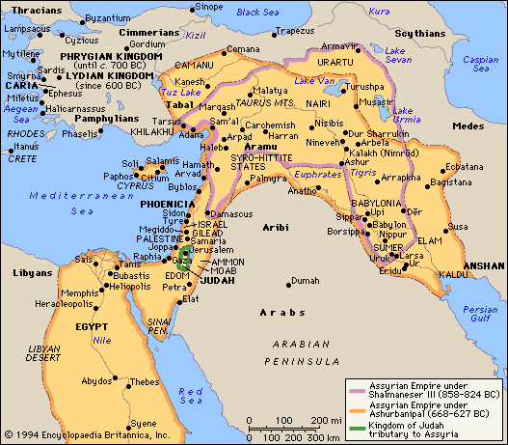
The Assyrians - New Empire
1,000 years after Hammurabi
Assyrians from north took over Mesopotamia

Slide 27
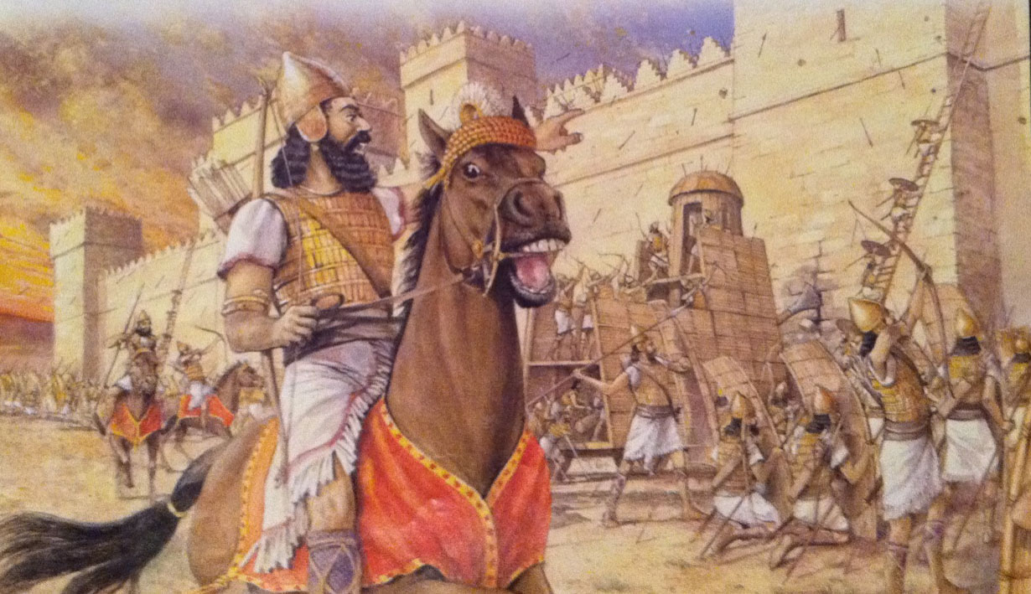
Assyria - Army
Assyria had a large army
defend its land
Used army to expand land
  Organized army
  Iron weapons
  Tunneled under or climbed over walls
  Set fire to buildings
  Forced high taxes

Slide 28
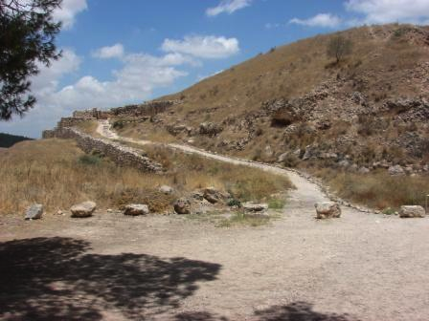
Assyrian - Government
Strong government
  Divided empire into provinces
  Officials ruled provinces
    Collected taxes
    Enforced laws
  Set up road system
    Connected empire

Slide 29
Assyrian - Life
Similar to that of other Mesopotamians
  Writing style
  Gods
  Laws, brutal punishment
Large elaborate buildings
  Temples
  Palaces
  Library
    First Library
    25,000 tablets
Assyria’s cruel treatment of others eventually turned on itself and as the empire fought over picking a new king a group of people, called the Chaldeans, rebelled and took over the city of Nineveh in 612 B.C.E. and the empire soon fell apart!

Slide 30
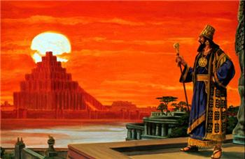
The Chaldean Empire

Slide 31
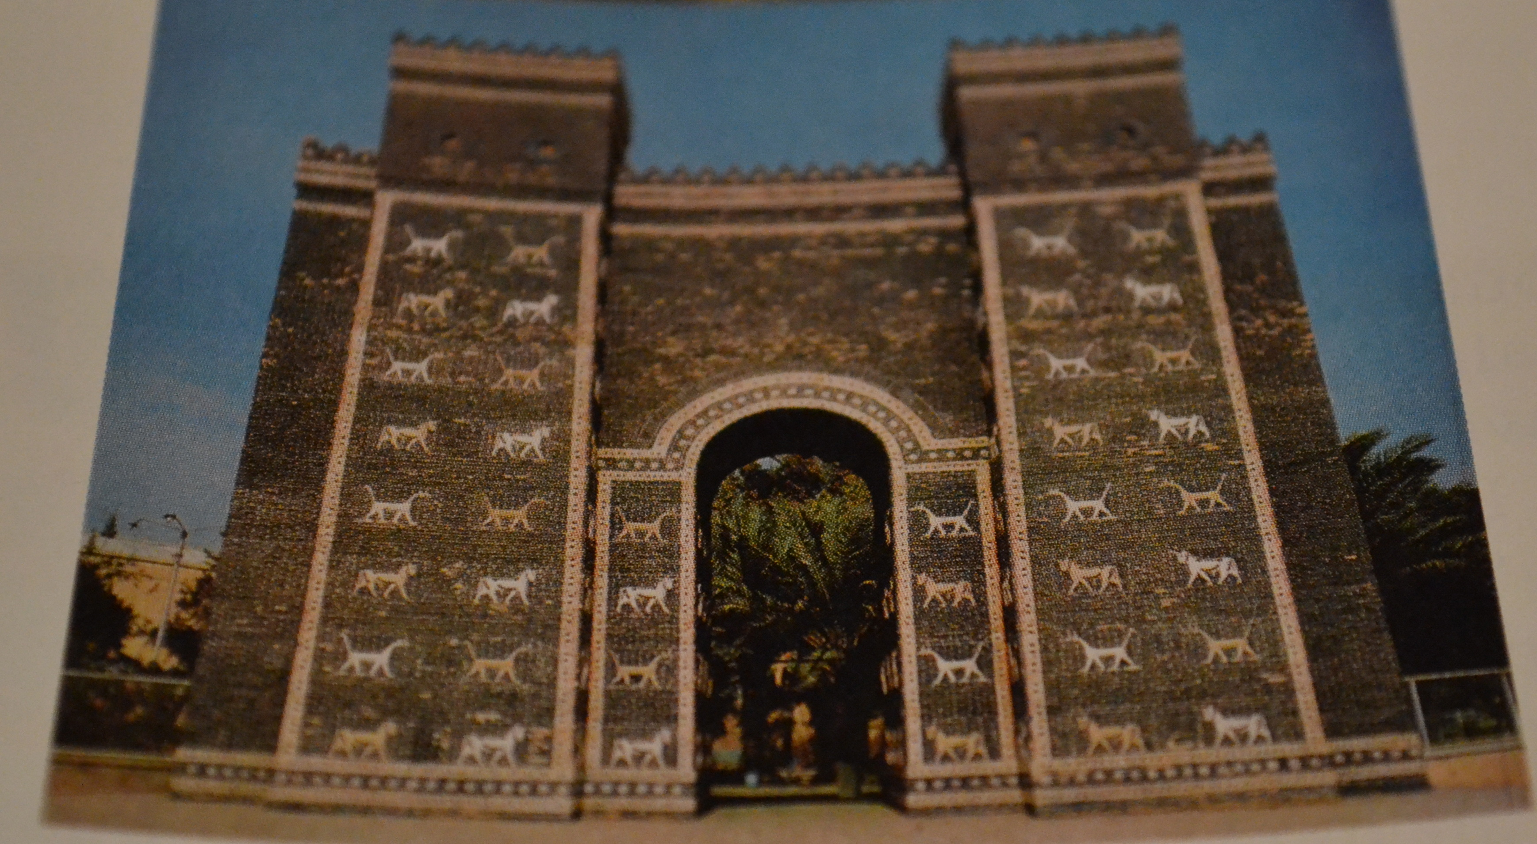
The City of Babylon
King Nebuchadnezzar instructed the rebuilding of Babylon
Became the largest and richest city
City filled with palaces and temples
The Hanging Gardens was built for the king’s wife
Above: Ishtar Gate Below: Hanging Gardens

Slide 32
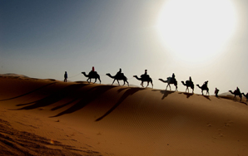
The Chaldean Empire
Trade
  Artisans traded their goods to passing caravans
  The city became very rich because of the location
A Center of Science
  Change in the sky revealed Gods plan
  Mapped stars, planets, and moon phases
  Created the first sundial
  Had the first seven-day week

Slide 33
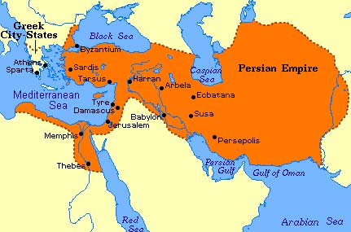
The Fall of the Empire
Loss of power
Unable to control people they conquered
In 539 B.C.E. Persians Captured Babylon
Mesopotamia became part of the Persian Empire

