Slide 1
Roman Civilization
Patricia Vigil
Yina Li
Standards:
6.7.8
7.1.1, 2,3

Slide 2
ROMAN CULTURE
Roman artists and writers borrowed many ideas from the Greeks.
They admired and studied Greek statutes, buildings, and ideas.
They copied many ideas, but changed things to meet their needs.

Slide 3
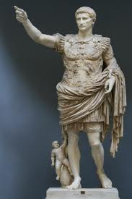
Roman Statues
Statues were made to
look realistic.
People were shown with:
Wrinkles
Warts
Less attractive Features

Slide 4
Buildings
They used Greek- style porches and rows of columns called colonnades.
But they also added their own features, such as arches, vaults, and domes.
This made their buildings more open than any other buildings before their time.
They also invented concrete - a mixture of volcanic ash, lime, and water
Concrete made buildings sturdier and allowed them to be built taller.

Slide 5
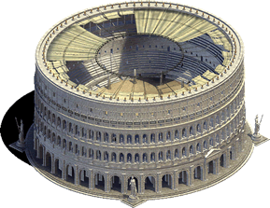
The Roman Colosseum
Completed about A.D. 80
Seated 60,000 people

Slide 6
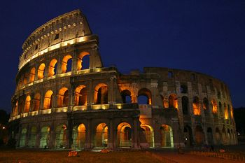
The Roman Colosseum

Slide 7
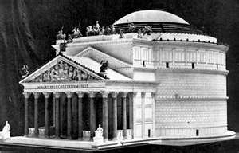
Pantheon
Built to honor Rome’s gods
Largest domed roof in it’s time

Slide 8
Roman Literature
Virgil- epic poem “Aeneid”
Horace – satires and odes
Ovid- based on Greek myths
Catullus- poems about love, sadness, and envy
Livy- “History of Rome” - 10 B.C.

Slide 9
Roman Science and Engineering
Galen- studied anatomy (the study of body structure)
Ptolemy- scientist who studied the sky
Engineers built a system of roads and bridges to connect the empire.
They also used advanced engineering to build aqueducts that brought water from the hills into the cities.

Slide 10
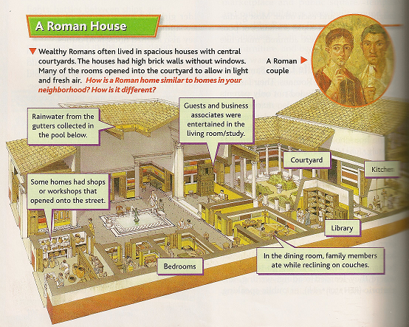
Daily life in Rome
The rich and the poor had very different lives.
Wealthy Romans:
-large, comfortable houses
-fine furniture
-beautiful gardens
-inner court - atrium
Poor Romans:
-apartment buildings - stone and wood
-high rent forced families to live in one room

Slide 11
Poverty
Most people were poor.
Roman apartments were up to six stories high.
They often collapsed because they were so poorly built.
Fire was also a constant danger.
The city was crowded, noisy, and dirty.
To keep the people from rioting, the government provided “bread and circuses”- free grain and shows.

Slide 12
Sports and Contests
Sports were important to the Romans
Events took place in the Colosseum, amphitheatres, and the Circus Maximus
- wild beast fights
- battles between ships
- gladiator contests
- chariot races
These events attracted thousands of Roman spectators

Slide 13
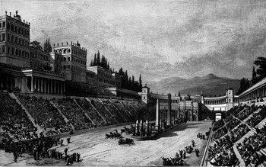
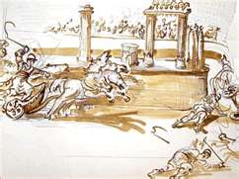
Circus Maximus
One of the largest arenas ever made
Used for chariot races

Slide 14
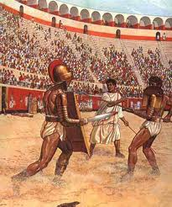
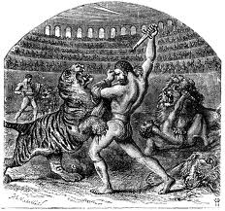
Gladiators
They were enslaved people, criminals, or poor people.
They fought animals and each other.
They were admired.

Slide 15
Slavery
Public slaves:
-owned by the state
-took care of important buildings and served government officials
Private slaves:
-owned by individuals
-forced to work long hours
-could be sold at any time
Spartacus- gladiator who led the slave revolt in 73 B.C.

Slide 16
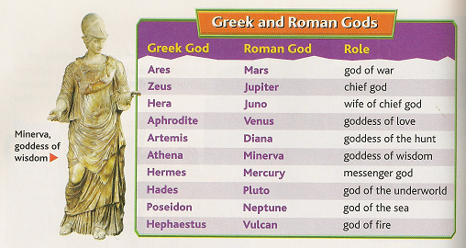
Roman Religion
They worshipped gods and goddesses, spirits, and emperors.
Romans honored their gods and goddesses by praying and offering food.
Every Roman home had an altar for their household gods.

Slide 17
Family Life
Paterfamilias- “father of the family”
They had complete control over family members.
He punished children severely if they disobeyed.
He also arranged their marriages.

Slide 18
Education
Poor Romans could not afford to send their children to school.
Wealthy Romans, however, hired tutors to teach their young children at home.
Some older boys went to school and learned reading, writing, and rhetoric.
Older girls did not go to school; they studied at home and learned household duties.

Slide 19
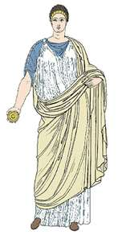
Becoming a Man
Roman boys between the ages of 14-16
They would burn their toys for offerings to the household gods.
Then they would put on a toga.
Once they came of age, they would join the family business, become a soldier, or begin a career in the government.

Slide 20
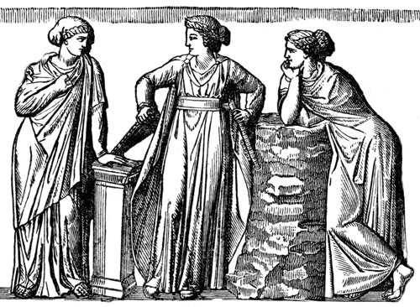
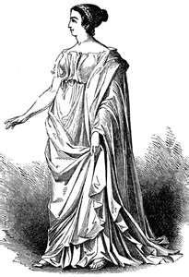
Roman Women
They became adults when they married.
They usually wore a long flowing robe with a cloak called a palla.

Slide 21
The Decline of Rome
Commodus – son of Marcus Aurelius
- became emperor in A.D. 180 after fathers death
- cruel and wasted money
- spent much of his time fighting as a gladiator
- A.D. 182 he was killed by his bodyguard.
Severans – emperors who ruled after Commodus
- worked toward putting down revolts
- protecting Rome’s borders
- ignored growing problems of crime and poverty

Slide 22
Political and Social Problems
The last Severan ruler died in A.D. 235
Rome’s government became very weak.
- Army leaders fought each other for the throne
- Rome had 22 different emperors during this time
- Fewer Romans honored the old ideals of duty, courage,
and honesty
- Many government officials took bribes

Slide 23
Economic and Military Problems
During the A.D 200s, Rome’s economy began to fall apart
- Roman soldiers and invaders seized crops and destroyed fields.
- Farmers grew less food, and hunger began to spread.
- People bought fewer goods
- Businesses closed
- Workers had to leave jobs and serve in the army
- A plague spread
- Inflation

Slide 24
Invasion
Germanic tribes raided Roman farms and towns
Armies from Persia pushed into the empire’s territories
Fighting increased and the government could no longer pay Romans as soldiers
The government started using Germanic warriors in the armies, but they were not loyal to Rome.

Slide 25
Diocletian
Diocletian became emperor in A.D. 284
- He divided the empire into four parts - “Tetrarchy”
- To slow inflation, he issued rules that set the prices of goods and the wages to be paid to workers
- He ordered workers to remain at the same jobs until they died
He retired from office in A.D. 305

Slide 26
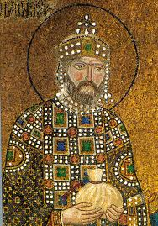
Constantine
Constantine became emperor in A.D. 312
To aid the economy, he issued several orders:
- The sons of workers had to follow
their fathers trades
-The sons of farmers had to work the land their fathers worked
- The sons of soldiers had to serve in the army

Slide 27
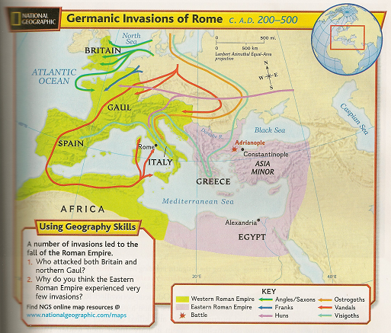
Constantine
He moved the capitol from Rome to Byzantium
The city became known as Constantinople

Slide 28
Theodosius
After Constantine died in A.D. 337, fighting broke out again.
Theodosius gained control and ended the fighting.
A.D. 395- the Roman Empire split into two separate empires

Slide 29
Different Germanic groups existed:
Ostrogoths, Visigoths, Franks, Vandals, Angles, Saxons
They came from the forests and marshes of northern Europe
They were looking for warmer climates and better grazing land for their cattle
Some were drawn by Rome’s wealth and culture
Some were fleeing the Huns (warriors from Mongolia)

Slide 31
In the late A.D. 300s, the Huns entered Eastern Europe and defeated the Ostrogoths.
The Visigoths feared they would be next so they asked the Eastern Roman emperor for protection.
Trouble broke out between the Visigoths and Romans.
-Visigoths forced to buy food at very high prices.
- Romans also kidnapped and enslaved many Visigoths

Slide 32
Visigoths rebelled, in A.D. 378 they defeated Roman legions at the Battle of Adrianople.
Rome was forced to surrender land to the Visigoths.
More and more Germanic warriors crossed the borders in search of land
In the winter of A.D. 406, the Rhine River in Western Europe froze
Germanic groups crossed the frozen river and entered Gaul
The Romans were too weak to force them back

Slide 33
In A.D. 410 the Visigoth leader Alaric and his soldiers captured Rome itself.
They burned records and looted the treasury.
It was the first time Rome had been conquered in 800 years.
The Vandals overran Spain and northern Africa, and then they sailed to Italy.
In A.D. 455 they entered Rome and spent 12 days stripping buildings of everything valuable and burning them.
“Vandalism”

Slide 34
Rome Falls
By the mid – A.D. 400s, several Germanic leaders held high posts in Rome’s government and army
In A.D. 476- Germanic general Odoacer took control and overthrew the western emperor, Romulus Augustulus.
After Romulus Augustulus, no emperor ever again ruled from Rome.
Historians use this event to mark the end of the Western Roman Empire.

Slide 35
Odoacer controlled Rome for almost 15 years
Visigoths seized the city and killed him
They set up a kingdom in Italy under their leader, Theodoric.
Germanic kingdoms arose throughout Europe
By A.D. 500, the Western Roman Empire had faded away!
Eastern Roman Empire prospers and becomes the “Byzantine Empire”

Slide 36
