Slide 1
Medieval Africa
Arely Marquez
Standards 7.4.3,7.4.4,7.4.5

Slide 2
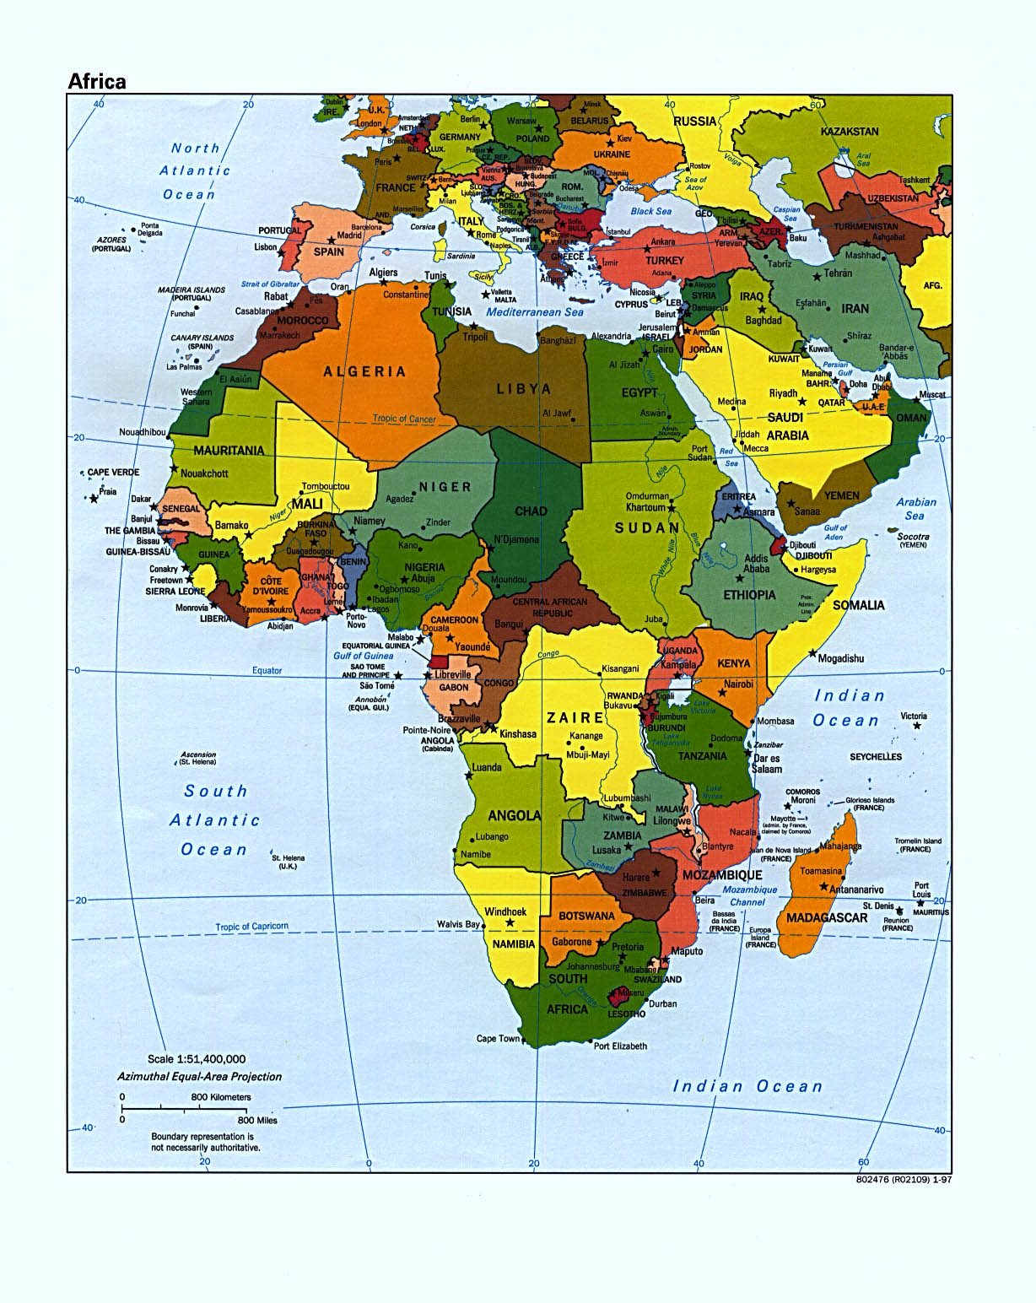
Government
Both Rulers and People Benefit
Favors
Taxes
Power
Loyalty

Slide 3
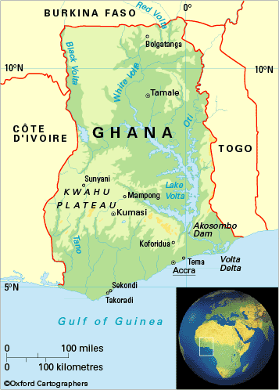
Ghana’s Government
Divided into provinces
Leaders
District Chiefs
Chiefs Clan
Kings held tightly to Power.
No Trade
Inherited

Slide 4
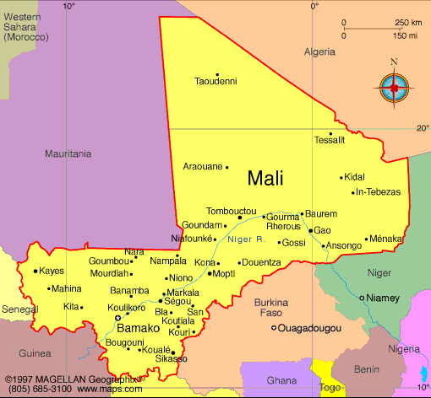
Mali’s Government
More Territory, People, Trade
Five Official
Fishing
Forest
Farming
Money

Slide 5
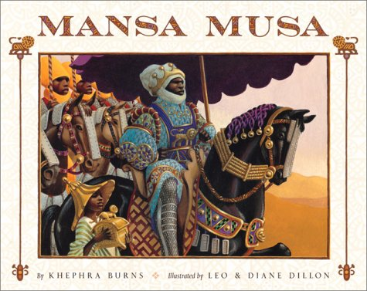
Mansa Musa
Rewarded Citizens
Allowed Different Religion
Build Mosques, Library
Journey to Makkah

Slide 6
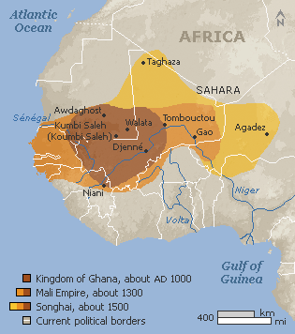
Songhai’s Government
Divided into Provinces but did not finished.
Sunni Ali
Practiced Traditional Religion
Declared himself Muslim
Muhammad Tuze
Loyal Muslim
Schools

Slide 7
Life in Medieval Africa

Slide 8
Bantu
Traveled Slowly and Different Routes
AD 400 Settled Down in Africa
Matrilineal
Valued Children

Slide 9
Education
Children Learned History and skills
Griots- Lesson

Slide 10
Roles
Women
Men
Acted as wives and mother
Served as soldiers
Rulers
Controlled much of what women did

Slide 11
Women Ruler
Queen Dahia Al-Kahina
Fight against Muslims invasion
Queen Nzinga
40 years battling Portugues slave traders

Slide 12
Slavery
Within Africa
Bantu- raided nearby villages for captives
Used for laborers
Slaved Criminals or enemies
Muslim
Enslavement of Muslim forbidden
Enslave non-Muslims

Slide 13
Slavery (cont)
European Slavery
1441 First 12 Africans captives taken to Portugal
1444 235 Slaves
1500s Portugal was World’s leading supplier of Sugar

Slide 14
African Culture

Slide 15
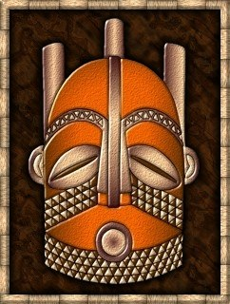
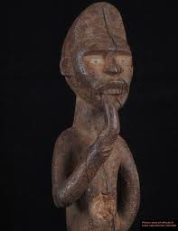
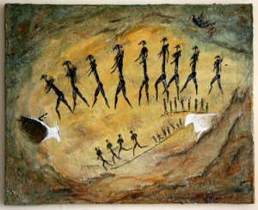
Art
Cave Painting
Mask
Statues
Wood, Ivory, or Bronze

Slide 16
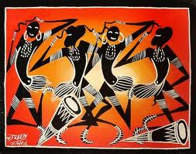
Music and Dance
Religion
Get through an everyday task
Spirits to express themselves

Slide 17
Storytelling
Record Story
Retold Stories
Repeated Stories

Slide 18
The End

