Slide 1
The
Renaissance
Begins
Arely Marquez
Standards:
7.8.1,7.8.2,7.8.3

Slide 2
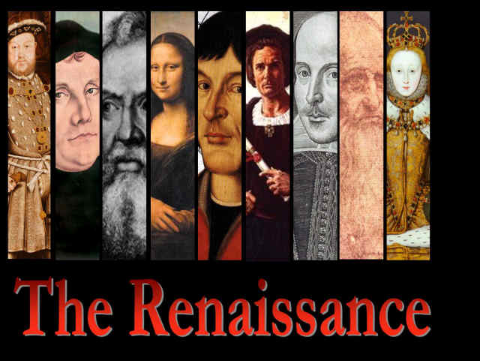
Humanism Triggers Renaissance
Dark Ages
Importance of the Individual
Rebirth

Slide 3
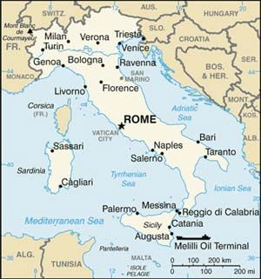
Began in Italy
Center of Roman Empire
Divided into city-states
City-State became Wealthy
Competed with each other
More people, more money

Slide 4
No ruler united Italy?
  Roman Catholic Church
    Church Leaders Afraid
  City-States were Equal in Strength
  City-States became wealthy
    Loan money

Slide 5
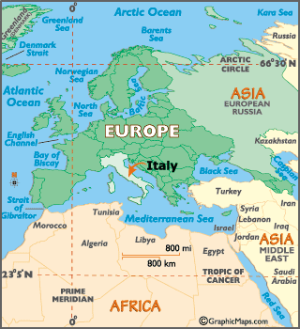
City-States Grew Wealthy
Geography
  Trade
  Silk Road
  Marco Polo

Slide 6
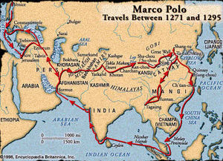

Slide 7
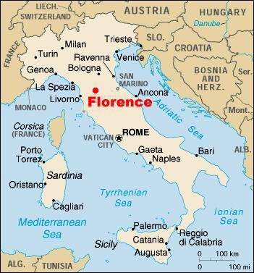
Florence, Italy
Renaissance began
Trade
  Clothes
Banking

Slide 8
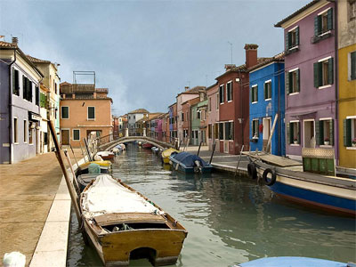
Venice, Italy
Wealthiest City
Shipbuilders

Slide 9
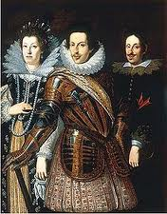
Government/Politics
Republicans
One Powerful Man
Diplomacy

Slide 10
City-States
Advantages
Disadvantages
Own Culture
Led by Leader
Development of Art and Science
Mistreated
Weak- Foreign groups invaded
Family battle each other
Rulers Wealthier
Poor poorer

