Slide 1
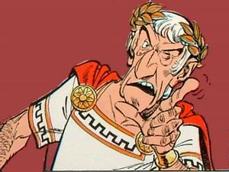
California Standards
By Brittany Wray
6.7.1 Identify the location and describe the rise of the Roman Republic, including the importance of such mythical and historical figures as Aeneas, Romulus and Remus, Cincinnatus, Julius Caesar, and Cicero.
6.7.2 Describe the government of the Roman Republic and its significance (e.g., written constitution and tripartite government, checks and balances, civic duty).

Slide 2
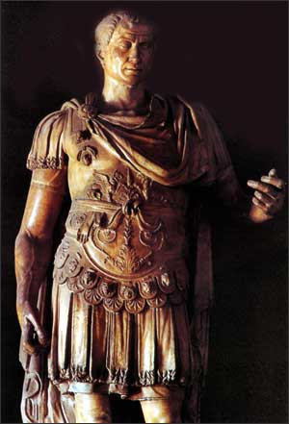
The Roman Republic
450 B.C. – 150 B.C.

Slide 3
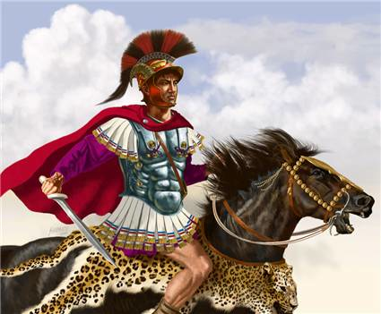
Get Ready to Learn!
Vocabulary
Important People
Patrician
  Wealthy landowners
Plebeian
  Artisans, shopkeepers, and owners of small farms
Consul
  Top government officials
Veto
  Reject a decision
Praetor
  Officials who act as judges
Dictator
  Had complete control, served the people and ruled during emergencies
Cincinnatus
Hannibal
Scipio

Slide 4
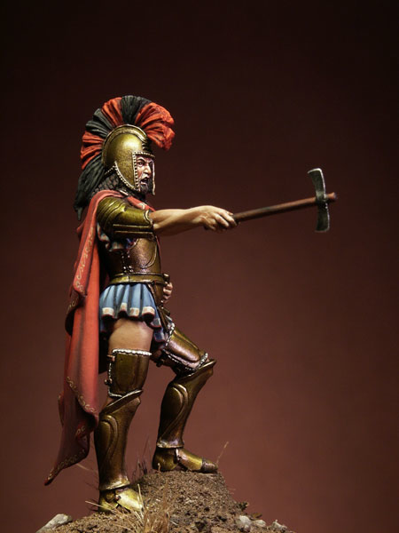
What’s the
Connection?
Suffered under cruel Etruscan Kings
Create their own government
The Roman Republic

Slide 5
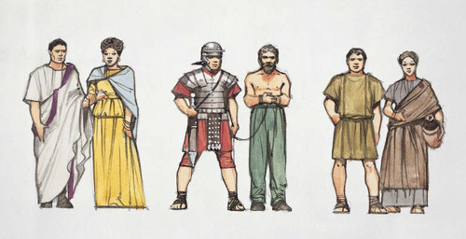
Government
Two Classes:
  Patricians (puh*TRIH*shuhnz)
    Wealthy landowners
    Ruling class
  Plebeians (plih*BEE*uhnz)
    Artisans, shopkeepers, owners of small farms
    Most people

Slide 6
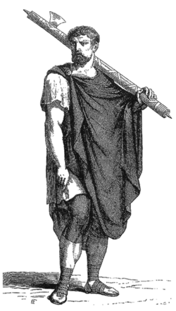
Government
Plebeians VS Patricians
Plebeians
  Little power
  Took ACTION!
  494 B.C.
    Strike
    Left city
  471 B.C.
    Council of Plebs
  455 B.C.
    Allowed to marry
  300’s B.C.
    Allowed to become consuls
  287 B.C.
    Pass laws for all Romans

Slide 7
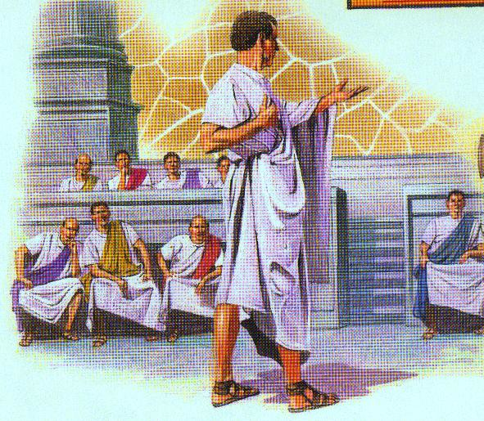
Government
Government Officials
  Consuls (KAHN*suhlz)
    Two (both patricians)
    Served one year
  Veto (VEE*toh)
    Kept each other in line
  Praetors (PREE*tuhrz)
    Judges
Legislative
  Senate
    Power Grew
    Served for life
  Assembly of Centuries
    Elected consuls & praetors
    Passed laws

Slide 8
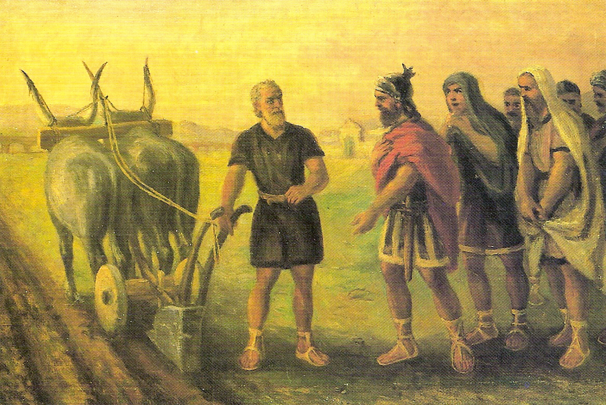
Government
Cincinnatus
Cincinnatus (Sihn*suh*NA*tuhs)
  Best-known early Roman dictator (DIHK*tay*tuhr)
    Temporary basis
    Appointed by senate
    Great danger
  460 B.C.
    Chosen dictator
    Two weeks
    Defeated the enemy
    Widely admired

Slide 9
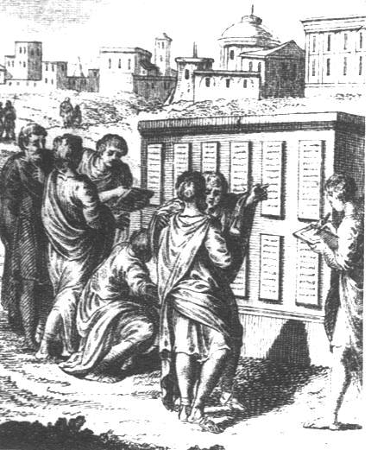
Roman Law
Twelve tables
  451 B.C.
  First code of laws
  Laws be put in writing
  Carved on bronze tablets
  Basis for future Roman laws
Law of Nations
  Principles of justice
  Not only Roman citizens
  Similar to ideas today

Slide 10
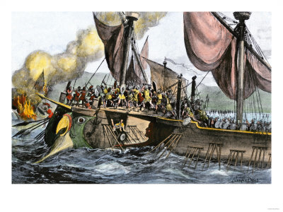
Rome Expands
The First Punic War
  264 B.C.
  Island of Sicily
  Roman invasion
  Roman’s created own navy
  20 YEARS!
  241 B.C.
  Roman victory

Slide 11
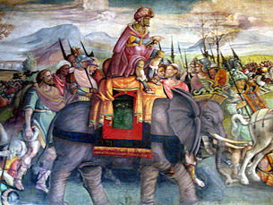
Rome Expands
The Second Punic War
  218 B.C.
  Hannibal (HA*nuh*buhl)
    Carthage’s greatest general
  Landed in Spain
  Marched east to Italy
  Severe losses
  216 B.C.
  Battle of Cannae
  Carthage victory
  202 B.C.
  Scipio (SIH*pee*OH)
  Led Roman force into Carthage
  Battle of Zama
  Roman victory

Slide 12
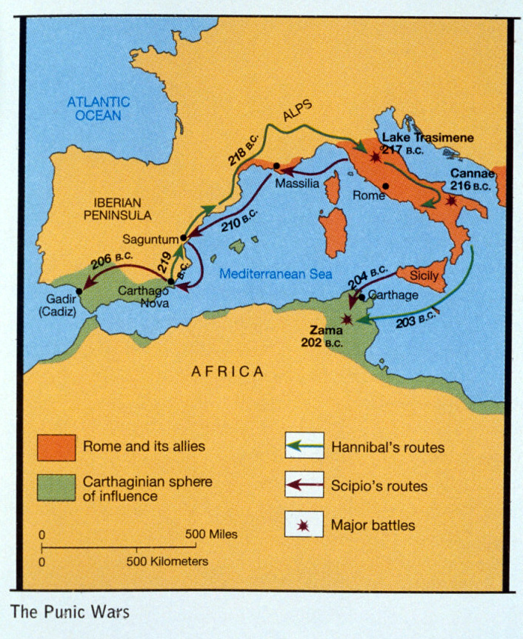

Slide 13
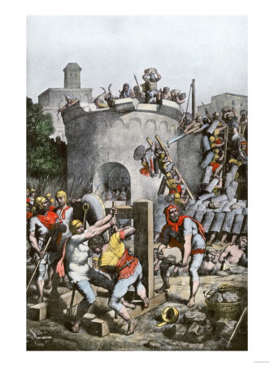
Rome Expands
The Third Punic War
  146 B.C.
  Burned Carthage
  Enslaved
    men, women, and children
  Roman victory

Slide 14
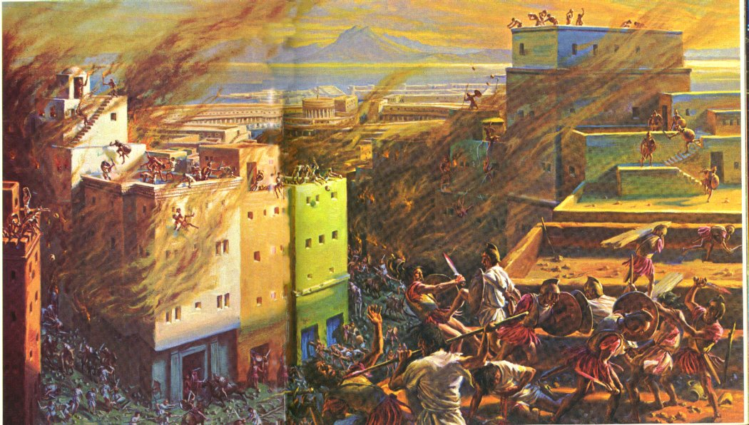

Slide 15
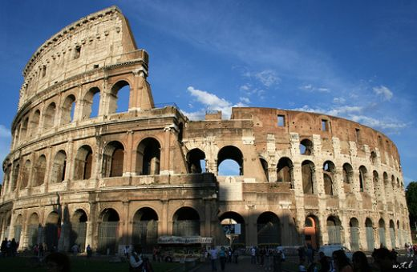
More Conquests
Rome was VERY Successful
  148 B.C.
    Macedonia
  146 B.C.
    Greece
  129 B.C.
    Asia
Mediterranean: mare nostrum “our sea”

Slide 16

Study Central
Online review, main ideas, building vocabulary, notes, web links, and quiz!
http://www.glencoe.com/apps/studycentral/0078688736/core_content.html

