Slide 1
Key Vocabulary
Tyrant: someone who takes power by force and rules with total authority
Oligarchy: a few people hold power
Democracy: all citizens share in running the government; comes from the Greek words for “rule of the people”

Slide 2
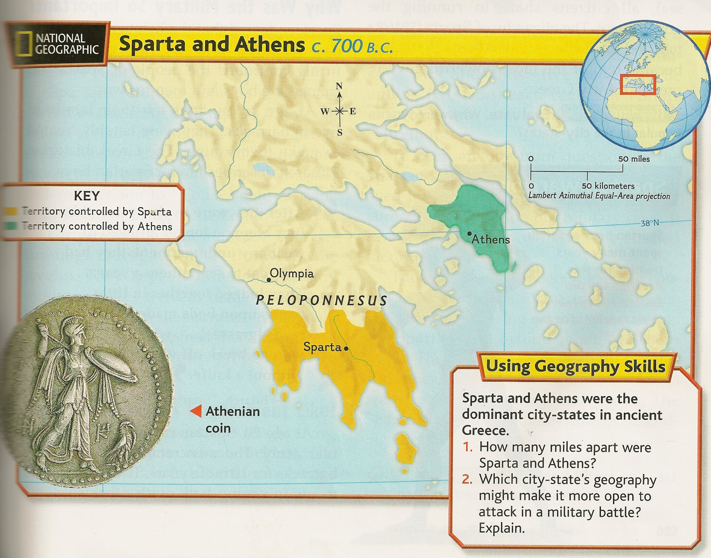
Athens
Northeast of Sparta

Slide 3
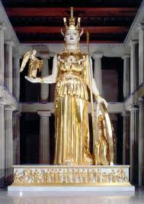
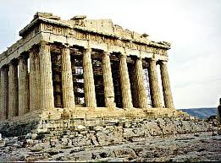
Named for the goddess Athena

Slide 4
From Oligarchy to Democracy
600s B.C- the nobles who owned large farms had seized power from the kings
They possessed the best land and controlled political life by means of a council of nobles
An assembly of all citizens existed, but it had few powers
Athens was actually an Oligarchy, like Sparta

Slide 5


Agriculture and Trade
  The economy was largely based on agriculture and trade:
    grains, vegetables, fruit
    grapes and olives to make wine and olive oil
    - sheep and goats for wool and dairy products

Slide 6
Economic Problems
  Around 600 B.C., the Athenians began to rebel against the nobles.
  Most farmers owed the nobles money
  Many sold themselves into slavery to pay their debts
  Farmers demanded an end to all debts, along with land for the poor

Slide 7
Solon
594 B.C.- the nobles trusted Solon and turned to him for help
Solon made several changes:
  Canceled all the farmers' debts
  Freed those who became slaves
  Allowed all male citizens to participate in the assembly and law courts
  But, refused to give away the wealthy nobles land

Slide 8
Peisistratus
560 B.C.- After Solon, a tyrant named Peisistratus seized power
Peisistratus won the support of the poor by:
  Dividing large estates among landless farmers
  Loaning money to the poor
  Giving jobs to the poor, such as building temples

Slide 9
Cleisthenes
508 B.C. - Cleisthenes came to power
“the father of democracy”
  Created a new council of 500 citizens to help the assembly
  Assembly members had new powers
  - they could debate matters openly
- hear court cases
- appoint army generals

Slide 10
Democracy
Athenians chose the members of the council each year in a lottery.
They believed this system was fairer than an election, which might favor the rich

Slide 11
How did Cleisthenes build a democracy?
He made the assembly the center of the government
He gave citizens more power
He created a citizen council to help the assembly

Slide 12
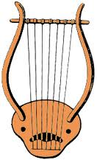
What was life in Athens like?
For Boys-
Athenian Schools taught:
  Reading
  Writing
  Arithmetic
  Sports
  Singing
  Lyre
Boys finished school at age 18 and became citizens.

Slide 13
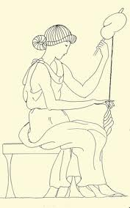
What was life in Athens like?
For Girls-
At home:
  Spinning
  Weaving
  Household duties
Some wealthy families paid for their daughters to
learn to read, write, and play the lyre.

Slide 14
What was life in Athens like?
For Men-
Had two years of military training that began at age 18
Worked in the morning
Exercised or were involved in political meetings later in the day
Enjoyed physical activities such as wrestling, hunting, and riding

Slide 15
What was life in Athens like?
For Women-
Very limited personal freedom
Had no political rights; could not own property
Main task was to run the house and bear children

Slide 16
Democracy
Athenians were more interested in building a democracy than building a military force.
They prepared Athenians for both peace and war
They believed this kind of life created well rounded citizens with good minds and bodies.

