Slide 1
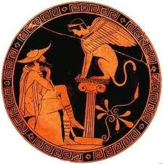
Group 4
Emerald Agpaod Yina Li
Alethia Ruiz
Melissa Tarr
Patricia Vigil

Slide 2
Unit 2: The Ancient World
Ancient Greece
  The Greeks developed democratic government
Early India
  The people of India invented the concept of zero
Early China
  The ancient Chinese created paper

Slide 3
Ch 4: The Ancient Greeks
Day 1
Section1: The Early Greeks
Section 2: Sparta and Athens
Day 2
Section 3: Persia Attacks the Greeks
Section 4: The Age of Pericles

Slide 4
California Standards for History and Social Science
Day 1
6.4 Students analyze the geographic, political, economic, religious, and social structures of the early civilizations of Ancient Greece.
1. Discuss the connections between geography and the development of city-states in the region of the Aegean Sea, including patterns of trade and commerce among Greek city-states and within the wider Mediterranean region.
3. State the key differences between Athenian, or direct, democracy and representative democracy.
6. Compare and contrast life in Athens and Sparta, with emphasis on their roles in the Persian and Peloponnesian Wars.

Slide 5
Day 2
2. Trace the transition from tyranny and oligarchy to early democratic forms of government and back to dictatorship in ancient Greece, including the significance of the invention of the idea of citizenship (e.g. from Pericles’ Funeral Oration).
5. Outline the founding, expansion, and political organization of the Persian Empire.
6. Compare and contrast life in Athens and Sparta, with emphasis on their roles in the Persian and Peloponnesian Wars.

Slide 6
Vocabulary: Section 1
Crete (KREET)
Minoan (muh-NOH-uhn)
Knossos (NAH-suhs)
Mycenae (my-SEE-nee)
Peloponnesus (PEH-luh-puh-NEE-suhs)
Hoplites (HAHP-lyts)
Peninsula
Colony
Polis
Acropolis
Agora

Slide 7
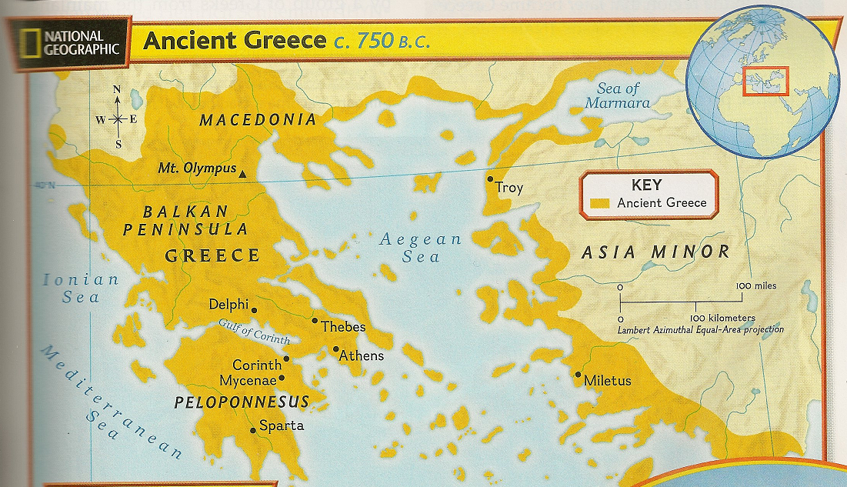
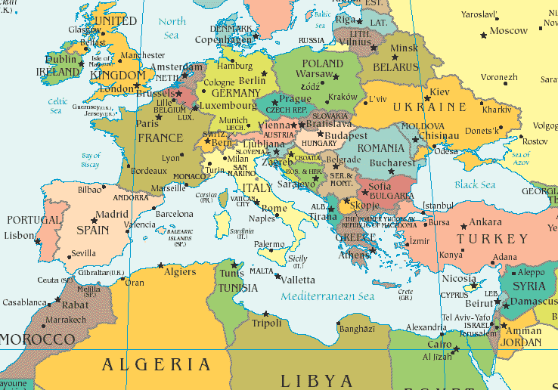
Where is Greece?
Mainland Greece
Peninsula – a body of land with water on three sides
Notes:
Map

Slide 8
Geography Influences
Most made a living from the sea
  Fishers
  Sailors
  Traders
Others settle in farming communities
  Mountains and rocky soils not ideal for growing crops
  Mild climate
    Grow wheat, barley, olives, and grapes
    Raised sheep and goats

Slide 9
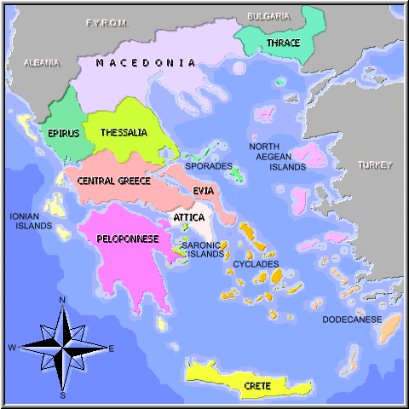
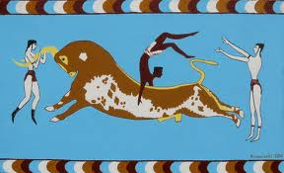
Minoans
From the island of Crete (KREET)
  Southeast from the mainland
In 1900 C.E.
  Arthur Evans, an English archaeologist
  Uncover the ruin of Palace of Knossos, center of Minoan civilization
Not Greek
  The region later became Greece

Slide 10
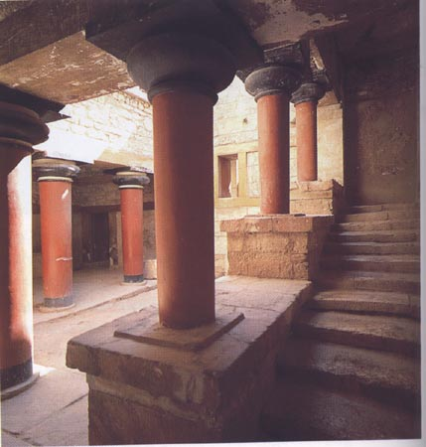
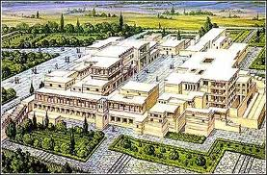
The Palace of Knossos
Twisting passageways
  Private quarters
  Storerooms: oil, wine, and grain
  Workshops: jewelry, vases, and small ivory statues
  Bathrooms!

Slide 11
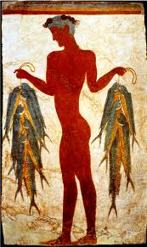
Minoans Wealth
Trades
  Build ships
  Sail
    Egypt
    Syria
By 2000 B.C.E., ships controlled the eastern Mediterranean Sea

Slide 12
Minoans Collapsed
About 1450 B.C.E. Minoan civilization suddenly collapsed
  Undersea earthquakes
  The cities were destroyed invaders
    Greeks from mainland, called the Mycenaeans
    (MY-suh-NEE-uhns)

Slide 13
Questions about the Minoans?

Slide 14
The Mycenaeans
In the late 1800’s C.E.
  German named Henrich Schliemann discovered a walled palace in Mycenae (my-SEE-nee)
  He named the people of this civilization the Mycenaeans
From central Asia
Invaded Greek mainland around 1900 B.C.E.

Slide 15
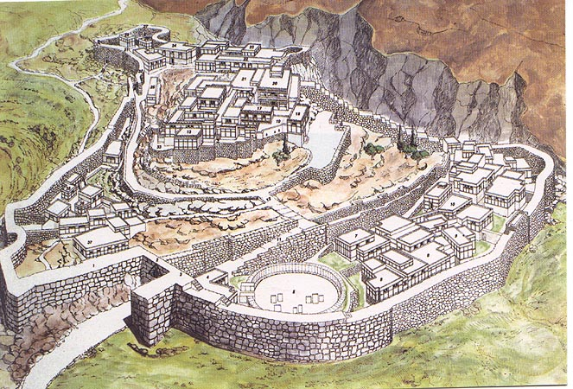
Mycenaean Kingdoms
Palace on a hill
  King or ruler
  Surrounded by stone walls
Large farms
  Belongs to the nobles
Slaves and farmers live on the estates of the nobles

Slide 16
Mycenaean Kingdoms cont.
Busy Kingdom
  Artisan
    Tanned leather
    Sewed clothes
    Made jars for wine and olive oil
  Workers
    Bronze swords
    Ox-hide shields

Slide 17
Mycenaean Government
Officials kept track of the wealth of every person
Collected wheat, livestock, and honey as taxes and stored them in the palace

Slide 18
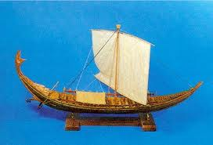
Trade
Minoan traders visit from Crete
Mycenaeans learned/adapted a lot of the Minoan culture
  Work with bronze
  Built ships
  Use sun and stars as navigation at sea
  Worshiping Earth Mother, Chief Goddess
Around 1400 B.C.E. the Mycenaeans replaced the Minoans

Slide 19
The Dark Age
By 1200 B.C.E.
  Earthquakes and fighting among kingdoms
By 1100 B.C.E.
  Mycenaeans civilization collapsed
Between 1100 B.C.E. and 750 B.C.E.
  Slowed oversea trade
  Proverty
  Not enough food
  Stopped teaching

Slide 20
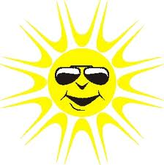
The Bright Side
Population shift
  Thousands of Greek left the mainland
  Settled on islands in the Aegean Sea
  Western shores of Asia Minor (present day Turkey)
Expanded Greek Culture

Slide 21
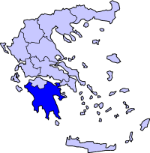
Dorians
Lived in Greece’s northern mountains
Move to south
  Settled in the Peloponnesus (PEH-luh-puh-NEE-suhs)
  Iron weapons
Began to farm again
  Surplus food
Increased trade

Slide 22
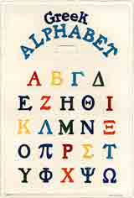
The Greek Alphabet
Trade = new way of writing
Got the idea from Phoenicians, trading partner
Greek Alphabet: 24 letters
Writing down tales

Slide 23
Questions about the Mycenaeans and the Dark Age?

Slide 24
Greece Recovered
Population rose quickly
By 700 B.C.E.
  Not enough food
Start colonies – a settlement in a new territory that keeps close ties to its homeland.
Between 750 and 550 B.C.E.
  Italy
  France
  Spain
  North Africa
  Western Asia

Slide 25
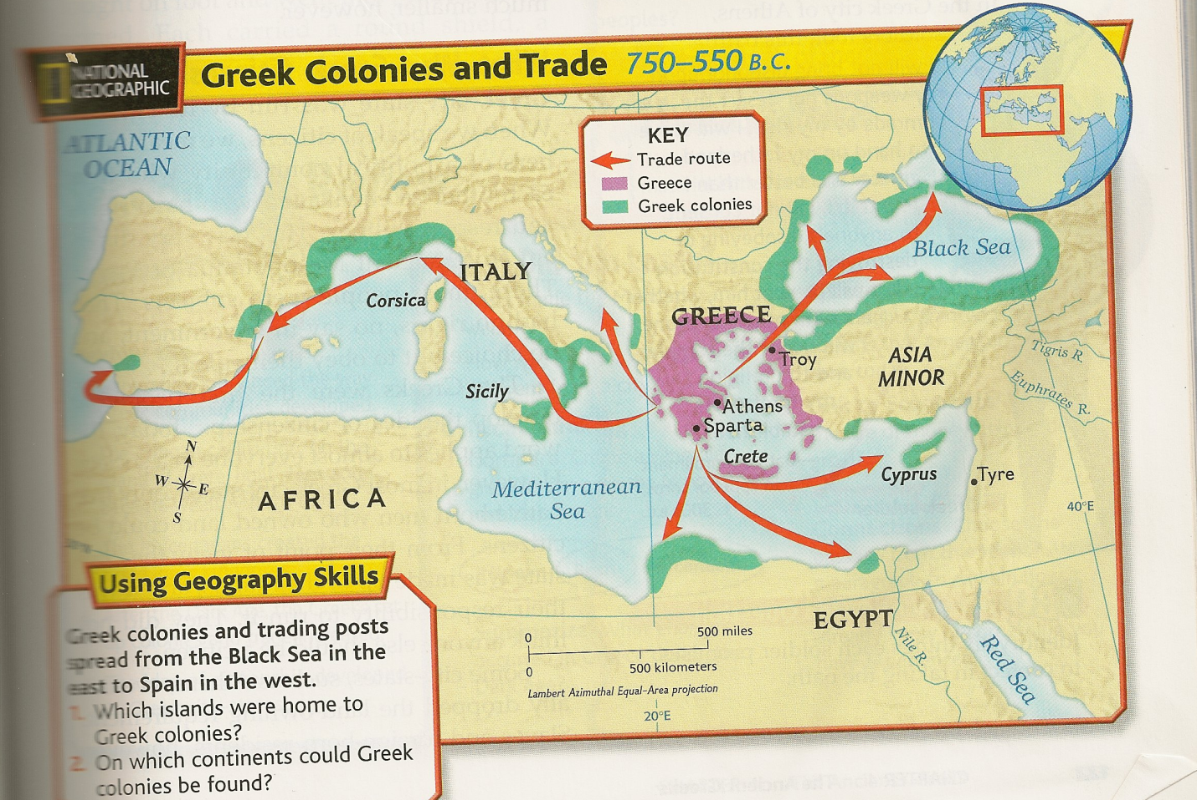
Greek Colonies and Trade

Slide 26
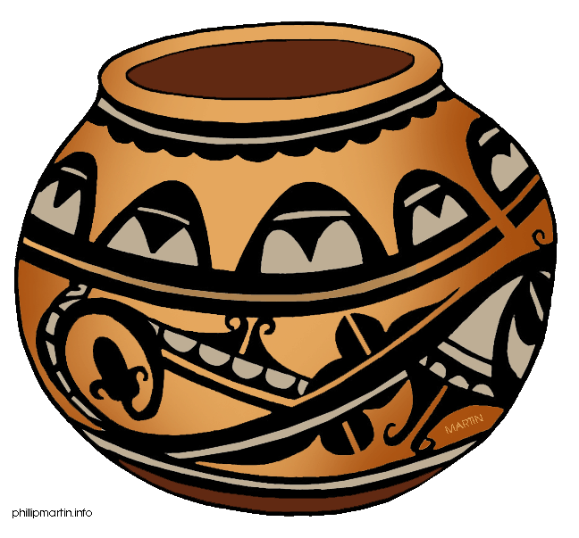


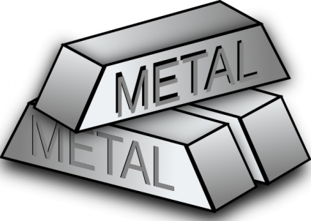

Trade
Grains
Metals
Fish
Timber
Enslaved people
Pottery
Wine
Olive oil

Slide 27
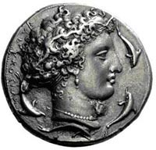
$ $ $
During 600s B.C.E.
  Minting coins
Exchanging goods for money
Trade → Industry
  Specializing products
    i.e. Clay = Pottery

Slide 28
The Polis (PAH-luhs)
Polis (PAH-luhs) is from the word “politics”
City-state
  Made up of a town or city and surrounding countryside
    varied in size
  A tiny independent country

Slide 29
The Polis Gathering
Acropolis (uh-KRAH-puh-luhs)
  Main gathering place
  Fortified area
  Top of the hill
  Safe refuge
  Religious center
Agora (A-guh-ruh)
  An open area below the acropolis
  Two functions
    Market
    Place to meet and debate issues

Slide 30
Greek Citizenship
First to develop the idea of citizenship
City-state run by its citizens
  Citizens means…
    Member of a political community
    Only free native-born men who owned land
Women and children might qualified for citizenship
Slave and foreign-born residents were excluded

Slide 31
Rights of Citizens
Choose their officials and pass laws
Right to vote
Hold office
Own property
Defend themselves in court
In return
  Their duty to serve in government
  Fight for their polis as citizen soldiers

Slide 32
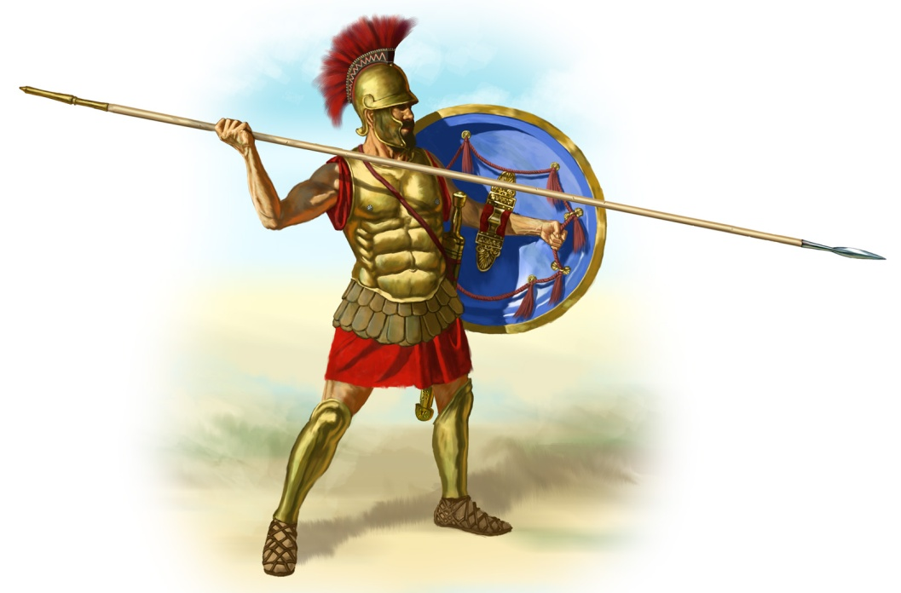
Citizen Soldiers
By 700 B.C.E.
  Armies of ordinary citizens called hoplites
  (HAHP-lyts)
Hoplites
  Fought on foot
  Heavily armed
    round shield
    Short sword
    9-foot spear
  Good soldiers
    pride
Lack of unity between city-states

Slide 33
Questions?
The Polis
Citizenship
Citizen Soldiers

