Slide 1
The Persian Empire

Slide 2
California Standard 6.4.5
Outline the founding, expansion and political organization of the Persian Empire.

Slide 3
How did it begin…
The Assyrian Empire was small Israelite state by Tigris River
In 700 BCE it included Mesopotamia, some of Asia Minor, Egypt and Palestine
They had a large and strong army and were known for committing atrocities against enemies

Slide 4
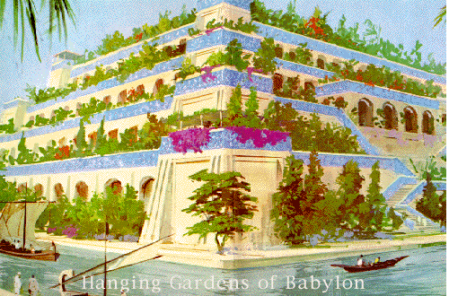
The Assyrians were conquered by the Chaldeans and King Nebuchadnezzar
He rebuilt Babylon
one of the greatest cities of the
ancient world
Notes:
King nebu was the one who created the hangng gardes for his wife

Slide 5
King Nebuchadnezzar of Babylonia fell to the Persians in 539 BCE
Persia gained all of the kings territory
The leader of the Persians was Cyrus

Slide 6
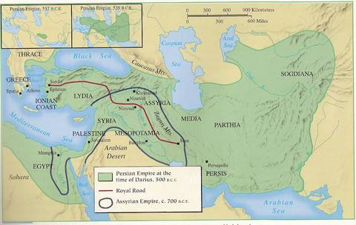
Map of the combined Persia Empire

Slide 7
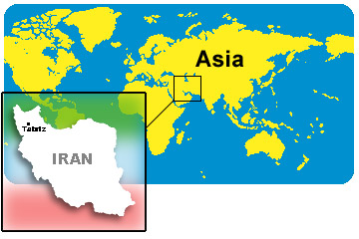
Who were the Persians…
Lived in southwestern Iran
Mostly nomadic and organized into tribes
The Persians were lead by Cyrus

Slide 8
Who was Cyrus the Great?
Cyrus (Sy-ruhs)
559-530 BCE
He captured Babylon in 539 BCE by uniting Persians
Turned Babylonia into a Persian providence and allowed many original officials to keep their positions
Notes:
Cyrus showed restraint and wisdom…. The jews had been brought to babylon but he allowed them to return to Jerusalem w/ sacred objects and allowed them to rebuild temples

Slide 9
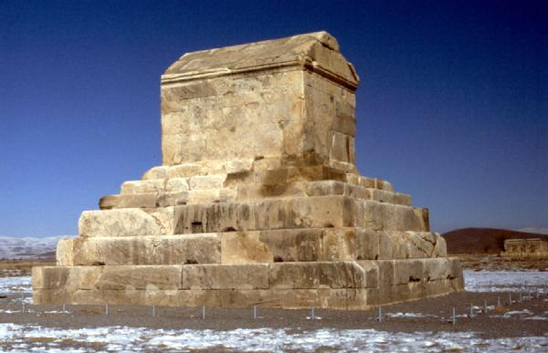
Created a postal system
Allowed Jews to return to Jerusalem
His compassion made others accept him as a ruler
Organized the capital in Pasargades
Tomb of Cyrus the Great in Pasargades
Notes:
The oldest recorded base isolated structure in the world

Slide 10
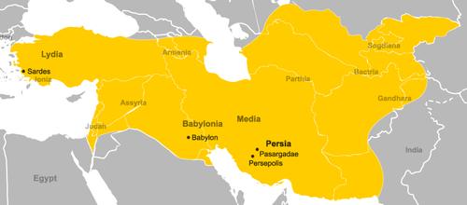
Map of the Persian Empire under Cyrus
“The largest empire the world has ever seen”
Notes:
About the size of the whole united stated

Slide 11
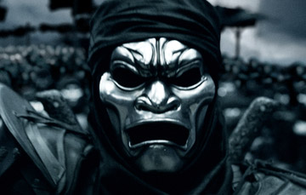
The Immortals
Created by Cyrus included 10,000 highly trained soldiers
Served as the Imperial Guard and in the army
Once one died they were immediately replaced

Slide 12
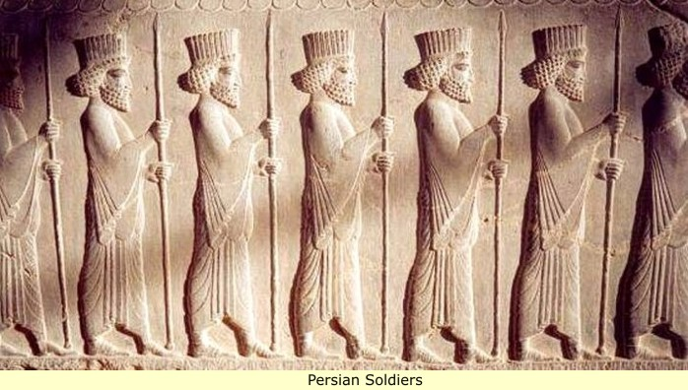
Soldiers in Persia
Soldiers were paid professionals
In Greek city states citizens only took up arms in times of war
Notes:
In Greek city states citizens took up arms in times of war

Slide 13
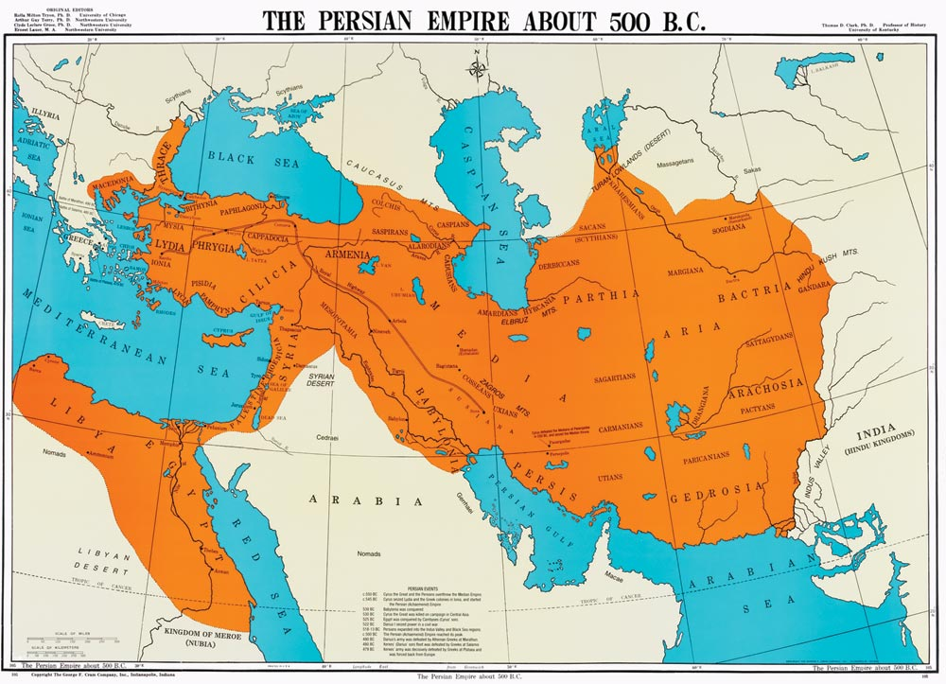
Cambyses
Son of Cyrus
530-522 BCE
Successfully invaded Egypt
Notes:
Only 16 years

Slide 14
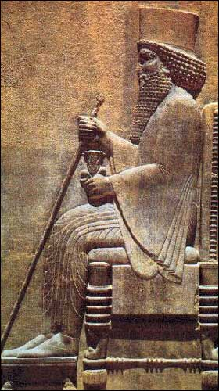
Darius
Darius (duh-RY-uhs)
521-486 BCE
Added new Persian providence in western India
Extended empire to Thrace and reached to the Aegean Sea
Notes:
Picture is right hand a royal staff and left a lotus blossom w 2 buds (symbol of royalty) found in new capital of percepolis

Slide 15
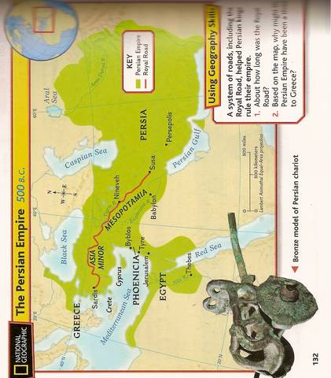
Persian Empire

Slide 16
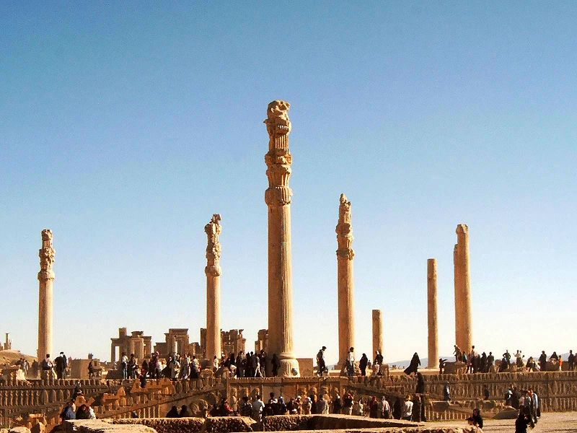
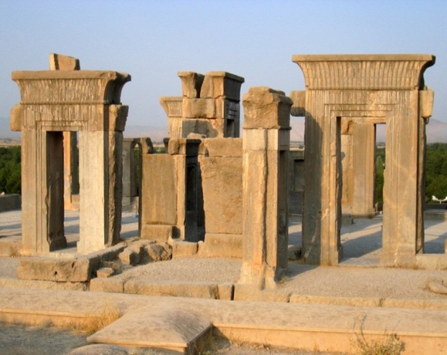
Moves the capital to Persepolis
Divided empire into 20 providences called satrapies (SAY-truh-peez)
The providences were ruled by a satrap (SAY-TRAP) : “protector of the kingdom”
They all answered to the king
Ruins of Persepolis
Notes:
The satrap collected taxes, responsible of security, keepin peace and justice commanded military forces of their satrapies, like miniature kings to darius’ kingdom

Slide 17
The Royal Road
Built by command of King Darius
From Sardis to Susa
Had stations with fresh horses for the kings messengers
Was 1,400-1,500 miles long

Slide 18
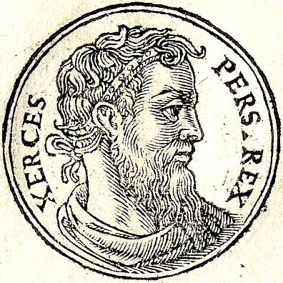
Xerxes
(ZURHK-seez)
486-465 BCE
Son of Darius
Led soldiers in battle of Thermopylae
Captures Athens

Slide 19
Greeks and Persians clash!
Notes:
While Greeks were building strong city states the Persian Empire was forming in the east.

Slide 20
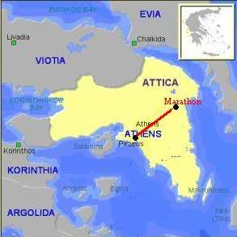
Battle of Marathon
490 BCE
Persians land 20,000 men in Marathon
( a few miles from Athens)
The Athenians had 10,000
•After a long wait the Persian
s board the ships with the
strongest cavalry 1st
Notes:
Persians were tired of waiting

Slide 21
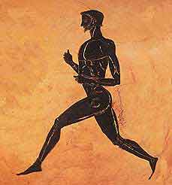
That was when the Athenians attacked
Caught foot solders waiting to get on the ships
Persians were defeated!
Athenians send Pheidippides running home with the news (about 25 miles)
modern marathons are named after this famous run
Notes:
He collapsed from exhaustion his last words were victory then he died

Slide 22
Battle of Themopylae
480BCE
Persians led by Xerxes
Spartans lead by King Leonidas
lasted 3 days then the Persians advanced
A narrow pass through mountains
Greeks lost
Notes:
A spartan warrior heard the Persian arrows would darken the sky and he responded “that is good news, we shall fight in the shade”

Slide 23
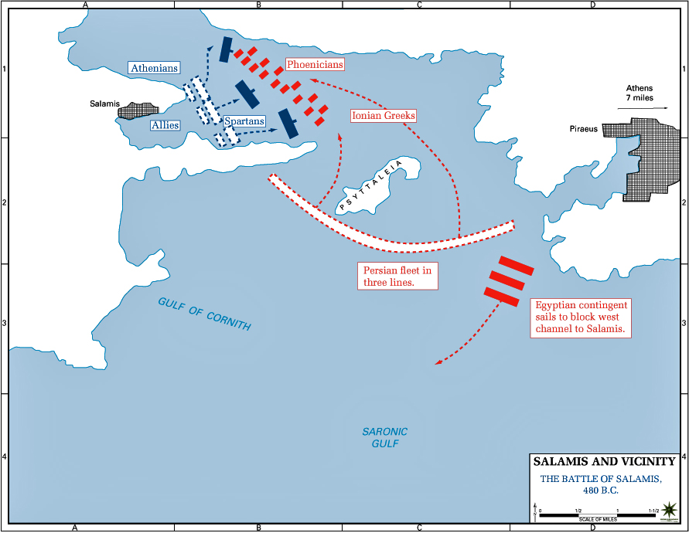
Battle of Salamis
Salamis (SA-luh-mush)
480BCE
Greeks attack Persians in the straight
Had smaller , faster ships
Notes:
Straight is a narrow pass of water between @ pieces of land
Big Persian ships were easy targets

Slide 24
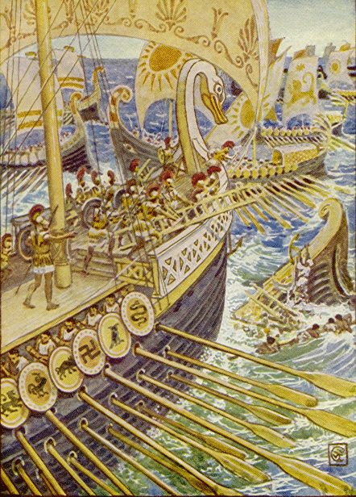
Greeks destroy most of the Persian fleet
But Persians reach Athens and burn the city

Slide 25
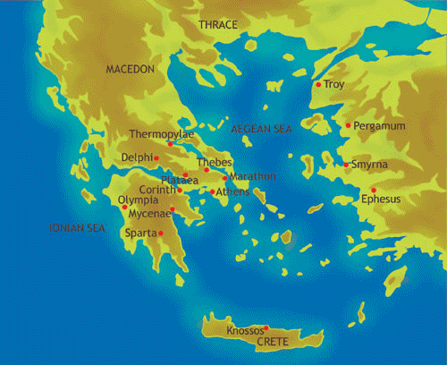
Battle of Plataea
Plataea (pluh-tee-uh)
479BCE
Greeks unite to fight and defeat Persians
Persians retreat and
Greeks are saved from invasion

Slide 26
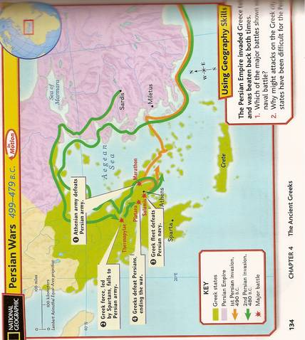
Notes:
Salamis naval battle … Persians in enemy territory far from supply base

Slide 27
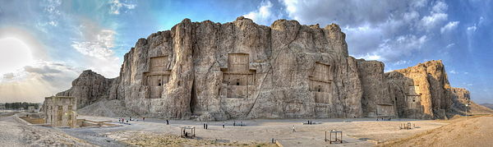
Burial site of Darius and Xerxes

Slide 28
What happened to the Persians?
In the end Persian rulers went corrupt, charged to much taxes & cause rebellions
Internal struggle for power
Alexander the Great invades in 334 BCE and rules over all the Persian land ☹
Notes:
6 of 9 rulers after darius were murdered
Cuz kings had many children , power divided

