Slide 1
Greek figures
Arts & sciences

Slide 2
Who would be the deity for math, science, and video games? Most students know that Athena is the goddess of war and wisdom. But many do not know that Athena was also the goddess of the useful arts. According to mythology, her gifts to mankind included letters and numbers and sequential order. As goddess of the useful arts, Athena taught the skills of weaving, making pottery, and fashioning utensils, each of which requires performing a series of steps that must be carried out in a precise sequence – skills also required in working a math problem, conducting a scientific experiment, or playing a video game.

Slide 3
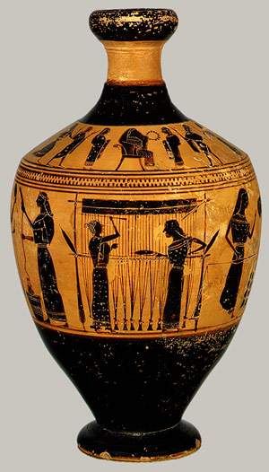
Greek sculptors studied the human body, especially how it looks when it is moving.
Greek artists painted detailed scenes on vases, pots, and other vessels.
Greek architecture still stands today

Slide 4
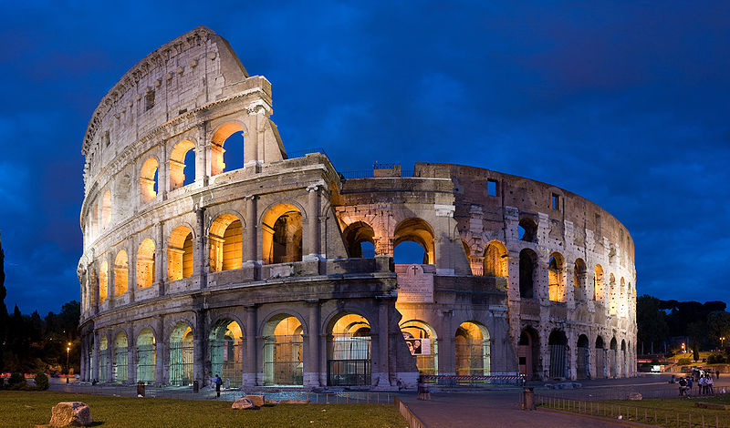
Coliseum in Rome, Italy

Slide 5
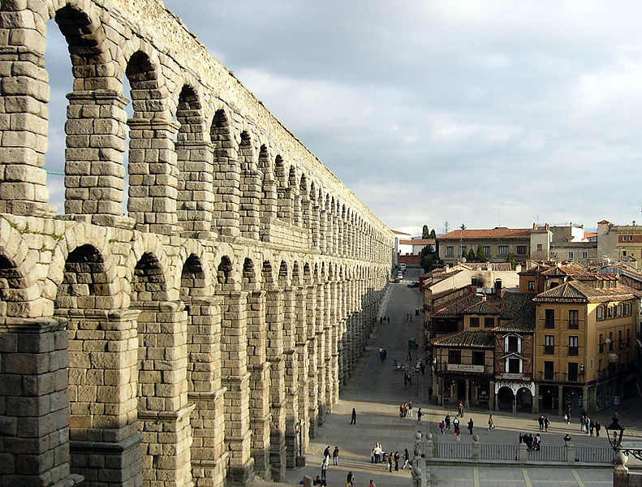
Aqueduct of Segovia, Spain

Slide 6
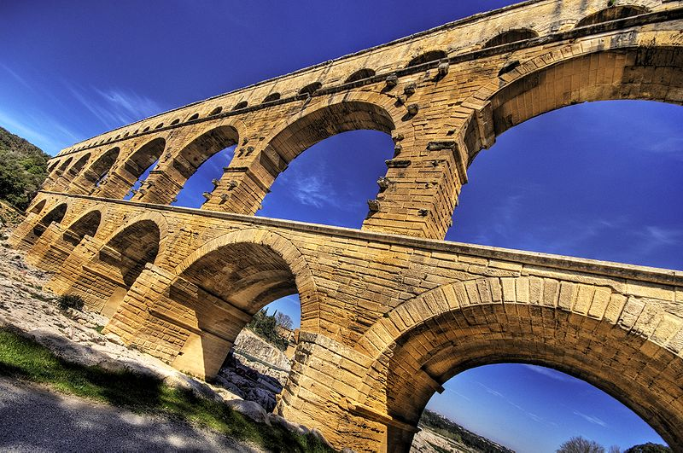
Pont du Gard, southern France

Slide 7
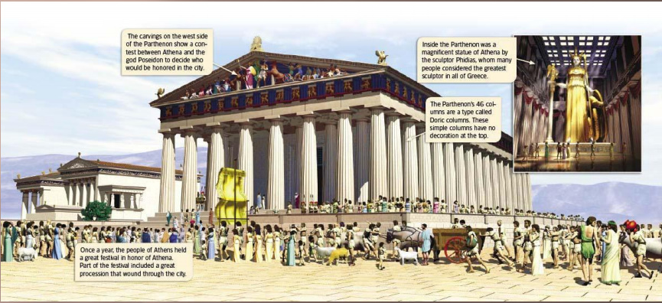
The Parthenon

Slide 8
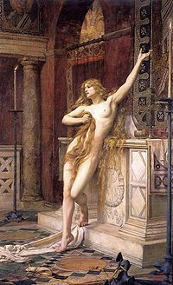
Hypatia
Wrote on mathematics, astronomy and philosophy, including about the motions of the planets, about number theory and about conic sections
Invented the plane astrolabe, the graduated brass hydrometer and the hydroscope
Contributed the charting of celestial bodies and the invention of the hydrometer

Slide 9
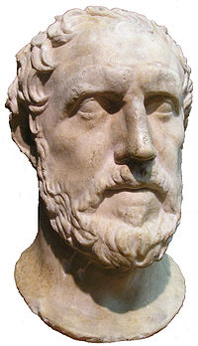
Thucydides
Had no political aim in view: he was purely a historian
Literary reconstructions rather than actual quotations of what was said
Today there is a plethora of documentation for historians to consult.
Confines himself to factual reports of contemporary political and military events, based on unambiguous, first-hand, eye-witness accounts

Slide 10
Thucydides
Dubbed the “Father of Scientific History”
He saw himself as recording an event, not a period, and excluded frivolous or extraneous information
Used epic poetry and tragedy to construct his history, which is also constructed as a narrative
Also the father of the school of political realism
Showed an interest in developing an understanding of human nature to explain behavior in such crises as plague, massacres

Slide 11
Philosophers
The ancient Greeks worshipped gods and goddesses whose actions explained many of the mysteries of the world.
500 BC people began to think about other explanations.
We call these people philosophers.
Philosophers believe in the power of the human mind to think, explain, and understand life.

Slide 12
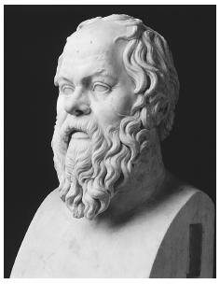
Socrates
Son of a sculptor and followed his father’s footsteps, working as both a stonemason and a sculptor.
He believed that everyone with a competent mind already knows the basic truths of life deep inside of one’s being.
Socrates would educe knowledge through conversations guided by an unfolding series of questions.

Slide 13
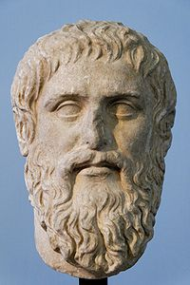
Plato
Wrote about philosophy as the guide to life
He established a school called the Academy to in Athens around 386 BCE
Plato’s ideas about the nature of reality, ethics, and politics have remained central to philosophy and political science to this day

Slide 14
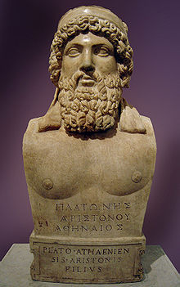
Plato
Influence on science is largely through Aristotle, who accepted with modifications Plato’s view that the world can be explained in terms of form and matter and teleology
Dominated and stifled scientific thinking until the scientific revolution of the 1600s
Influence continued after

Slide 15
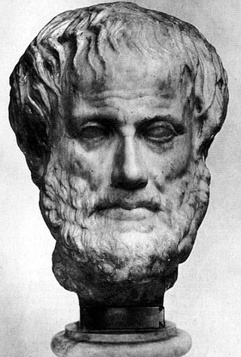
Aristotle
Taught that people should live lives of moderation, or balance. He believed that moderation was based on reason.
He founded a school in Athens at the Lyceum
His lectures followed a pattern that formed the basis of the scientific method.

Slide 16
Aristotle
Physics
  Examined the nature of matter, space, time and motion
  Proved that infinite linear motion and voids could not exist on Earth.
  Laid the groundwork for Galileo, Newton and Einstein.
  Reasoned that infinite velocities could not exist, that time and movement are continuous and inseparable, and that time was even flowing, infinite, and the same everywhere at once
    All true and apart of Einstein’s Theory of Relativity

Slide 17
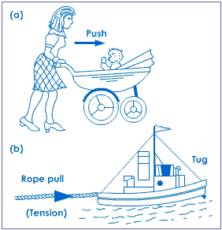
Aristotle
Discovered force is a push or pull
Rest is the natural state of matter and the mover is acted on by that which it moves
He observed that there was both static and kinetic friction that opposed motion by studying shiphaulers
Furthermore, he observed that the power needed to keep the ship moving depended on the force required and the speed

Slide 18
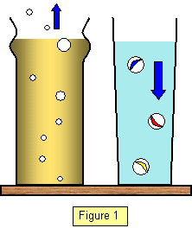
Aristotle
Examined objects falling in fluids and realized friction existed there also
He found that the speed of objects increased as the weight of the object and decreased with the thickness of the fluid
This is now a part of Stoke’s Law for an object falling at its terminal velocity

Slide 19
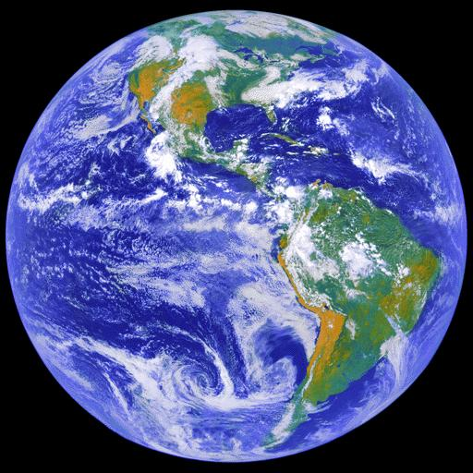
Aristotle
Cosmology
  Proved the world is a sphere
  A sphere is the shape that allows this as it is the shape with the smallest surface for a given volume
  Argument is used today to explain the erosion of mountains, surface tension, the shape of droplets, and why the moons, planets, and stars are spheres

Slide 20
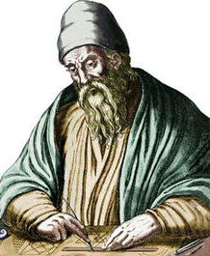
Euclid
Often referred to as the “Father of Geometry”
Euclid is considered one of the world’s greatest mathematicians.
Euclid wrote about the relationship between mathematics and other fields, including astronomy and music
Geometry learned in school—the study of flat shapes and lines—is called Euclidean geometry.

Slide 21
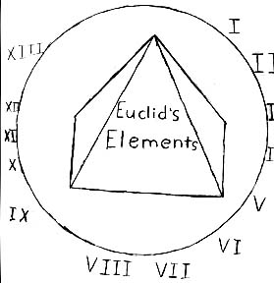
Euclid
Wrote “The Elements”
  Covered plane geometry, arithmetic and number theory, irrational numbers, and solid geometry
  Organized the known geometrical ideas starting with simple definitions, axioms, formed statements called theorems, and set forth methods of logical proofs.
  Pythagorean theorem

Slide 22
Many of the rules we still use today to measure and calculate were first developed by Greek mathematicians like Euclid.
Greek inventors also made many discoveries that are still in use, from practical devices like water screws (which bring water up from a lower level to a higher one) to playful mechanical toys.

Slide 23
The Culture of Ancient Greece
6.4.4
Explain the significance of Greek mythology to the everyday life of people in the region and how Greek literature continues to permeate our literature and language today, drawing from Greek mythology and epics, such as Homer's Iliad and Odyssey, and from Aesop's Fables.

Slide 24
Important aspects of Ancient Greek Culture
Mythology
  Greek Gods/Goddesses
  Myths
Literature
  Fables
  Epics

Slide 25
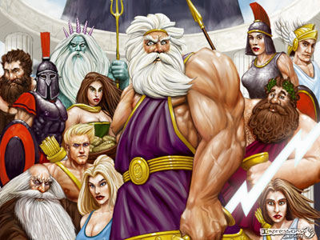
Greek Mythology
The ancient Greeks worshiped many gods
Created along with myths to explain how the world works, there are dozens of them.
The most significant ones are the twelve Olympian Gods.
Their stories are still popular today

Slide 26
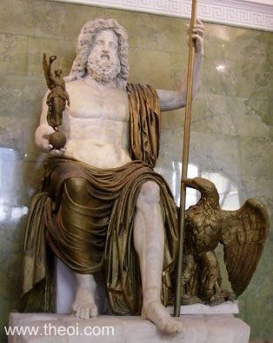

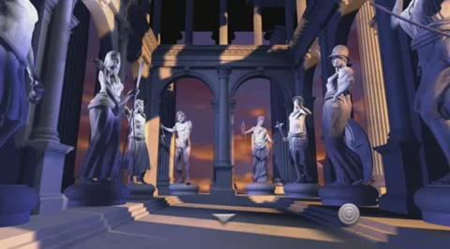
Zeus
The lord of the gods, most powerful and ruler of Mount Olympus and the sky

Slide 27
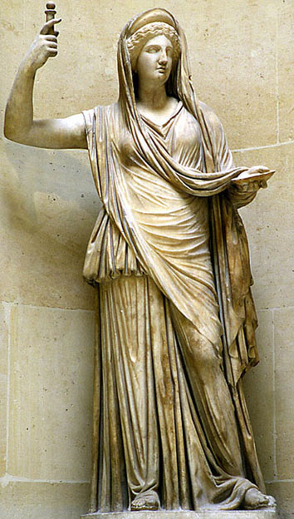
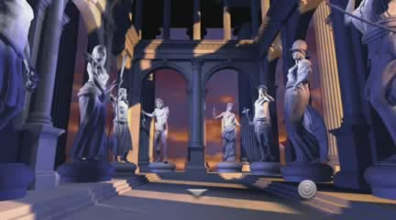
Hera
the wife and one of three sisters of Zeus
Her chief function was as the goddess of women and marriage
Hera was known for her jealous and vengeful nature

Slide 28
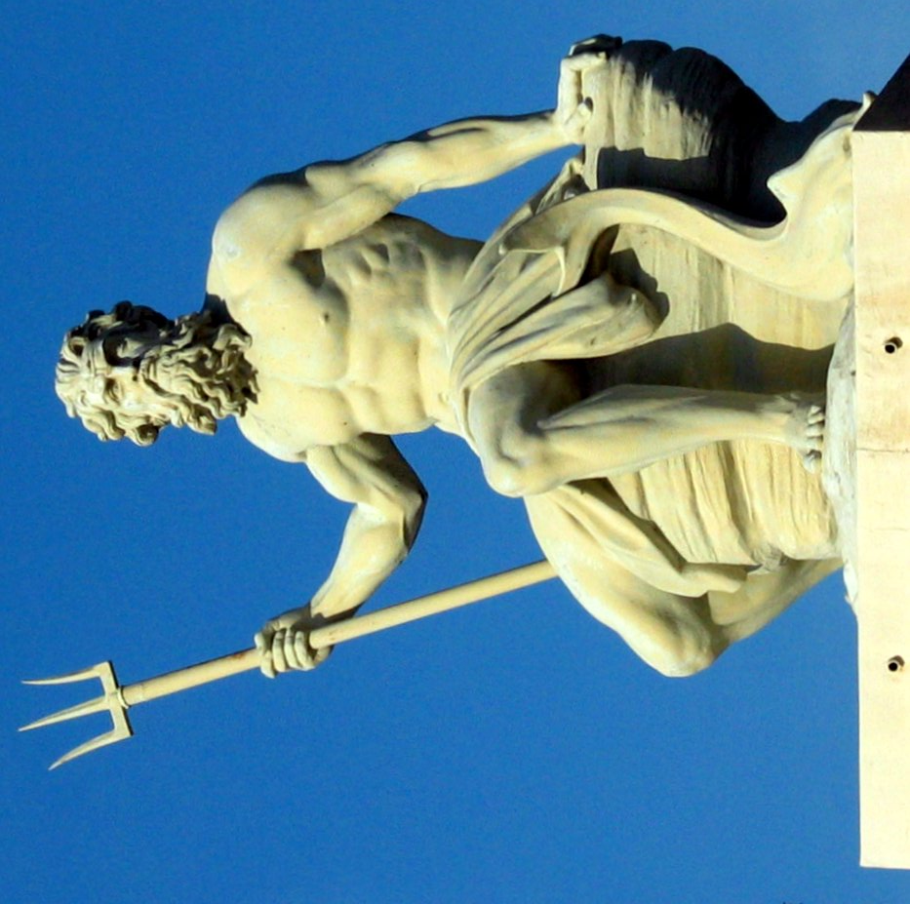
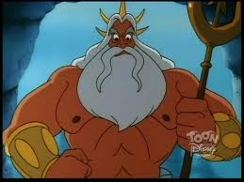
Poseidon
Lord of the seas, earthquakes and horses. Symbols include the horse, bull, dolphin and trident.
He would watch over settlers and shipmen traveling the sea.

Slide 29
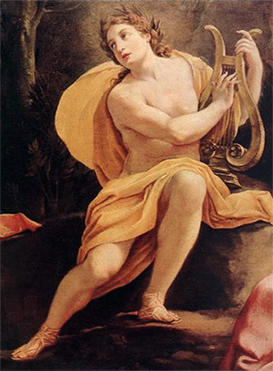
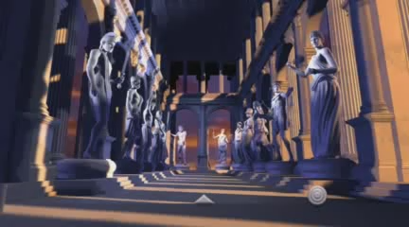
Apollo
Son of Zeus
has been variously recognized as a god of light and the sun, truth and prophecy, medicine, healing, plague, music, poetry, arts, archery and more
Known for bringing the day and then the night with his chariot.

Slide 30
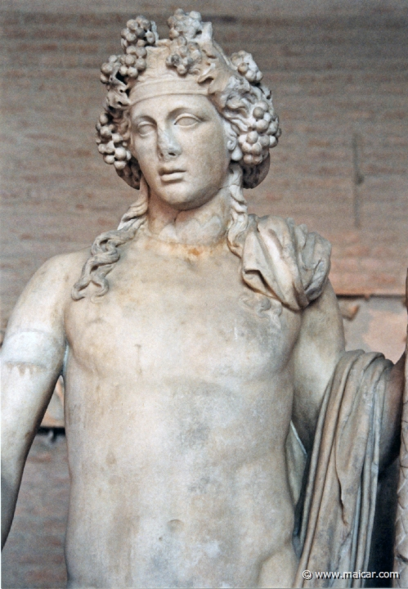
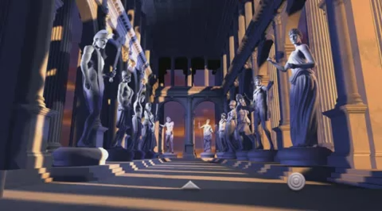
Dionysus
god of the grape harvest, winemaking, wine, and theater
His festivals were the driving force behind the development of Greek theater.

Slide 31
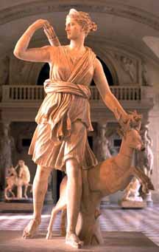

Artemis
goddess of the hunt, wild animals, wilderness, childbirth, virginity and young girls, bringing and relieving disease in women; she often was depicted as a huntress carrying a bow and arrows.

Slide 32
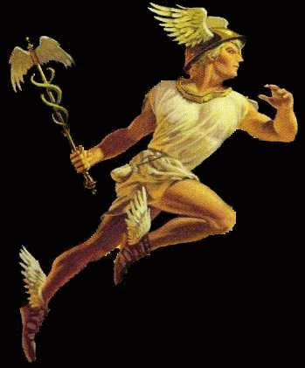
Hermes
The messenger of the gods
Patron god of travelers
Known for his winged shoes

Slide 33
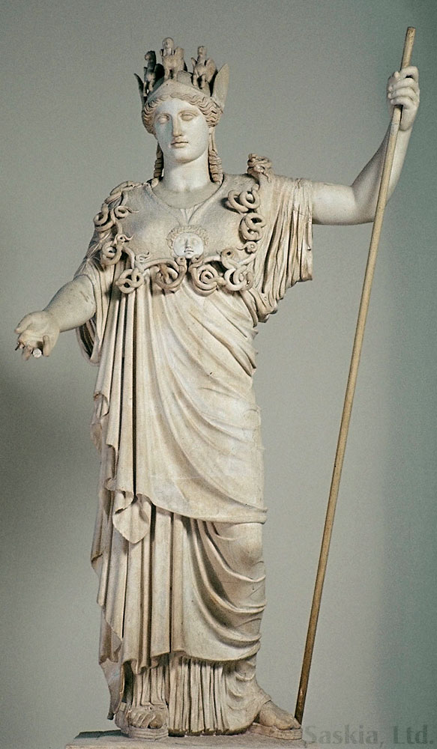

Athena
the goddess of wisdom, courage, inspiration, civilization, warfare, strength, strategy, female arts, crafts, justice and skill
The Athenians built the Parthenon on the Acropolis of her namesake city, Athens

Slide 34
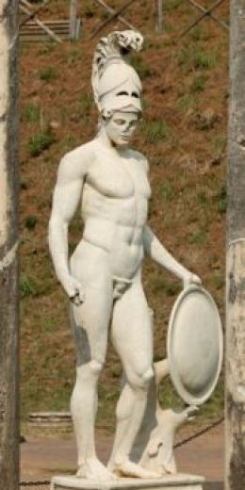

Ares
God of War, Violence, and bloodshed.
Son of Zeus
All the other gods despised him (except Aphrodite)

Slide 35
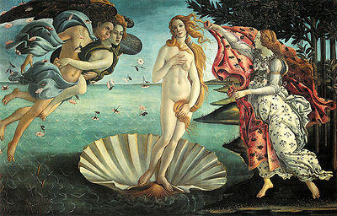

Aphrodite
Goddess of Love, beauty and desire.
Daughter of Zeus
Her name gives us the word Aphrodisiac (wouldn’t tell the kids that)

Slide 36
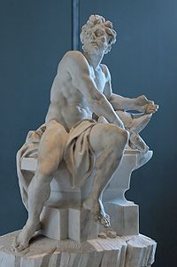
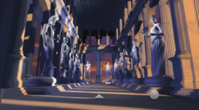
Hephaestus
Master blacksmith and craftsmen of the gods
God of fire and the forge and technology
Unlike other gods he was Lame (couldn’t walk)

Slide 37
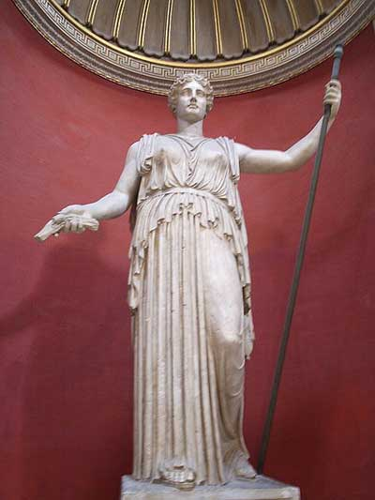

Demeter
Goddess of fertility, agriculture, nature and the seasons.
the season of winter happens because of her lost daughter to Hades

Slide 38
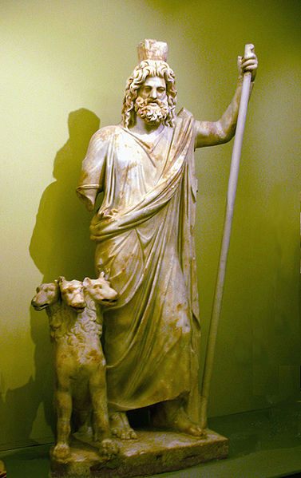
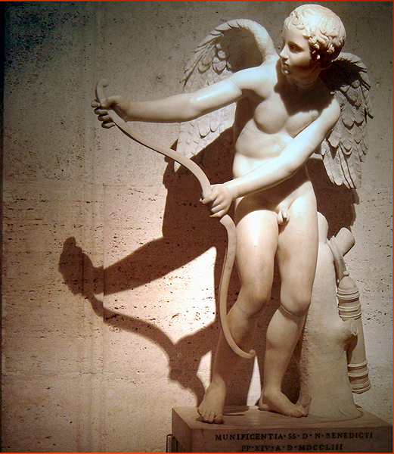
Other gods (non-Olympian)
Hades
  God of the underworld
Nike
  Goddess of Victory
Eros
  God of sexual love and beauty (cupid)
Pan
  God of the wild, Sheppards and flocks

Slide 39
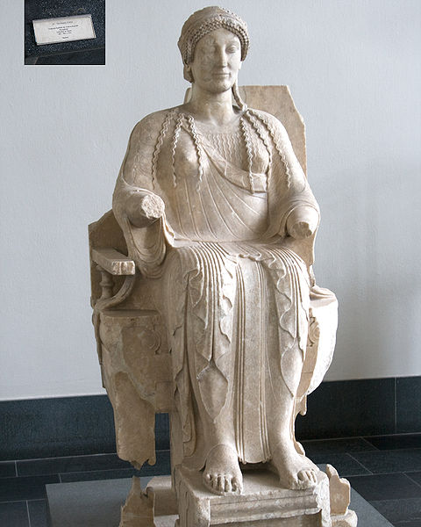
Other gods Cont.
Morpheus
  God of dreams
Persephone
  Wife of Hades, daughter of Demeter, reason for seasons
Phobose
  God of fear
  Where we get the word Phobia

Slide 40
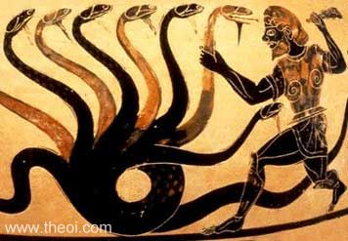
Myths
There are many famous myths
Heroes
  Hercules and his labors
  Achilles and the Trojan war

Slide 41
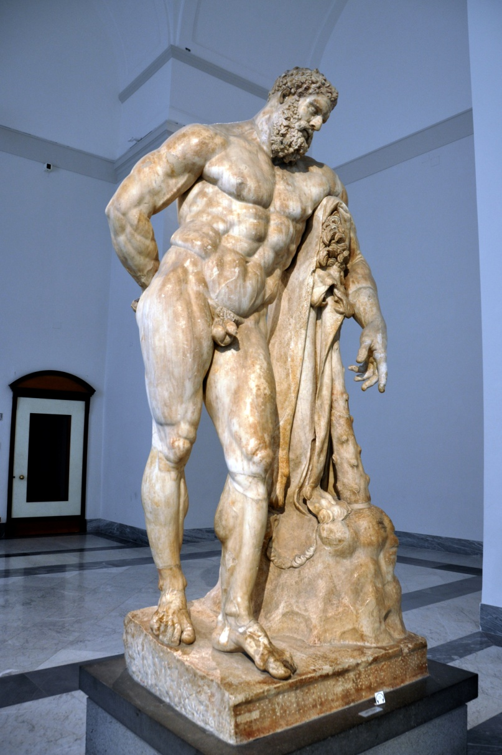
Heracles
He was the greatest of the Greek heroes, a paragon of masculinity
Extraordinary strength, courage, ingenuity
Twelve labors to repent for killing children
Notes:
Herculean strength list 12 labors

Slide 42
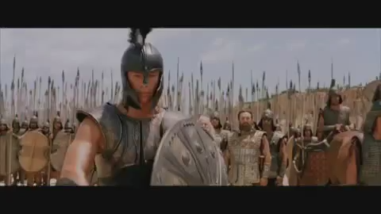
Achilles
Greek hero of the Trojan War, the central character and the greatest warrior of Homer's Iliad.
Still popular today, depicted in movies and television programs.
Achilles heel

Slide 43

Fables
credited to Aesop, a slave and story-teller supposed to have lived in ancient Greece between 620 and 560 BCE
remain a popular choice for moral education of children today.
Notes:
A story where animals talk and display human characteristics. There is usually a moral at the end of the story : such as, Slow and steady wins the race, and "There are many who pretend to despise and belittle that which is beyond their reach." .

Slide 44

The Tortoise and the Hare
One of the most popular fables
Moral of the story is “slow and steady wins the race”
Notes:
Video not quite what the fable, but still relevent today

Slide 45
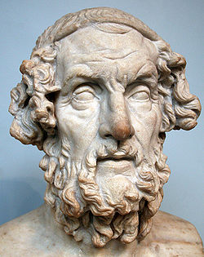
Epics
The two most famous epics were the Iliad and Odyssey, both written by Homer
His works are very influential to western literature.
Notes:
Homer -850 BCE

Slide 46

Odyssey
Story of Odysseus
Travels home after Trojan war
Angers the gods
The trip home to much longer than anticipated
Odyssey- long voyage/trip

Slide 47
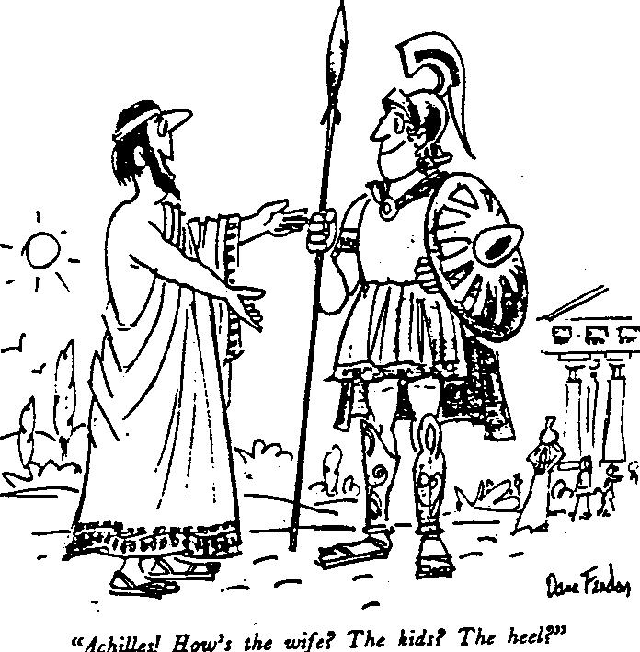
Iliad
tells of the battles and events during the weeks of a quarrel between King Agamemnon and the warrior Achilles.
One of the oldest pieces of western literature
Has influenced many great authors including Shakespeare.

