Slide 1
The First Americans
7.7. 1) Study the locations, land forms, and climates of Mexico, Central America, and South America and their effects on Mayan, Aztec, and Incan economies, trade, and development of urban societies.

Slide 2
Main Ideas
First people in the Americas came from Asia during ice age
Invention of farming led to the civilizations
Early people build complex cultures based on farming and trade

Slide 3
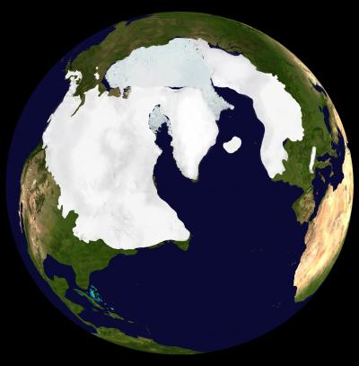
Ice Age
Ice age: a period when temperatures dropped sharply.
Earth’s water was frozen
into huge sheets of ice
= glaciers
America used to be
connected by land to the
rest of the world

Slide 4
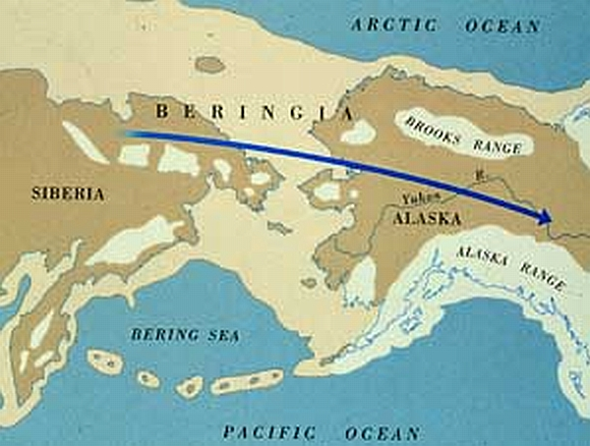
Beringia
Dry land was exposed between Asia and Alaska – land bridge called Beringia
People in Asia
followed animals
they were hunting
across the bridge
into Americas
Arrived 15,000 to
40,000 years ago

Slide 5
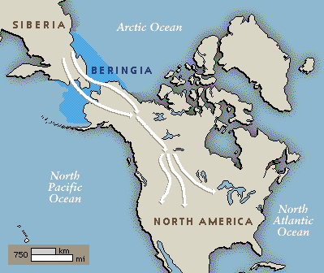
Ice Age ended
10,000 years
ago, glaciers
melted and
water released
back into seas
Land bridge
disappeared
beneath waves

Slide 6
Hunting & Gathering
Constantly on the move
Gathered nuts, fruits and roots
Fished, hunted woolly mammoth, antelope, caribou and bison
  Provided food, clothing & tools

Slide 7
Farming
Began in Mesoamerica 9,000-10,000 years ago
Meso – “middle” lands from Valley of Mexico to Costa Rica in Central America
  Rich soil and mild climate
  Rain in the spring and autumn
  Pumpkins, peppers, squash, gourds and beans
  Corn started as wild grass
Notes:
Took hundreds of years for them to learn how to farm corn.

Slide 8
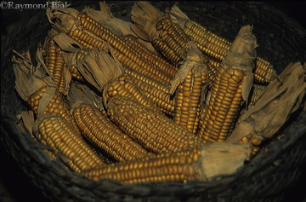
Mesoamerican Civilizations
Corn = stop wandering = more complex societies
1500 BC, first of several ancient civilizations
  Olmec
  Toltec
  Maya
  Moche
  Inca

Slide 9
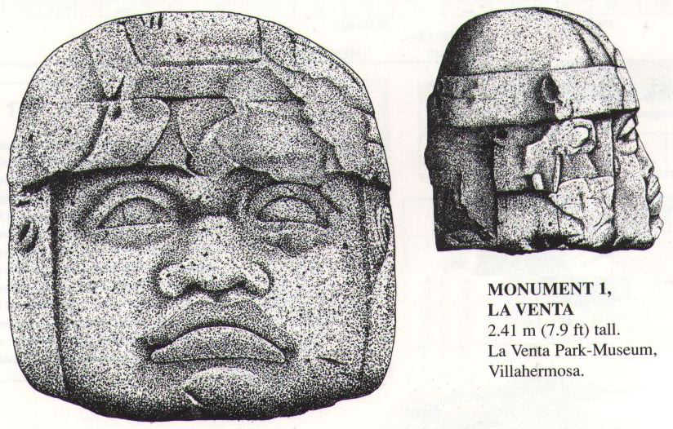
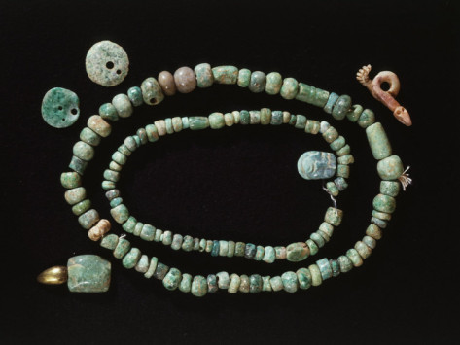
Olmec
Rich farming resources, but lacked raw materials
Traded salt and beans to get jade for jewelry and obsidian to make shape-edged knives
Made polished mirrors and basalt for carving stone heads

Slide 10
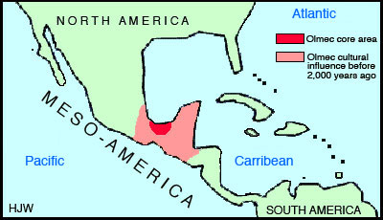
Vera Cruz, Mexico
1200BC and lasted 800 years
Rivers as highways for trade, but inland peoples seized control

Slide 11
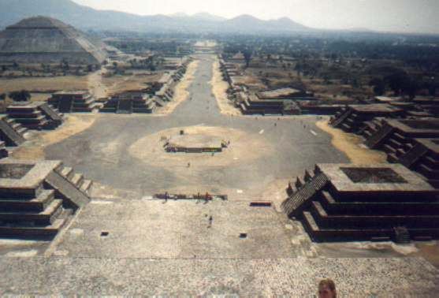
Teotihuacan
“Place of Gods” or “Where men become Gods”

Slide 12
First planned city in Americas
Height around AD400
Population of 120,000-200,000
Power spread to Mayan civilization
AD600, Teotihuacan decline

Slide 13
Maya
Civilization in Yucatan Peninsula
Traded throughout Mesoamerica
Reached into southern Mexico & Central America
Hit peak in AD400 and AD500
AD750, city was destroyed
Mayan civilization lasted 200 years longer
Both came to mysterious ends

Slide 14
Toltec
Toltec took over the deserted city the Maya left behind
Northern Mexico
Warrior nomads built the city of Tula northwest of Mexico City
Conquered lands all the way to the Yucatan Peninsula
Tightly controlled trade

Slide 15
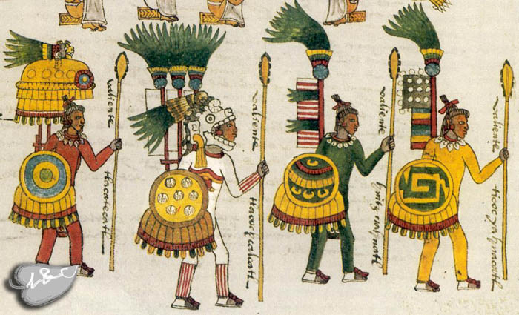
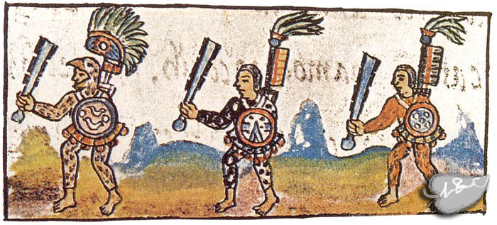
Aztec
AD1200, captured by the north
Aztec invaded them, admired them and copied them.
Aztec warriors took control of trade and built empire
Europeans arrived in AD1500s
Notes:
Aztecs ruled 5 million people

Slide 16
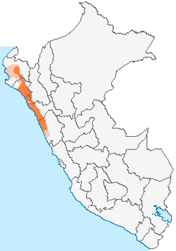
Moche
Dry coastal desert of Peru
Ruled from AD100-AD700
Dug canals to carry water from rivers in Andes mountain ranges
Desert bloomed with crops
Corn, squash, beans, and peanuts
Hunted llamas and guinea pigs and fished in Pacific Ocean

Slide 17
Wealth of food freed Moche to do other things
Engineers designed pyramids
Traders exchanged goods with people as far as the rain forests of Amazon River valley
Included pottery, cloth and jewelry
Notes:
Pottery
Animals

Slide 18
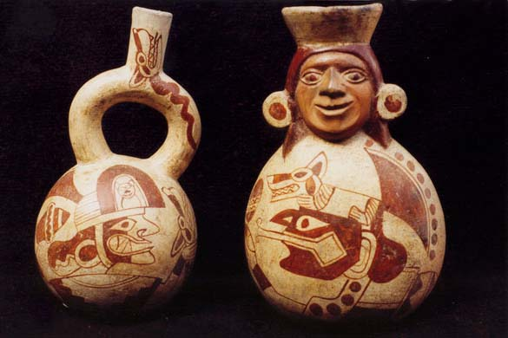
No written language - told through artwork
Never expanded achievements beyond homeland

Slide 19
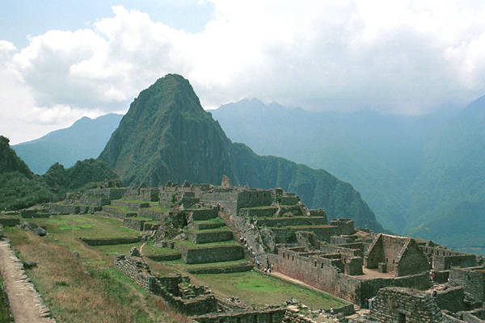
Inca
Work of empire
building belonged
to Inca
Homeland lay in
Andres mountain
ranges in Peru
High river valleys,
10,000 feet above

Slide 20
Built the biggest empire in the ancient Americas
Centered around capitol of Cuzco, founded in AD1100
Native Americans learned to farm through northern Mesoamerican neighbors
As farming developed, so did new civilizations

Slide 21
Civilizations in North America
Hohokam
Anasazi
Mound-builders
Mississippians
Cahokia

Slide 22
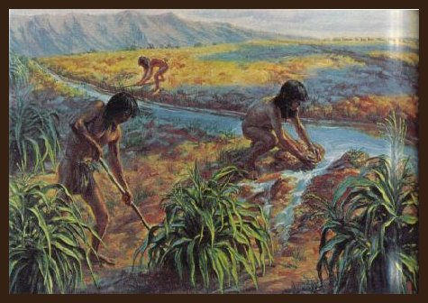
Hohokam
200 years to try farming in scorching deserts
AD300, Hohokam planted gardens on lands between the Salt and Gila Rivers
Dug more than 500miles of canals

Slide 23
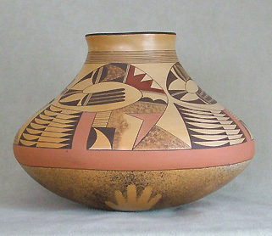
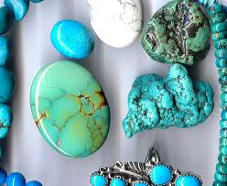
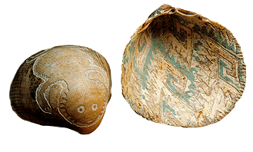
Corn, cotton, beans, and squash
Made pottery, turquoise pendants, and etchings
Thrived for 1000 years
AD1300, mysteriously fled

Slide 24
Anasazi
AD600, moved into the region’s canyons and cliffs
Took up farming
Collected water that ran off cliffs during heavy rains
Controlled trade in turquoise – used as money
Notes:
Did not rely on rivers for irrigation

Slide 25
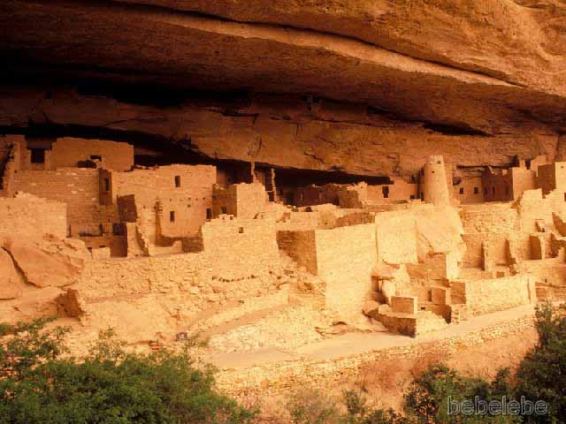
Lived in huge apartment-like houses carved into cliffs
Hundreds of rooms that held thousands of people
Prospered until a
50-year drought
occurred in AD1000
Also drifted away

Slide 26
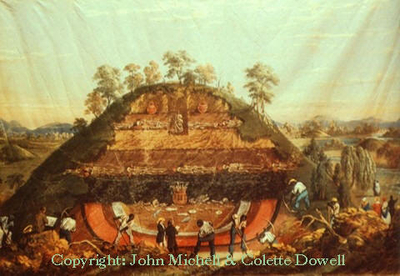
Mound Builders
1000BC and lasted until AD400
Built huge mounds made of earth
Adena and Hopewell formed culture
Settled on lands stretching from Great Lakes to Gulf of Mexico
Notes:
East, across Mississippi River
Some in shape of animals

Slide 27
Lived mostly as hunters and gatherers, also tried farming
Tamed wild plants such as sunflowers, gourds, and barley
Women gathered wild foods while men hunted
Corn was carried there by traders in AD100
Most objects placed in huge burial mounds to honor dead

Slide 28
Mississippians
Hopewell declined and Mississippians emerged
Reached from Ohio, Indian and Illinois, south to Gulf of Mexico
Harvested enough crops between floodplains along river to become full-time farmers
Corn, squash and beans
Farming led to the rise of cities
Notes:
Named for their location in Mississippi River valley
Cahokia, largest city, had 30,000 people
Remains can still be seen in Illinois
Some cities contained more than 10,000

Slide 29
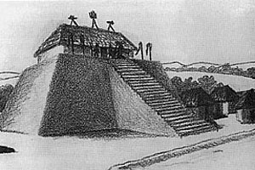
Mississippians built a different kind of mound
Pyramids but with flat tops
Rulers gazed down at dozens of smaller mounds
Flat tops of the mounds
held temples, homes for
the rich, and burial places
AD1300, Mississippian
civilization collapsed
and cities were abandoned

Slide 30
Places to locate
Mesoamerica
Teotihuacan
Cuzco
Cahokia

Slide 31
The Spanish Arrive in America
•Christopher Columbus

Slide 32
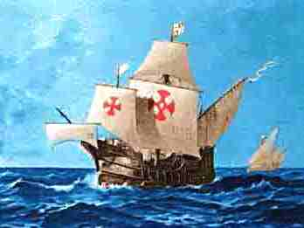
Western Europe wanted a trade route to East Asia
(1400s)
-Portugal sailed around Africa
- Spain asked Columbus

Slide 33
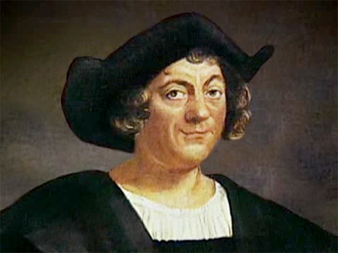
Christopher Columbus:
Spaniard
Italian Sea Captain
his goal was to sail west, find Asia

Slide 34
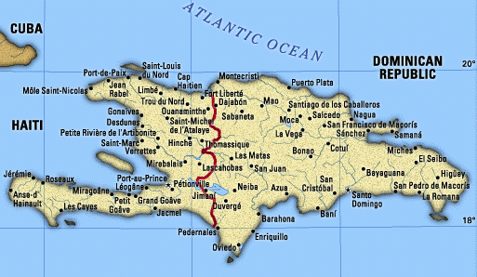
August 1492 Columbus sets sail
-landed on island in Caribbean
(found “Asia”)
Hispaniola

Slide 35
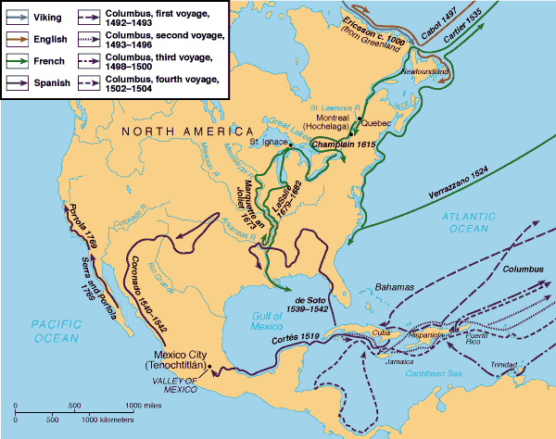

Slide 36
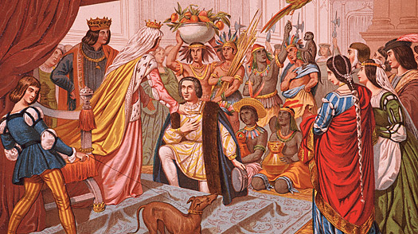
Columbus returned home a hero
Brought: parrots, gold, spices, and Native American captives.

Slide 37
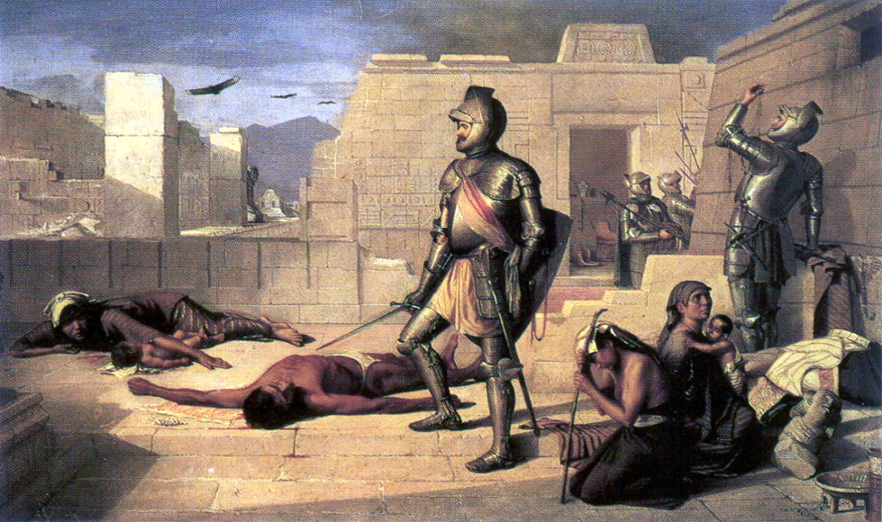
Conquistadors
Conquistadors
- 1493 Columbus returns to Hispaniola with soldiers
enslave the Taino

Slide 38
Life in the Americas
7.7.2 Study the roles of people in each society, including class structures, family life, war-fare, religious beliefs and practices, and slavery.

Slide 39
The Mayan People
Mayan city-states built on a “flat region” called Pete’n by the Mayan.
Located in present day Guatemala
Pete’n had a dense forest that blocked the sun. The forest’s inhabitants included stinging insects, poisonous snakes, monkeys, and parrots.
Mayan city-states fought amongst themselves, between kings, who wanted to have the last say in deciding on leadership and military force for building projects

Slide 40
Mayan Ball Games
Many ball courts throughout the Mayan cities
Teams of 2-3 players would try to drive a round rubber ball through a decorated stone ring with their hips. The stone ring was located 27 feet above ground.
The losing team was sacrificed to the gods in a ceremony after the game.

Slide 41
Mayan Cities
Rulers of the city-states claimed to have descended from the sun.
“God-kings” had huge monuments constructed to honor them.
Mayans believed in human sacrifice to keep the gods happy.
Mayans believed that gods offered rain as a life giving fluid and that in the gods offering their life giving fluid human sacrifices should be made in return

Slide 42
Human Sacrifices
Chac, the Mayan god of rain
If there was a drought, Mayans would offer captives of the ruling party that they had conquered in battle to Chac.
Priests would perform the sacrifices
Other captives were enslaved to work

Slide 43
Mayan Gods
Mayans believed that everything on Earth was controlled by their gods
Religion was a huge part of the Mayan way of life
Huge temples were constructed to honor the gods. A huge pyramid would be constructed with a temple at the top. The temple towered over all Mayan city-states.

Slide 44
Mayan Women
ROYAL Mayan Women married into other royal families within the Mayan city-states.
This helped increase trade, form alliances, and political agreements.
The city-state of Calakmul had at least 2 all-powerful queens.

Slide 45
7.7.4 Describe the artistic and oral traditions and architecture in the three civilizations.
7.7.5 Describe the Meso-American achievements in astronomy and mathematics, including the development of the calendar and the Meso-American knowledge of seasonal changes to the civilizations’ agricultural systems.

Slide 46
Science and Writing
The heavens were studied closely in hopes of revealing what the gods were planning next
Priests believed that the gods showed their plans through movements of the sun, moon, and stars
Priests learned about astronomy by watching the sky
They developed a 365-day calendar to keep track of the celestial movements in hopes of getting more crops
Invented method of counting based on 20
Used a method of hieroglyphics
Symbols represented sounds, words, or ideas and only nobles could read them

Slide 47
Aztec
The Aztec were warlike nomads arrive in the Valley of Mexico in A.D. 1250
Sun god, Quetzalcoatl, the feathered serpent
Quetzalcoatl promises a land to the Aztecs where an eagle will scream, spread its wings, and eats a serpent. They found this to be true at Lake Texcoco.
Aztecs settle in Lake Texcoco in A.D. 1325

Slide 48
Lake Texcoco/Tenochtitlan
The priests were told by the gods to build a great city
They worked day and night to build the city on a swampy island
Kings were chosen by a council of warriors, priests, and nobles
Kings claimed descent from the gods
Kings/emperors were at the top of the population
The remaining four classes consisted of: nobles, commoners, unskilled laborers, and enslaved people
Kings had to prove themselves by leading their troops into battle

Slide 49
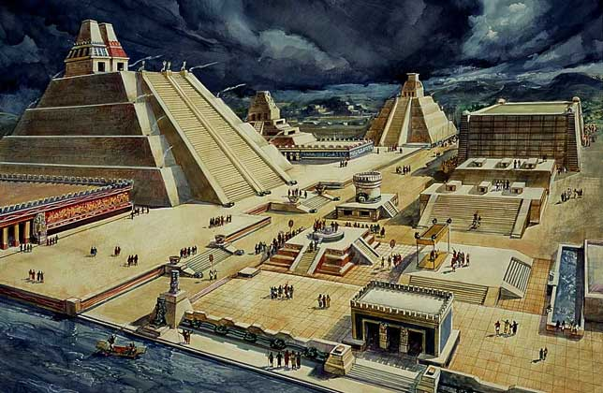
Tenochtitlan

Slide 50
Aztec Life
Aztec homes were built for usefulness
Aztecs had 2 calendars; 1 for religious purposes, 260 days to keep track of rituals and festivals, and the other for keeping track of when to plant and harvest crops. The second calendar was 365 days in length. It was divided into 18 months, 20 days each, and a special 5 day week at the end of the year
Afterlife was believed to be for those that died in battle, captives that were sacrificed, and women that died in childbirth

Slide 51
Aztec Life cont’d.
Boys were taught that they were born to be warriors
Girls stayed home, but if they gave birth – they were honored
Population – 400,000 people at its height
Surrounding city-states, under Aztec control, housed over a million people
Government and military actions were paid for through trade, taxes, and conquests

Slide 52
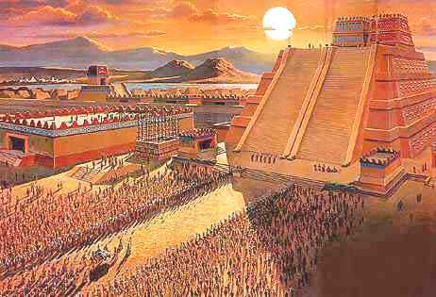
The Great Temple
135 feet high, 100 steps, 1000s were sacrificed to the gods from the top of the temple

Slide 53
Unsuitable Land for Crops
Large population in need of ample food
The region was unsuitable for growing a large amount of crops
Aztecs figured out how to irrigate, fertilize fields, and drain lakes to make room for crops

Slide 54
Inca Empire
Incan capital - Cuzco
Incas blamed earthquakes on the god Pachacamac, Lord of the Earth/highest Incan god
The Incan Leader was known as Pachacuti, Earthshaker
Pachacuti builds the largest ancient empires in the Americas in A.D. 1438 (2,500 miles long)
He set up a strong central government and allowed local rulers to remain in power.

Slide 55
Pachacuti
Unites Incas by having them learn one language, Quechua.
Designed system of roads for travel and trade. They covered 25,000 miles
Incas irrigated and fertilized farmland. Incan engineers developed terraced farming. They also herded llama.

Slide 56
Organized Society
Level I – Rulers and their wives – Coyas
Level II – Head priest and commander of the armies
Level III – Regional army leaders
Level IV – Temple priests, army commanders, and skilled workers (musicians, artisans, and accountants)
Level V – Farmers, herders, and ordinary soldiers
All over age 5 were forced to work

Slide 57
Incan Culture
The Inca only turned to human sacrifices in times of trouble, earthquakes or special occasions
They built large works of stone to please their gods
Machu Picchu was a retreat for Incan kings
Inca used a quipu to make calculations. It was a rope with knotted cords of different lengths and colors. Each knot represented a number or item.
Skilled engineers. They fit stones so closely that not even a knife could fit between the stones and the stones were fit together so that they could slide during earthquakes

Slide 58
North America - INUIT
A.D. 1500 – 2 million people live north of Mesoamerica
Inuit settle in present day Alaska and Canada around 3000 B.C. They lived in igloos, used dogsleds to travel on land, and sealskin kayaks to travel by sea.
They hunted and ate seals, walruses, caribou, polar bears, and whales. They used the blubber from seals and whales for oil for their lamps.

Slide 59
West Coast
Pacific coast Native Americans consisted of: Tlingit, Haida, and Chinook.
Used canoes to hunt otters, seals, whales, and salmon.
Scientists estimate that California was home to around 500 different cultures of Native Americans
In the Northern Coast, the Chumash hunted fish.
The Southern Desert – Cahuilla harvested dates, seeds, roots, and pods
Central Valley – Pomo gathered acorns which were then turned into flour

Slide 60
Southwest
Built sun-dried mud brick homes called adobe
A.D. 1500s, Apache and Navajo arrive
Apache were hunters
Navajo farmed the dry land

Slide 61
Great Plains
Dense grass from Rocky Mountains to the Mississippi River made farming difficult
Mandan, Hidatsa, and Pawnee grew gardens along the Missouri, Arkansas, and Red Rivers
Women looked after the gardens
Men hunted buffalo for meat, bones for tools, and skins for shelter and clothing
They hunted on foot – NO HORSES in America at that time

Slide 62
Eastern Woodlands
Farming, hunting, and fishing
Governments formed
Natchez – present day Mississippi – strict social classes
Cherokee in George and North Carolina had formal codes of law
The Iroquois League included the Onondaga, Seneca, Mohawk, Oneida, and Cayuga. The League was formed to end fighting amongst one another.
The Great Peace, a code of laws, governed the league
Women that controlled Iroquois land chose the Grand Council members
The members worked out differences in complete agreement
The Council worked together to form unifications against the Algonquian

Slide 63
Spanish Arrive in America
7.7.3 Explain how and where each empire arose and how the Aztec and Incan empires were defeated by the Spanish

Slide 64
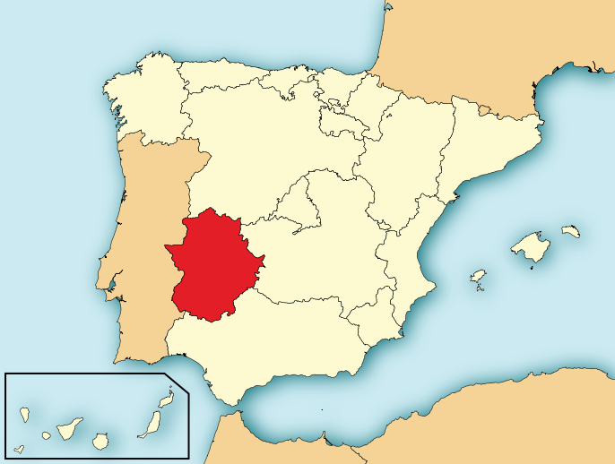
Hernan Cortes (1485-1547)
● Extremadura, Spain
Poor soil, hot summers, and very cold winters led to little chance for wealth
● He was given (3) options:
Lawyers, Soldier, or Priest
● At the age of 19, he knew that he wanted to be rich and chose to be a SOLDIER
● He did so well in the military that he was “given” land by his superior officer
Extremadura, Spain

Slide 65
Cuba
1504 - Cortes leaves Spain for Hispaniola
(Haiti and the Dominican Republic)
1511 – Assisted in the invasion of Cuba
Cortes was given control over Native American villages and the goods produced by the Spanish commander (Diego Velazquez)
1517 – Smallpox kill thousands of Native Americans in Cuba (by the end of 1519 – the population was nearly wiped out)
1519- Cortes sets sail for Mexico to find new workers after hearing that there was a friendly exchange between the Mayans and his fellow soldiers.

Slide 66
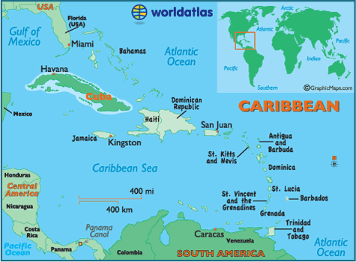
CUBA – Indigenous Population (Approximately 80,000)
- Hispaniola
(Approx. 55,000-60,000)

Slide 67
Veracruz, Mexico (1519)
Spain forces Tabascans (thousands of people) to surrender by using scare tactics (horses and guns)
Malintzin was given to Cortes – she spoke Mayan and Nahuatl (Aztec language)
She aided Cortes by telling him the lay of the Aztec land, how the Aztec people hated their rulers, and helped him to form alliances
MEASLES and SMALLPOX

Slide 68
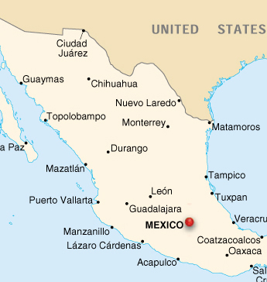
Veracruz, Mexico

Slide 69
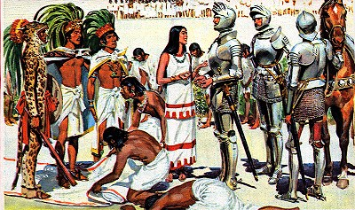
Tenochtitlan, Mexico (AZTEC Capital)
Spain (Cortes)
Mexico (Montezuma II)
Cortes brought
- 550 soldiers
- 16 horses
- 14 cannons
- GUNS
- and a few dogs
- Armor and Swords
Measles and SMALLPOX
Montezuma had a dream that the Spanish were coming.
Initially thought Cortes was Quetzalcoatl
Aztec war club
Large population

Slide 70
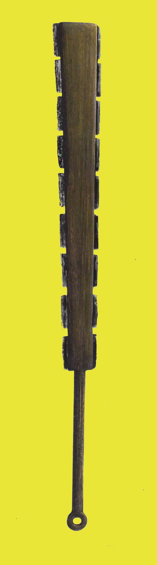
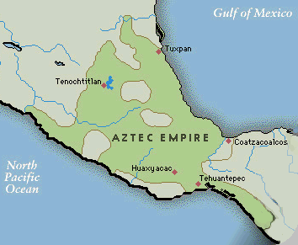
Tenochtitlan, Mexico

Slide 71
Montezuma (1480-1520)
Montezuma did not attack Cortes initially because he believed him to be a light-skinned god named Quetzalcoatl that had left Tenochtitlan and promised to return one day. Quetzalcoatl was a god that did not believe in sacrifices.
Montezuma decided to ambush the Spaniards but Cortes learned of his plan and killed 6,000 Aztecs.
Spaniards took over Tenochtitlan, took Montezuma hostage, and ordered the ceasing of sacrifices

Slide 72
Spain Defeats Aztecs
Aztecs rebel
Thousands of Aztecs killed
Montezuma was killed during the rebellion when he tried to stop the fighting
Spain was outnumbered and retreated to the hills with their allies
Smallpox breaks out in Tenochtitlan
Spaniards were immune to smallpox, as they were exposed as young children
June 1521, Spain takes over the Aztec capital
Aztecs are too weak to fight from smallpox

Slide 73
Smallpox
AZTEC Death by SMALLPOX
Symptoms
The disease spread rapidly from island to island and then hit the mainland.
Aztecs would bathe in steam baths furthering the spread of smallpox
Aztecs bathed together, slept in close proximity, and ate together
Food shortages occurred because the women were to ill to work to grind the maize
Some treatments included finely grinding obsidian and putting it in the wound and then making a plaster to cover the area
Fever
Nausea
Headache
Delirium is possible
SECOND PHASE
Oil glands are destroyed turning the skin red
Skin looks scalded and feels scalded (to infected person and someone that touches them)
small, red, flat marks
SIMILAR TO CHICKENPOX, but smallpox can be deadly

Slide 74
Cortes
Cortes returns to Spain wealthy
During his encounter with Montezuma, Montezuma gives Cortes a bitter tasting drink consisting of cacao
After defeating the Aztecs, Cortes returns to Europe with the cacao bean. Europeans develop chocolate by adding milk and sugar to the bean.
Dies near Seville, Spain (1547)

Slide 75
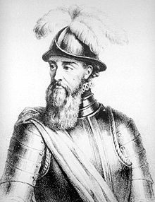
Francisco Pizarro conquers the Incas
Living in the new world since 1502, he helped explore and became a wealthy landowner.
In 1530 led 160 men up the mountain and into the Inca homeland.

Slide 76
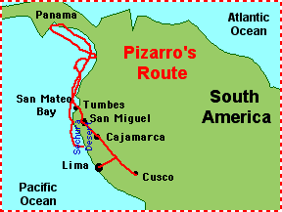
Francisco Pizarro conquers the Incas (Cont.)
Inca tried ignoring him, but he didn’t leave. Raided Inca storehouses and fired against villagers.

Slide 77
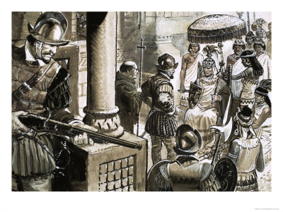
Francisco Pizarro conquers the Incas (Cont.)
Incan Emperor, Atahualpa, thought Pizarro was crazy, how would 160 men defeat 80,000 Incan warriors?
Atahualpa meet with Pizarro, was asked to denounce gods.

Slide 78
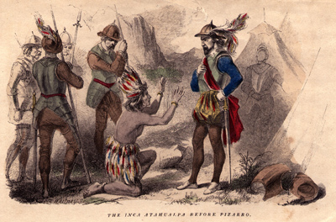
Francisco Pizarro conquers the Incas (Cont.)
Atahualpa laughed at this request.
Pizzaro attacked , there was a full out battle.
Pizarro seized Atahualpa and took him off the battlefield.

Slide 79
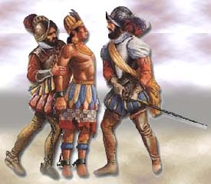
Francisco Pizarro conquers the Incas (Cont.)
Atahualpa tried to buy his freedom by offering to fill his jail cell with gold.
Pizzaro agreed to deal, but didn’t keep his end of the deal and charged Atahualpa with many crimes: plotting a rebellion, worshipping false gods, having multiple wives

Slide 80
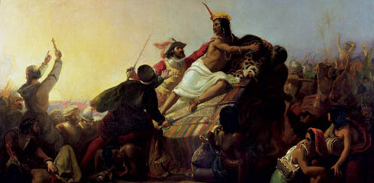
Francisco Pizarro conquers the Incas (Cont.)
Was found guilty and sentenced to death.
Pizarro was appointed the governorship of Peru for his victory by the king of Spain
Pizarro then choose a new Inca Emperor who was loyal to him.

