Slide 1
California Standards
Group 3 Chapter 3 By Brittany Wray and Katya Prupis
6.3.1 Describe the origins and significance of Judaism as the first monotheistic religion based on the concept of one God who sets down moral laws for humanity.
6.3.2 Identify the sources of the ethical teachings and central beliefs of Judaism: belief in God, observance of law, practice of the concepts of righteousness and justice and the importance of study; and describe how the ideas of the Hebrew traditions are reflected in the moral and ethical traditions of Western civilization.
6.3.3 Explain the significance of Abraham, Moses, Naomi, Ruth, David, and Yohanan ben Zaccai in the development of the Jewish religion.
6.3.4 Discuss the locations of the settlements and movements of Hebrew peoples, including the Exodus and their movement to and from Egypt, and outline the significance of the Exodus to the Jewish and other people.
6.3.5 Discuss how Judaism survived and developed despite the continuing dispersion of much of the Jewish population from Jerusalem and the rest of Israel after the destruction of the second Temple in A.D. 70.

Slide 2
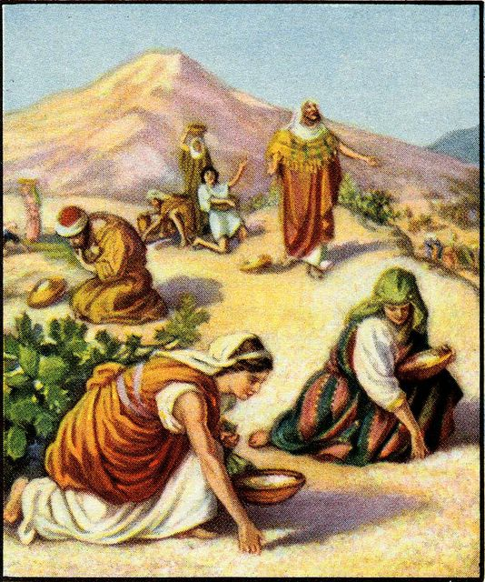
The First Israelites
1400 B.C. – 1000 B.C.
Brittany Wray

Slide 3
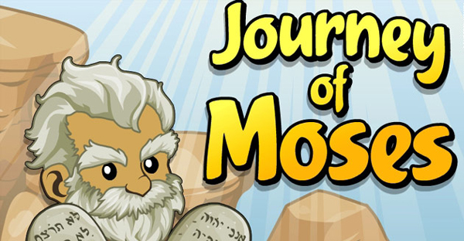
Get Ready to Learn!
Vocabulary
Important People
Monotheism
  Belief in one God
Tribe
  Separate family group
Torah
  Laws Moses received from God
Covenant
  An agreement
Alphabet
  Group of letters that stand for sounds
Abraham
Jacob
Moses
Deborah
Phoenician

Slide 4
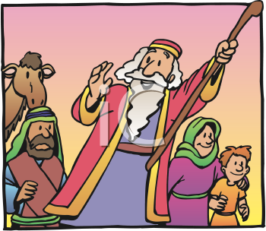
What’s the Connection?
Egyptians built a great civilization
During this time another nation was forming
These people were called Israelites
  Also known as the Children of Israel
Egyptians called them habiru or foreigners

Slide 5
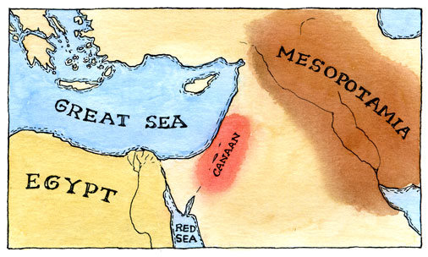
The Early Israelites
1000 B.C.
Israelites (IHZ – ruh – LYTS)
Kingdom in Canaan (KAY – nuhn)
Located along the Mediterranean Sea in southwest Asia

Slide 6
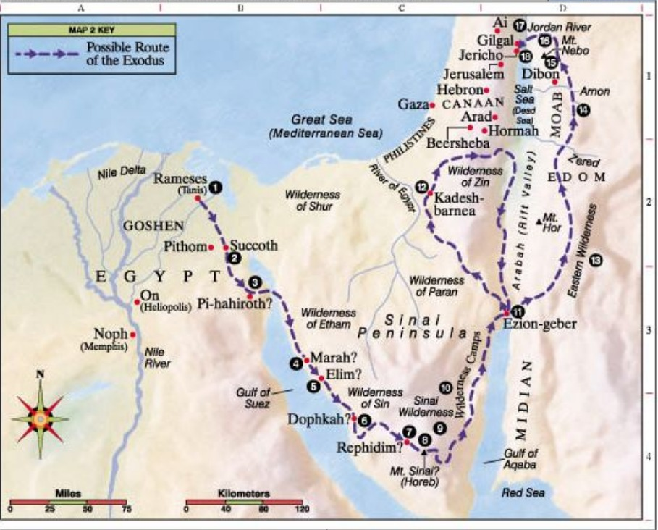

Slide 7
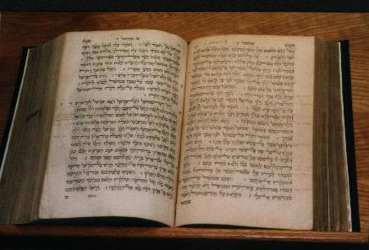
Who Were the Israelites?
Monotheism
  The belief in one God
Practiced Judaism
  Followers of this religion were known as Jews
  Influenced Christianity and Islam
Spoke Hebrew
  Hebrew Bible
Herders & Traders

Slide 8
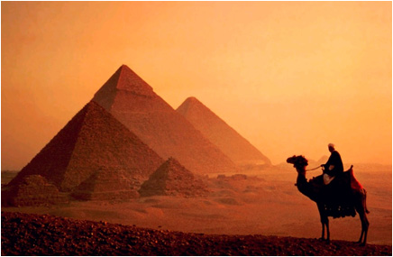
Who Were the Israelites?
Abraham
  Messages from God
  Reason for settling in Canaan
Jacob
  Abraham’s grandson “Israel”
  Raised twelve sons
  Family divided into tribes
Long drought
  No crops or livestock
  Israelites traveled to Egypt

Slide 9
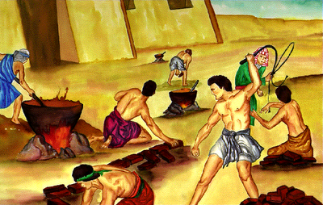
Slavery in Egypt
Pharaoh’s pyramids
Enslaved Israelites
Baby boys thrown in Nile
Baby in a basket: Moses
1290 B.C.
  Burning Bush & voice
  God’s message
Ten plagues
  Last plague killed all first born children
Pharaoh let Israelites leave
Passover

Slide 10
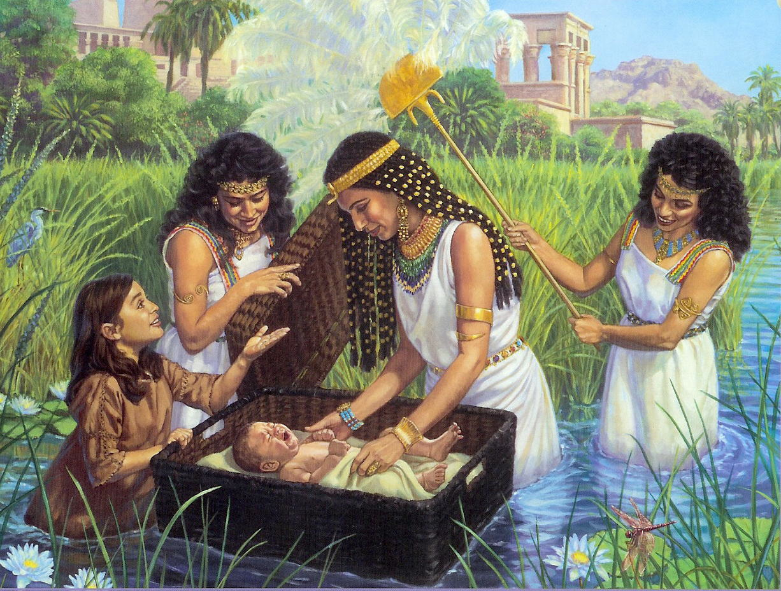

Slide 11
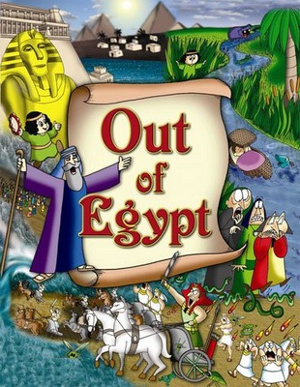
The Red Sea
Israelites headed east
Pharaoh sent army
God parted the Red Sea
Water drowned Egyptian soldiers
Israelite escape: Exodus

Slide 12
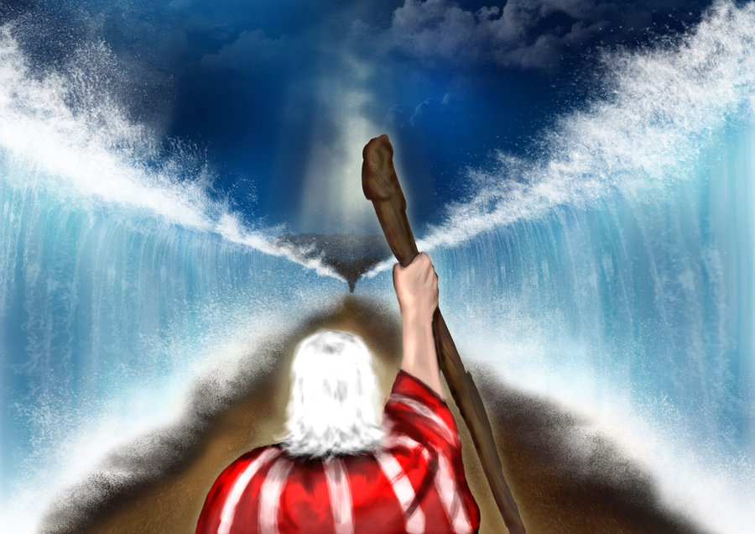

Slide 13
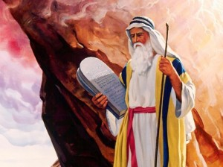
Back to Canaan
Sinai Desert
Moses went to top of Mount Sinai (SY – NY)
Received laws from God
Also known as the Torah
Described a covenant
Right & wrong

Slide 14
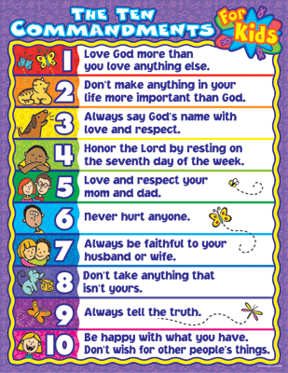
Back to Canaan
Ten Commandments
  Loyal only to one God
Shaped basic moral laws
  Do not steal, murder, or lie
  Avoid jealousy
  Honor parents
“Rule of Law”

Slide 15
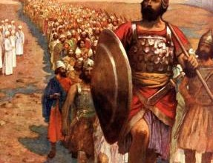
Back to Canaan
The Promised Land
40 years later
Moses died & Joshua took over
Occupied by Canaanites (KAY – nuh – NYTS)
Joshua led them into battle
Jericho
  City walls crumbled
  Three more wars
  Land divided among twelve tribes

Slide 16
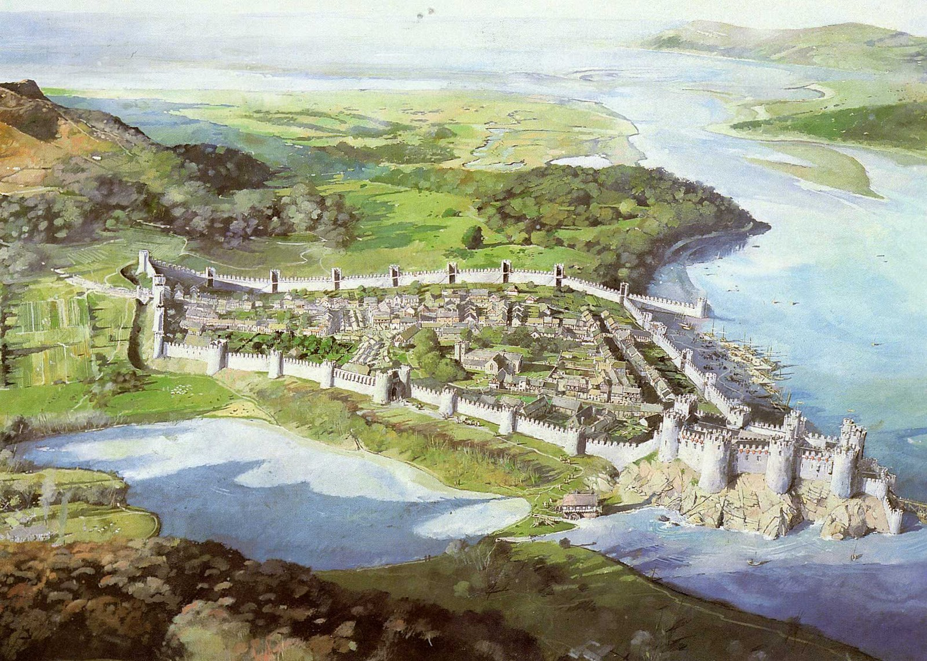
Who Were the Fighting Judges?
Joshua died
Israelites looked to Judges for leadership
Military leader
1 or 2 tribes
Deborah
  Woman judge
  1125 B.C. helped destroy King Jabin and army
Israelites won control of hilly region
  Built walled towns
Canaanites kept flat, coastal areas

Slide 17
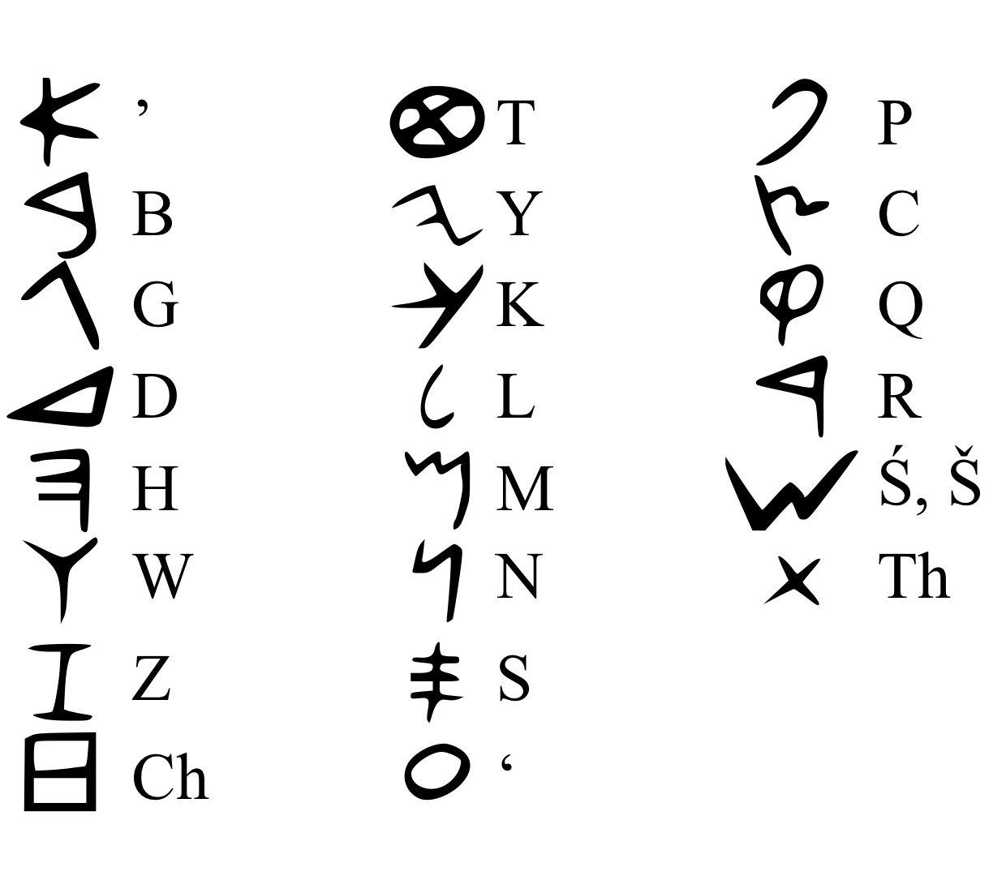
The Phoenician Alphabet
Phoenicians
  One group of Canaanites
  Lived along Mediterranean Sea
  Skilled sailors and traders
    Spread ideas & goods
Alphabet
  One of the most important ideas
  Made writing simpler
  Helped keep records
Phoenicians -> Greeks -> Romans

Slide 18

Study Central
Online review, main ideas, building vocabulary, notes, web links, and quiz!
http://www.glencoe.com/apps/studycentral/0078688736/core_content.html

