Slide 1
Today’s lecture:
Seismology: the study of earthquakes
Seismic waves: terminology, classification, the transfer of energy, how waves move
Measuring earthquakes
Layers of the Earth and seismic waves
What information a seismologist is able to interpret from a seismogram

Slide 2
Other information on slides
Wave terminology
Seismology
Seismic waves
Locating an epicenter
Measuring earthquakes
Foreshocks and aftershocks

Slide 3
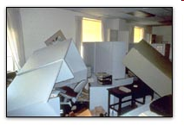
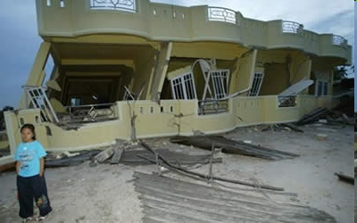
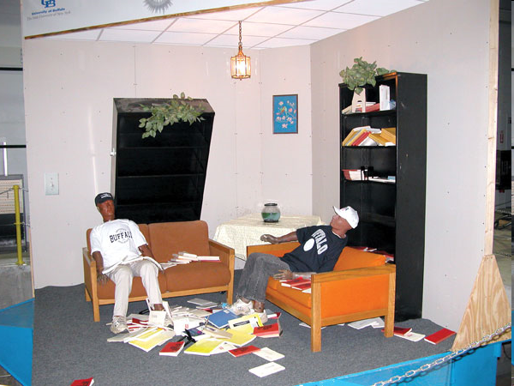
How do you know there is an earthquake?

Slide 4
Describe what you have felt during an earthquake.
Jolt
Loud boom
Shaking back and forth
Rolling
This is the result of different seismic waves transferring energy through earth and structural materials.

Slide 5
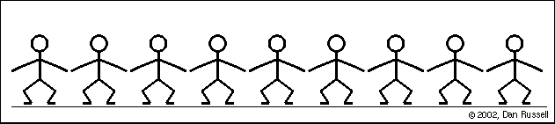
Stand up: half the class move to the front of the classroom the other group move to the back of the classroom.
You will represent the transfer of energy through the Earth.

Slide 6
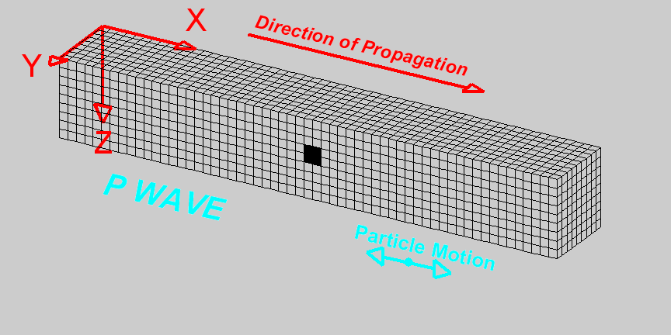

Compressional Wave (P-Wave) Animation
IRIS
Deformation propagates. Particle motion consists of alternating
compression and dilation. Particle motion is parallel to the
direction of propagation (longitudinal). Material returns to its
original shape after wave passes.

Slide 7
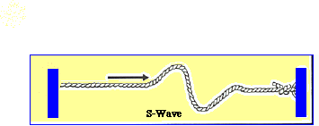
Next wave: energy is transferred differently
The first person should bend at the waist
As soon as your neighbor has completed the motion, you should begin
Energy is transferred in a shear motion

Slide 8
Notice…
This motion takes a longer period of time to complete
Motion is more complicated
Shear motion is perpendicular to wave movement

Slide 9
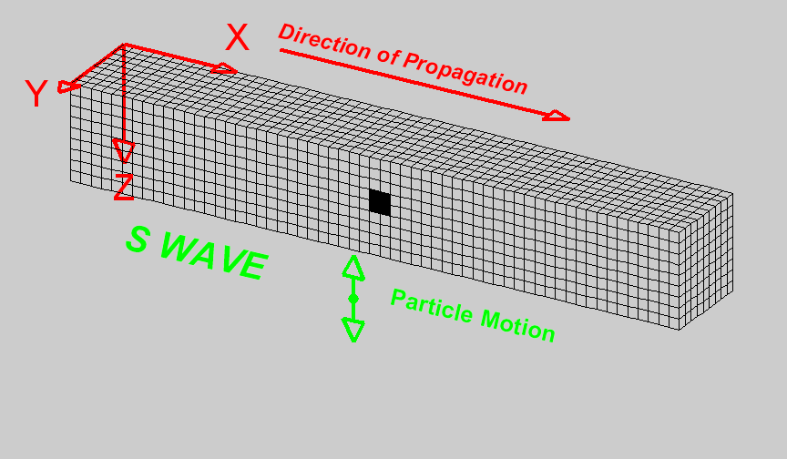
Let go of your neighbor and stand a few inches apart.
The first person should bend at the waist
Move, only if you feel this person move
This represents energy transferred by shear movement

Slide 10
What happened?
Shear waves cannot travel through liquids because of how energy is transferred.

Slide 11
Shear Wave (S-Wave) Animation
Deformation propagates. Particle motion consists of alternating transverse motion. Particle motion is perpendicular to the direction of propagation (transverse). Transverse particle motion shown here is vertical but can be in any direction. However, Earth’s layers tend to cause mostly vertical (SV; in the vertical plane) or horizontal (SH) shear motions. Material returns to its original shape after wave passes.

Slide 12
Seismic waves
Body waves initiate at the focus
Leave in wave fronts moving in all directions
Body waves
  Primary wave: transfers energy by compression and dilation
  Secondary wave: transfers energy by shear motion

Slide 13
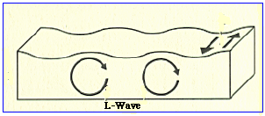
Surface waves
When the body waves hit the Earth’s surface, body waves transfer energy as surface waves
Love waves transfer energy in a shear motion
Rayleigh waves transfer energy in an orbital motion (similar to wind blown waves)

Slide 14
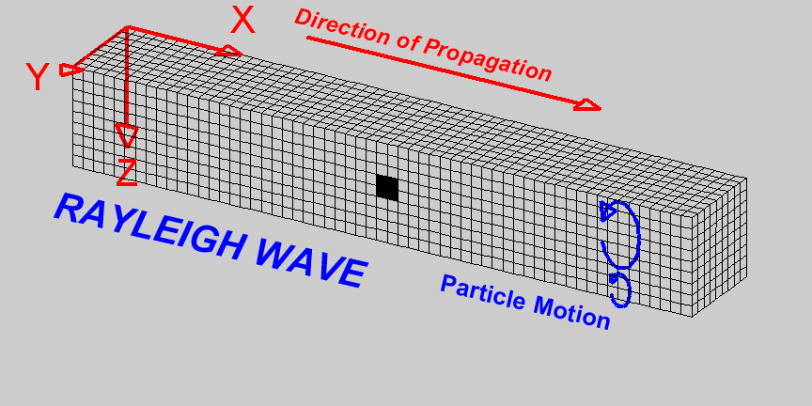
Rayleigh Wave (R-Wave) Animation
Deformation propagates. Particle motion consists of elliptical motions (generally retrograde elliptical) in the vertical plane and parallel to the direction of propagation. Amplitude decreases with depth. Material returns to its original shape after wave passes.

Slide 15
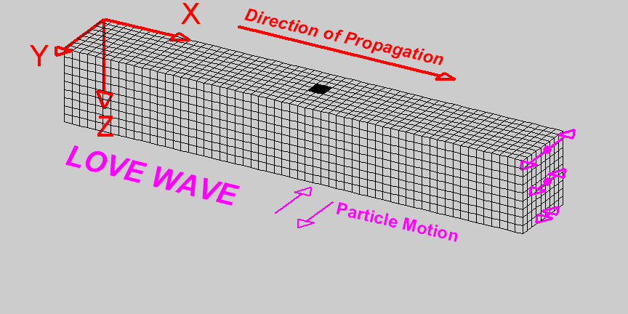
Love Wave (R-Wave) Animation
Deformation propagates. Particle motion consists of elliptical motions (generally retrograde elliptical) in the vertical plane and parallel to the direction of propagation. Amplitude decreases with depth. Material returns to its original shape after wave passes.

Slide 16
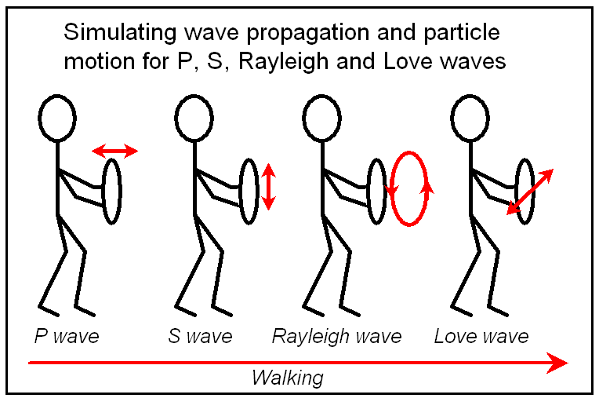
Schematic diagram illustrating students performing wave simulations. Student holds a poster board or cardboard circle in front of his or her body and walks forward (like the seismic waves propagating in the Earth). While walking, the student moves their circle forward and backward (“push and pull”, for the P wave), or up and down (transverse motion for the shear wave), or in a retrograde ellipse (for the Rayleigh wave), or side to side horizontally (for the Love wave), as shown above.

Slide 17
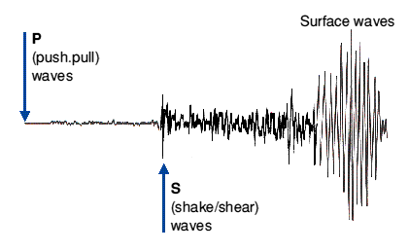
Earthquake Waves
The seismic waves are recorded in a predictable pattern.

Slide 18
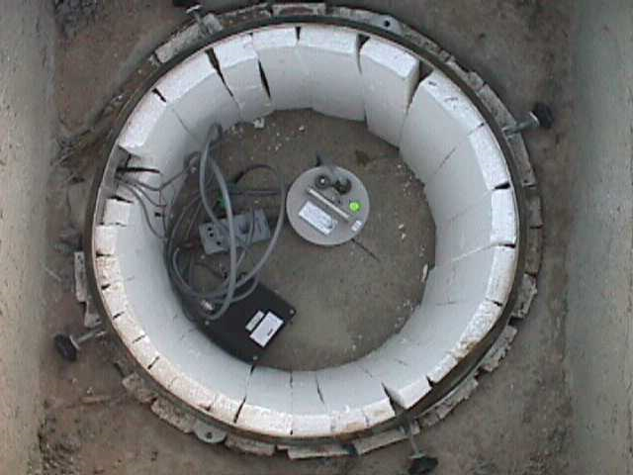
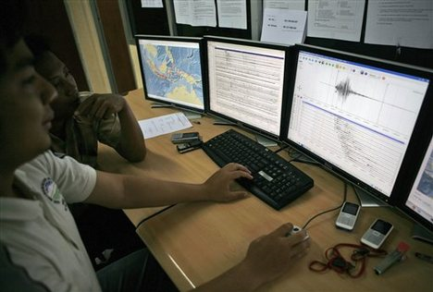
Seismometers are placed in the ground
Signal is sent to a computer
Transfers image to a digital record

Slide 19
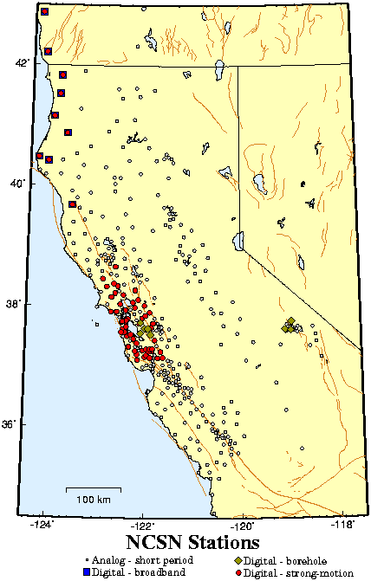
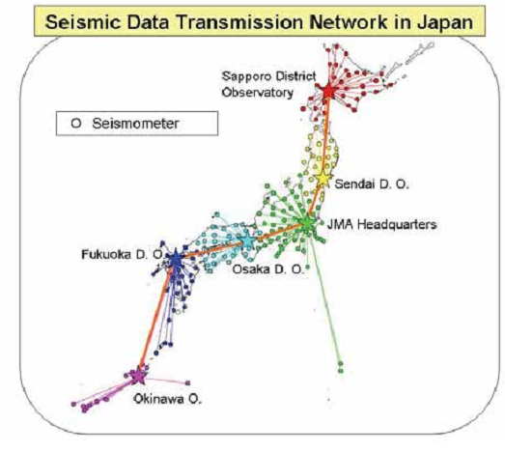
Seismic networks in Japan and California

Slide 20
Wave terminology

Slide 21
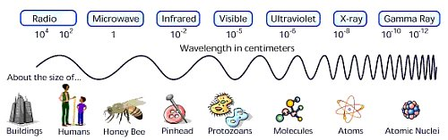
Waves
Waves have different wavelengths, energies and frequencies.

Slide 22
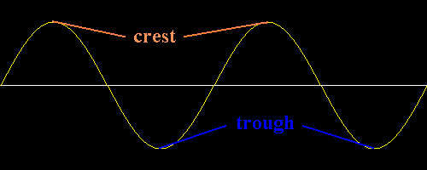
Waves
All types of waves can be described using the same terminology
Each wave type has its own characteristic, wave length, amplitude, frequency.

Slide 23
Period
Period is the amount of time it takes one wavelength to pass a point
Seismic waves with a long wavelength have a larger period (2-4 seconds)
Seismic waves with a short wavelength have a shorter period (.05-2 seconds)
Wavelength

Slide 24
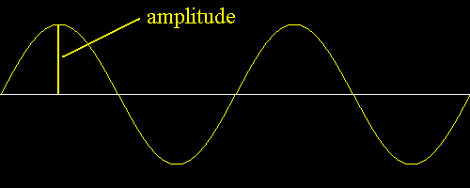
Amplitude
The length between the base line and crest of the wave or base line and trough of a wave

Slide 25
Frequency
The number of cycles that pass an observer at a given time.
How many cycles per second
Measured in Hertz
1 Hz = 1 cycle per second

Slide 26
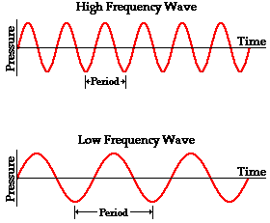
Frequency
Related to wavelength
  Long wavelengths have a low frequency
    Surface waves: less than one cycle/second
  Short wavelengths have a high frequency
    Body waves: .5 to 20 Hz or cycles per second
Low frequency waves travel the farthest distance from the epicenter

Slide 27

Shake Recorder
Cheng Heng, mathematician
132 CE
China
Balls fall from dragon mouths recording the direction of ground movement
Recognition that earthquakes may be recorded using a scientific method

Slide 28
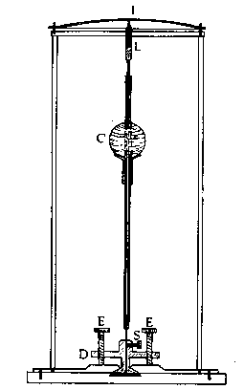
Forbes’ Seismometer, 1844
Special committee formed to monitor seismicity in Great Britain
vertical rod with mass
pencil above the mass to magnify movement 2 or 3 times

Slide 29
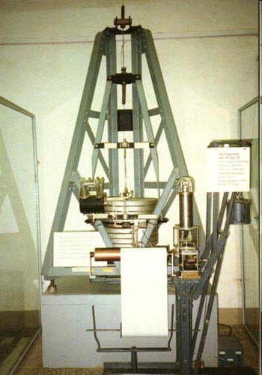
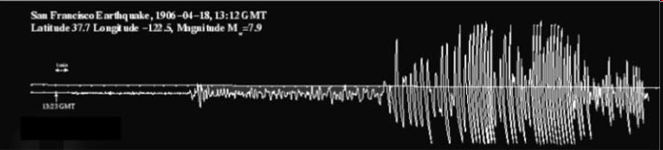
Sarajevo
1905
Recorded the 1906 Earthquake

Slide 30
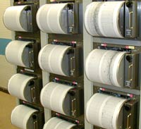
Drum Recorders
Seismogram translates the sent message
A pen records the movement
These drums are considered old-fashioned but are on display for the public

Slide 31
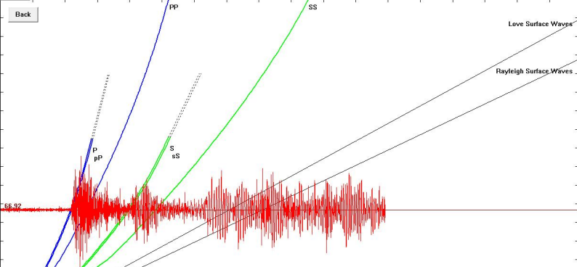
Seismic waves arriving recorded in Portland, Oregon

Slide 32
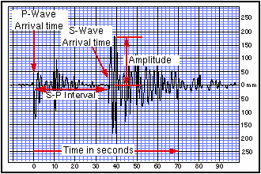
Distance from epicenter
Understand that seismic waves travel at a predictable velocity
The longer the distance from the epicenter the larger the time between the P and S wave arrival times

Slide 33
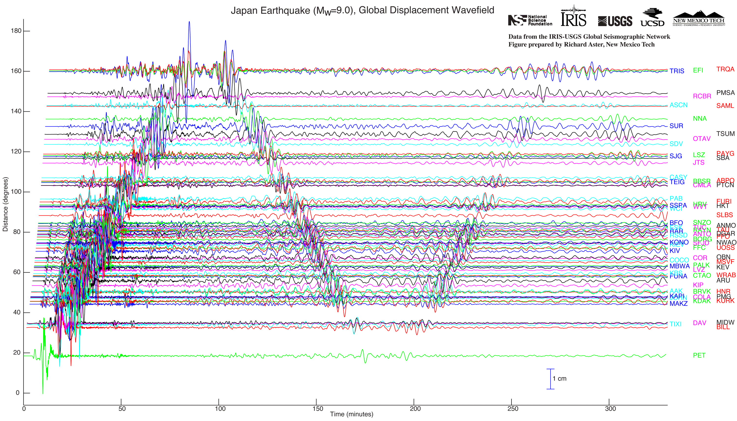
Japan earthquake

Slide 34
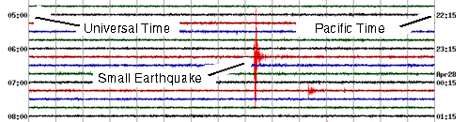
Digital seismograms
Records how the ground moves during a 24 hour period
Background noise may be from traffic, wind, oceanic microseisms
Each line represents 15 minute intervals
Time-Greenwich Time, Pacific Time

Slide 35
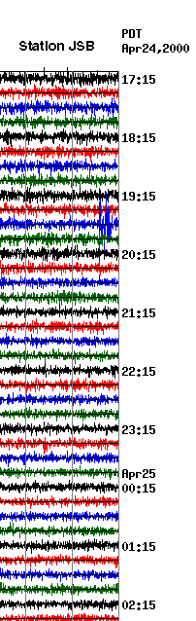
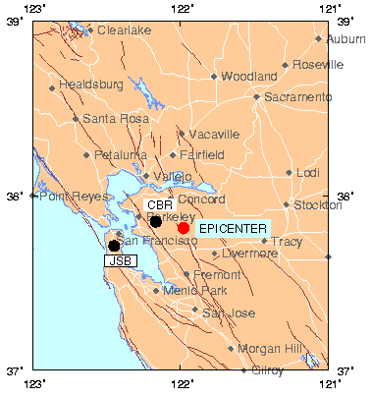
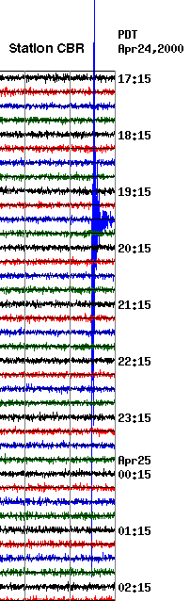
Magnitude 1.9 earthquake
Relationship between distance from epicenter and recording on seismogram.

Slide 36
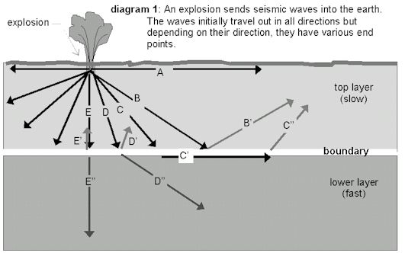
As seismic waves travel through the Earth, energy is transferred, the material oscillates.
When a wave reaches a different rock layer, the wave will refract (bend) or reflect (bounce of the layer).

Slide 37
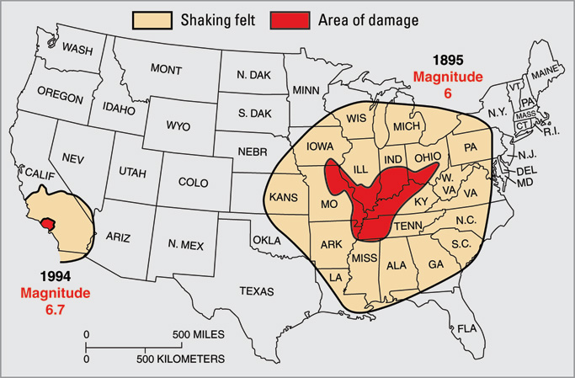
Seismic wave energy dissipates faster when there are more rock layers.
Notice the area in Southern California is smaller than in the New Madrid area.
The geology in Southern California is much more complicated.

Slide 38
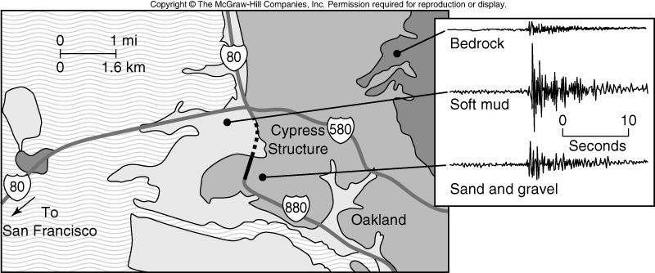
Seismic waves respond to the density of earth material
Describe the waves in terms of wavelength, period and frequency.

Slide 39
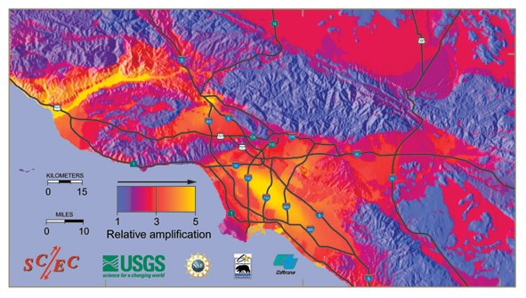
Seismic waves respond to the density of earth material
Can you determine the location of loosely consolidated sediments?

Slide 40
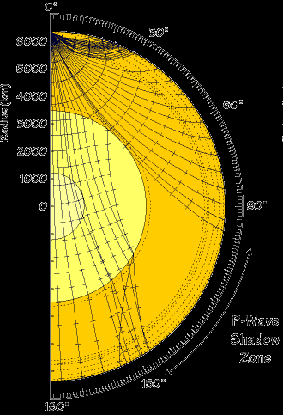
The Earth’s Layers were determined by seismic waves.
P-waves are able to travel through all states of matter
S-waves are able to travel only through solid material

Slide 41
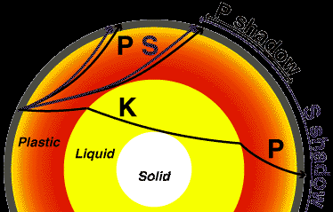
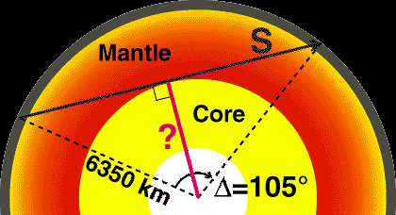
Earth’s Interior
Therefore, the S-wave shadow zone helped determine the diameter of the core

Slide 42
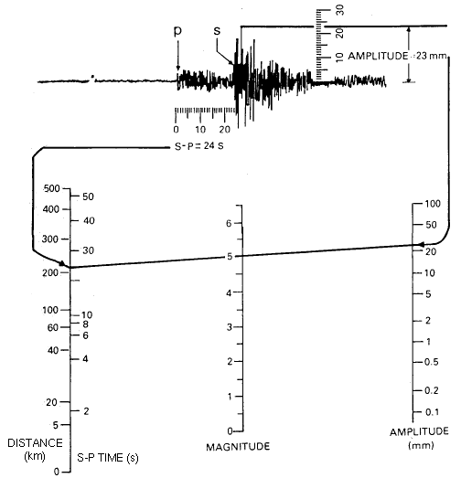
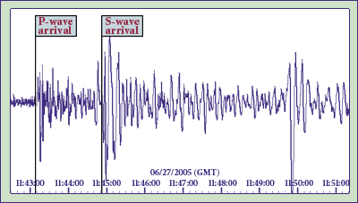
Interpreting seismogram recordings
Arrival times of seismic waves
Approximate distance based on the difference between the S-wave and P-wave arrival times
Amplitude that may be applied to the Richter Scale

Slide 43
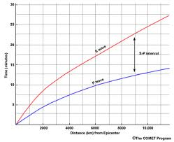
After the S-P time is determined, a time /distance chart is used to find the distance.

Slide 44
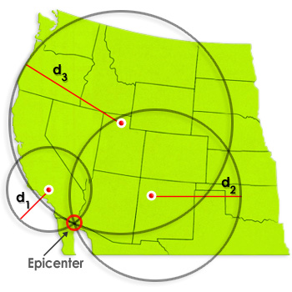
Locating the epicenter
Three seismic stations are needed to find the epicenter
This method is named triangulation
Computer generated records find the epicenter
Sometimes the local seismographs are knocked off line due to seismic shaking

Slide 45
Measuring Earthquakes
Richter Magnitude
Seismic Moment Magnitude
Modified Mercalli Scale
What does M 9.0 mean?

Slide 46
Seismic waves produce ground shaking.
What Controls the Level of Shaking?
Magnitude
  More energy released
Distance
  Shaking decays with distance
Local soils
  amplify the shaking

Slide 47

The Richter Scale
Developed in 1935 by Charles Richter
Ground motion is a valid indicator of earthquake size
Amplitude of seismic wave measured off the seismogram
Scale is 1-10

Slide 48
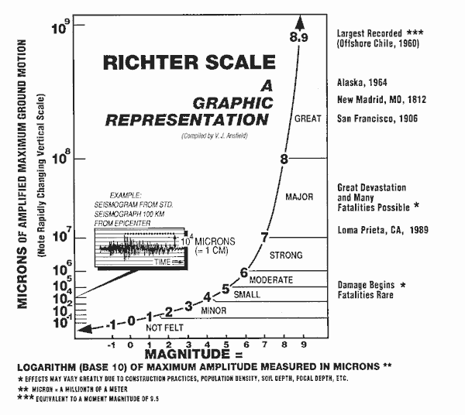
Logarithmic scale
-Increase in number indicates a 10 fold increase in amplitude size

Slide 49
Richter Magnitude-measuring the amplitude of the largest seismic wave.
The amplitude and distance is plotted on a standardized chart
The line intersects the magnitude reading

Slide 50
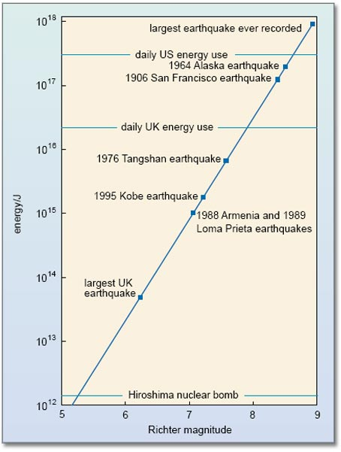
Energy Released
Each increase in magnitude releases about 30 times the energy of the previous
3 to 4 is 30 times
3 to 5 is 30 x 30 times more energy
3 to 6 is 30 x 30 x 30 times more energy

Slide 51
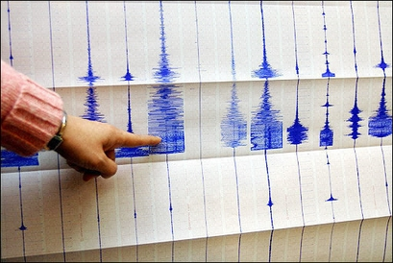
Problems with the Richter Scale
Assumes all seismic waves have the same wavelength
When earthquakes are larger than M7.5, the energy released tends to “flood” or overload the recording
Assumes the seismographs are 100KM from the epicenter
Indonesia, M9.3

Slide 52
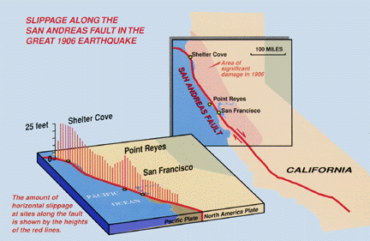
Seismic Moment Magnitude Scale
The method is used by scientists
Includes more variables
Relies on the amount of movement along the fault that generated the earthquake
Moment= (rock rigidity) X (fault area) X (slip distance)
Mw

Slide 53
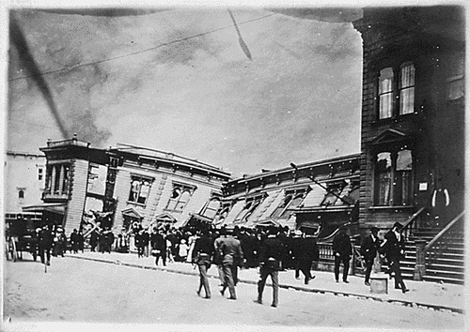
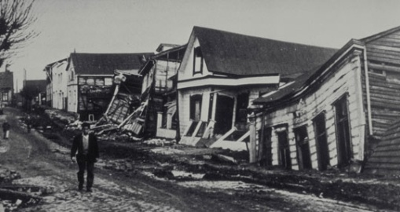
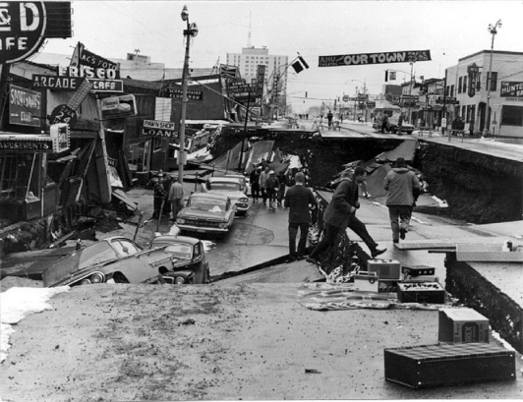
Comparison of Large Earthquakes
Earthquake | Original Magnitude | Moment Magnitude
1906, San Francisco | 8.25 | 7.7
1960, Chile | 8.5 | 9.5
1964, Alaska | 8.4 | 9.2

Slide 54
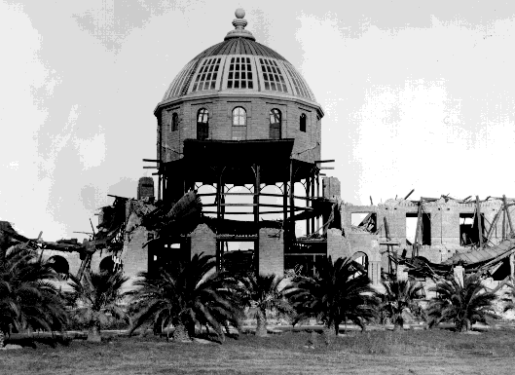
The Modified Mercalli Scale
Measures what we feel
Subjective
Intensity of earthquake
Distance from earthquake
Building style and design
Duration of shaking
Scale from I (no damage)- XII (complete devastation)

Slide 55

Description of Damage

Slide 56



Magnitude 8.9 NEAR THE EAST COAST OF HONSHU, JAPAN
Friday, March 11, 2011 at 05:46:23 UTC
Shaking intensity scales were developed to standardize the measurements and ease comparison of different earthquakes. The Modified-Mercalli Intensity scale
is a twelve-stage scale, numbered from I to XII. The lower numbers represent imperceptible shaking levels, XII represents total destruction. A value of IV indicates a level of shaking that is felt by most people.
Perceived
Shaking
Extreme
Violent
Severe
Very Strong
Strong
Moderate
Light
Weak
Not Felt
Modified Mercalli Intensity
Image courtesy of the US Geological Survey
USGS Estimated shaking Intensity from M 8.9 Earthquake

Slide 57

Intensity Scale

Slide 58
Magnitude / Intensity Comparison
Magnitude | Typical Maximum Modified Mercalli Intensity
1.0 - 3.0 | I
3.0 - 3.9 | II - III
4.0 - 4.9 | IV - V
5.0 - 5.9 | VI - VII
6.0 - 6.9 | VII - IX
7.0 and higher | VIII or higher

Slide 59


Magnitude 8.9 NEAR THE EAST COAST OF HONSHU, JAPAN
Friday, March 11, 2011 at 05:46:23 UTC
USGS PAGER
Population Exposed to Earthquake Shaking
The USGS PAGER map shows the population exposed to different Modified Mercalli Intensity (MMI) levels. MMI describes the severity of an earthquake in terms of its effect on humans and structures and is a rough measure of the amount of shaking at a given location.
Overall, the population in this region resides in structures that are resistant to earthquake shaking.
The color coded contour lines outline regions of MMI intensity. The total population exposure to a given MMI value is obtained by summing the population between the contour lines. The estimated population exposure to each MMI Intensity is shown in the table below.
Image courtesy of the US Geological Survey

Slide 60


Magnitude 8.9 NEAR THE EAST COAST OF HONSHU, JAPAN
Friday, March 11, 2011 at 05:46:23 UTC
Peak ground acceleration is a measure of violence of earthquake ground shaking and an important input parameter for earthquake engineering.
The force we are most experienced with is the force of gravity, which causes us to have weight. The peak ground acceleration contours on the map are labeled in percent (%) of g, the acceleration due to gravity.
Map showing measured Peak Ground Accelerations across Japan measured in percent g (gravity).
Image courtesy of the US Geological Survey

Slide 61
Acceleration
A measurement made on structures relative to gravitational force
1 g = 32 ft/sec squared or 9.8 meters/second squared
Building codes are at about 40-60 percent of that or written as .4 to .6
Structures are built to maintain their integrity due to gravity

Slide 62
Acceleration
Added strength is needed to maintain a structures integrity when subjected to lateral accelerations

Slide 63


Acceleration
Acceleration readings vary with earthquakes
What type of fault would produce the highest accelerations?

Slide 64


Slide 65

Foreshocks and aftershocks
Small earthquakes preceding and after the main event
Yellow: March 9 and 10
Orange and red: 24 hours after earthquake

Slide 66

Foreshocks and aftershocks
Yellow: M 5-6
Orange: > 7

Slide 67

Fault Rupture
30-40 meters (90-120 feet) of upward movement
300 kilometers (180 miles) long and 150 km (90 miles) wide rupture
Foreshock of M 7.2 and several M 6 aftershocks

Slide 68

Aftershock: April 7th
M 7
30 miles: hypocenter

Slide 69


Tsunami Warning

Slide 70
Review
Seismology: the study of earthquakes
Seismic waves: terminology, classification, the transfer of energy, how waves move
amplitude

Slide 71
Review
What information a seismologist is able to interpret from a seismogram
  Amplitude
  Arrival times
  S-wave minus P-wave arrival time to find distance to epicenter

Slide 72
Review
Period
Frequency
Refraction and reflection

Slide 73
Review
Layers of the Earth and seismic waves

Slide 74
Review
Measuring earthquakes
Richter Magnitude (M)
Moment Magnitude (M_{w} )
Modified Mercalli Scale

