Slide 1
Astronomy
Historical Perspective

Slide 2
Observations of Indigenous People
Enabling people to track seasons when dependent on agriculture
The Moon’s cycle of phases
The seven days are named after the Sun, Moon, and five recognized planets in ancient times
Teutonic name
Sun | Sun | Sunday
Moon | Moon | Monday
Mars | Tiw | Tuesday
Mercury | Woden | Wednesday
Jupiter | Thor | Thursday
Venus | Fria | Friday
Saturn | Saturn | Saturday

Slide 3
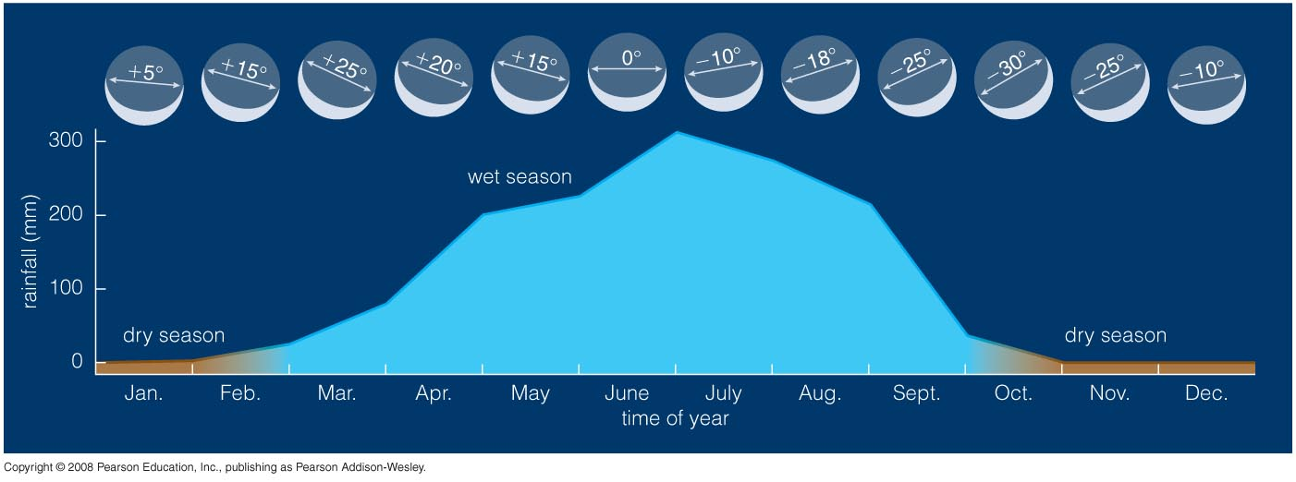
Africans: 6500BCE
Used the angle of the waxing moon to predict the rainy season.

Slide 4
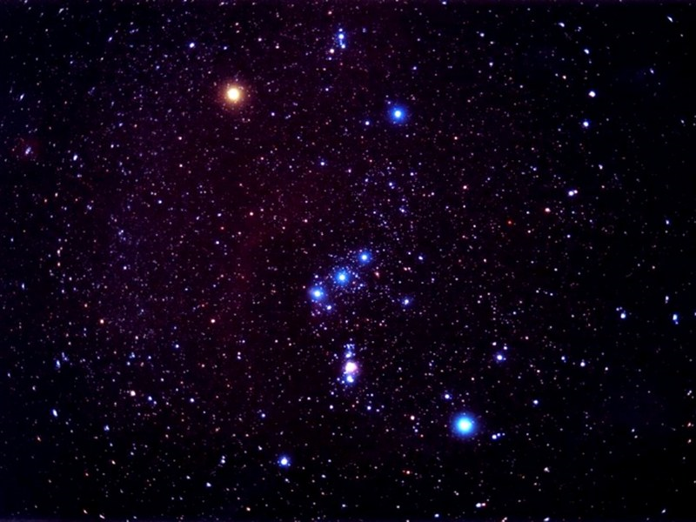
Orion: winter constellation
Rises around sunset in December
Sets around sunrise

Slide 5
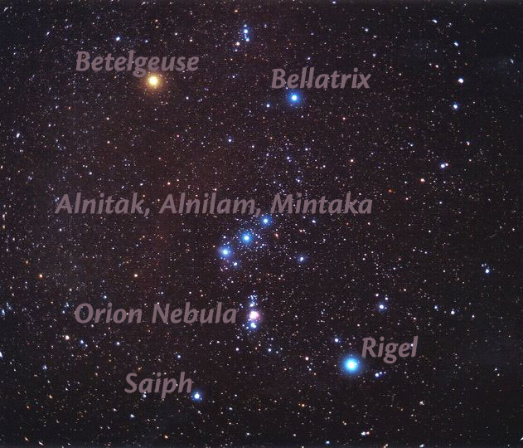
Stars of the Orion Constellation

Slide 6
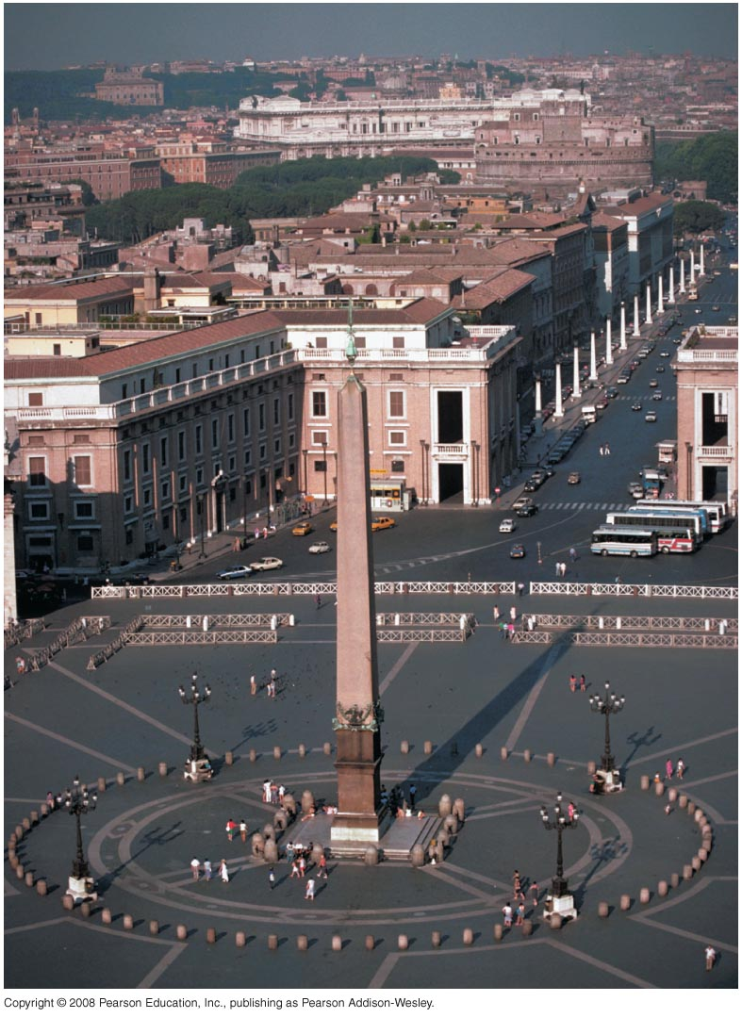
Determining the time of day
Ancient Egypt, 4,000 ybp
Divided daylight into 12 equal parts (varied from summer to winter)
Divided night into 12 different parts based on star clocks
1500 ybp: water clocks
Shadows cast by the obelisk may have been used to tell time

Slide 7
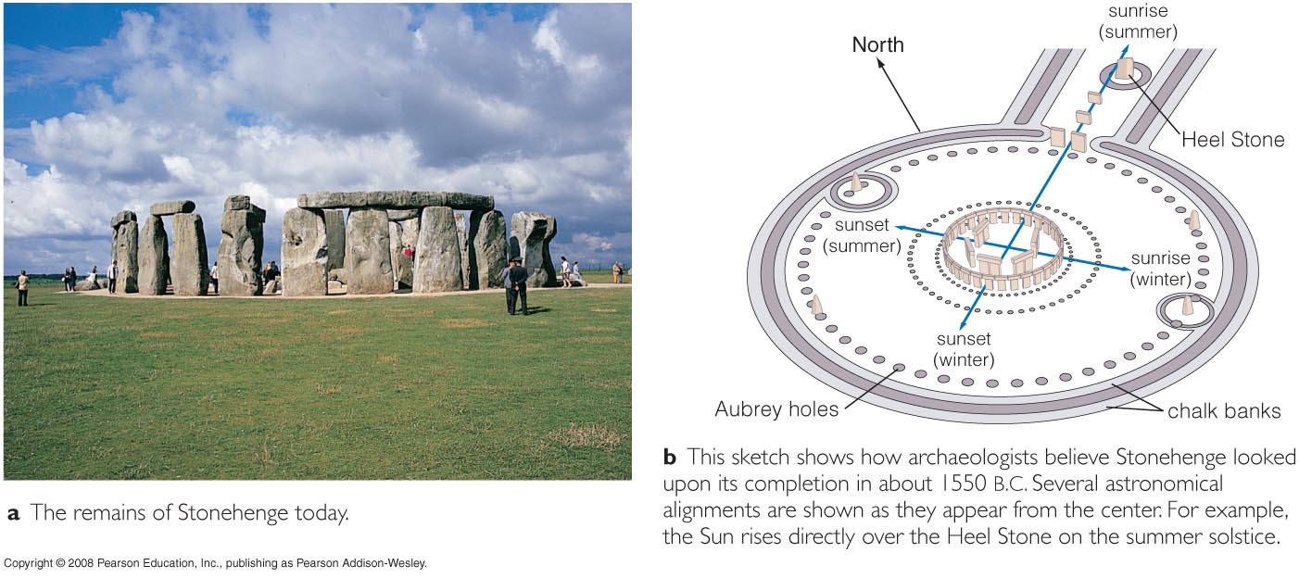
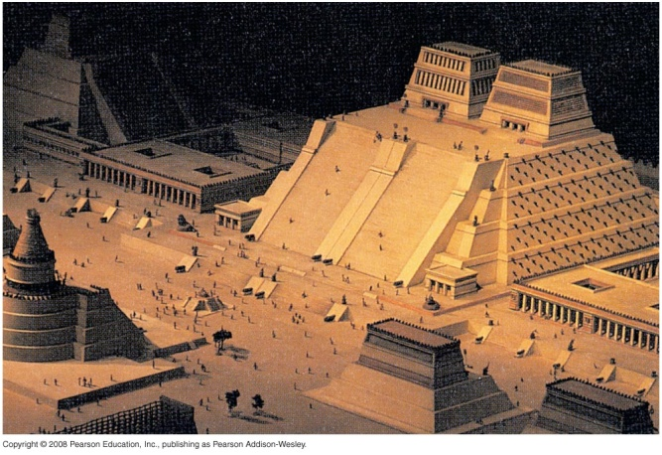
Marking the seasons
Stonehedge, southern England
Templo Mayor, Aztec City of Tenochititlan
The sun rose through the notches during the equinoxes

Slide 8
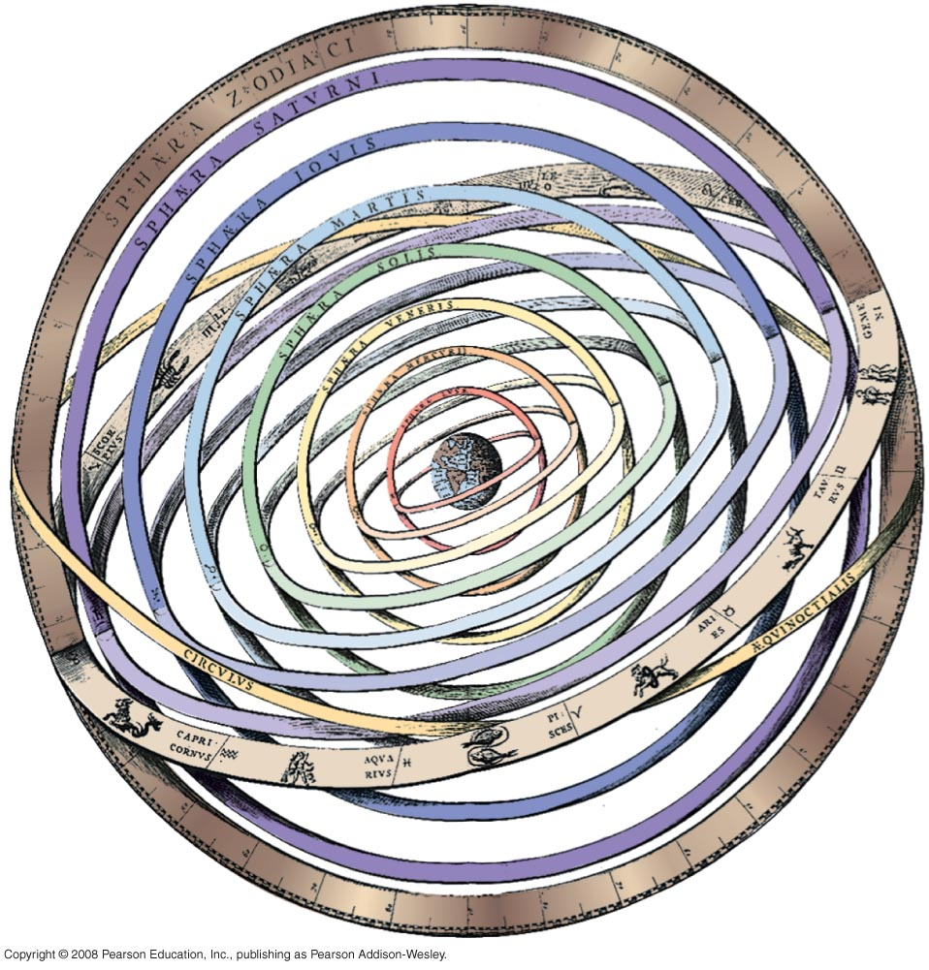
Ancient Greek Science
Constructed models of nature to explain motion of the stars, Sun, Moon, and planets.
Geocentric model: Earth is a sphere that rests in the center.

Slide 9
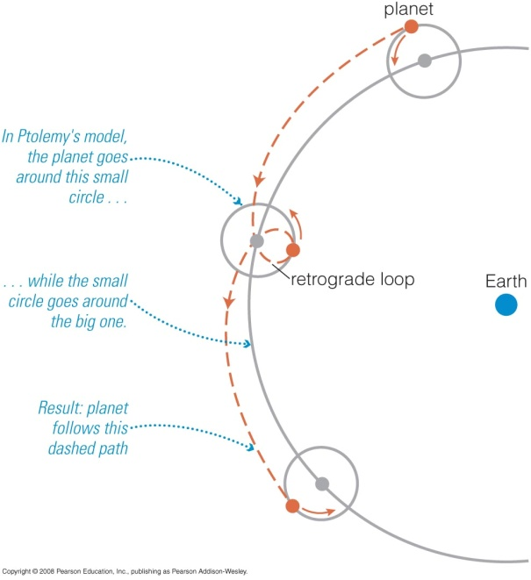
Ptolemy’s Model
Observable motions of the celestial bodies
Second century, CE
Celestial sphere made a daily trip around a motionless Earth
Retrograde motion: each planet appears to stop, reverse direction and then resume the original direction

Slide 10
Astronomical ideas lost until the middle ages including the idea of a spherical Earth.

Slide 11
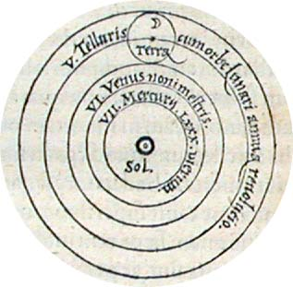
Nicolaus Copernicus (1473-1543)
Earth is a planet
Heliocentric model: Sun in the center and the planets orbit around it

Slide 12
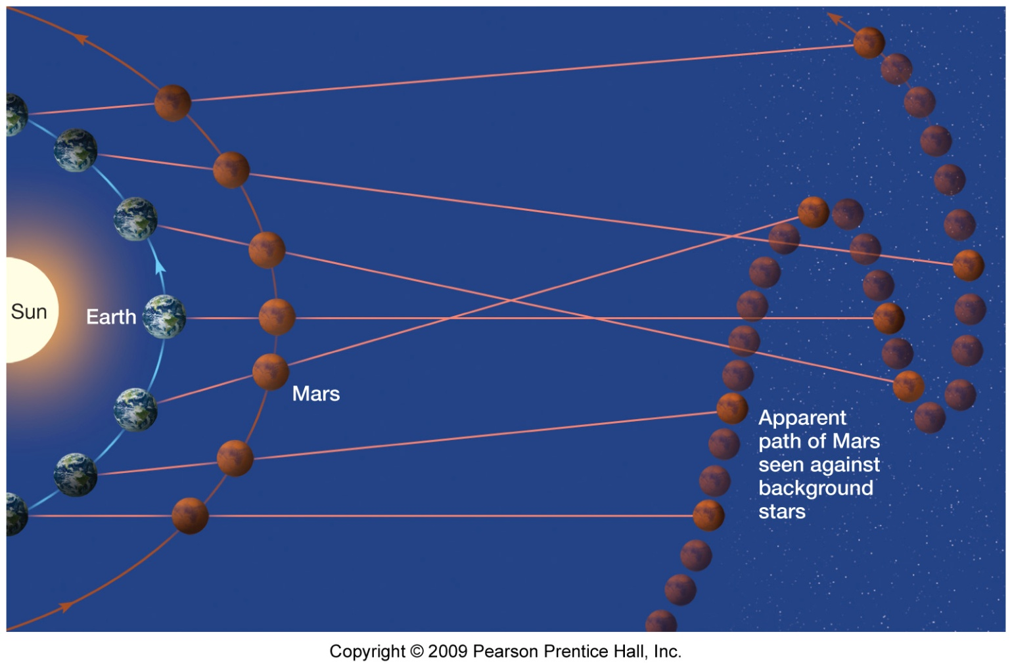
Explanation of retrograde motion supported the Heliocentric model
Explains how planet movements are viewed from Earth in relation to the constellations.

Slide 13
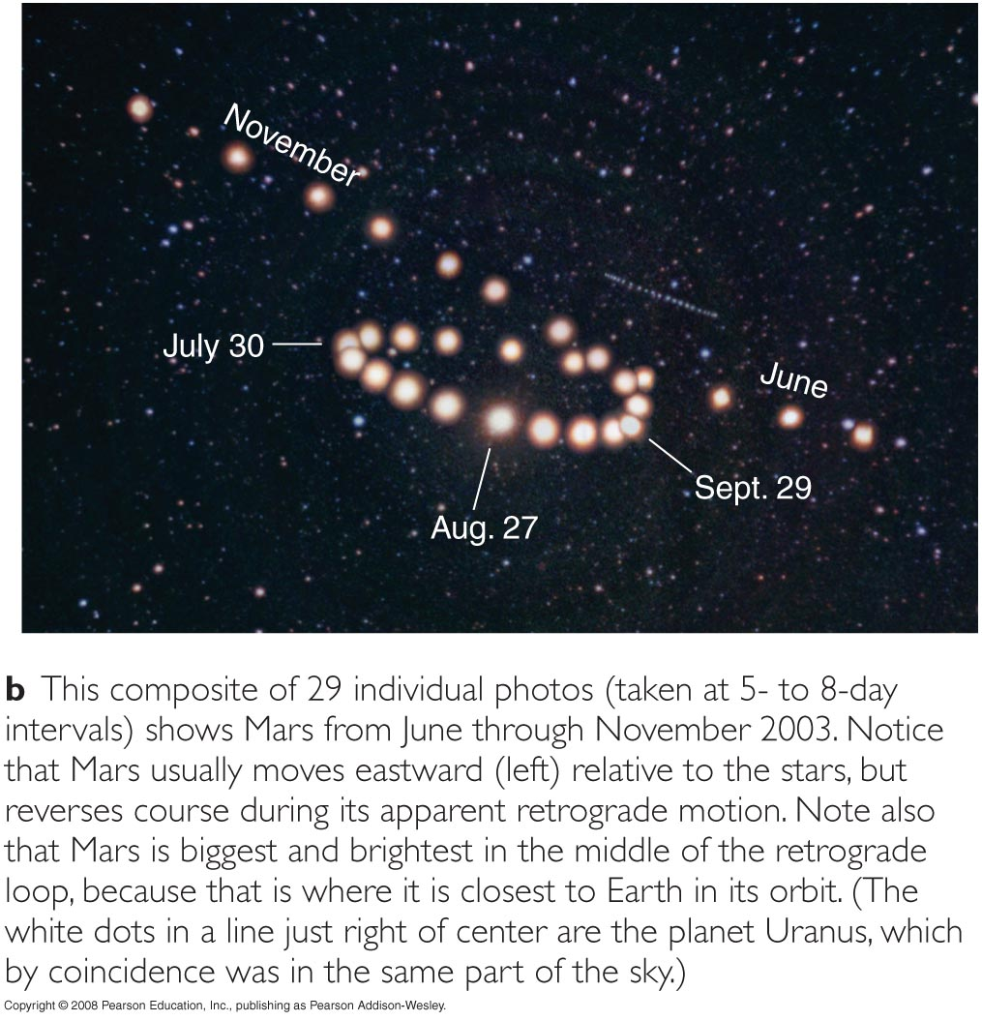
Retrograde motion

Slide 14
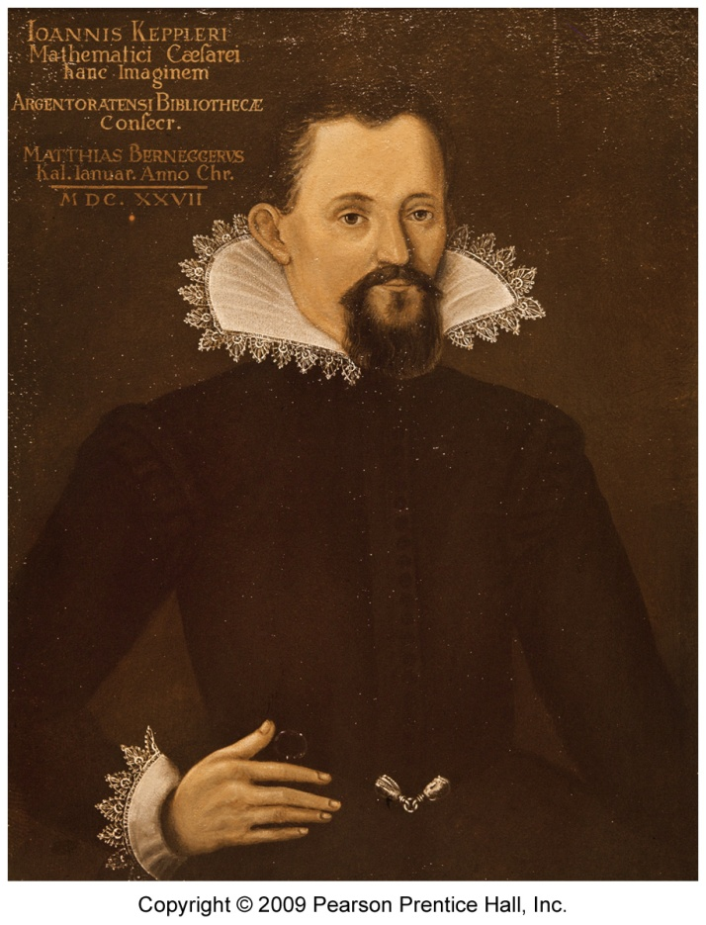
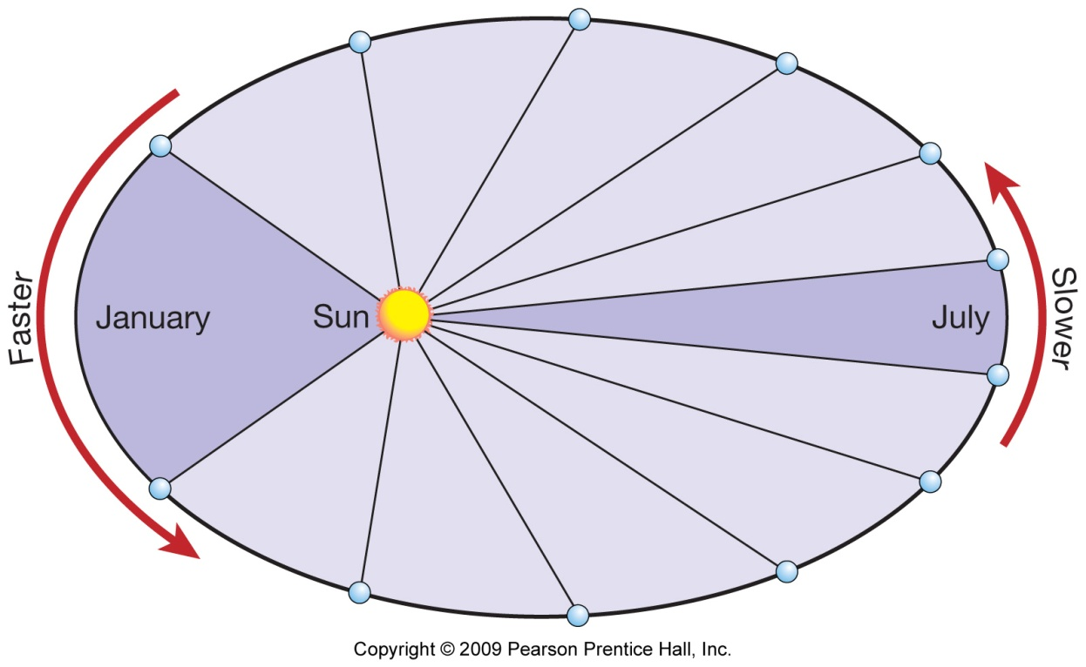
Johannes Keppler, (1571-1630)
Law #1: Planets have an elliptical orbit
Law #2: A planet to sweep equal areas in the same amount of time
Travels more rapidly when closer, slower when farther
Average orbital period of the Earth: Planet’s distance to the Sun is the mean distance = 93,000 miles or 1 astronomical unit

Slide 15
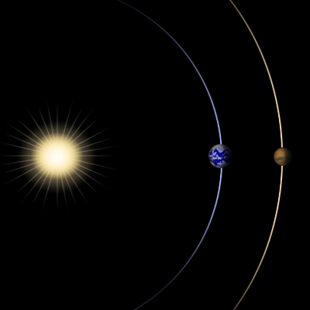
The orbital periods of the planets and their distances to the Sun are proportional
Kepler’s 3rd law: solar distances of the planets can be calculated when the orbital period is known
Mars: 687 Earth days to orbit or revolve around the Sun
687/365 = 1.88
1.88 squared equals 3.54
The cubed root of 3.54 is 1.52
The distance from Mars to the Sun

Slide 16
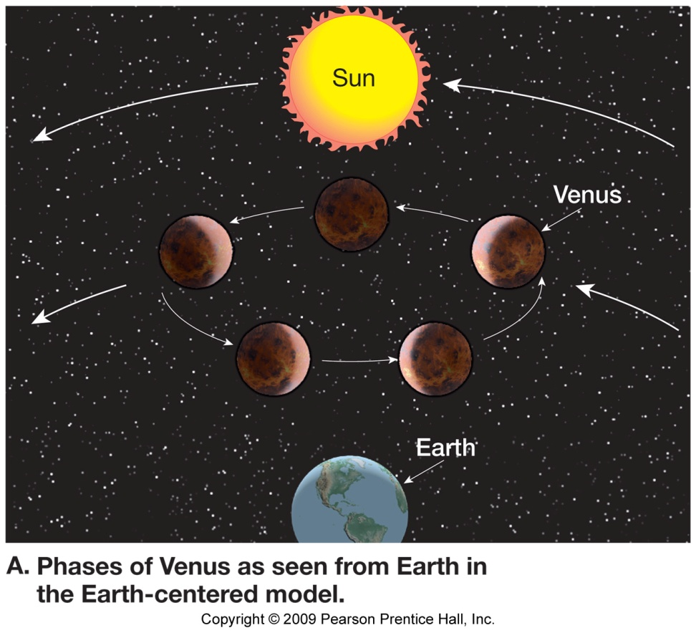
Galileo Galilei (1564-1642)
Use of the telescope
Planets are Earth like not star like
Venus exhibits phases just like the moon
Moon’s surface is not smooth
The Sun has sunspots with slightly lower temperatures

Slide 17
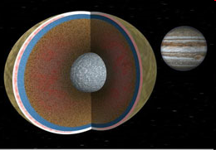
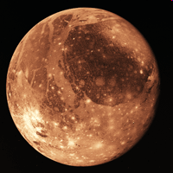
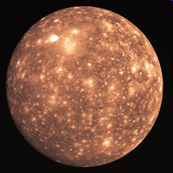
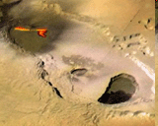
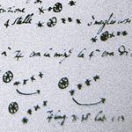
Galileo: observed 4 of Jupiter’s 63 moons
Io:
Ganymede:
Europa:
Callisto:

Slide 18
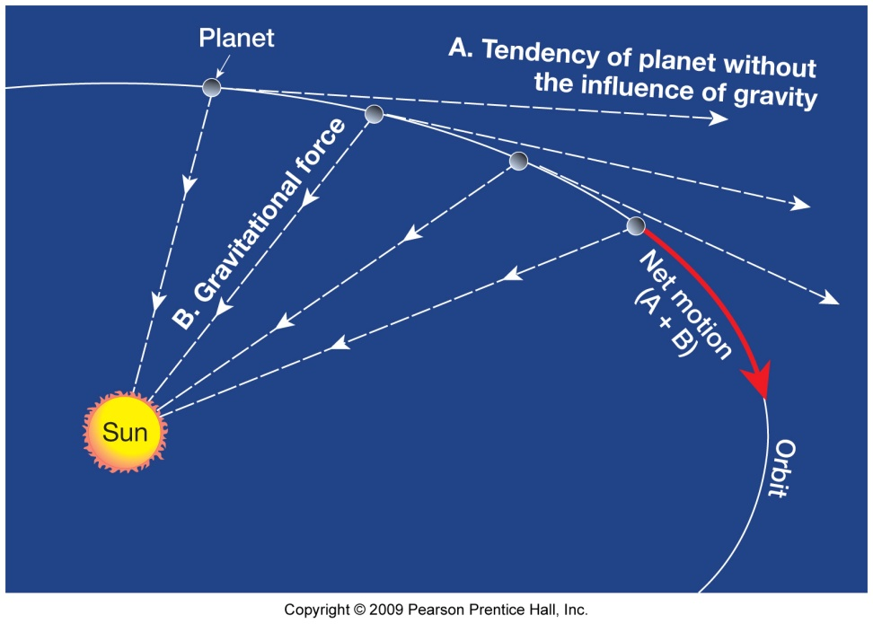
Sir Isaac Newton (1642-1727)
Gravitational force:
Gravity=G x mass1 x mass2 ……………distance x distance
Proved planets have an elliptical orbit

Slide 19
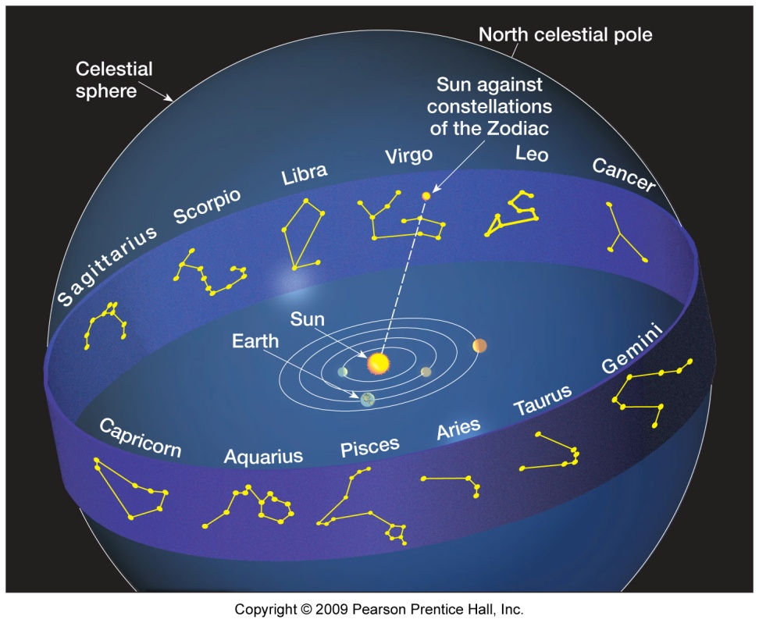
The Celestial Sphere
A method of examining the stars
Dividing the sky by constellations
Spring equinox (12 hours of day, 12 hours of night) originally when the Sun was against Aries
  Today, against Pisces

Slide 20
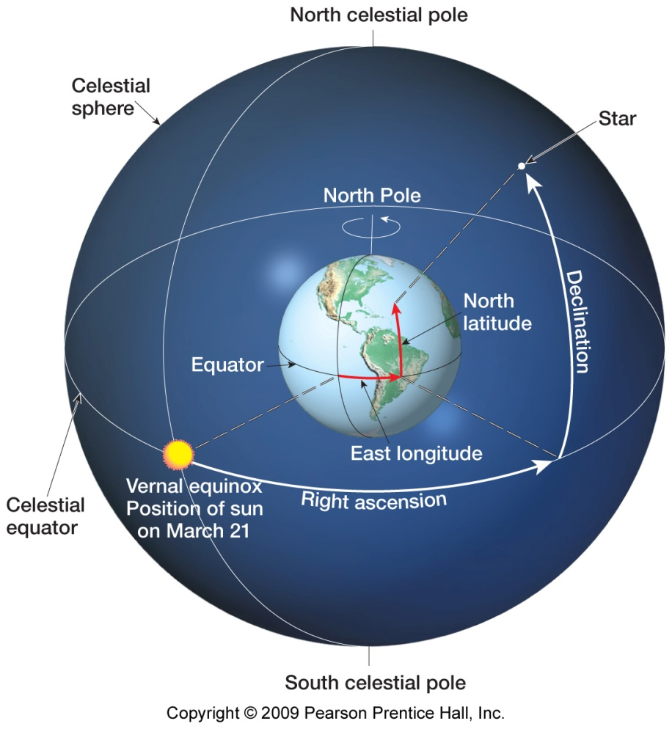
The Celestial Sphere
Equatorial system
Constellations
Extension of Earth’s latitude and longitude
650 light years
500 light years
1500 light years

Slide 21
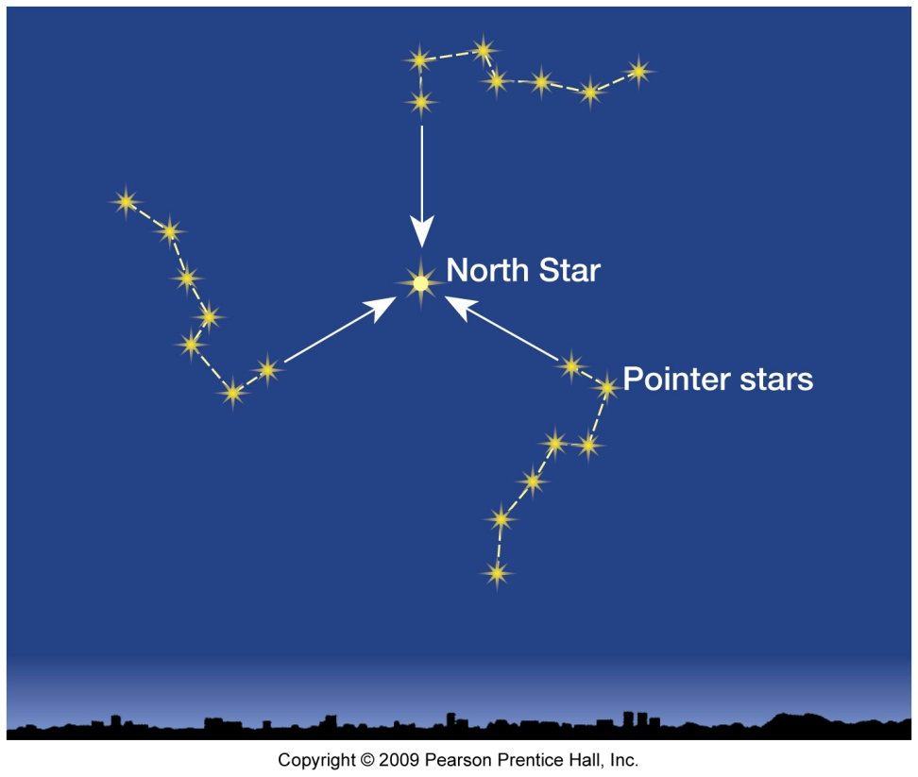
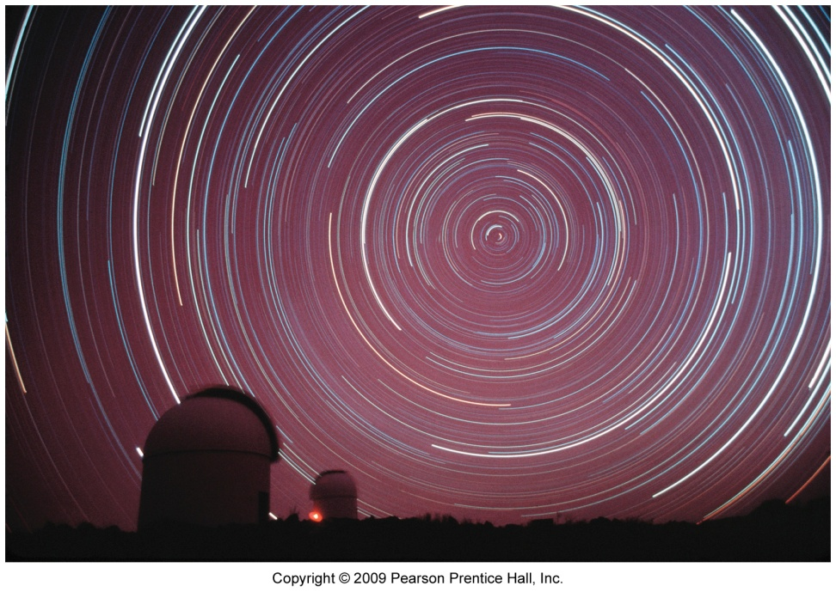
North celestial pole is near the North Star
The big dipper will appear to rotate around the North Star.
Time exposure picture of this rotation.

Slide 22
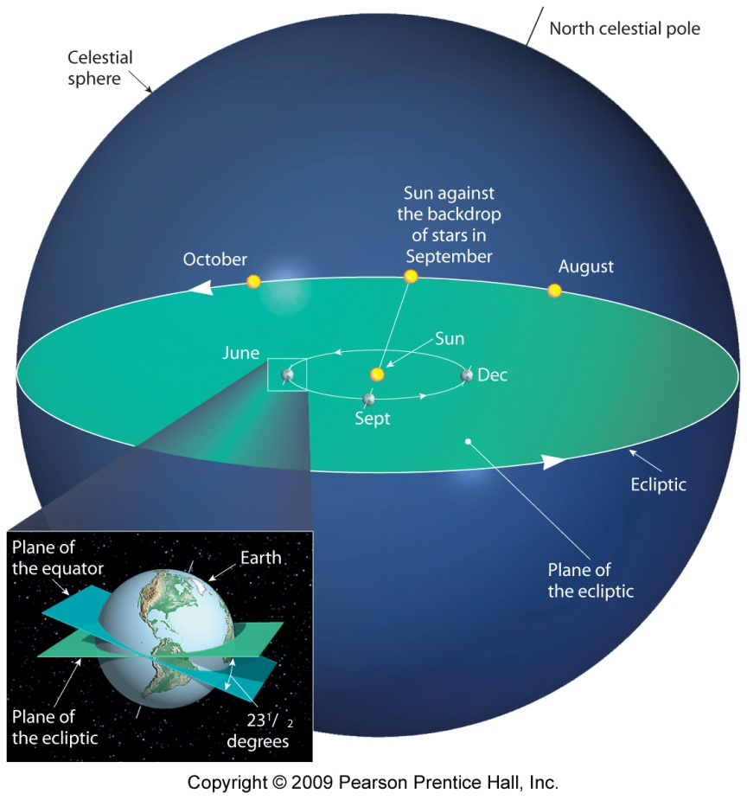
Earth’s motions
Revolution: once per year around the sun; elliptical
Rotation
Creates day and night
Solar day: from noon to noon
Sideral day: one full rotation in respect to a distant star
Moon and Sun travel on the same plane

Slide 23
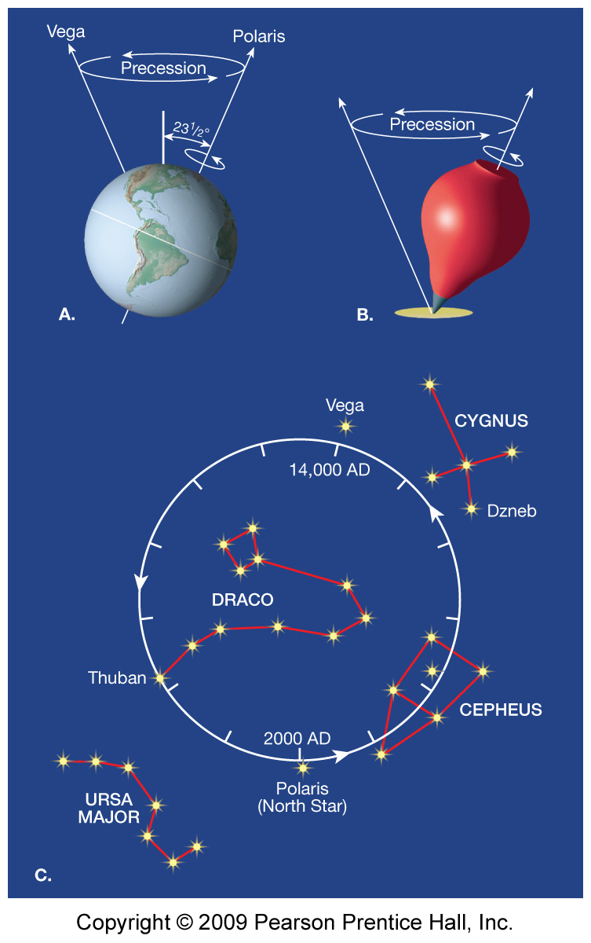
Precession
Wobble
Compared to a spinning top
Period (time to complete one circle) is 26,000 years
Associated with climate change

Slide 24
Summary:
Indigenous Peoples: understanding of lunar, solar, celestial, and seasonal variations
Egyptians: time
Greeks: geocentric model, five planets, star mapping, spherical revolutions and the spherical Earth
Spherical Earth idea lost during the middle ages
Renaissance:
  Copernicus: heliocentric model; explained retrograde motion
  Kepler: planet’s revolve in an ellipse; law of equal areas; planets and distance to Sun proportional, and astronomical unit
  Galileo: 4 of Jupiter’s moons; planets are not stars; Venus has phases; Moon’s surface is not smooth; and the Sun has spots with lower temperatures
  Newton: gravitational force

Slide 25
Summary:
The celestial sphere: definition; location; divisions; spring equinox; North Star location
Constellations: Orion; big dipper
Earth’s motions: solar versus sideral day; rotation; revolution or orbit; precession

