Slide 1
Earthquake Hazards

Slide 2
Hazards are produced from the response of energy released
Amount and duration are related to the amount of energy released

Slide 3
Which hazards do you know?

Slide 4
Earthquake Hazards
Tsunami: displacement of a large volume of water
  Shallow hypocenter, large volume of displaced crust, large earthquake
Ground shaking: determined by proximity of epicenter; magnitude of earthquake; and earth materials

Slide 5
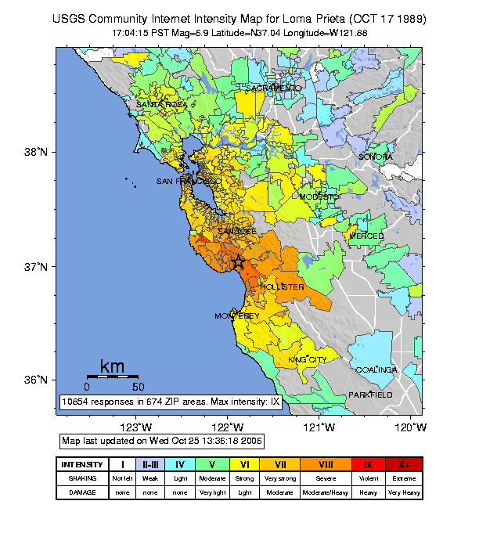
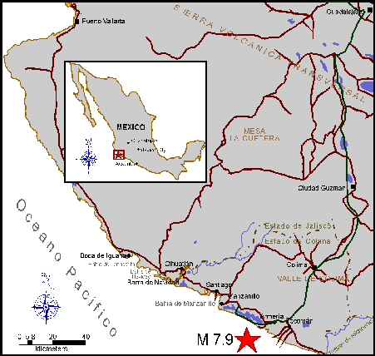
Ground shaking
In general, more intense closer to the epicenter: exceptions
Mexico City, 1985- 200 miles from epicenter
Loma Prieta, 1989- 60 miles from epicenter

Slide 6
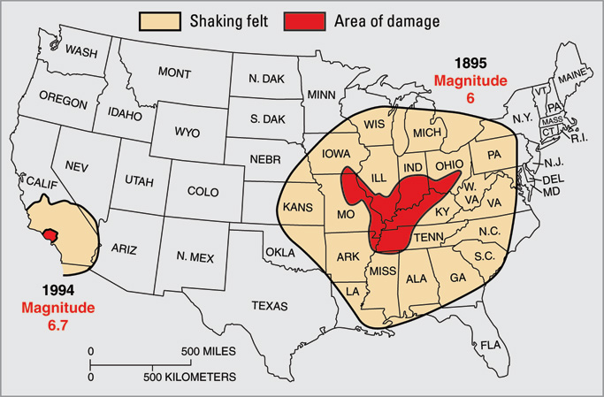
Seismic wave energy dissipates faster when there are more rock layers. Notice the area in Southern California is smaller than in the New Madrid area. The geology in Southern California is much more complicated.

Slide 7
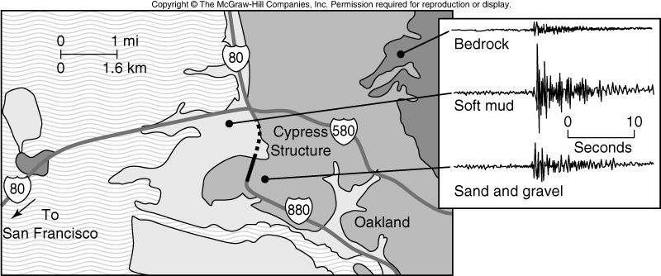
Seismic waves vary in amplitude and wavelength depending on Earth material
Bedrock is more dense- higher frequency, lower amplitudes
Soft mud is less dense-lower frequency, higher amplitudes

Slide 8
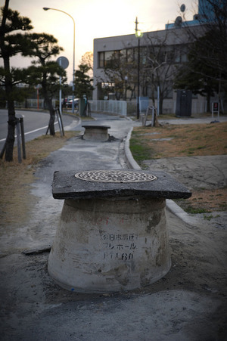
Liquefaction
Magnitude 7.5 or larger
Ground turns to slurry
Occurs where water meets land
Especially unengineered fill

Slide 9
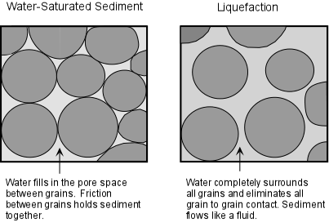
Liquefaction: earth material can no longer support any structures including water lines and pipes

Slide 10
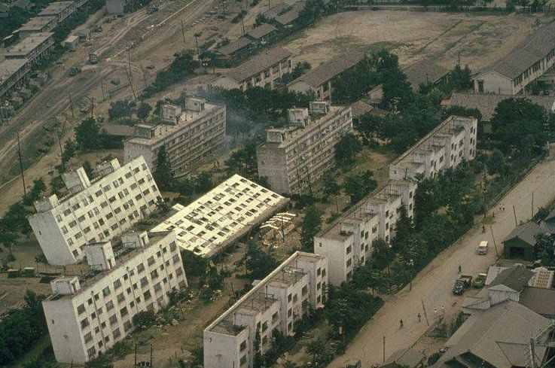
Liquefaction, Japan 1964

Slide 11
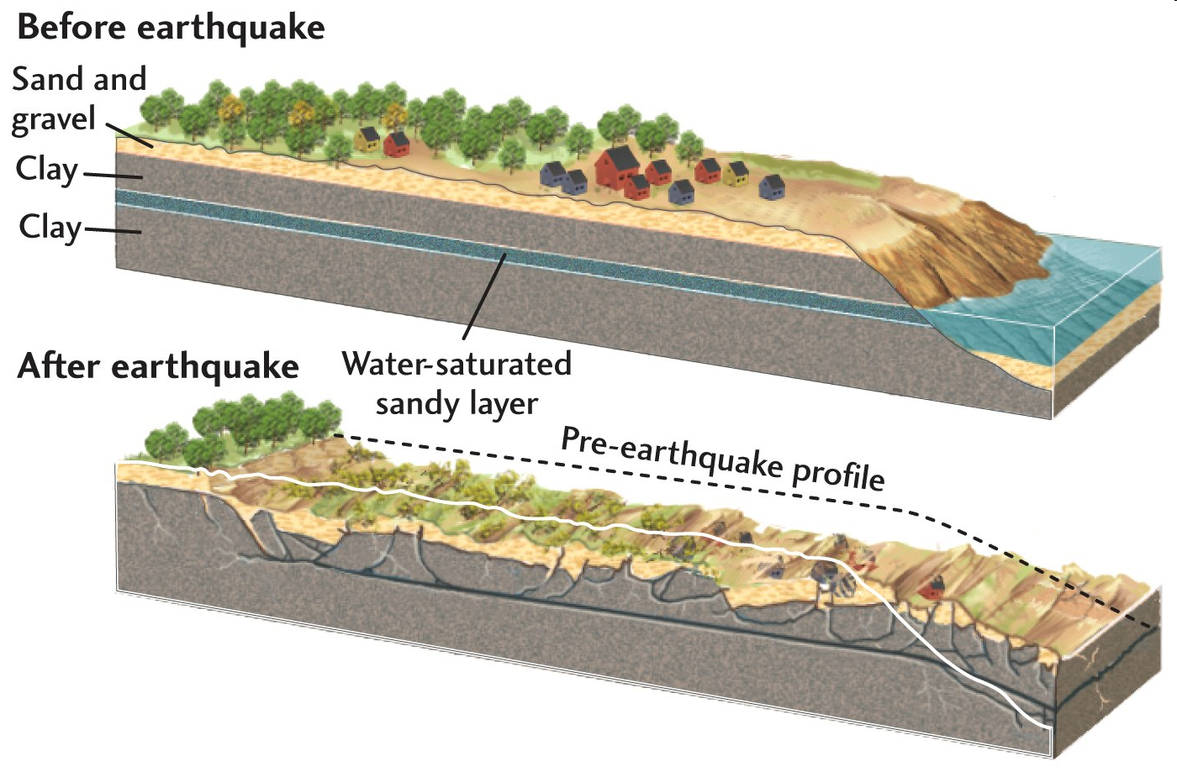
Landslide

Slide 12
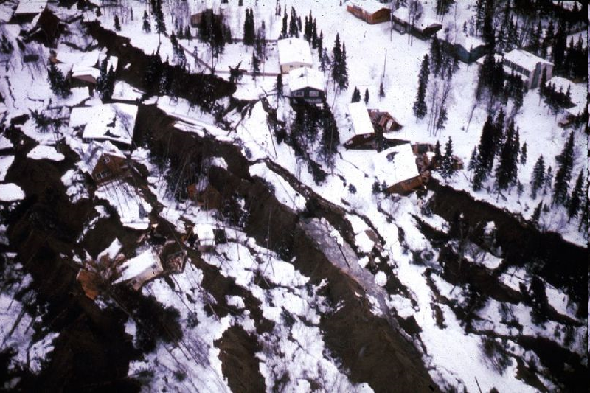
Massive Landslide, Turnagain Heights

Slide 13
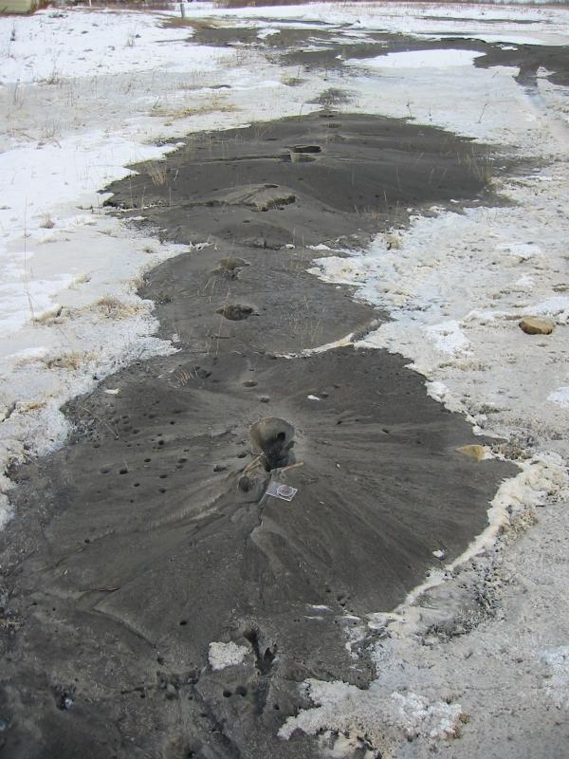
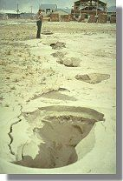
Sand volcanoes occur in association with liquefaction: >M7
Alaska, 2002
Japan,1964

Slide 14
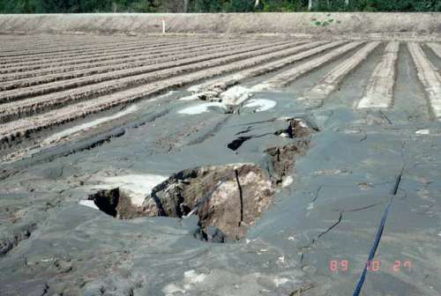
Sand volcano, Loma Prieta earthquake

Slide 15
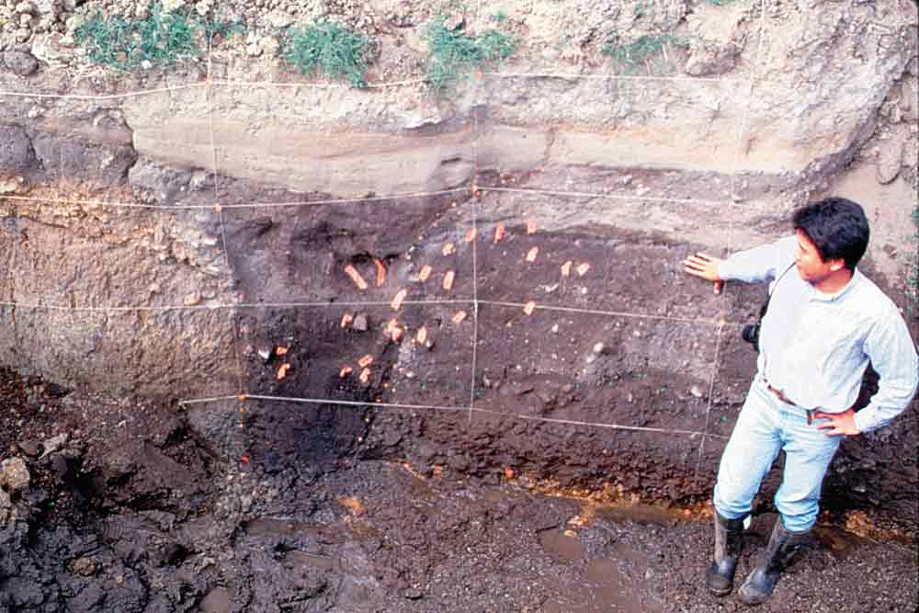
Sand Volcanoes
Geologists infer a large earthquake occurred due to the presence of the sand volcano
The timing is determined using carbon 14 dating methods

Slide 16
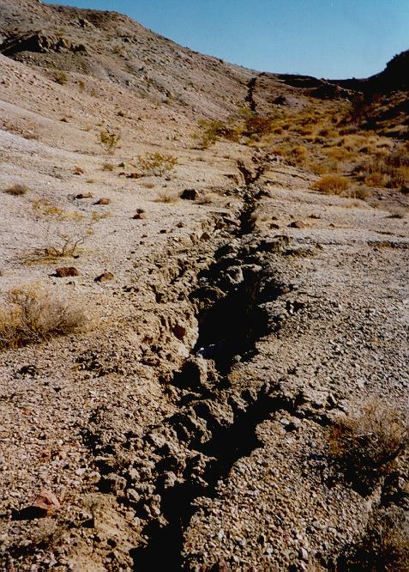
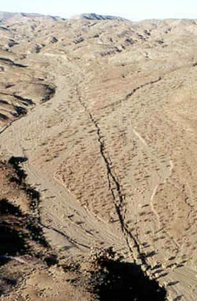
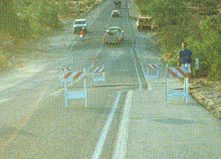
Ground Rupture
Landers, 1992- Mw 7.3
Hecter Mine, 1999- Mw 7.1

Slide 17
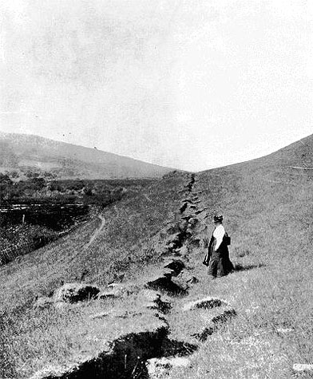
Ground Rupture: 1906 earthquake

Slide 18
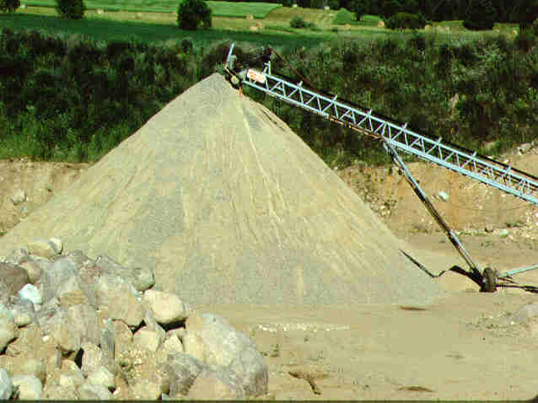
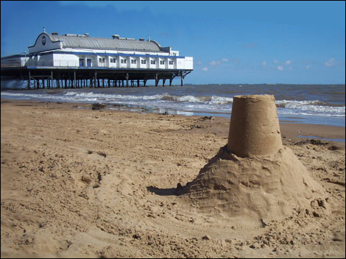
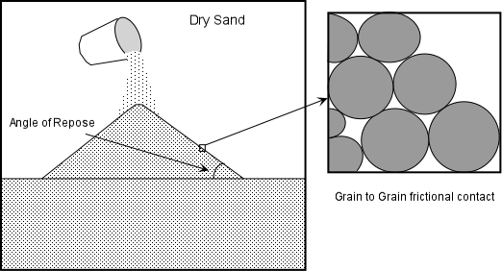
Landslides or mass movement
Different types of earth material are stable at different angles
Angle of repose:
  dry sand versus wet sand

Slide 19
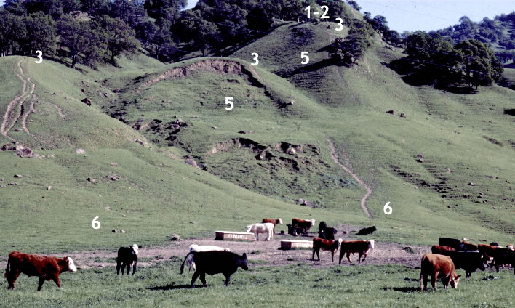
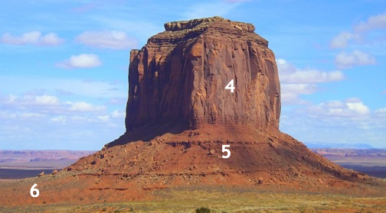
Angle of repose: depends on Earth material and climate
Coast Ranges, California
Utah
Numbers indicate different part of slope but not addressed in this class

Slide 20
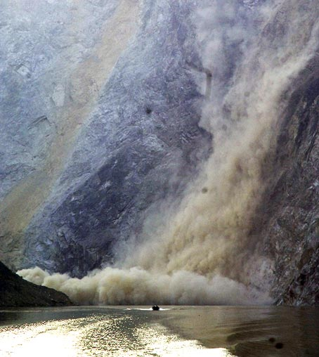
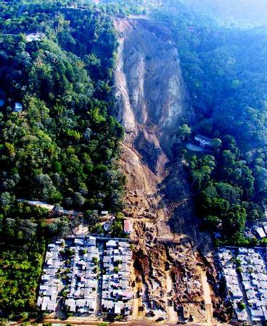
Landslides or mass movement
Any change in physical properties of the earth material, causes the slope to readjust
China, 2009
El Salvador

