Slide 1
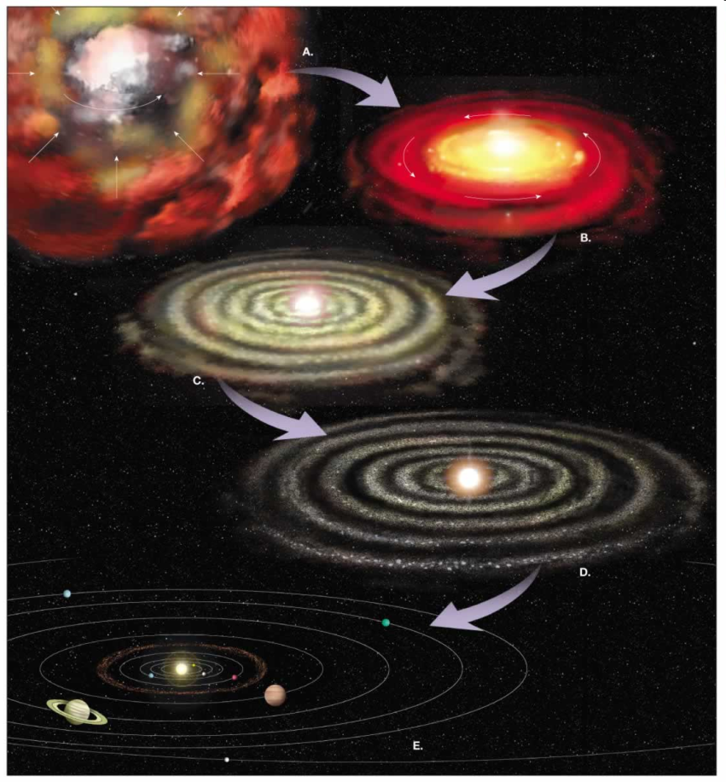
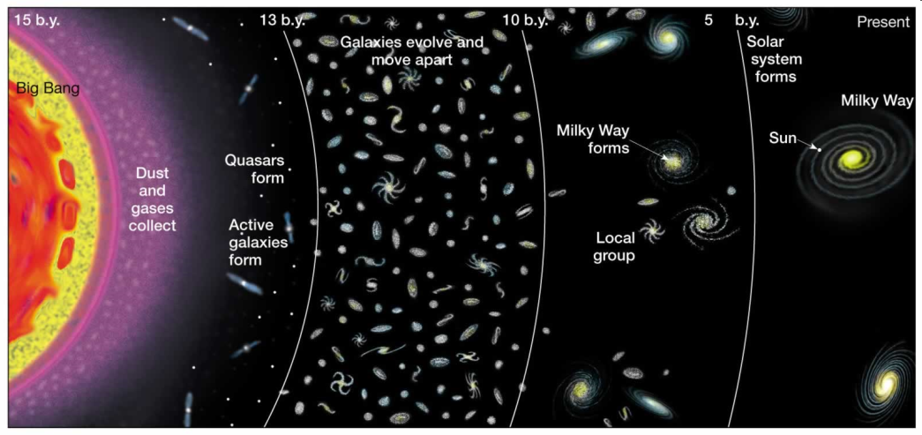
How was Earth formed?

Slide 2
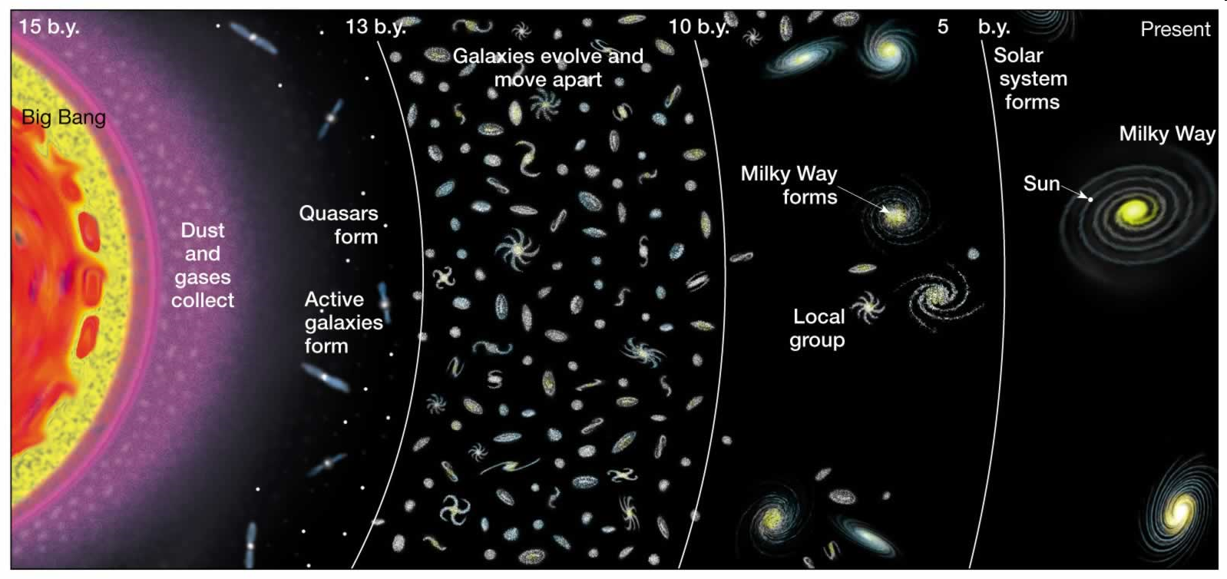
Big Bang Theory
13.7 billion years ago
Creation of all matter
Hydrogen and Helium the first
More complex elements evolved through time

Slide 3
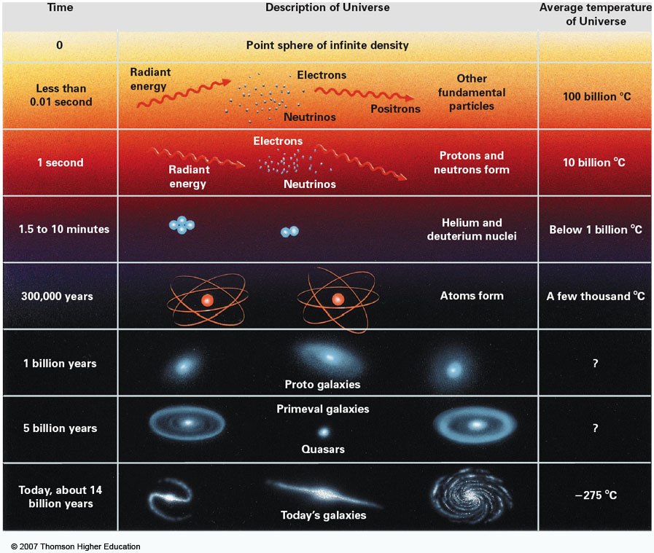

Slide 4
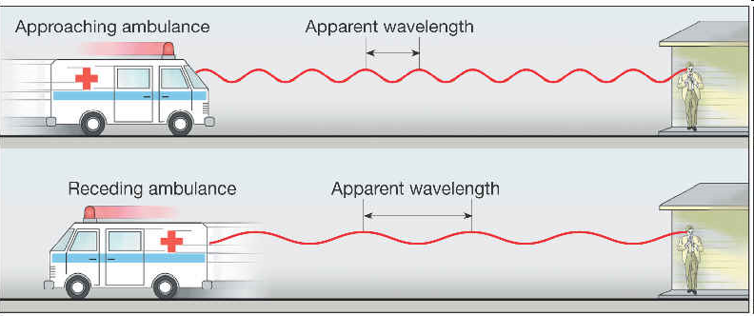
The Expanding Universe
The Doppler effect is used to document the expanding universe

Slide 5
Red shift

Slide 6
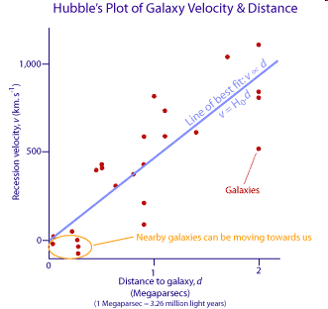
Hubble’s Law
Red shift is related to distance
The farther galaxies are moving faster than the closer galaxies

Slide 7
The Nebula Hypotheses

Slide 8
The Nebular Hypothesis
The solar system formed from a collapsed nebula
1734 by Emanuel Swedenborg
Observations support this idea

Slide 9
Nebulae: step 1
Gas (98%) and dust (2%)
Rotates and is held together by gravitational force

Slide 10
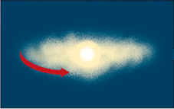
Step 2: The Nebula collapses
The collapsed mass forms a proto-sun due to gravitational force
Contraction increases speed of rotation: collapse

Slide 11
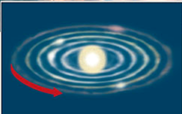
Step 3: sun is formed, disk cleared
The disk is “cleared out” due to the immense amount of energy released.
Sun is formed
Dust and gases cool and condense in defined orbits around the sun

Slide 12
Nebula hypothesis: step 4- planet formation
Temperature differences with respect to distance from sun
Closer, where temperatures are higher, iron and silicates condense
Farther, cooler, hydrogen, water condense
material collides and accretes forming planetesimals (small planets)

Slide 13
Evidence: Orion Nebula
Third star down on Orion’s belt
100 light years across (1 light year equals 6 trillion miles)
Reflection of dust and hydrogen

Slide 14
Evidence: Collapsed nebulae discs found in the Orion nebula
Gaseous disks are circling proto-suns.
2-17 times larger than our solar system
About 153 protoplanetary disks found in the Orion Nebula

Slide 15
Early Earth
13:40
Homogenous
Very hot

Slide 16
Segregation of elements: gravitational force
Compositionally distinct layers
Physically distinct layers
Remember: the liquid outer core with the Earth’s rotation produces the magnetic field.

