Slide 1
Bay Area Faults and Earth Material

Slide 2
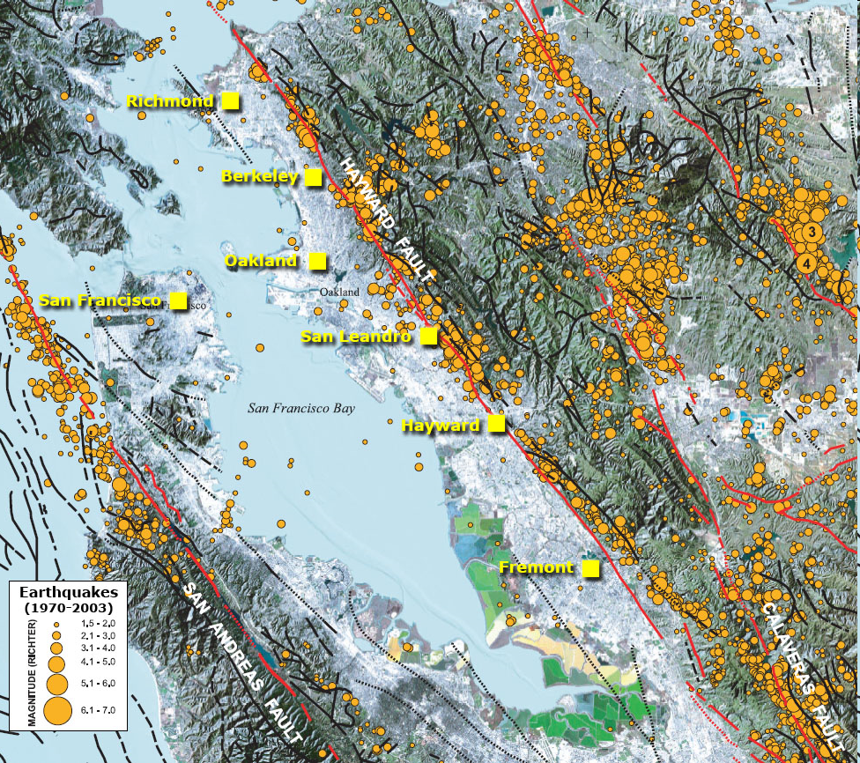
Bay Area
Faults

Slide 3
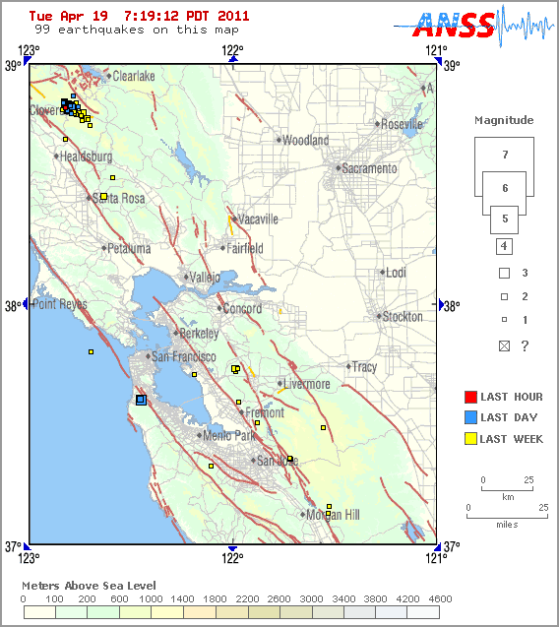
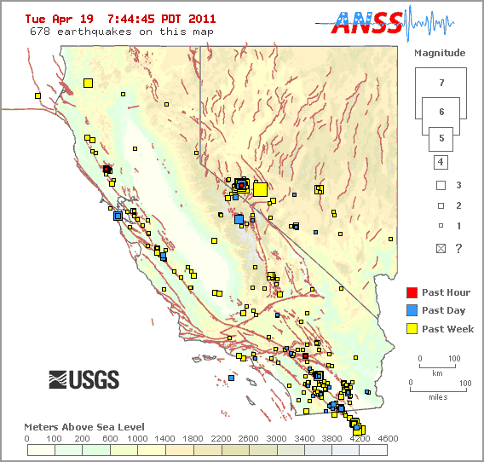
Earthquakes Today

Slide 4
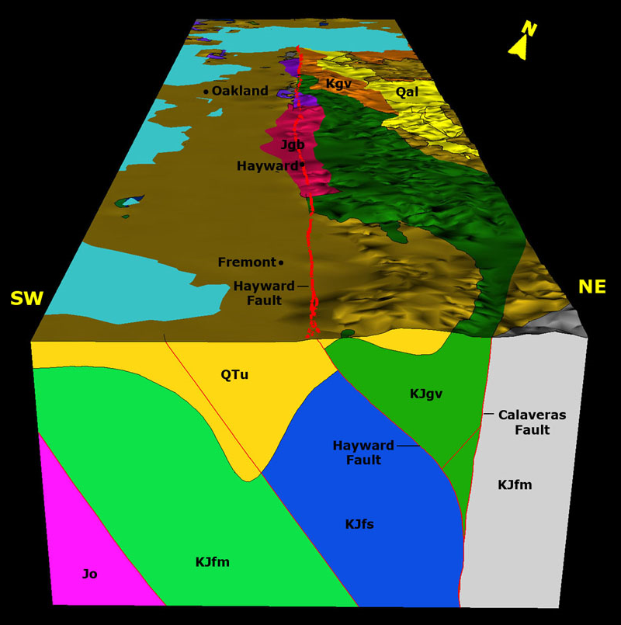
Geological Cross-section

Slide 5
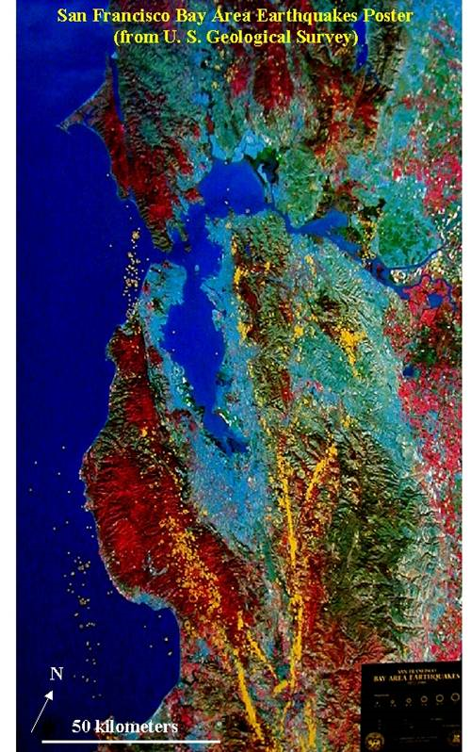
General breakdown:
Baymud: flat area near bay- marshland
Unconsolidated sediments: area that is flat toward the hills- sediment from hills filling in basin
Bedrock: hills (not all hills are stable but for this discussion we will assume this)

Slide 6
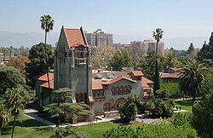
San Jose State University
San Jose State is built on unconsolidated sediments and is surrounded by mountains (bedrock).

Slide 7
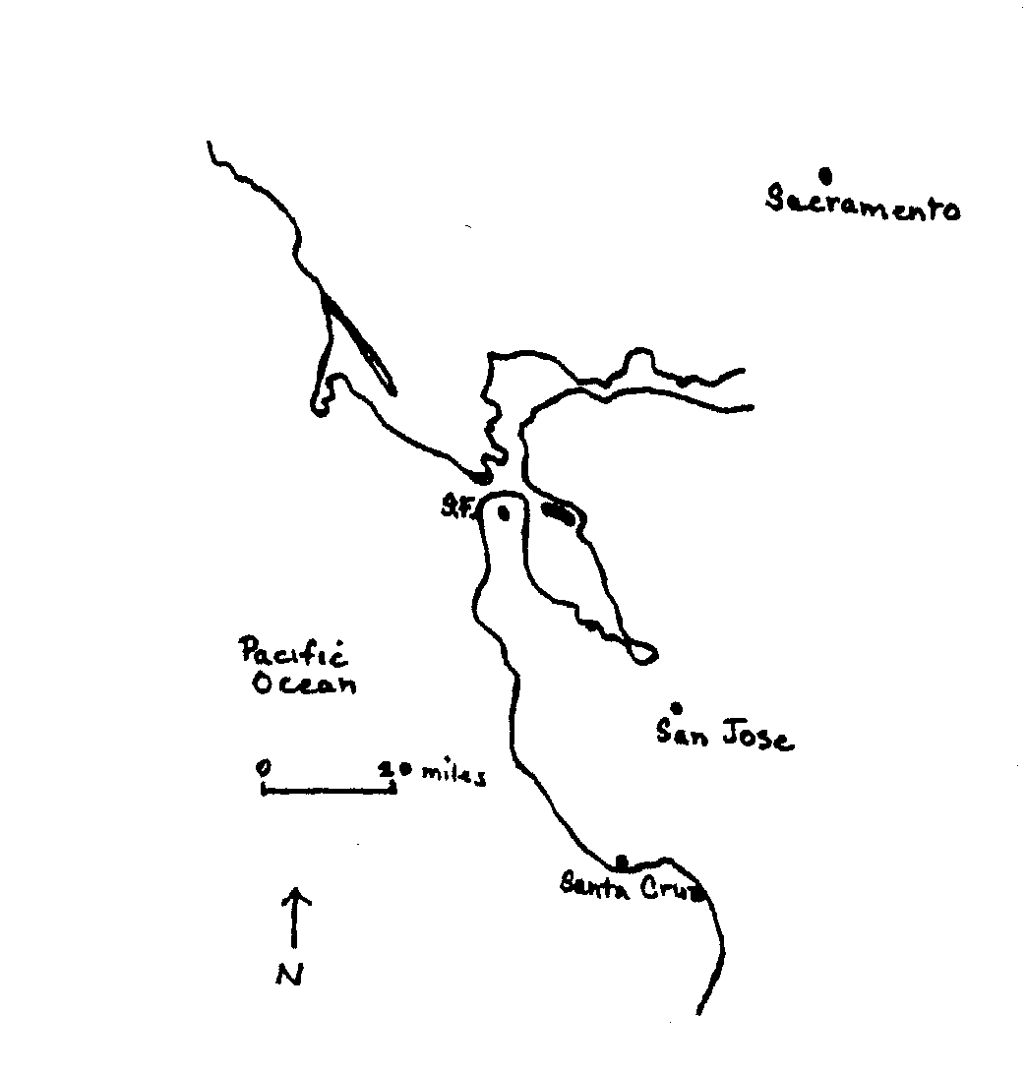

Slide 8
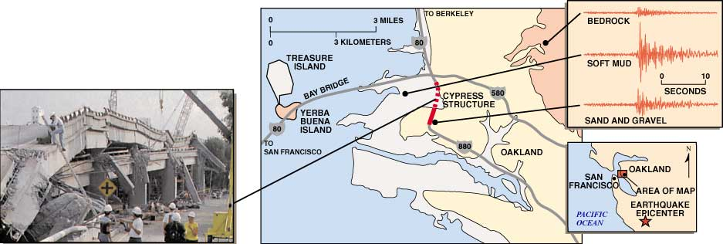
Earth Materials and ground shaking

Slide 9
When the Bay Area Quakes
Understand general earthquake hazards
Know the general location of faults in the Bay Area
Have a general idea of the topography and earth materials of the Bay Area
Movie: specific locations of hazards; structural failures (Cypress structure addressed); forecasting eqs- recurrence interval and seismic gap

