Slide 1
Ch. 2: From Ancient Cities to an Urban world
Notes:
See I can’t send this urban sociology

Slide 2
Categories in ancient period and rapid industrialization
Increase in scale of human settlements and consequences for social organization ie. social stratification.
Impact of city on culture and experience
Process of political and economic centralization
POET- population, organization, environment, and technology; keep these in mind as we go through the course!!

Slide 3
Emergence of urban form
Permanent settlement is thought to have emerged less than 10,000 years ago, populations turned from hunting agriculture and domesticating livestock;
Mumford (1961:55) “origin of city would read more clearly were not for that most critical changes took place before historical era opens. By the time city comes into view, it is already old”

Slide 4
Changing in scale of social organization
After 3000 BC estimates for specific sites range from 12,000 to 24,000( Ur). Small population size of early cities raises question of how big population center has to be before recognized as city or truly “urban” place;
Better to look for effects of increasing population size on number and nature of roles and relationships in dense populations.
Concentration of population leads to specialization within workforce, specialists freed from agricultural production; specialization creates interdependence in population;

Slide 5
Effects verse timing
We can understand the relationship between size and density populations and how these give rise to diversity stratification more difficult to reconstruct reasons that populations were drawn together in first place;
Conclusion: as society became more urbanized it became more socially differentiated, more specialized; specialization created interdependence among members of society no longer capable of providing for all of their material needs; variety of works, luxuries, and comforts magnified and defined what it meant to be rich or poor;

Slide 6
Rise of state and growth of political – economic power
We must not look only within the city walls but outside city walls. As urban form took shape and room size of territory that came under its influence grew also. Minimum requirement for urban existence is a sufficient productive agricultural base;
Sjoberg ”peasant farmers rarely produce and relinquish a surplus willingly in feudal societies; tribute, taxation must be exacted if cities are going to gain wherewithal to support populations.” As city emerges we witness creation of a hinterland that is not urbanite but subject to urban rural;

Slide 7
Development of early cities in China and Mesoamerica
Debate over whether new world population centers of ancient Mesoamerica qualify as “true” cities; two main features distinguish early Mesoamerica and population centers from ancient centers elsewhere in world: traditionally been interpreted primarily a ceremonial rather than commercial centers ancient sites served as foci for large regional populations, these populations were not housed within the city walls. Populations were spread out over large areas(Flanagan, 2010: 42)

Slide 8
Mayan civilization: 300 BC to 800 CE
Increasing populations, increasing nucleation of population, craft specialization, growth of wealth and power of urban elite, increase social stratification, and increasing competition between cities:
Declining Mayan civilizations included decline in agricultural and other resources, warfare, declining authority of kings, increasing impact of severe drought, aggressive general population, and disease.

Slide 9
Significance of Early Urbanization
V. Gordon Childe designated ancient era as “Urban Revolution” growth of technology, especially architecture and smelting of metals, long-distance trade among urbanizing cultures led to diffusion of ideas skills, and goods.
Athens 120,000 to 180,000 inhabitants at its peak in fifth century BC estimates of population of city of Rome range from half a million to a million; in Rome as many as 200,000 poor received regular rations of bread issued from public storehouses (43).

Slide 10
The Hellenic city
Athens is widely regarded as apex of ancient Western urbanism. Athens turned to the sea a Greek ship could carry 7000 pounds of grain 65 nautical miles a day and do it at 1/10 the cost of land transportation;
Social invention – polis or city-state enables families and tribes to organize for mutual aid and protection as citizens of common state; citizenship and religion were two sides same coin. Socrates was put to death for questioning the existence of Greek gods, terms pagan and heathen refer to those beyond the city walls;

Slide 11
population
City of Athens achieve a population of possibly 250,000 including slaves and noncitizens (slaves constituted perhaps one third of population). Max Weber, “the full urbanite of antiquity was a semi – peasant.”
Greeks preferred smaller cities, Plato and Aristotle believed that government was directly related to size of the city, “if citizens of the state are to judge and distribute offices according to merit, they must know each others’ characters, where they do not possess this knowledge, both elections offices and decisions of lawsuits will go wrong.”

Slide 12
Significance of Early Urbanization
Kingsley Davis believed influence of urbanization in any era before late 18th century was too limited to qualify as “urban revolution.” He noted the inclination of researchers to call any on earthed settlement a city if it had “a few streets and a public building or two.”
Renaissance Florence –a city – state of the 1400s witness rebirth of artistic and other high cultural achievement in Europe Florence had at most 95,000 people equivalent to present a population of eight “small English country town.”

Slide 13
Renaissance Florence
Hall argued “these works were the conscious creations of the entire collectivity, there are not simply expressions of individual creativity are genius, the result of long deliberations and committees and rigorous, indeed contentious and bitter, competition among artists of huge talent – and frequently – egos to match”
We may ask to what extent it is appropriate to argue that the city, rather than its artists, produced Florence’s contribution to the Renaissance?

Slide 14
Industrial REvolution
“True” Urban Revolution

Slide 15
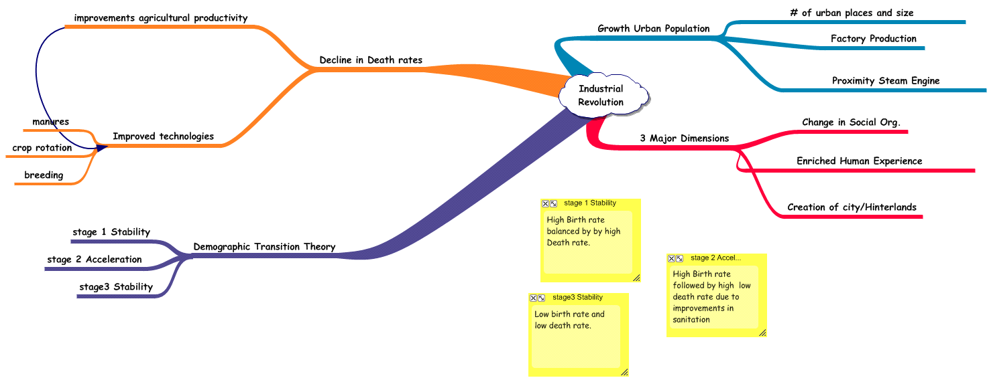

Slide 16
Urban Change Present Era
Persisting power of propinquity- cost of overcoming space had not yet become zero;
Urban trends include growth of megacities, over 10 million people;
Important consider level of urbanization(proportional increase) and size of increase(# of people involved).
From 1975-2007, urban pop increased 37.3% to 49.4%; total pop. went from 4 billion to over 6.5 billion; 1.8 billion of 2.5 billion of those added to pop were living in urban areas; most in less developed nations;

Slide 17
Globalization
Social Organization-corporate decisions about production driven by dictates of global competition, not national allegiance;
Culture- converging styles and tastes; wireless electronic communication; cultural homogenization; attractive products and ideas disseminated through web emanate from urban-based enterprises, styles, and art forms;
Political Order- Regional trade agreements, lowering or eliminating tariffs, creating free trade zones for manufacturing;

Slide 18
Globalization
Global economic order is everywhere, exists independent of place, but also economic and political actors strategize, manage, make rules, take profit from global economy occupy specific spaces;
Certain cities more important than others;

